Slide 1



Retweeting activity on Twitter: Signs of Deception
Informatics Department
Aristotle University of Thessaloniki
School of Computer Science
Carnegie Mellon University
Maria Giatsoglou¹, Despoina Chatzakou¹, Neil Shah², Christos Faloutsos², Athena Vakali¹
¹ Informatics Department, Aristotle University of Thessaloniki, Greece
² School of Computer Science, Carnegie Mellon University, USA

Slide 2
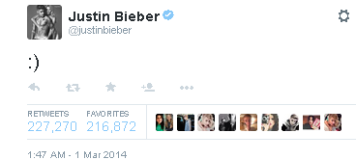
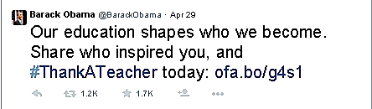
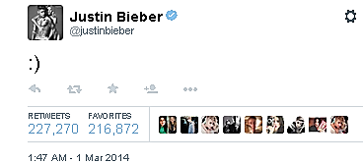
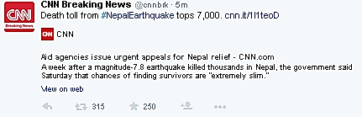




Content popularity in Twitter
Content in microblogs is of great diversity
It receives different levels of attention

Slide 3
Retweet fraud
Typical reasons for retweeting (rebroadcasting) a post:
its high quality / interestingness, and / or
the influence / popularity of its author.
# retweets serves as a post’s popularity indicator
Retweet fraud: falsely create the impression of popularity by artificially generating a high volume of retweets
Twitter estimates 14% (5%) of user accounts being bots (spam bots); the problem is probably much bigger
Such content is vacuous, spammy / malicious and detracts from Twitter content’s credibility and users’ experiences
%

Slide 4
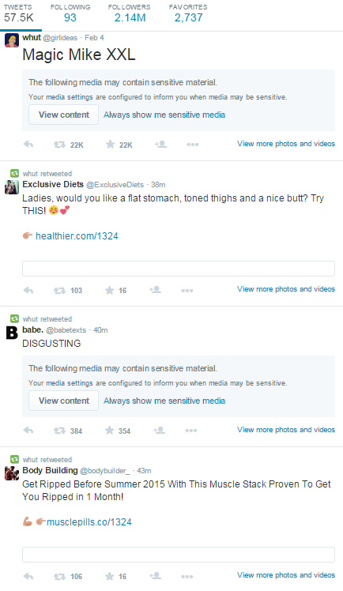
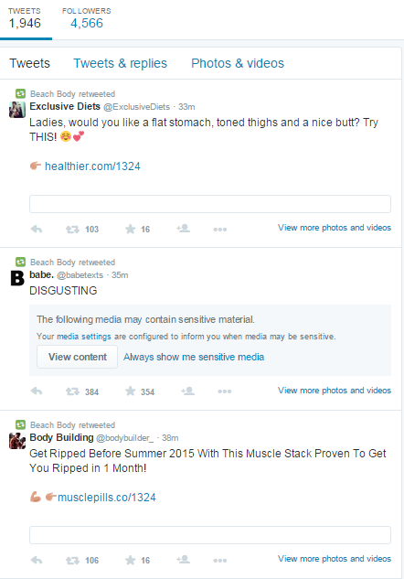
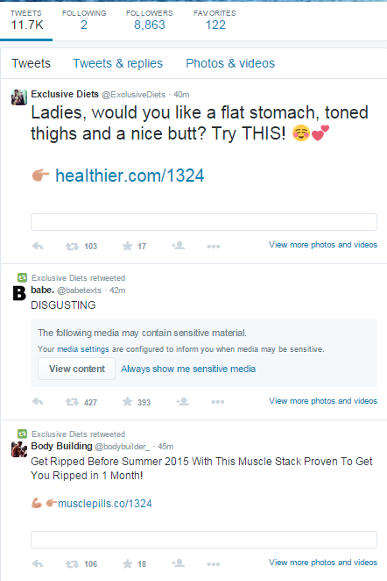
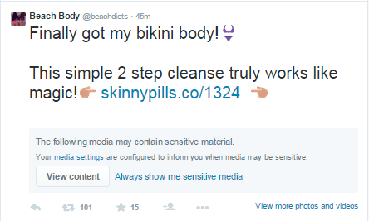
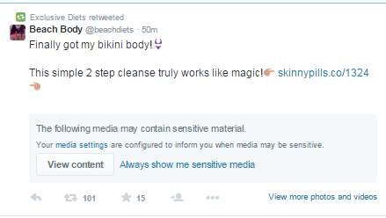
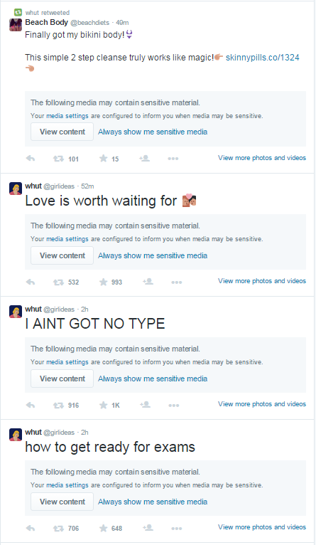
Retweet fraud example

Slide 5
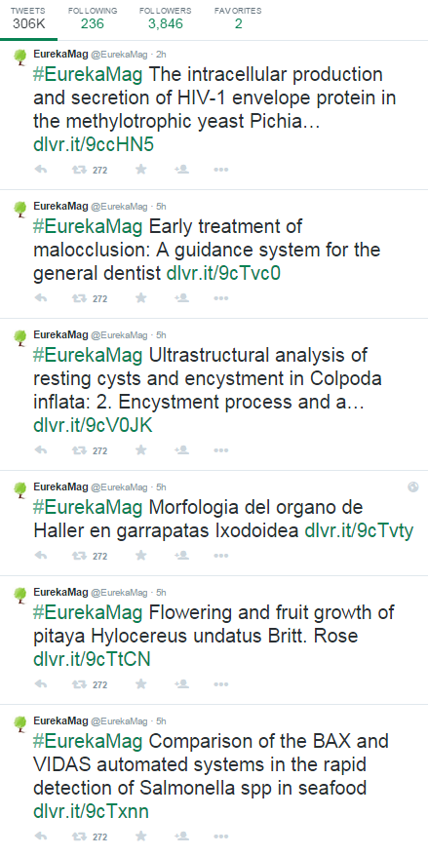
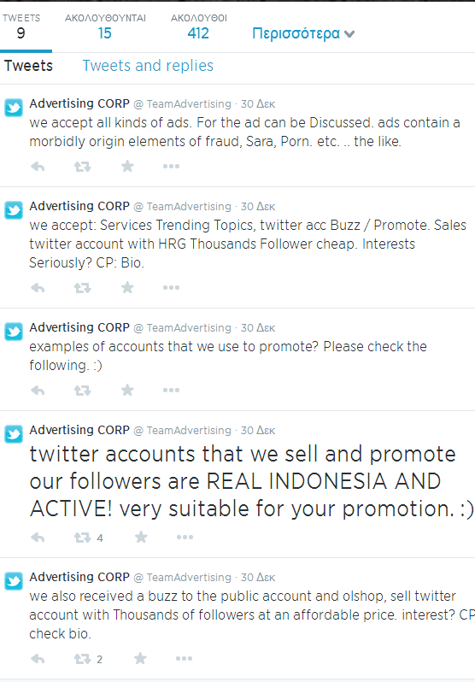
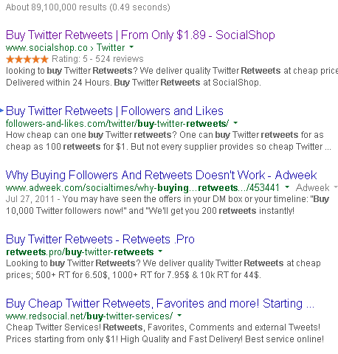
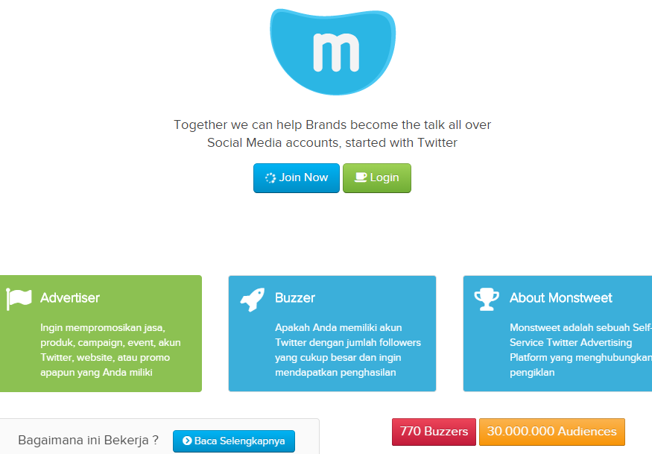
Retweet fraud examples

Slide 6
Outline
Problems addressed and Background
Retweet dataset
RTSCOPE: Discovery of retweeting activity patterns
Retweeters’ connectivity patterns
Activity summarization patterns
Retweeters’ activation patterns
RTGen: a retweeting activity generator
Conclusions

Slide 7
Hypotheses and problems addressed
There are distinctive patterns in retweet fraud in terms of
H1. the timing of retweets (use of automation tools)
H2. the accounts that retweet (fraudsters acting in lockstep)
H3. the connectivity of retweeters (bot networks, “camouflage”)
Retweet-thread level problem
Given: the i^{th} tweet of user u; its induced retweet activity (user IDs &timestamps)
Identify: if the activity is organic or not.
User level problem
Given: a user u; a set of tweets of user u; their induced retweet activity
Identify: if u is a spammer.
What features tell fake from genuine reactions?
How do they relate to the targeted problems ?
promiscuous fraudsters
RTSCOPE addresses these issues
cautious fraudsters

Slide 8
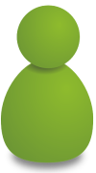








Background
“R-A” network
(of R_{u,1})
User u: a given Twitter account
Tweet tw_{u,i}: the i^{th} post of user u
Retweet thread: all re-posts of a tweet
can be honest OR fraudster
u
Tim
Alex
Mary
Debbie
###
%%%
***
$$$
Peter
tw_{u,1}
tw_{u,2}
tw_{u,3}
tw_{u,4}
u
t₁
t₂
t₃
t₄
time
“R” network
(of R_{u,1)}
###
###
###
###
###
Alex
###
Alex
Mary
Tim
Peter
Debbie
R_{u,1}
tw_{u,1}
t₁
t₂
t₃
t₄
t₄
time
Mary
Debbie
Peter

Slide 9
Outline
Problems addressed and Background
Retweet dataset
RTSCOPE: Discovery of retweeting activity patterns
Retweeters’ connectivity patterns
Activity summarization patterns
Retweeters’ activation patterns
RTGen: a retweeting activity generator
Conclusions

Slide 10


Dataset generation for gaining insight
Manual selection of target users (both and )
users with most retweeted tweets and heavy use of spammy keywords in a 2-day Twitter sample
active & popular (> 100 retweets) users (twittercounter.com)
Target users tracked for 2-3 months (all tweets & their retweets)
Pruned “unpopular” users (all retweet threads < 50 retweets)
User categorization
13 fraudulent –FD- : tweets with spammy links and terms, repetitive promotions; fabricated profiles
11 honest of varying popularity:
HP - high (followers>100K), LP - low (followers<10K), or MP - medium

Slide 11
Dataset overview
Type | #Tweets | #Original tweets | #Retweeted tweets | #Retweets
honest | 35,179 | 18,706 | 13,261 | 708,814
fraudulent | 92,520 | 50,536 | 27,809 | 5,330,407
BOTH | 127,699 | 69,242 | 41,070 | 6,039,221
(Available at http://oswinds.csd.auth.gr/project/RTSCOPE)
Observations
Variety. Fraudsters have various behaviors in terms of posting frequency and timing (hyperactive vs. subtle); level of camouflage (naïve vs. sophisticated)
FF imbalance. Fraudsters’ followers-to-followees FF ratio is not always ~1, which was reported in earlier works (typical bot network members, FF~1, vs. celebrity imitators, FF >>1)
Notes:
hyperactive, posting many tweets (> 100 per day); others are more subtle, posting few tweets per day, while sometimes mixing original
posts with retweets to other users’ posts, implying some type of cooperation
some FD users often produced (resembling) honest posts along with fraudulent ones. This may indicate the existence of “occasional” fraudsters, or intended camouflage practiced by “professional” fraudsters.

Slide 12
Outline
Problems addressed and Background
Retweet dataset
RTSCOPE: Discovery of retweeting activity patterns
Retweeters’ connectivity patterns
Activity summarization patterns
Retweeters’ activation patterns
RTGen: a retweeting activity generator
Conclusions

Slide 13
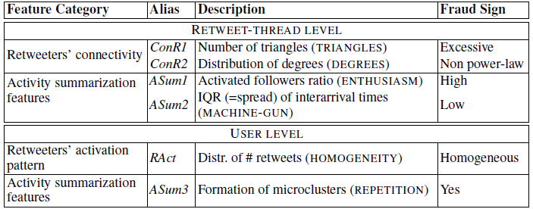
Introducing the RTSCOPE approach
RTSCOPE: series of tests for spotting fraudsters with varying behaviors

Slide 14
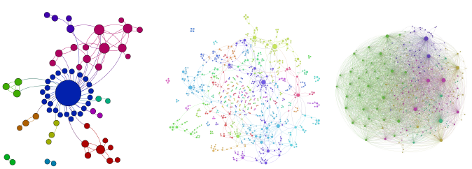
Connectivity in retweet networks
MP user
HP user
FD user
Very dense “R” networks are indicative of fraudulent activity
TRIANGLES and DEGREES patterns reveal fake retweet threads

Slide 15
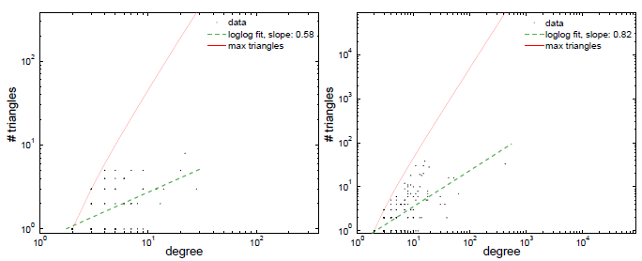
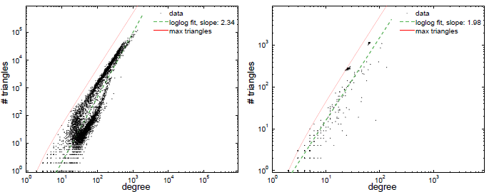
Connectivity: TRIANGLES pattern
degree²
degree²
Triangles vs. degree plots
Honest
few triangles (<100;often 0)
Fraudulent
power-law relationship with high (1.1-2.5) slope
near-clique networks; almost max triangles per node
In “R-A” networks
Honest
many “satellites”: retweeters who follow only the author
fraction of satellite nodes between 0.1 and 0.9
Fraudulent
small fraction of satellite nodes (< 0.001)
honest
“R” network
degree²
degree²
fraudulent
“R” network

Slide 16

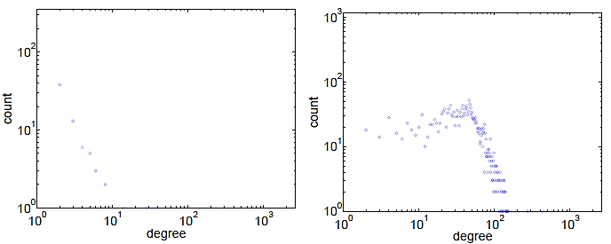
Connectivity: DEGREES pattern
honest
“R” network
fraudulent
“R” network
power-law
spike at
30
Degree distribution in “R-A” and “R” networks
Honest users: power-law
Fraudulent users: large deviation for power law & spikes
Notes:
DEGREES: Honest users have “R-A” and “R” networks with power-law degree distribution
(Figure 3(a)) while fraudulent ones deviate (Figure 3(b)). The spike at degree
30 for the latter, agrees with the botnet hypothesis.
SATELLITE: In honest “R-A” networks, the author has many “satellites”, i.e. retweeters
that follow him, and no other retweeters. The fraction s of such satellite nodes
is 0:1 < s < 0:9 for honest users, but s < 0:001 for many fraudulent users.

Slide 17
Activity Summarization - Features
Temporal & popularity features per retweet thread
Log-log pairwise feature scatterplots for all retweet threads reveal dense microclusters for fraudsters
ratio of activated followers | author’s followers who retweeted
response time | time between the tweet’s posting and first retweet
lifespan | time between first and last retweet (constrained to 1 month)
Arr-IQR | inter-quartile range of inter-arrival times for retweets

Slide 18
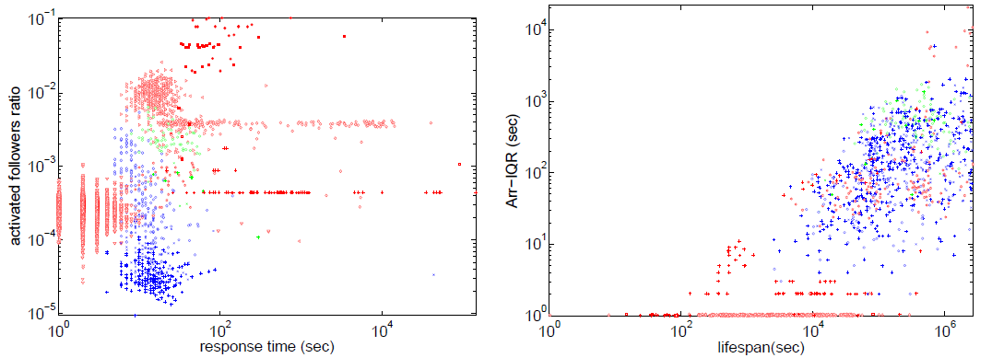
Activity Summarization - Patterns
ENTHUSIASM
MACHINE-GUN
HP , MP , LP , FD users
ENTHUSIASM: High infection probability for followers of fraudsters
MACHINE-GUN: Fraudsters retweet all at once or with similar time delay
REPETITION: Fake retweet threads form microclusters due to similar response time, Arr-IQR, activated followers ratio

Slide 19



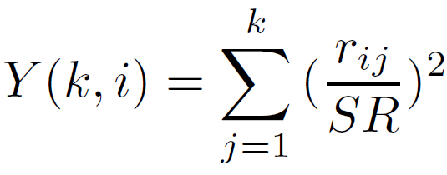
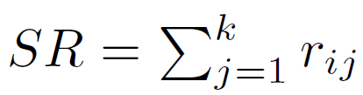
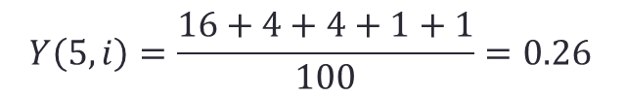
Retweeters activation: Disparity
Given the posts of user u_{i}, what is the distribution of retweets across retweeters?
Disparity reveals if retweeting activity spreads homogeneously over retweeters or it is skewed towards few dedicated users.
Disparity for u_{i} and a retweet thread size of k
,
***
%%%
###
$$$
u_{i}
4 posts
###
###
###
###
###
Alex
Mary
Tim
Peter
Debbie
$$$
r_{i,4} = 1
k = 5
***
%%%
%%%
r_{i,2} = 2
r_{i,3} = 2
r_{i,5} = 1
$$$
r_{i,1} = 4
$$Y\left(5,i\right)=\frac{16+4+4+1+1}{100}=0.26$$

Slide 20
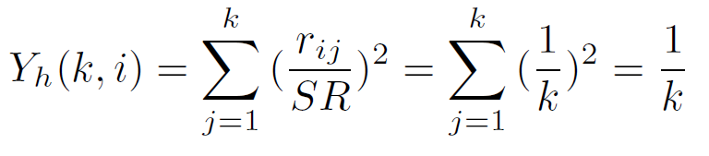


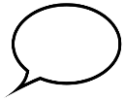

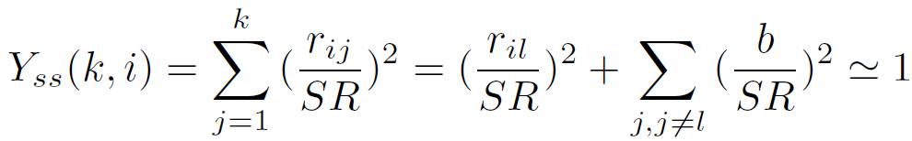
Disparity – Special cases
DETAIL
Disparity for homogeneous distr. (all users have the same #retweets)
Disparity for super-skewed distr. (one user makes the majority of retweets; the rest retweet rarely)
***
%%%
###
$$$
u_{i}
4 posts
###
###
###
###
###
bot1
bot2
bot3
bot4
bot5
$$$
$$$
$$$
$$$
k = 5
%%%
%%%
%%%
%%%
$$$
***
***
***
***
%%%
r_{i,1} = 4
r_{i,2} = 4
r_{i,3} = 4
r_{i,4} = 4
***
r_{i,5} = 4

Slide 21
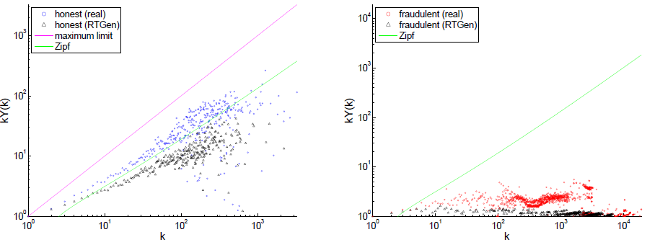

FAVORITISM & HOMOGENEITY patterns
super-skewed
favoritism
favoritism
homogeneity
Disparity of a Zipf distribution
(proof in paper)
FAVORITISM. Participation of honest users to retweets follows a Zipf law.
HOMOGENEITY. Participation of fraudulent users to retweets is homogeneous.
DETAIL

Slide 22
Outline
Problems addressed and Background
Retweet dataset
RTSCOPE: Discovery of retweeting activity patterns
Retweeters’ connectivity patterns
Activity summarization patterns
Retweeters’ activation patterns
RTGen: a retweeting activity generator
Conclusions

Slide 23

RTGen
For each simulation
Given a set of users and their follow relationships:
HONEST retweeting simulation
Kronecker graph for users
FRAUDULENT retweeting simulation
dense Erdös–Rényi graph
Select an author and N, i.e. number of simulations (tweets)
“Activate” author and then recursively followers of activated users’ with probability P (depends on tweet’s interestingness b)
Activated users form the set of retweeters
N
times
user
simulation
random value in (0,1]
#followers
B₁ (camouflage) OR B₂ (fraud), B₁ << B₂

Slide 24
Disparity based on RTGen
100 simulations for 10 honest and 10 fraudulent users.
Averaged disparity per author and k-sized retweet thread
RTGen closely emulates retweeting honest and fraudulent activity

Slide 25
Outline
Problems addressed and Background
Retweet dataset
RTSCOPE: Discovery of retweeting activity patterns
Retweeters’ connectivity patterns
Activity summarization patterns
Retweeters’ activation patterns
RTGen: a retweeting activity generator
Conclusions

Slide 26
Conclusions
Patterns: discovered several patterns (RTSCOPE) for spotting various types of retweet fraud, e.g.
TRIANGLES reveals strong connectivity in retweeter networks
HOMOGENEITY indicates uniform retweet disparity
Generator: proposed RTGEN which produces organic and fraudulent retweet activity
useful for experimentation / evaluation scenarios where labeled retweet data are missing

Slide 27

Questions?
Download code and dataset at:
http://oswinds.csd.auth.gr/project/RTSCOPE
ENTHUSIASM
MACHINE-GUN

