Slide 1
The 3×3 stride-1 convolution kernel
Om Tank · YOLOv8n on one Broadwell core, built like the Assignment 2 kernel
32
66%
94%
84%
layers: C2f bottlenecks + Detect head
of YOLOv8n's 8.74 GFLOP
of peak: best microkernel alone
of peak across all 32 real layers
Notes:
My kernel is the 3x3 stride-1 convolution: 32 layers, the C2f bottlenecks and the Detect head, two thirds of YOLOv8n's work. The story: it is the Assignment 2 kernel, I followed the same four steps, and the measurements chose the tile. Best microkernel alone: 94% of the 32 FLOPs/cycle peak; inside all 32 real layers: 84%. All percentages assume the core runs at 3.4 GHz, as in Assignment 2.

Slide 2
It is the Assignment 2 kernel, with floats
 | Assignment 2 | Stride-1 microkernel
m (broadcast) | 5 rows of A | 5 output pixels
n (vector loads) | 8 = 2 × 4 doubles | 16 channels = 2 × 8 floats
k (reduction) | 32 to 512 | C × 9 (144 to 2304)
Accumulators | 10 | 10 (2×5) or 12 (2×6)
Registers | 13 of 16 | 13 or 15 of 16
Peak per core | 16 FLOPs/cycle | 32 FLOPs/cycle
C
input channels of the layer (16 to 256)
k = C × 9
multiply-adds per output: C channels × the 9 taps of the 3×3 filter (A2's k)
accumulator
one YMM register = 8 outputs (8 channels of one pixel); one dependency chain
tile 2×5 (10)
Same Broadwell core: 2 FMA units × 8 lanes × 2 FLOPs = 32 FLOPs/cycle. Latency 5 × throughput 2 = 10 chains in flight.
outputs per call: 2 blocks of 8 channels × 5 pixels = 80 outputs in 10 accumulators
Notes:
Same machine as Assignment 2 and the same kernel. In A2, m was 5 rows of A broadcast, n was 8 doubles = 2 vectors of B. Here m is 5 output pixels, n is 16 output channels = 2 vectors of 8 floats, and k is input channels times the 9 taps of the 3x3 filter. 10 accumulators, 13 registers, exactly the A2 budget. Peak is 32 FLOPs per cycle because floats give 8 lanes instead of 4. Terms: C is input channels; k = C x 9 is the length of each output's sum; an accumulator is one register holding 8 outputs; the tile is the block of outputs one call computes.

Slide 3
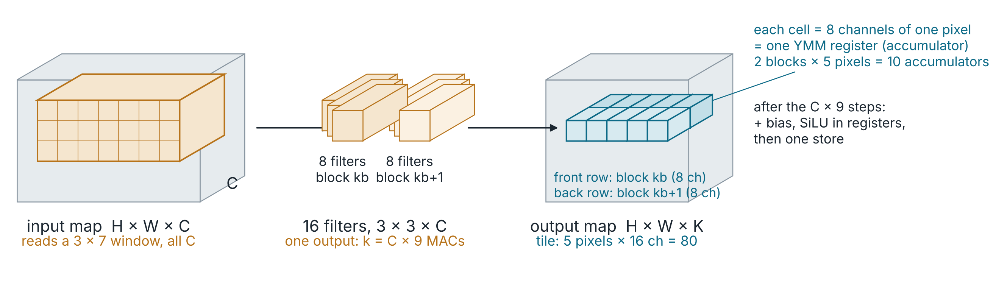
One kernel call = 80 outputs
Per step (one input channel at one of the 9 taps): load 2 weight vectors, broadcast 5 inputs, 10 FMAs. Repeat k = C × 9 times, then bias, SiLU and one store per register.
Notes:
One call of the microkernel computes this teal strip: one output row, 5 pixels wide, 16 output channels deep, 80 numbers. Each cell is 8 channels of one pixel, which is exactly one YMM register, so the strip is 10 accumulators. To compute it, the kernel reads a 3 by 7 window of the input across all C channels and 16 filters of 3 by 3 by C. Each step multiplies 2 weight vectors by 5 broadcast inputs, 10 FMAs, and it repeats that k = C times 9 times before applying bias and SiLU and storing.

Slide 4
Four steps: ops → accumulators → tile → benchmark
1
Independent ops
Every output is its own dot product of length C × 9: 102,400 in a 40×40, 64-channel layer.
2
Outputs in flight
Latency 5 × 2 FMA/cycle = 10 accumulators; 1 accumulator runs at exactly 10% of peak.
3
Kernel size
2×5 tile: 10 acc + 2 weights + 1 broadcast = 13 regs; 7 loads per 10 FMAs; 5 divides every width.
4
Benchmark like A2
Microkernel alone, k = 72 to 4608, 3 runs, 2 s warm-up, cycles at 3.4 GHz as in A2, checked vs a reference.
Notes:
Step 1: every output is an independent dot product, so there is plenty of parallelism; the only chain is the reduction. Step 2: 5-cycle latency times 2 FMAs per cycle means 10 independent accumulators. The chart shows it: 1 accumulator is 10%, each one adds about 10 points. Step 3: 2x5 gives 10 accumulators in 13 registers, 7 loads per 10 FMAs, and 5 divides 160, 80, 40 and 20. Step 4: benchmark the kernel alone exactly like Assignment 2.

Slide 5
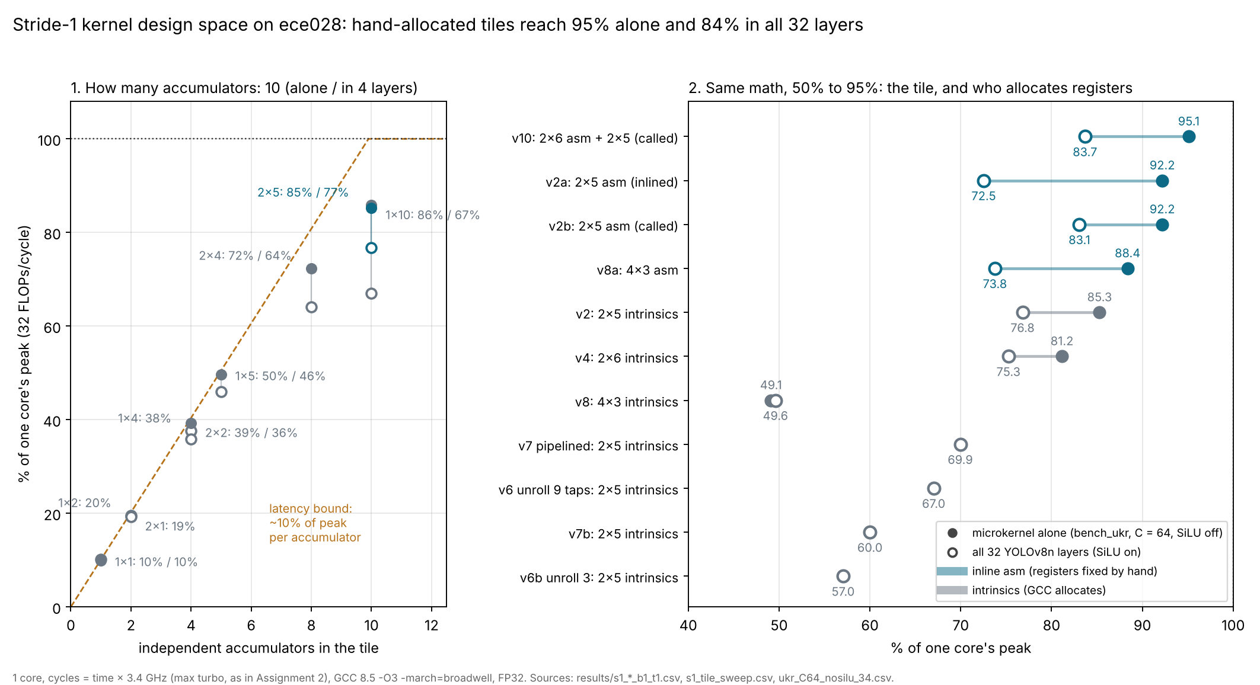
Same math, 50% to 95%: tile and register allocation
Intrinsics
GCC: clean at 13 regs, copies at 15, spills at 16
Inline asm
2×6 by hand: 95% alone, 84% in layers
Unroll, pipeline
lost: uop cache, spills
Notes:
Every kernel I built, same arithmetic, same layout. Filled dots are the microkernel alone, hollow are all 32 layers. Left: the accumulator count. Right: the 2x6 tile my teammates suggested loses with intrinsics because GCC adds 11 register copies per tap at 15 live registers, but with the registers fixed in inline asm it is the best kernel, 95% alone. 4x3 needs all 16 registers; GCC spills it to 49%. The lecture techniques, unrolling and software pipelining, made it worse: full unrolling overflowed the uop cache and partial unrolling made GCC spill.

Slide 6
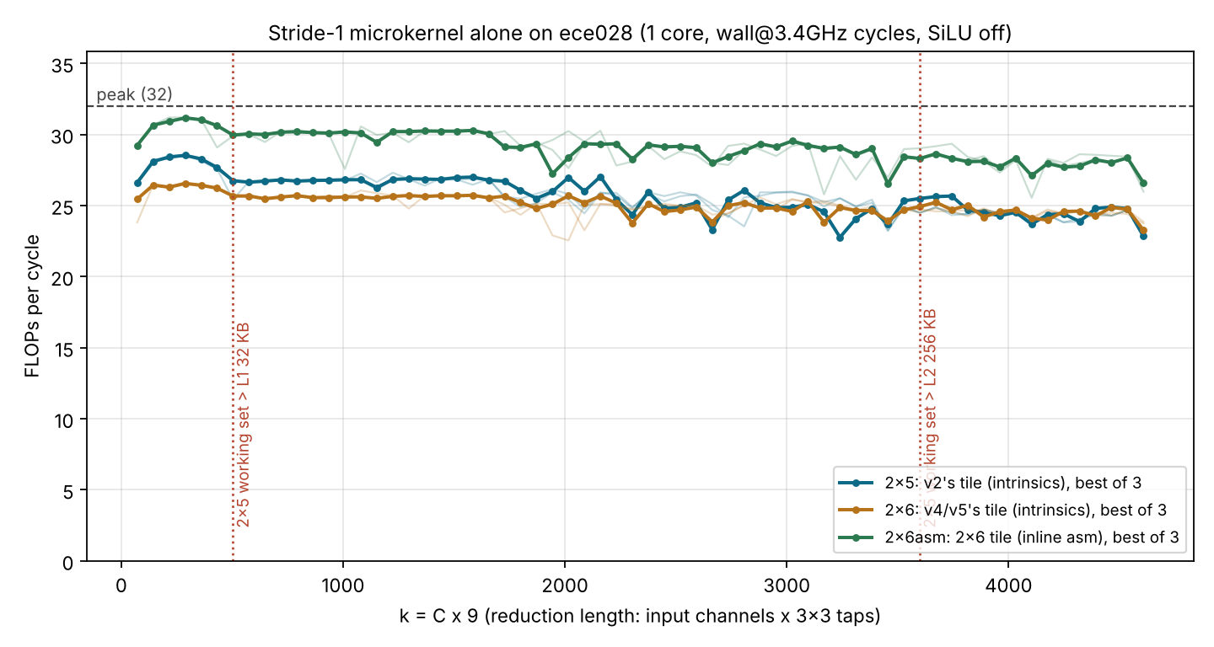
Benchmarked like Assignment 2: FLOPs/cycle vs k
94–97%
2×6 asm: 30–31 FLOPs/cycle, ~102 GFLOP/s on one core
83–89%
2×5 intrinsics (v2's tile)
k ≈ 500
SiLU off, cycles = time × 3.4 GHz, as in A2. 3 runs, every point checked (576 pass).
L1 dip: 2×5 weights pass 32 KB, like k ≈ 315 in A2
Notes:
This is the Assignment 2 figure for my kernel: FLOPs per cycle against the reduction length k. Cycles are time times 3.4 GHz, the max turbo, exactly as in Assignment 2, so this can only understate. 2x6 asm holds 30 to 31 FLOPs per cycle, 94 to 97 percent of peak. 2x5 intrinsics is 83 to 89. The dip near k = 500 is the 2x5 weights leaving L1, the same effect as k = 315 in A2. Cross-checked: the hardware FP-instruction counter matches our FLOP count exactly, and real perf cycles give the same or slightly higher numbers.

Slide 7
Alone vs in a layer: keep the kernel a function
v2a (2×5 asm): 92.2% alone, 72.5% when GCC inlines it into the layer loop
vmovaps 168(%rsp), %ymm1 # reload acc
...asm block: 80 FMAs...
vmovaps %ymm1, 168(%rsp) # store acc
Inlined, GCC keeps 3 of 10 accumulators on the stack around every tap. Called as a function, as in the benchmark: 83.1% (v2b); with the 2×6 tile, 83.7% (v10).
Next: cache blocking for C ≥ 128 (the 4×3 drop-off), NUMA-aware threads (v10 on 20 cores: 4.74 ms).
Notes:
Kernel A, 2x5 in asm, beat kernel B, 2x5 intrinsics, by 7 points alone but lost by 4 in the layers. The assembly shows why: inlined into the layer loop, GCC keeps 3 accumulators on the stack and reloads them around every tap. Calling the microkernel as a function, exactly as the benchmark does, fixes it: 83.1% for 2x5 and 83.7% for v10, all at 3.4 GHz. v10 is 1.36 times faster than OpenCV and within 2% of ONNX Runtime on all 32 layers. Next: cache blocking and threading.

