Slide 1
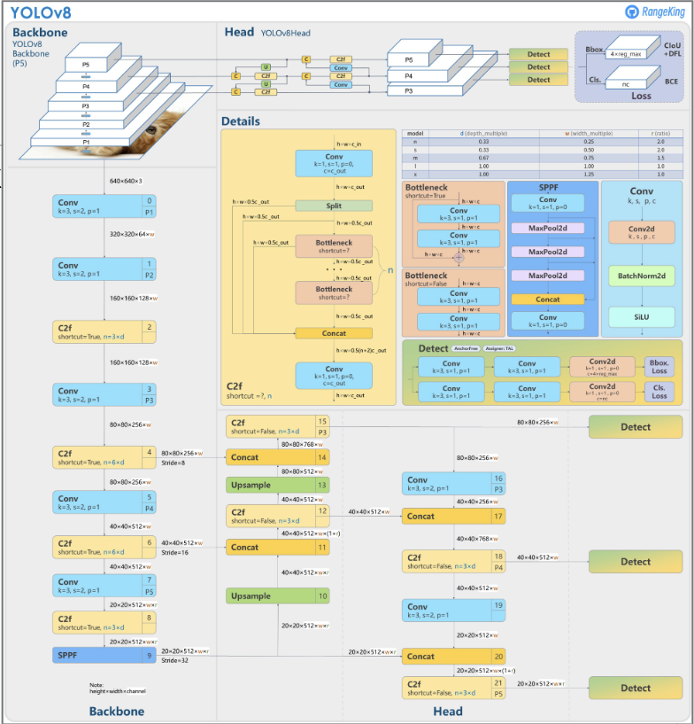
YOLOv8n on one Broadwell machine: what we build
Model: pretrained YOLOv8n, FP32 inference, batch 1, 640×640: 8.74 GFLOP per image in 63 conv layers. Baseline: OpenCV DNN, same ONNX model.
Machine: ece028
32
Xeon E5-2640 v4 (Broadwell), 2.4 GHz, 3.4 turbo
2 sockets × 10 cores, AVX2 + FMA, 16 YMM registers
L1D 32 KB, L2 256 KB per core; L3 25 MB per socket
FLOPs/cycle/core
2 FMA × 8 lanes × 2
Kernel | Owner | Layers | Work
3×3 conv, stride 1 | Om | 32 | 66%
3×3 conv, stride 2 | O'Malley | 7 | 15%
1×1 conv | Simon | 24 | 19%
SiLU (fused into the conv) | Simon | 57 of 63 | in the kernels
SPPF max-pool | Simon | 1 | < 1%
YOLOv8 architecture. Diagram: RangeKing (Ultralytics GitHub).
Notes:
Quick recap, since the project is approved. We take the pretrained YOLOv8n detector and write our own FP32 inference kernels for its convolutions; no training. One image is 640 by 640, batch 1, 8.74 GFLOP, almost all of it in 63 convolution layers. Our machine is ece028, a Xeon E5-2640 v4, Broadwell: AVX2 and FMA, 16 vector registers, so one core peaks at 32 FLOPs per cycle, 2 FMA units times 8 floats times 2. The convolutions split into three kernels: 3 by 3 stride 1, 66 percent of the work; 3 by 3 stride 2, the downsampling, 15 percent; and 1 by 1, 19 percent. 57 of the 63 convolutions are followed by SiLU, which we fuse into the kernels, and SPPF adds max-pooling. We compare against OpenCV DNN on the same model and images. Each of us presents our own kernel.

