Slide 1
The 3×3 stride-1 convolution kernel
Om Tank · YOLOv8n on one Broadwell core, built like the Assignment 2 kernel
32
66%
85%
77%
layers
of YOLOv8n's work
of peak, kernel alone
of peak, 32 layers
Notes:
My kernel is the 3x3 stride-1 convolution: 32 layers, the C2f bottlenecks and the Detect head, two thirds of YOLOv8n's work. The story: it is the Assignment 2 kernel, I followed the same four steps, and the measurements chose the tile. The 2x5 microkernel alone: 85% of the 32 FLOPs/cycle peak; inside all 32 real layers: 77%, 1.24 times faster than OpenCV. Intrinsics only, no assembly. All percentages assume the core runs at 3.4 GHz, as in Assignment 2.

Slide 2
It is the Assignment 2 kernel, with floats
 | Assignment 2 | Stride-1 microkernel
m (broadcast) | 5 rows of A | 5 output pixels
n (vector loads) | 8 = 2 × 4 doubles | 16 ch = 2 × 8 floats
k (reduction) | 32 to 512 | C × 9 (144 to 2304)
Accumulators | 10 | 10 (2×5) or 12 (2×6)
Registers | 13 of 16 | 13 or 15 of 16
Peak per core | 16 FLOPs/cycle | 32 FLOPs/cycle
C
input channels of the layer (16 to 256)
k = C × 9
multiply-adds per output: C channels × the 9 taps of the 3×3 filter (A2's k)
accumulator
one YMM register = 8 outputs (8 channels of one pixel); one dependency chain
tile 2×5 (10)
Same Broadwell core: 2 FMA units × 8 lanes × 2 FLOPs = 32 FLOPs/cycle. Latency 5 × throughput 2 = 10 chains in flight.
outputs per call: 2 blocks of 8 ch × 5 pixels = 80 outputs in 10 accumulators
Notes:
Same machine as Assignment 2 and the same kernel. In A2, m was 5 rows of A broadcast, n was 8 doubles = 2 vectors of B. Here m is 5 output pixels, n is 16 output channels = 2 vectors of 8 floats, and k is input channels times the 9 taps of the 3x3 filter. 10 accumulators, 13 registers, exactly the A2 budget. Peak is 32 FLOPs per cycle because floats give 8 lanes instead of 4. 10 accumulators is the minimum (5 x 2); the 2x6 tile uses 12, two chains of slack.

Slide 3
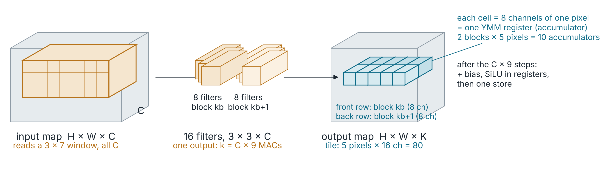
One kernel call = 80 outputs
Per step: 2 weight loads + 5 broadcasts feed 10 FMAs; repeated k = C × 9 times, then bias, SiLU, one store.
SIMD
Intrinsics
Reuse
Layout
one vfmadd231ps = 8 multiply-adds (8 output channels): 32 FLOPs/cycle vs 4 scalar
C calls that are one instruction each, e.g. _mm256_fmadd_ps = vfmadd231ps
each weight vector used 5×, each broadcast 2×, each accumulator stored once
8 channels of a pixel are contiguous: one aligned load fills one register
Notes:
One call computes the teal strip: one output row, 5 pixels wide, 16 output channels deep, 80 numbers. Each cell is 8 channels of one pixel, exactly one YMM register, so the strip is 10 accumulators. It reads a 3 by 7 window of the input across all C channels and 16 filters of 3 by 3 by C. Each step multiplies 2 weight vectors by 5 broadcast inputs, 10 FMAs, repeated k = C x 9 times, then bias, SiLU, store.

Slide 4
(a)–(c): size, registers, allocation
16 YMM registers, 8 floats each (row 1: block kb, row 2: kb+1)
(a) Size
c[0][0]
c[0][1]
c[0][2]
c[0][3]
c[0][4]
80 outputs per call: 5 pixels × 16 output channels (2 blocks of 8).
c[1][0]
c[1][1]
c[1][2]
c[1][3]
c[1][4]
(b) Registers
w0
w1
x
free
free
free
Need 13 of the 16 YMM registers (AVX2, no AVX-512). At least 10 accumulators: FMA latency 5 × 2 FMA units.
c[b][j] output block b (8 ch), pixel j: 10 accumulators
w0, w1 8 weights for blocks kb, kb+1 (one load each)
x one input value broadcast to 8 lanes
(c) Allocation
Outputs: 10 accumulators, live for the whole C × 9 loop. Inputs: 2 weight + 1 broadcast. Temporaries: none in the loop; 3 free. Pointers and counters live in integer registers.
Notes:
Answering the handout questions directly. (a) One call computes 80 outputs: 5 pixels of one output row times 16 output channels. (b) It needs 13 YMM registers out of the 16 that AVX2 gives on Broadwell: 10 accumulators, 2 weight vectors, 1 broadcast input. 10 accumulators is the minimum to hide FMA latency: 5 cycles latency times 2 FMA units. (c) Outputs: the 10 accumulators stay in registers for the whole C x 9 reduction. Inputs: the 2 weight registers hold 8 output channels each for one input channel and tap; the broadcast register holds one input value copied to all 8 lanes. Temporaries: none inside the loop; 3 registers stay free. We write intrinsics, so GCC assigns the physical registers; we checked GCC's output for v2 and it keeps all 13 in registers with no spills.

Slide 5
(d)–(e): register reuse and the code
(d) Reuse
(e) Implementation, AVX2 intrinsics (v2)
Weight w0, w1
c[b][j] = _mm256_load_ps(bias + 8*(kb+b)); // b<2, j<5
for cb in C/8: for r in 0..2: for s in 0..2:
for ci in 0..7: // unrolled by GCC
w0 = _mm256_load_ps(W[kb ][cb][r][s][ci]);
w1 = _mm256_load_ps(W[kb+1][cb][r][s][ci]);
for j in 0..4: // unrolled
x = _mm256_broadcast_ss(&In[cb][oh+r][ow+j+s][ci]);
c[0][j] = _mm256_fmadd_ps(x, w0, c[0][j]);
c[1][j] = _mm256_fmadd_ps(x, w1, c[1][j]);
c[b][j] = epilogue_ps(c[b][j], fuse_silu); // SiLU
_mm256_store_ps(&Out[kb+b][oh+1][ow+j+1][0], c[b][j]);
1 load → 5 FMAs (one per pixel)
Input x
1 broadcast → 2 FMAs (one per block); the one x register is reused for all 5 pixels
Accumulator c
C × 9 FMAs → 1 store (bias as start value)
Per step
7 loads : 10 FMAs, under the 2 loads/cycle limit
Weights packed [K/8][C/8][3][3][8 ic][8 oc]; activations NCHW8c with a 1-pixel zero halo, so no edge branches. Outer loops: output-channel pairs kb, rows oh, pixel groups ow of 5.
Notes:
(d) Reuse. Each weight register is loaded once and used by 5 FMAs, one per pixel. Each broadcast input is used by 2 FMAs, one per output block. The single x register is reused 5 times per step, once per pixel, because each broadcast is consumed right away. Each accumulator is reused C x 9 times and written to memory once. So one step is 7 loads for 10 FMAs, which the 2 load ports handle with room to spare. (e) The code: initialize the accumulators with the bias, so the add is free. Then loop over input-channel blocks, the 3 by 3 taps, and the 8 input channels of the block; load 2 weight vectors, then for each of the 5 pixels broadcast one input and issue 2 FMAs. After the loop, apply SiLU in registers and store. The zero halo means no edge branches. GCC fully unrolls the inner 8 channels and 5 pixels, so the loop body is 80 FMAs, 40 broadcasts and 16 loads.

Slide 6
How the numbers are measured
Machine and code
Peak
ece028, Xeon E5-2640 v4, 1 core (taskset); C++ with AVX2 intrinsics only, GCC 8.5 -O3
2 FMA units × 8 FP32 lanes × 2 FLOPs = 32 FLOPs/cycle per core (AVX2, no AVX-512)
Cycles
FLOPs
wall time × 3.4 GHz (max turbo), as in Assignment 2: can only understate % of peak
2 × outputs × C × 9: only the convolution's multiply-adds; bias and SiLU count as zero
Microkernel alone
Full layers
one tile of data reused (stays in L1/L2), 2 s warm-up, best of 3 runs, SiLU off
all 32 real YOLOv8n layers, batch 1, 640 × 640 image, FP32, SiLU on
Correct
Baseline
every result checked: max relative error ≤ 1e-4 vs a scalar reference / OpenCV's real outputs
OpenCV DNN on the same ONNX model, 1 thread, its own per-layer timer
Notes:
These are the assumptions behind every number in the talk. The important one: cycles are wall time times 3.4 GHz, the CPU's maximum turbo, exactly the Assignment 2 convention. The core can never run faster than that, so the percentages can only understate.

Slide 7
Four steps: ops → accumulators → tile → benchmark
1
Independent ops
Each output is a dot product of length C × 9: 102,400 in a 40×40, 64-ch layer.
2
Outputs in flight
5 × 2 FMA/cycle = 10 accumulators = 80 outputs; 1 accumulator = 10% of peak.
3
Kernel size
2×5 tile: 10 acc + 2 weights + 1 broadcast = 13 regs; 7 loads per 10 FMAs.
4
Benchmark like A2
Kernel alone, k = 72 to 4608, 3 runs, 2 s warm-up, cycles at 3.4 GHz, checked.
Notes:
Step 1: every output is an independent dot product; the only chain is the reduction. Step 2: 5-cycle latency times 2 FMAs per cycle means 10 independent accumulators, 80 outputs in flight. The chart: 1 accumulator is 10%, each adds about 10 points. Step 3: 2x5 gives 10 accumulators in 13 registers, 7 loads per 10 FMAs, and 5 divides 160, 80, 40 and 20. Step 4: benchmark the kernel alone exactly like Assignment 2.

Slide 8
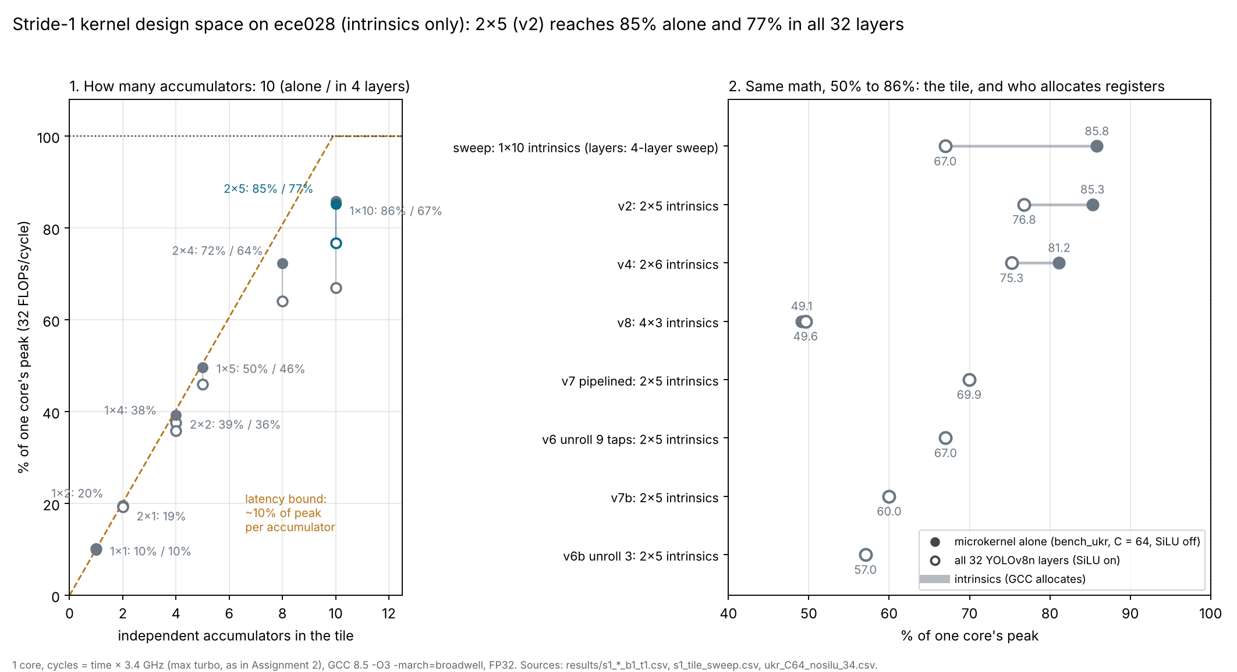
Same math, 50% to 86%: the tile and GCC's registers
Best: 2×5
13 registers, 85% alone, 77% in all 32 layers
GCC's registers
clean at 13, 11 copies per tap at 15 (2×6), spills at 16 (4×3: 49%)
Unroll, pipeline
lost: uop cache overflow, spills
Notes:
Every kernel I built, all intrinsics, same arithmetic, same layout. Filled dots: the microkernel alone; hollow: all 32 layers. 2x5 is the best in the layers: 85% alone, 77% in all 32 layers. Bigger tiles lose because of how GCC allocates registers: at 15 live registers (2x6) it adds 11 register copies per tap, found by reading GCC's generated assembly; at 16 (4x3) it spills accumulators to memory and drops to 49%. Unrolling and software pipelining made it worse: full unrolling overflowed the uop cache and partial unrolling made GCC spill.

Slide 9
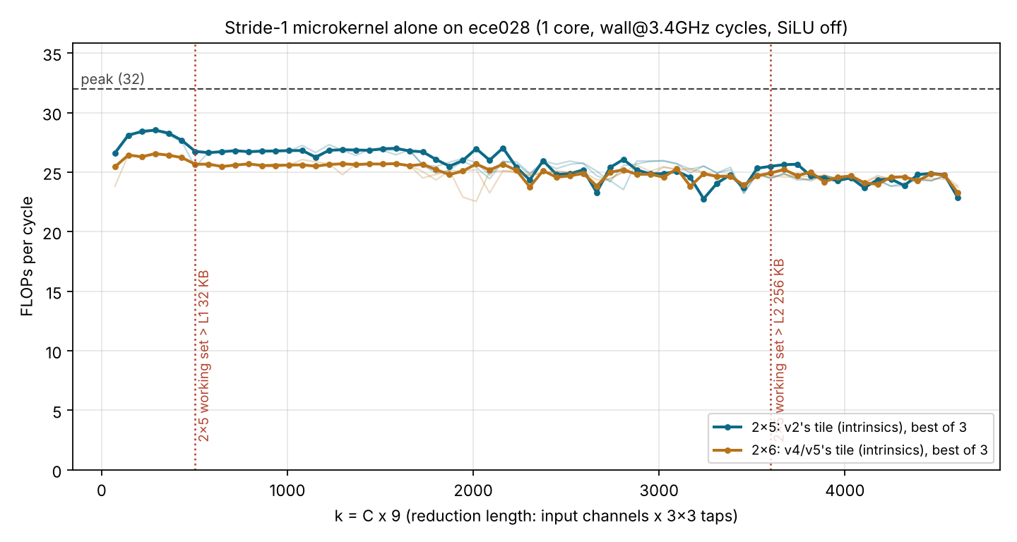
Benchmarked like Assignment 2: FLOPs/cycle vs k
83–89%
2×5 (v2's tile): 27–28.5 FLOPs/cycle, ~93 GFLOP/s on one core
80–83%
2×6: GCC adds register copies at 15 live registers
k ≈ 500
L1 dip: 2×5 weights pass 32 KB, like k ≈ 315 in A2
SiLU off, cycles = time × 3.4 GHz, as in A2. 3 runs, every point checked (576 pass).
Notes:
This is the Assignment 2 figure for my kernel: FLOPs per cycle against the reduction length k. Cycles are time times 3.4 GHz, the max turbo, exactly as in Assignment 2, so this can only understate. 2x5 holds 27 to 28.5 FLOPs per cycle, 83 to 89 percent of peak; 2x6 sits about 3 points lower, 80 to 83, because of GCC's register copies. The dip near k = 500 is the 2x5 weights leaving L1, like k = 315 in A2. Cross-checked: the hardware FP-instruction counter matches our FLOP count exactly.

Slide 10
Tied alone, 10 points apart in the layers
 | 1×10 | 2×5
Loads per 10 FMAs | 11 | 7
Output channels per call | 8 | 16
Times each input row is read | 2× | 1×
Alone: all data in L1, so 1×10's extra loads still fit.
In a layer: data streams from L2 and 1×10 reads inputs twice as often, so loads become the limit.
Pick the tile in the real layer, not only alone.
1×10 in layers: 4-layer tile sweep (C = 16–128).
Notes:
Two tiles with the same 10 accumulators: 1x10, one block of 8 channels times 10 pixels, and 2x5. Alone they tie: 85.8 and 85.3 percent. Inside real layers 2x5 wins by 10 points: 76.8 against 67.0. Alone, everything sits in L1, so 1x10's 11 loads per 10 FMAs still fit through the 2 load ports. In a layer the inputs and weights stream from L2, and because each 1x10 call covers only 8 output channels, the layer reads every input row twice as often as with 2x5. So loads become the limit. 2x5 needs only 7 loads per 10 FMAs, so it has room to spare. Lesson: pick the tile in the real layer, not only alone.

Slide 11
1.24× faster than OpenCV on all 32 layers
1.24×
v2 vs OpenCV DNN, all 32 layers, 1 core
77% vs 62%
of peak: v2 vs OpenCV DNN
Next: cache blocking for C ≥ 128, then threads on 20 cores (v3: 13.5× on 20 cores).
Notes:
Total time for all 32 stride-1 layers, one core, same model and image. OpenCV DNN takes 86.4 milliseconds. Our kernel, v2, the 2x5 tile written with intrinsics, takes 69.5: 1.24 times faster, at 77 percent of peak against OpenCV's 62. Next: cache blocking for the layers with 128 or more input channels, and threading across 20 cores.

Slide 12
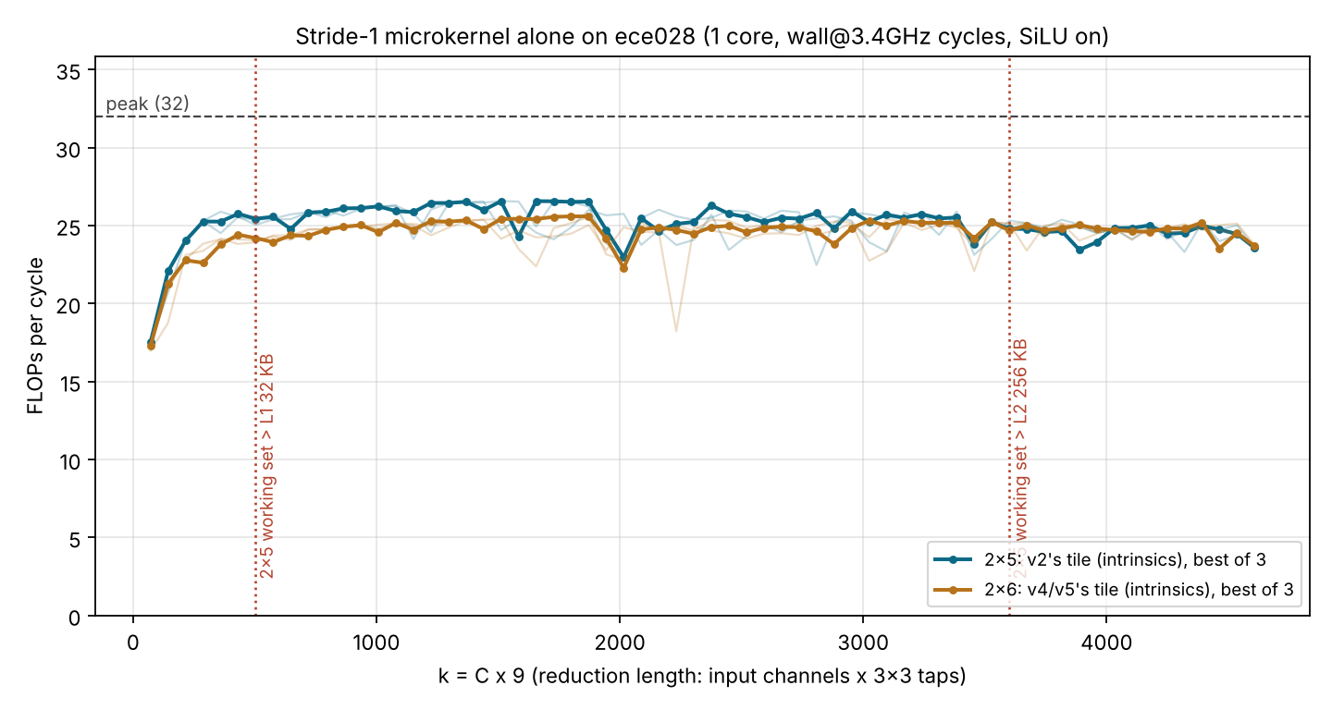
Backup: the same sweep with SiLU on
SiLU on: 2×5 81.4% mean (C = 32–256), 2×6 about 3 points lower.
Cost: a fixed 160–290 cycles per call, 20% of the call at C = 16, about 4.5% at C = 64, nothing measurable from C = 128.
Notes:
With the fused SiLU on, the curves sit about 4 to 5 points lower: SiLU costs a fixed 160 to 290 cycles per call, a big share at small k and almost nothing from C = 128 up.

