Slide 1
SPPF max-pool microkernel: the work and its peak
Task (model.9)
vmaxps per output vector
3 chained 5×5 max-pools, stride 1, pad 2, on 128 ch × 20 × 20; concat X, P1, P2, P3 → 512 ch.
Step | vmaxps / output
Direct 5 × 5 window | 24
Separable: 5 columns, then 5 rows | 4 + 4 = 8
Shared pair maxes in the row pass | 3 + 3 = 6
Microkernel
one 5×5 pool of one 8-channel plane (20 × 20 pixels × 8 channels).
Unit of work
vmaxps: max of 8 channels in one YMM register. No FLOPs.
6
0
Peak
cycles per output vector at best (6 vmaxps at 1 per cycle)
running sums: outputs are independent, no accumulator chain
vmaxps: latency 3, port 1 only → 1 vmaxps per cycle.
Notes:
SPPF in model.9 runs three chained 5 by 5, stride 1, pad 2 max-pools on a 128-channel 20 by 20 tensor and concatenates input and the three results. Our microkernel is one 5 by 5 pool of one 8-channel plane: 20 by 20 pixels, 8 channels each. There are no FLOPs, so the unit of work is vmaxps, one instruction that takes the max of 8 channels. On Broadwell vmaxps has a latency of 3 cycles and issues only on port 1, one per cycle, so the peak is 1 vmaxps per cycle. A direct 5 by 5 window is 24 maxes per output. We split it: a max over 5 columns, then over 5 rows, 4 plus 4. Then each row pass shares pair maxes, so it needs 3 per output instead of 4: 6 vmaxps per output, so at best 6 cycles per output vector. Unlike a convolution there is no running sum, so outputs do not depend on each other and we do not need many accumulators to hide latency.

Slide 2
(a)–(c): size, registers, allocation
16 YMM registers in the inner loop (8 floats each)
(a) Size
x = s[i]
p2 = P[i]
p1 = P[i−1]
p0 = P[i−2] → out
One call: 20 × 20 pixels × 8 channels = 3200 outputs (400 vectors). One inner step: 1 vector = 8 outputs.
free
free
free
free
free
free
free
free
(b) Registers
Need 4 of the 16 YMM registers. No accumulation, so latency is hidden by overlapping independent outputs; port 1 is the limit.
free
free
free
free
input s[i]; s[i+1], s[i+2] come from memory as vmaxps operands
temporaries P[j] = max(s[j], s[j+1]): the new one and the last two
output max(P[i−2], P[i], s[i+2]), stored at once
(c) Allocation
Input: 1 register + 2 memory operands. Temporaries: 3 pair maxes. Output: 1 register, stored immediately. Pointers and counters in integer registers.
Notes:
(a) One call computes one plane: 20 by 20 pixels times 8 channels, 3200 outputs, 400 output vectors. Each step of the inner loop finishes one output vector, 8 outputs. (b) The inner loop uses 4 of the 16 YMM registers. It needs so few because nothing accumulates: each output is done after 3 vmaxps, and consecutive outputs are independent, so out-of-order execution overlaps them and hides the 3-cycle latency. The limit is port 1, not registers. (c) Inputs: s of i is loaded into a register; s of i plus 1 and s of i plus 2 are read straight from memory as the vmaxps operand. Temporaries: the two previous pair maxes and the new one. Output: the result register, stored right away. These counts are from GCC's generated code for the loop; we write intrinsics and GCC assigns the physical registers.

Slide 3
(d)–(e): register reuse and the code
(d) Reuse
(e) Implementation, AVX2 intrinsics
Pair max P[j]
// one pass: d[i] = max(s[i-2..i+2]) along a line of n vectors
d[0] = max(s0,s1,s2); d[1] = max(s0..s3); // clamped edges
p0 = _mm256_max_ps(s[0], s[1]); // P[0]
p1 = _mm256_max_ps(s[1], s[2]); // P[1]
for (i = 2; i < n-2; i++) {
x = _mm256_load_ps(s + 8*i);
p2 = _mm256_max_ps(x, s[i+1]); // P[i]
out = _mm256_max_ps(_mm256_max_ps(p0, p2), s[i+2]);
_mm256_store_ps(d + 8*i, out);
p0 = p1; p1 = p2; // rotate
}
d[n-2], d[n-1]: clamped edges; plane: rows (in→tmp), columns (tmp→out)
computed once, used by outputs j and j+2: kept in registers, rotated each step
8 channels
one vmaxps = 8 maxes: one instruction serves 8 outputs
Rows-pass plane
each value read by 5 outputs of the columns pass
Per output
3 vmaxps + 3 loads + 1 store per pass; port 1 is the limit
Layout: NCHW8c, 8 channels of a pixel = 32 contiguous bytes = one aligned load. Padding acts as −∞ (input is after SiLU and can be negative).
Notes:
(d) Reuse. Each pair max P of j is computed once and used by two outputs, j and j plus 2, so it stays in a register for two steps: the three pair registers rotate by one each step. Every vmaxps works on 8 channels at once, so one instruction serves 8 outputs. The rows-pass result is written to a temporary plane, and each value there is read by 5 outputs of the columns pass. (e) The code. The plane is in our NCHW8c layout, 8 channels of a pixel in 32 contiguous bytes. Rows pass: for each row, the first two and last two outputs use the clamped window, which is the same as minus-infinity padding; the interior runs the 3-vmaxps step. Columns pass: the same step down each column of the temporary plane, into the output plane.

Slide 4
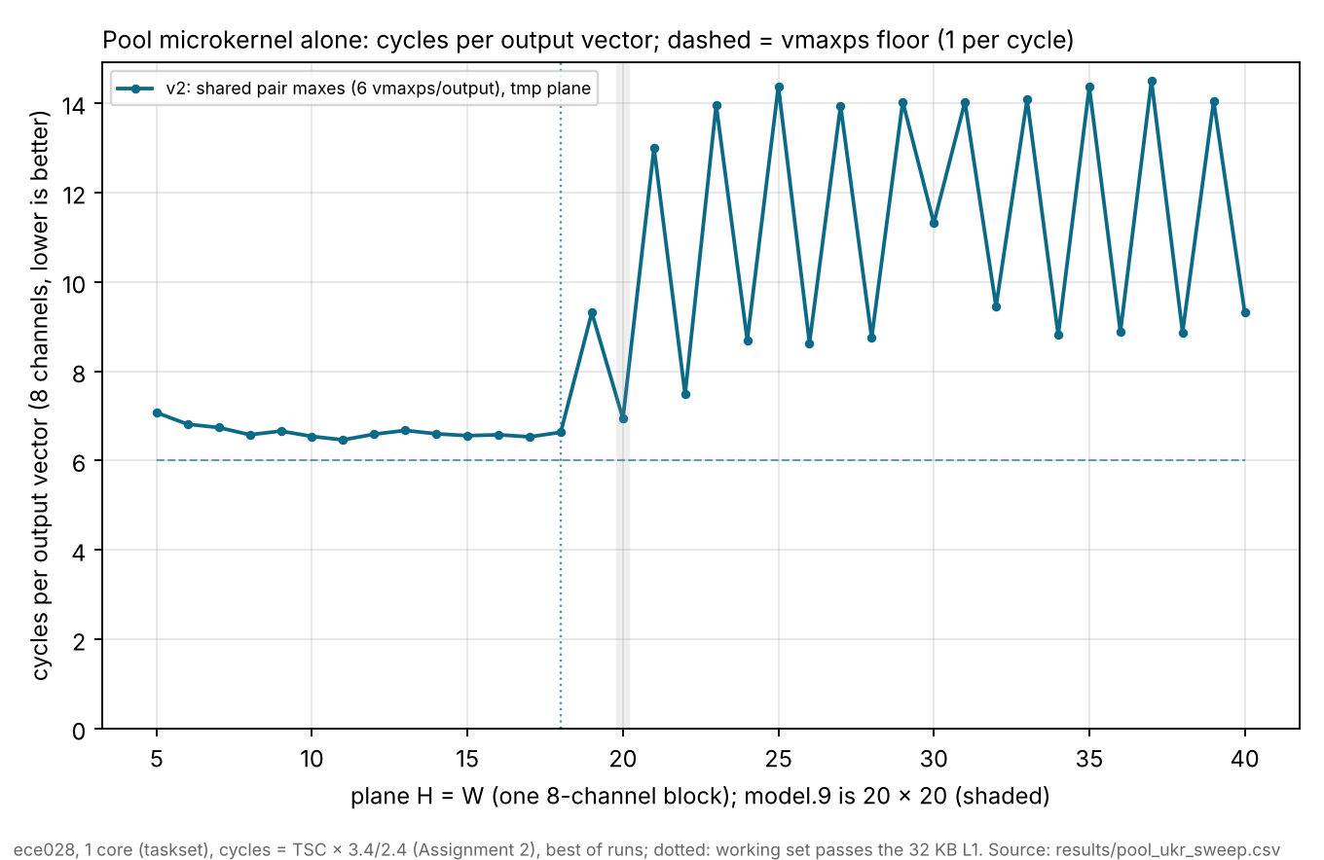
Alone on ece028: 86% of the port-1 peak
86%
of the port-1 peak at 20×20 (0.86 vmaxps/cycle)
6.94
cycles per output vector (floor 6.0)
0 error
vs scalar 5×5 max and OpenCV's model.9 outputs
Notes:
Benchmarked like Assignment 2: one plane pooled over and over so it stays in cache, a 2-second warm-up, one pinned core, cycles from the TSC times 3.4 over 2.4. At model.9's 20 by 20 plane: 2775 cycles per call, 6.94 cycles per output vector against the floor of 6, so 0.86 vmaxps per cycle, 86 percent of port 1's peak. Swept over the plane size, it holds about 6.6 cycles per output while the source, temporary and output planes fit in the 32 KB L1, up to 17 by 17. Past that the temporary plane pushes the working set out of L1 and the time per output rises. Keeping only the 5 rows the columns pass needs is the next step. Every result matches a scalar 5 by 5 max exactly, and the full pool matches OpenCV's real model.9 outputs with zero error.

