Slide 1
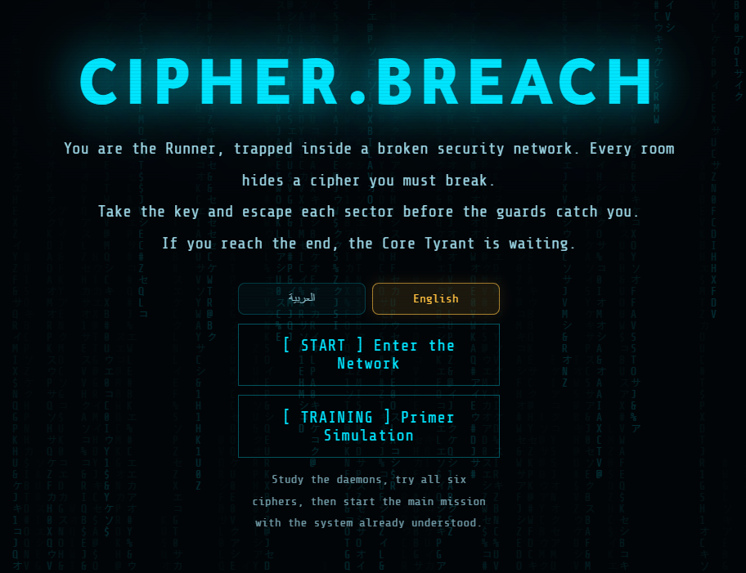
Kingdom of Saudi Arabia | Ministry of Education
King Faisal University
College of Computer Sciences & Information Technology
CIPHER.BREACH
A 3D Cryptography Game
CS320 Computer Security
Supervised by Dr. Abdullah Albuali
Date: May 2026
PROJECT GROUP
Abdullah Ali Alkhulaifi
223002824
Bashar Ibrahim Farhat
223039656
Ayed Ahmed Almutairi
223041875
Abdulelah Adel Alhinity
223023047
Ahmed Amer Abdulmalik
223049879

Slide 2
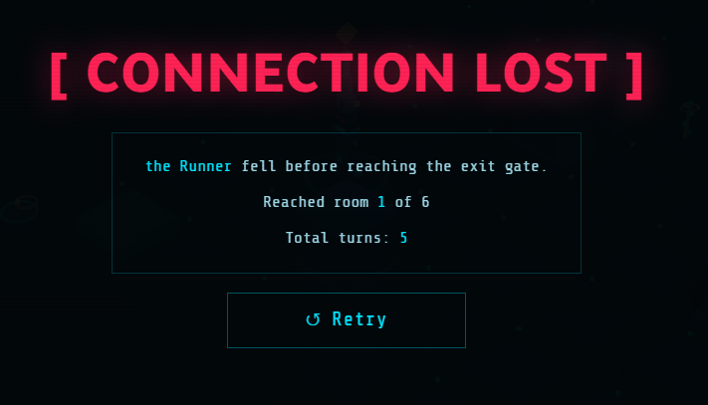
What is CIPHER.BREACH?
A 3D browser game that turns classical ciphers into a cybersecurity escape mission.
Player goal
Escape a hostile digital network by solving cipher rooms, avoiding daemon enemies, collecting the exit key, and clearing each sector.
ROOMS
LANGUAGES
PLATFORMS
STACK
6 + 1 hidden
AR / EN
Desktop + mobile
HTML / CSS / JS

Slide 3
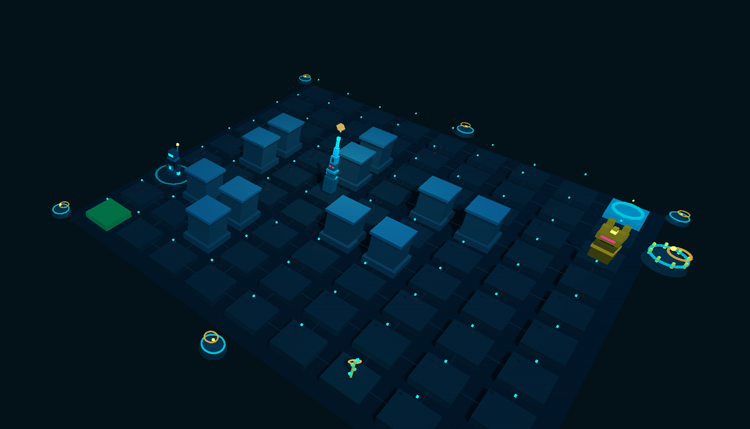
Core gameplay loop
Explore a room-based 3D map with walls, enemies, a keyholder, and an exit node.
Avoid or outmaneuver daemon patrols; if caught, the game opens a cipher battle screen.
Solve the puzzle, secure the exit key, and reach the next room before health runs out.
Hints help, but they still cost health, so guessing is never free.
Daemon Types
Med kit
Hints
Rook & Bishop
+5 Health
-2 Health

Slide 4
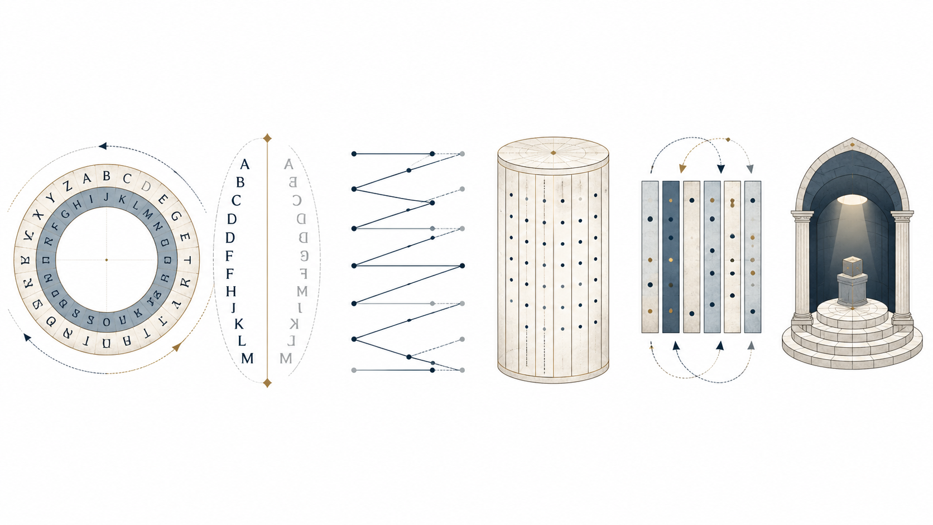
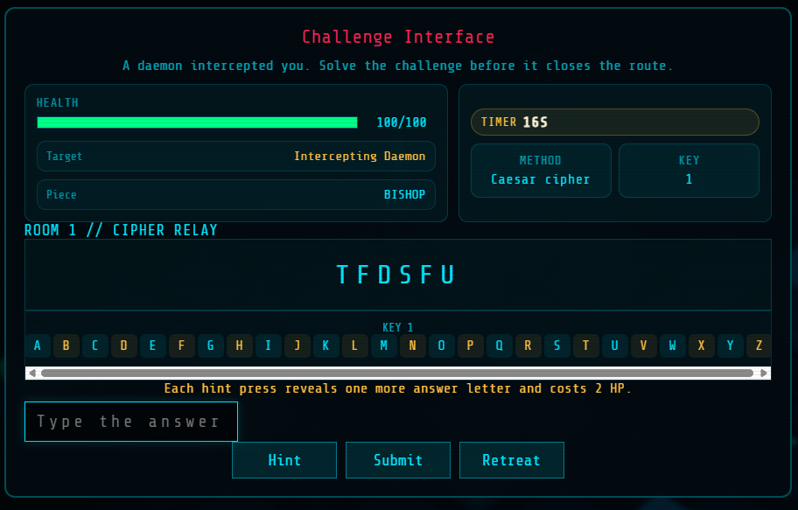
Cipher room progression
Each room pairs one classic method with a security theme.
1
Cipher Relay
Caesar cipher
Cryptography
2
Token Cache
Reverse
Cryptography
3
Password Vault
Atbash
Authentication
4
Identity Gate
Rail Fence
Authentication
5
Payroll Gate
Scytale
Access Control
6
Contractor Window
Columnar Transposition
Access Control
7
Secret
Classified
????

Slide 5
Systems that create pressure
Daemons
Battles
Health
Progress
Mobile HUD
Patrol, detect, and chase inside the grid.
Cipher encounters open when a daemon catches the player.
Wrong answers, hints, and timer damage all reduce HP.
Key first, exit second. Every room enforces the loop.
Controls were adjusted so buttons do not cover play.
Balancing values constants in game.js
hero hp = 100 | battle time = 17 | medkit heal = 5 | wrong answer damage = 5 | hint damage = 2 | room daemons = [2,2,3,3,4,4]

Slide 6
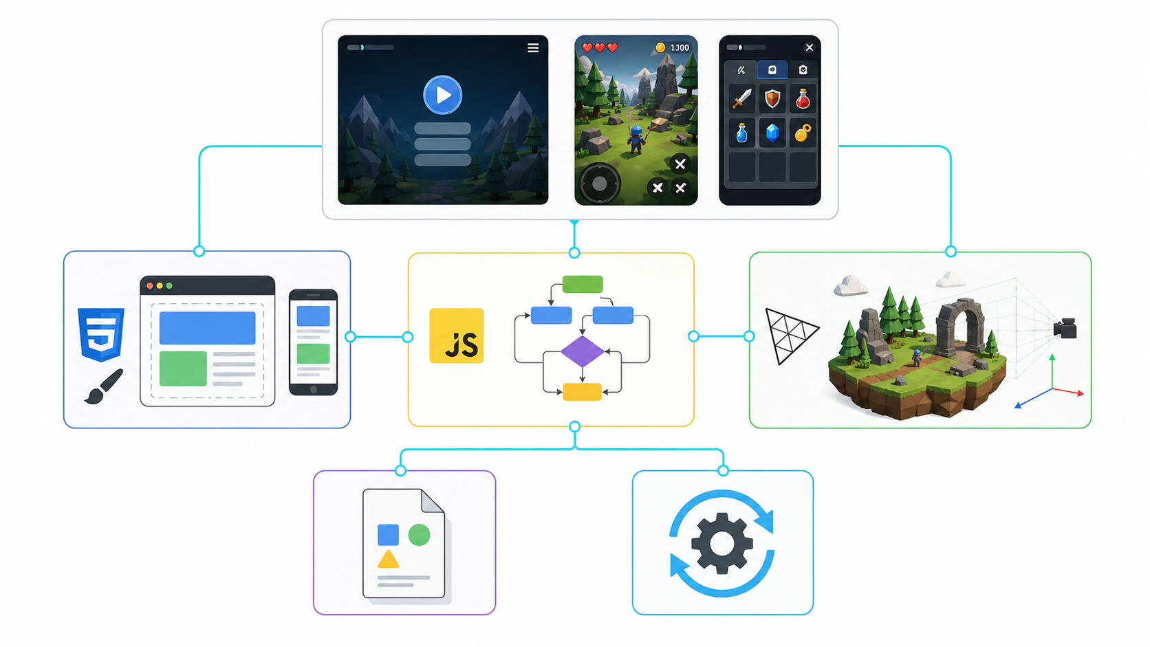
Implementation architecture
Main files
index.html. screens, overlays, HUD, menus, win/loss states.
assets/styles.css. visual style, layout, bilingual alignment, mobile rules.
assets/game.js. player state, rooms, enemies, health, battles, language switching.
manifest.webmanifest + sw.js. basic PWA packaging for installability and web app behavior.
GitHub language split
JS
CSS
HTML
86.5%
10.3%
3.2%

Slide 7
Conclusion
PROJECT RESULT
FINAL TAKEAWAY
A complete single-page browser game with desktop and mobile support.
Six main cipher rooms plus a hidden final challenge.
Cybersecurity concepts presented through movement, enemies, health, keys, and timed cipher battles.
The project is ready because it has fully deployed gameplay mechanics, visible systems, balanced values that fits casual gamers, and a direct connection between cryptography and game mechanics.

Slide 8

Thank You.
Questions?
Try The Game!

