Slide 1
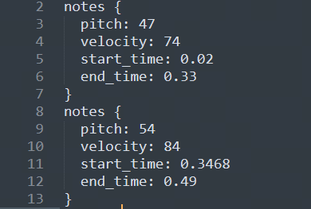
1
当前进展
团队目前主要在针对新的技术路线做研究，这段时间已有突破，但也遇到了新的问题。目前技术路线如下：
谷歌mt3卷积神经网络
Note-Sequence
MIT作品：music21的py库
谱子
Mp3文件
规则解析
已走通
走通
https://www.cnblogs.com/ghj1976/p/magenta-noteseq.html
https://web.mit.edu/music21/doc/about/what.html
该路线目标：实现纯钢琴曲、流行音乐的钢琴伴奏的制谱，准确度≥70%

Slide 2
2
目前问题
团队目前在解决规则解析问题:
notes_data = [
{"pitch": 47, "velocity": 74, "start_time": 0.02, "end_time": 0.33},
{"pitch": 54, "velocity": 84, "start_time": 0.3468, "end_time": 0.49},
{"pitch": 59, "velocity": 78, "start_time": 0.67, "end_time": 0.77},
{"pitch": 54, "velocity": 82, "start_time": 1.01, "end_time": 1.12},
{"pitch": 82, "velocity": 79, "start_time": 1.02, "end_time": 1.14},
{"pitch": 91, "velocity": 69, "start_time": 1.34, "end_time": 1.35},
{"pitch": 43, "velocity": 78, "start_time": 1.33, "end_time": 1.45},
{"pitch": 84, "velocity": 68, "start_time": 1.67, "end_time": 1.68},
{"pitch": 50, "velocity": 73, "start_time": 1.67, "end_time": 1.82},
{"pitch": 55, "velocity": 82, "start_time": 2.0, "end_time": 2.13},
{"pitch": 67, "velocity": 75, "start_time": 2.01, "end_time": 2.13},
{"pitch": 98, "velocity": 54, "start_time": 2.36, "end_time": 2.4},
{"pitch": 50, "velocity": 74, "start_time": 2.34, "end_time": 2.45},
{"pitch": 84, "velocity": 65, "start_time": 2.34, "end_time": 2.67},
{"pitch": 100, "velocity": 60, "start_time": 2.68, "end_time": 2.7},
{"pitch": 45, "velocity": 71, "start_time": 2.67, "end_time": 2.77},
]
上面这段数据，每一个元素代表1个音符，start_time、end_time分别代表音符的起、止时间，现在需要给这些数据分组，分组规则:
1、根据start_time和duration，得出音符的时值（4分、8分、16分音符）
2、每组包含的元素个数不一定，但每组的所有元素时值之和与其相邻组的时值之和的差值应该在正负0.02内（第1组和最后一组不用考虑）
请给出python代码，输出分组后，每个小组的时间和

