Slide 1
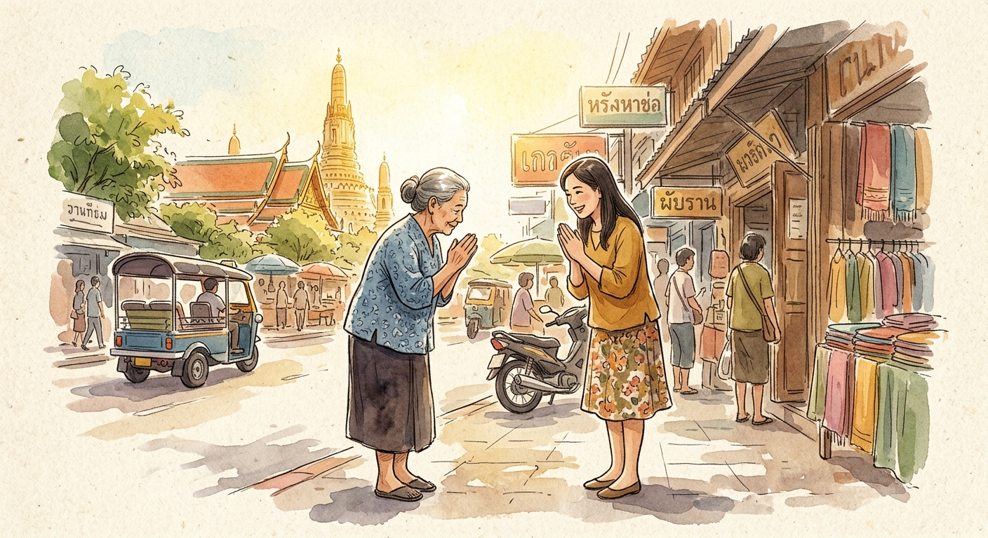
Nine
First Contact and Courtesy · A0
M01-L001
Hello and Basic Courtesy
Lesson focus
You can greet people politely, thank others, apologize, and respond yes/no in a friendly first encounter.
Deliver a 2-line greeting exchange with the correct polite ending.
Immersion Thai with Nine

Slide 2
Nine
Lesson objectives
What you will learn
1
2
You can greet people politely, thank others, apologize, and respond yes/no in a friendly first encounter.
You can recycle recent vocabulary while using basic affirmation and negation in short controlled output.
3
4
Deliver a 2-line greeting exchange with the correct polite ending.
Catch greetings, thanks, apologies, and polite particles in slow speech.

Slide 3
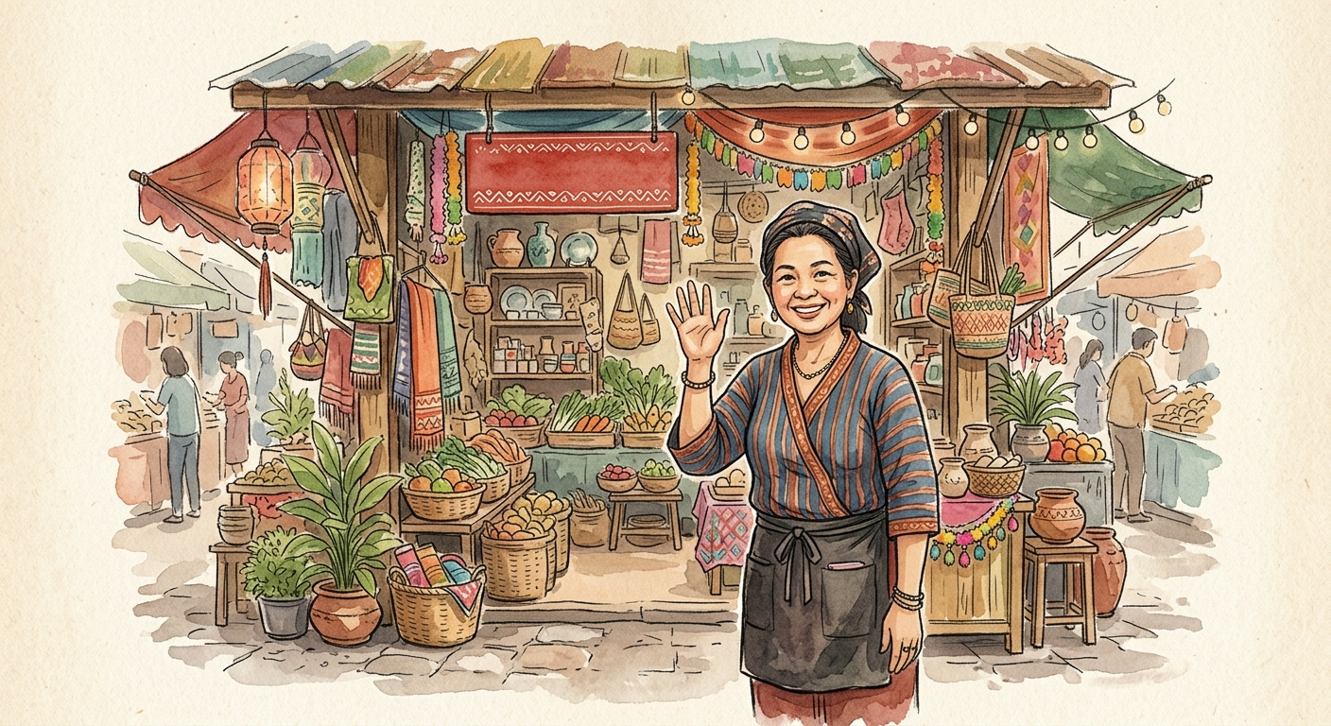
Nine
Teaching slide
Your first Thai word: สวัสดี (sà-wàt-dii)
สวัสดี
sà-wàt-dii
hello
Practice
Listen and repeat: สวัสดี (sà-wàt-dii) sà-wàt-dii. Say it three times.
Pause-and-produce: you walk into a hotel lobby. What do you say? Say it aloud before I show the answer.

Slide 4
Nine
Teaching slide
Polite endings: ครับ (khráp) and ค่ะ (khâ)
ครับ
khráp
polite ending (male)
ค่ะ
khâ
polite ending (female)
สวัสดีครับ
sà-wàt-dii khráp
hello (male, polite)
สวัสดีค่ะ
sà-wàt-dii khâ
hello (female, polite)
Notes:
[Practice — moved to notes, no room on slide]
• Listen and repeat: ครับ khráp. Now: ค่ะ khâ. Repeat each three times.
• Substitution drill: I say สวัสดี — you add ครับ. Now I say สวัสดี again — you add ค่ะ.
• Your turn: I point to male or female. Say the correct full greeting: สวัสดีครับ or สวัสดีค่ะ.

Slide 5
Nine
Teaching slide
Thank you and sorry: ขอบคุณ (khàawp-khun) and ขอโทษ (khǎaw-thôot)
ขอบคุณ
khàawp-khun
thank you
ขอโทษ
khǎaw-thôot
sorry / excuse me
ขอบคุณครับ
khàawp-khun khráp
thank you (male, polite)
ขอโทษค่ะ
khǎaw-thôot khâ
sorry (female, polite)
Notes:
[Practice — moved to notes, no room on slide]
• Listen and repeat: ขอบคุณ khàawp-khun. Now: ขอโทษ khǎaw-thôot. Say each three times.
• Discrimination drill: I describe a situation. You choose ขอบคุณ or ขอโทษ — say it aloud. Situation 1: someone helps you carry a bag. Situation 2: you need to pass through a crowd.
• Substitution drill: say ขอบคุณ with ครับ. Now with ค่ะ. Say ขอโทษ with ครับ. Now with ค่ะ.

Slide 6
Nine
Teaching slide
Respond naturally: ไม่เป็นไร (mâi bpen rai), ใช่ (châi), ไม่ใช่ (mâi châi)
ไม่เป็นไร
mâi bpen rai
it is okay / no problem
ใช่
châi
yes / that is right
ไม่ใช่
mâi châi
no / not right
Notes:
[Practice — moved to notes, no room on slide]
• Listen and repeat: ไม่เป็นไร mâi bpen rai. Say it three times. Now: ใช่ châi. Three times. Now: ไม่ใช่ mâi châi. Three times.
• Response-building drill: I say ขอโทษครับ — what do you say back? Pause and answer. I say ขอบคุณค่ะ — what do you say back?
• Pause-and-produce: is this สวัสดี? ใช่ or ไม่ใช่? Say it aloud before I show the answer.

Slide 7
Nine
Teaching slide
Pronunciation beat: hearing Thai tones
ครับ
khráp
high tone — voice rises sharply
ค่ะ
khâ
falling tone — starts high, drops down
ขอบคุณ
khàawp-khun
low tone on khàawp — voice stays low
Notes:
[Practice — moved to notes, no room on slide]
• Tone echo drill: I say ครับ khráp — repeat it. Now I say ค่ะ khâ — repeat it. Feel the difference in your voice.
• Minimal pair choice: I say two words. Which one is the high tone ครับ and which is the falling tone ค่ะ? Point before I tell you.

Slide 8
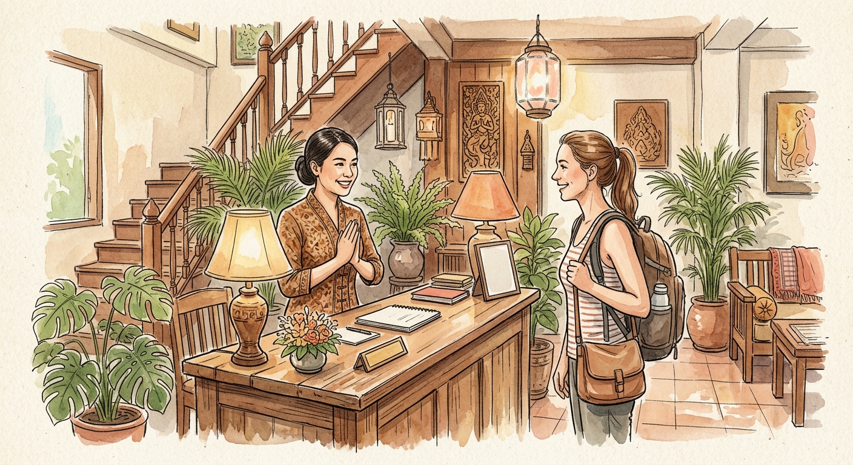
Nine
Roleplay
Roleplay
You
สวัสดีครับ
sà-wàt-dii khráp
Hello.
Staff
สวัสดีค่ะ
sà-wàt-dii khâ
Hello.
You
ขอโทษครับ นี่โรงแรมสยามใช่ไหมครับ
khǎaw-thôot khráp nîi roong-raem sǎ-yǎam châi mái khráp
Excuse me, is this the Siam Hotel?
Staff
ใช่ค่ะ
châi khâ
Yes, it is.
You
ขอบคุณครับ
khàawp-khun khráp
Thank you.

Slide 9
Nine
Recap
Recap
What you can now do
How do you say hello politely as a male speaker? Say it aloud.
Someone helps you. What do you say? Add a polite ending.
Someone apologises to you. What is the warm Thai response?
What is the difference between ใช่ (châi) and ไม่เป็นไร (mâi bpen rai)?
Say sorry politely as a female speaker.
Remember
Say sorry politely as a female speaker.

Slide 10
Nine
Closing
Closing
Next steps
By the end, you can greet, thank, apologise, respond to thanks, and answer yes or no politely.
Next: First Contact and Courtesy continues.

