Slide 1
DEPARTMENT OF METEOROLOGY KNUST, GHANA
A STUDY ON THE EQUATORIAL KELVIN AND ROSSBY WAVES
NAME: OTI JAMES ACHEAMFOUR ANTWI
INDEX NUMBER:9474919

Slide 2
EQUATORIAL WAVES
Equatorial waves are an important class of eastward and westward propagating disturbances
These waves propagate zonally
Present in atmosphere and ocean
Trapped about the equator (they decay away from the equator)
Types of waves
Equatorial Kelvin waves, Equatorial Rossby(ER), Mixed Rossby-Gravity(MRG), inertia-gravity wave
Atmospheric equatorial waves are excited by diabatic heating by organized tropical convection
Ocean equatorial waves are excited by wind stresses
These waves communicate the effects of convective storms over a large distance

Slide 3
EQUATORIAL KELVIN WAVE
The Kelvin wave is a large-scale wave motion of great practical importance in the Earth’s atmosphere and ocean
Kelvin waves are large-scale waves whose structure "traps" them so that they propagate along a physical boundary such as a mountain range in the atmosphere or a coastline in the ocean
In the tropics, each hemisphere can act as the barrier for a Kelvin wave in the opposite atmosphere, resulting in "equatorially–trapped" Kelvin waves
Kelvin waves are thought to be important for the initiation of the El Niño Southern Oscillation (ENSO) phenomenon and for the maintenance of the MJO.
Equatorially trapped convectively coupled Kelvin waves travel eastward at phase speeds of 15-20 m/s over the West Pacific and 12-15 m/s over the Indian Ocean because they tend to be more strongly coupled to convection. They are nondispersive, so their group speed is equal to their phase speed

Slide 4
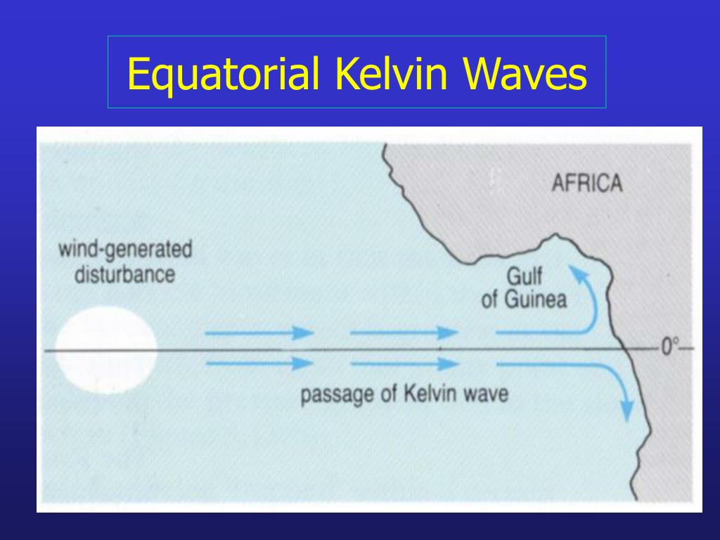

Slide 5
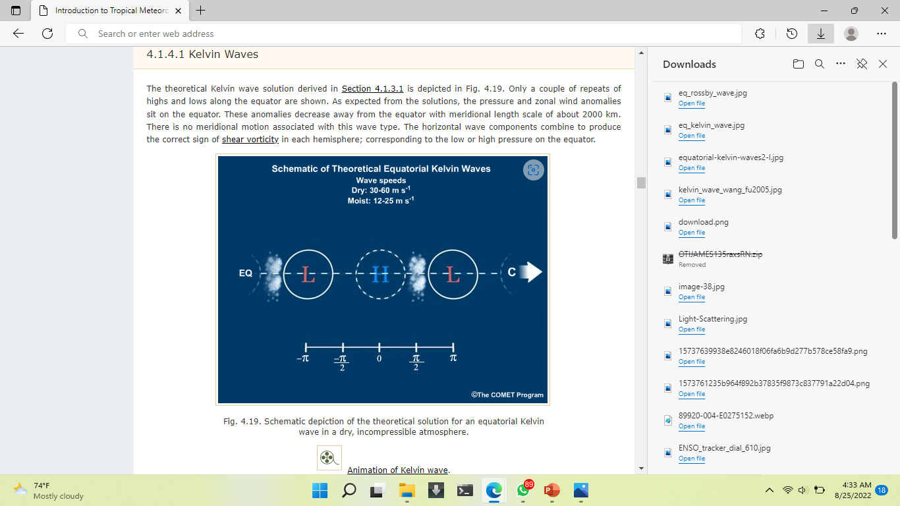
THE EQUATORIAL KELVIN WAVE PROPAGATION
we use mass advection due to wave-relative motion to explain wave propagation:
With the low to the west of the high: Having mass divergence between them (to the east of the low) leads to pressure falls on the equator. This means falling pressure to the west of the high (east of the low), so the wave moves towards the east.
With the high to the west of the low: Having mass convergence between them (to the east of the high) leads to pressure rises on the equator. This means rising pressure to the east of the high (west of the low), so the wave moves towards the east.
Both of these thought experiments give eastward propagating Kelvin waves.

Slide 6
EQUATORIAL ROSSBY WAVES
Rossby Wave also known as a planetary wave is a natural phenomenon in the atmosphere and ocean of planets that largely owing to their properties of rotation
Oceanic Rossby waves move along the thermocline which is the boundary between the warm upper layer and cold deeper part of the ocean
Atmospheric waves are as a result of potential vorticity and are influenced by the Coriolis force and pressure gradient
Rossby waves are due to the variation in the Coriolis effect with the latitude
It is a dispersive wave
Special Properties: twin cyclones, equatorial symmetry, convection is displaced off the equator, can come in different “flavors”.
Propagation Characteristics: Travel westward at roughly 5 m/s.
Horizontal Structure: The twin cyclones are one of the key aspects, as well as the location of the convection
"Long" Rossby waves typically range in size from around 4,000 to 10,000 km. The meridional distance scale of this wave is about 20° of latitude since the centers are located roughly 10° on either side of the equator.

Slide 7
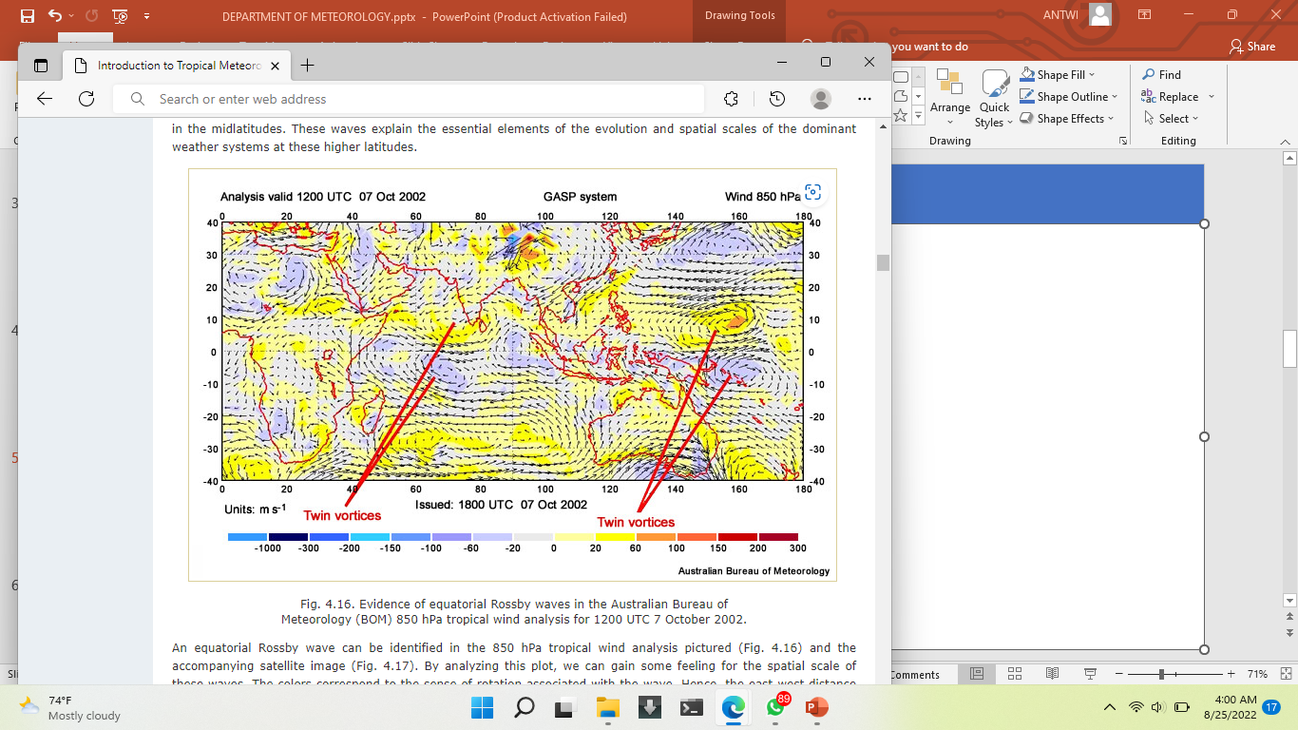

Slide 8

EQUATORIAL ROSSBY WAVES
Note that since the n=1 Rossby waves have the same sense of vorticity on either side of the equator, references to high and low pressure systems are equally applicable to the Southern and Northern Hemispheres. Also, flow in the wave pattern closer to the equator is stronger than flow away from the equator.
With high to the west of the low, mass is advected poleward, leading to pressure drops, so the low moves westward.
With low to the west of the high, mass is advected into the region, leading to pressure rises, so the high moves westward.
Thus, in both thought experiments, the wave propagates westward

Slide 9
Equatorial Rossby waves are observed to have a long lifetime, on the order of days to weeks
Given that the equatorial Pacific is about 17,760 km across, an atmospheric Rossby wave would cross the Pacific in roughly 18 days and an oceanic Rossby wave would take approximately 210 days

Slide 10
REFERENCES
LINKS
Introduction to Tropical Meteorology, Ch. 4: Tropical Variability (ucar.edu)
https://github.com/jeffjay88/MET356_SYNOPTIC_ANALYSIS_AND_NOWCASTING_LECTURE_SERIES

