Slide 1
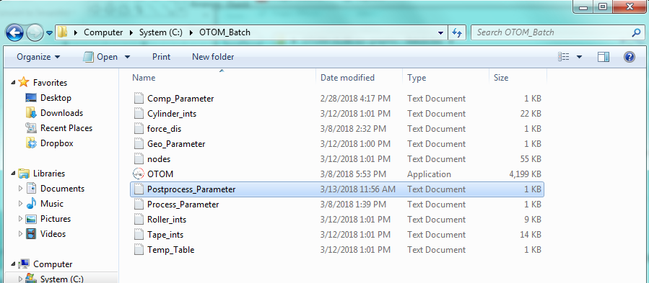
2. OTOM Engine
Directory
Computational parameter (mandatory)
Force-displacement Data (optional)
Post-process parameter (mandatory)
Geometrical parameter (mandatory)
Process parameter (mandatory)

Slide 2
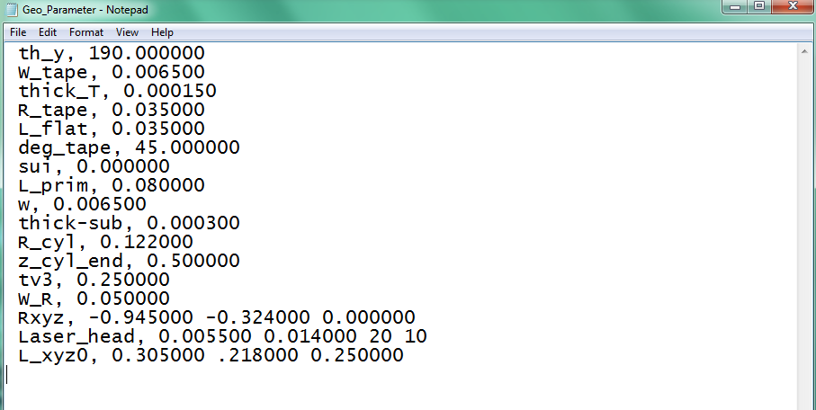
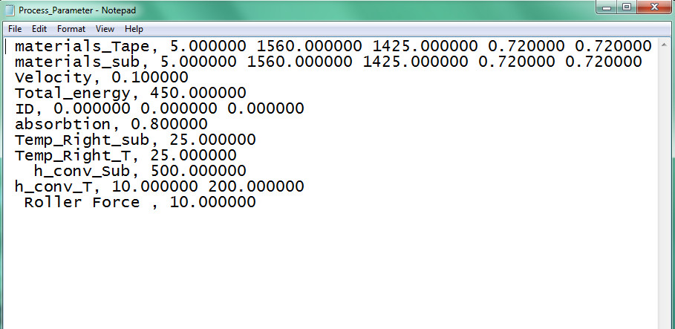
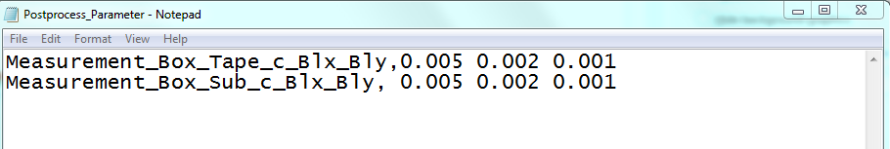
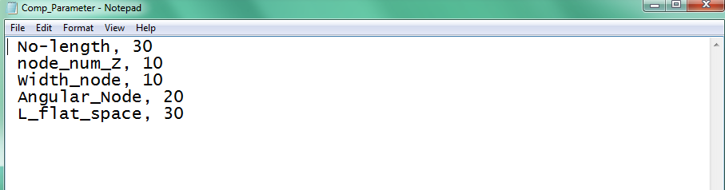
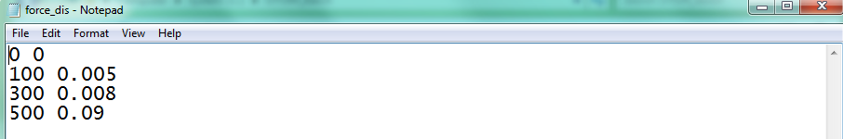
2. OTOM Engine
File Content- inputs
Geometrical parameters
Process parameters
Post-process parameters
Computational parameters
Force-displacement Data

Slide 3
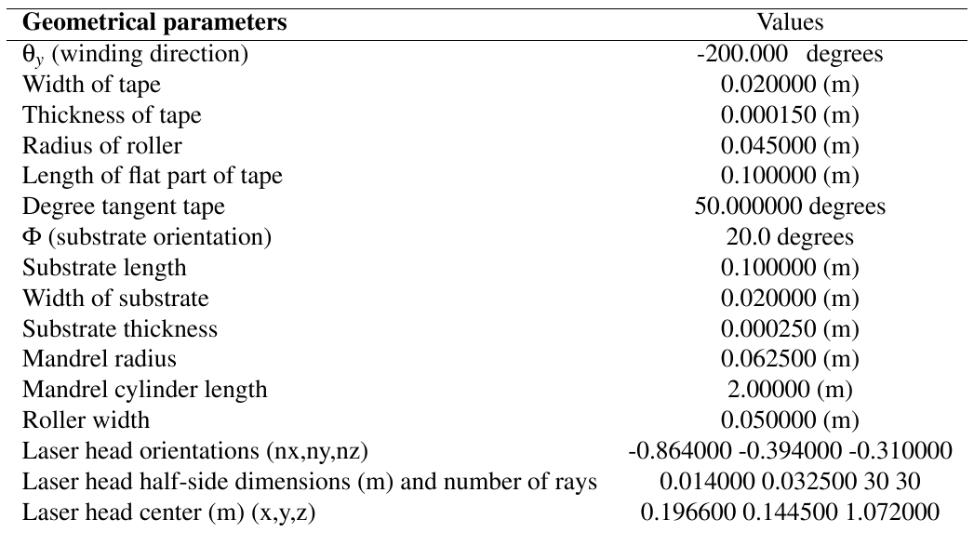
2. OTOM Engine
Geometrical parameters

Slide 4














2. OTOM Engine
Process parameters
$$k_{x} (thermal conductivity)$$
$$C_{p }(heat capacity)$$
$$k_{y}(thermal conductivity)$$
$$ρ (density)$$
$$k_{z} (thermal conductivity)$$
$$Velocity$$
$$Total laser Power$$
$$Laser ID \left(0:uniform , 2:gaussian\right), parameter of Laser_{X},parameter of Laser_{Y}$$
$$Incoming Temperature of Substrate (degree)$$
$$Incoming Temperature of Substrate (degree)$$
$$heat convection coeeficient of substrate$$
$$heat convection coeeficient of Tape (h1, h2)$$
$$Roller Force$$

Slide 5
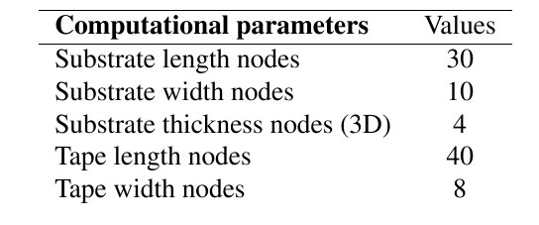
2. OTOM Engine
Computational parameters
Fixed in OTOM Engine

Slide 6






2. OTOM Engine
Post-process parameters
$c$ (m)
$$Blx (m)$$
$Bly$(m)
Tape
$c$(m)
$$Blx(m)$$
$Bly$(m)
Substrate

Slide 7
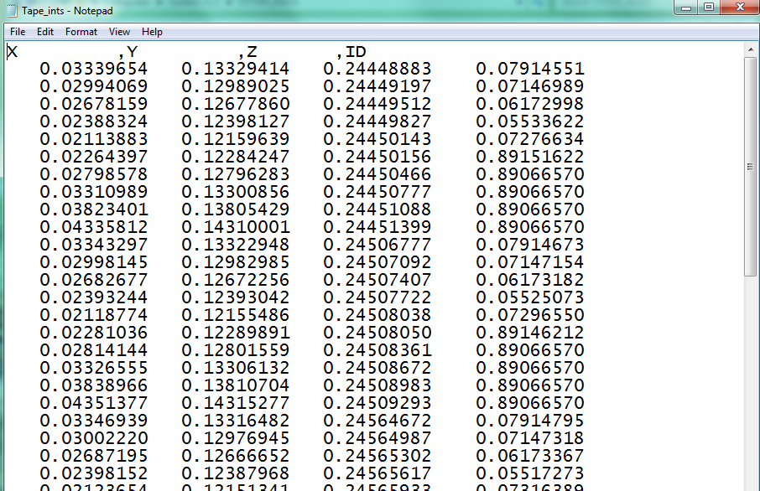
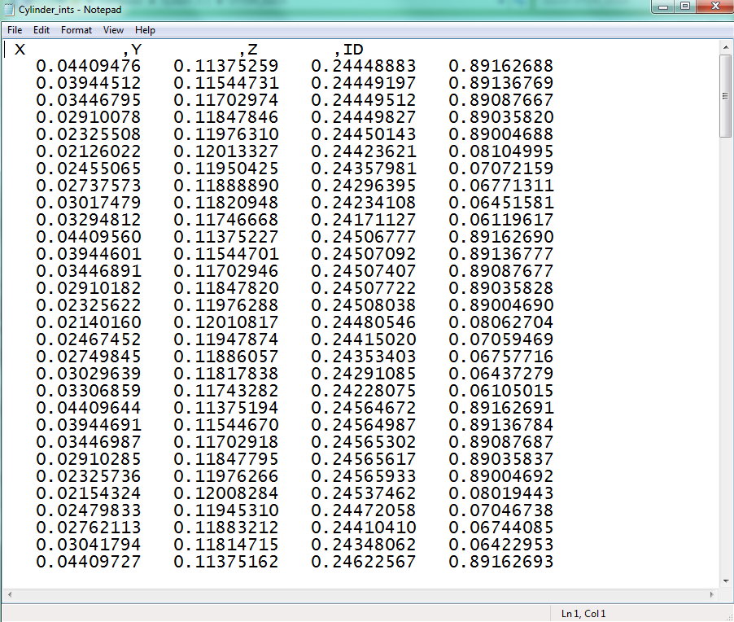
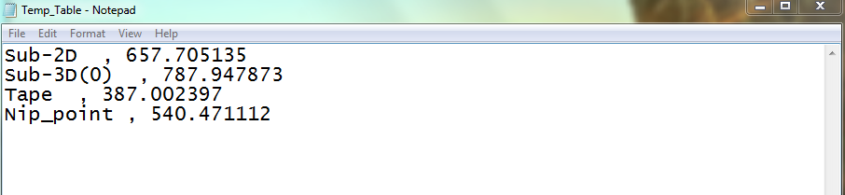
2. OTOM Engine
File Content- outputs
Tape intersection points + energy
Cylinder intersection points + energy
Output temperature

