Slide 1
Webomberchicken456
team_unity_3d_2
Minh Le, Viet Huy Vu, Tin Vuong

Slide 2
About Us
Team:
Minh: Sophomore CS, C++ and Python, No experience with game engines
Tin: Sophomore CS, C++ and Python, more interested in cybersecurity but games are cool too.
Huy: Sophomore CS, C++ and Python, enjoy doing coding exercise online.
Main Operating System: Windows
Tin uses MacOS
Meeting Times: Saturday 2:00 - 5:00 P.M

Slide 3
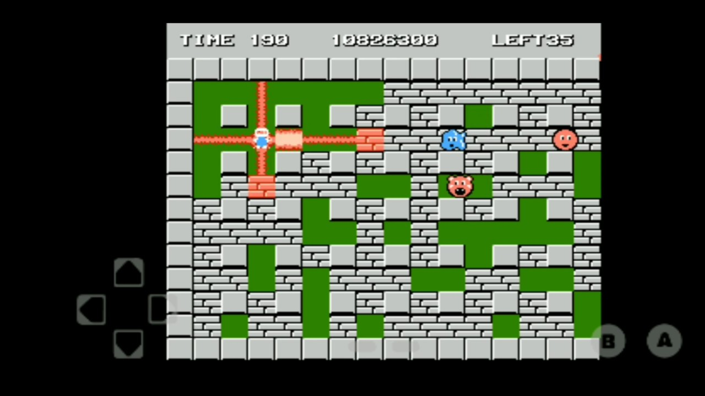
About Our Project
Bomberman Ripoff using Unity 2D engine. Bomberman is an action maze game!
Tools: Unity, Unity Shop, GitHub, Visual Studio, VS Code.
Extra Tools: Piskel (online sprite maker), FL Studio (Audio Design).
Technology Stack: Unity libraries.
End Goal: Using bomberman’s core mechanic to make a game that involved spawning minions, same device multiplayer and capture the flag style gameplay
(In an ideal world: our own design texture, Soundtrack, Multiplayer, Storyline, Cutscenes)

Slide 4
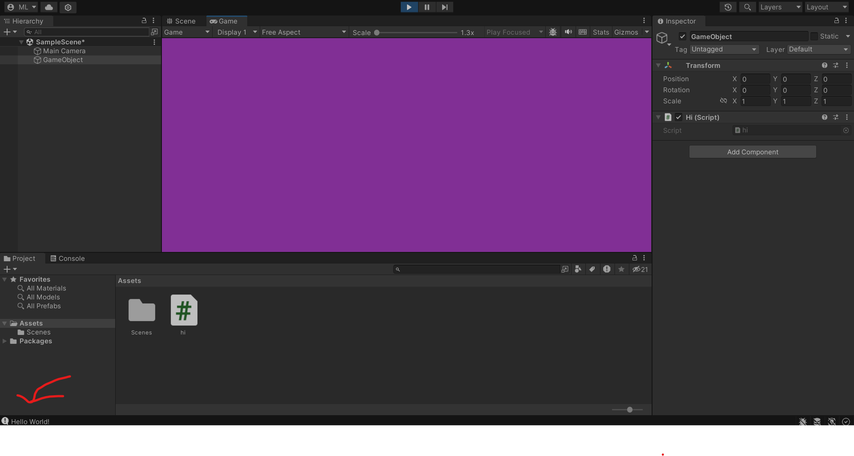
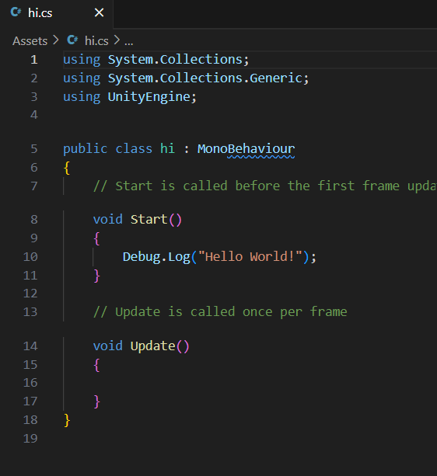
Hello World

Slide 5
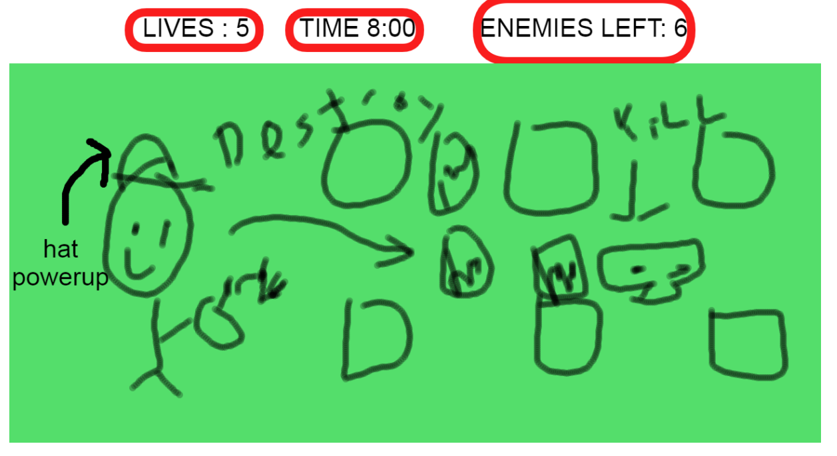
Main Game GUI

Slide 6
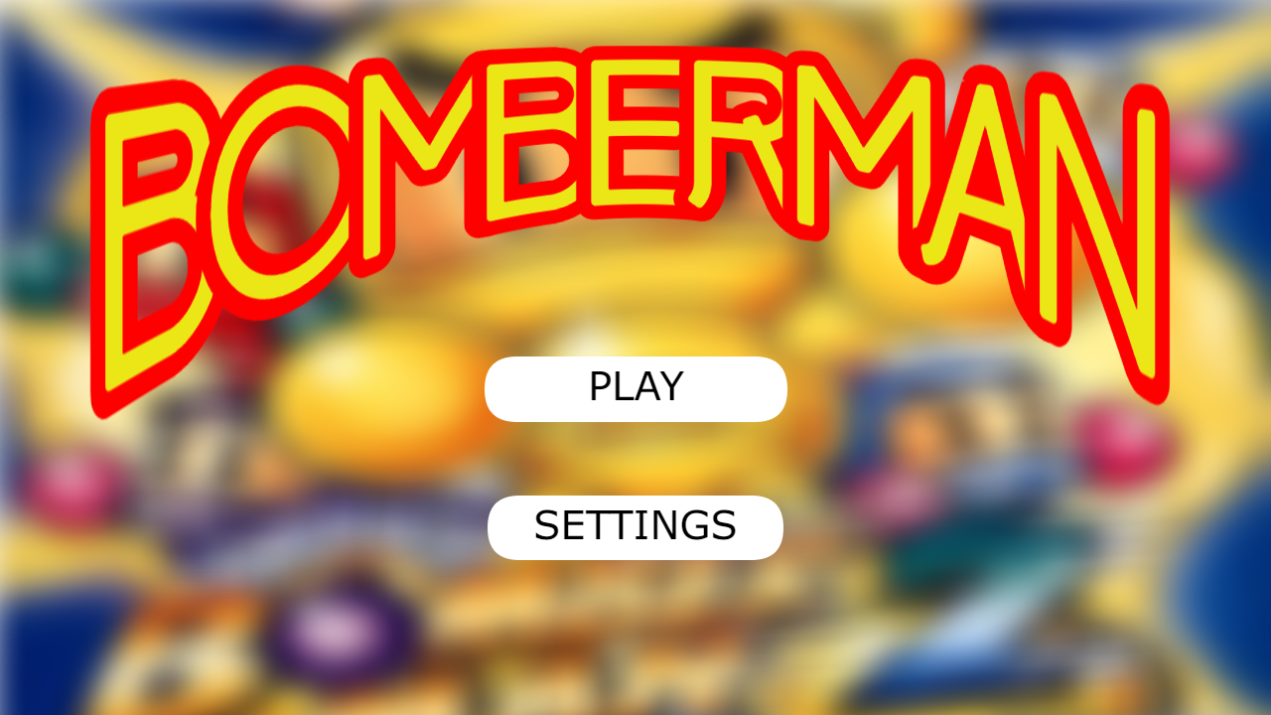
Title Screen

Slide 7
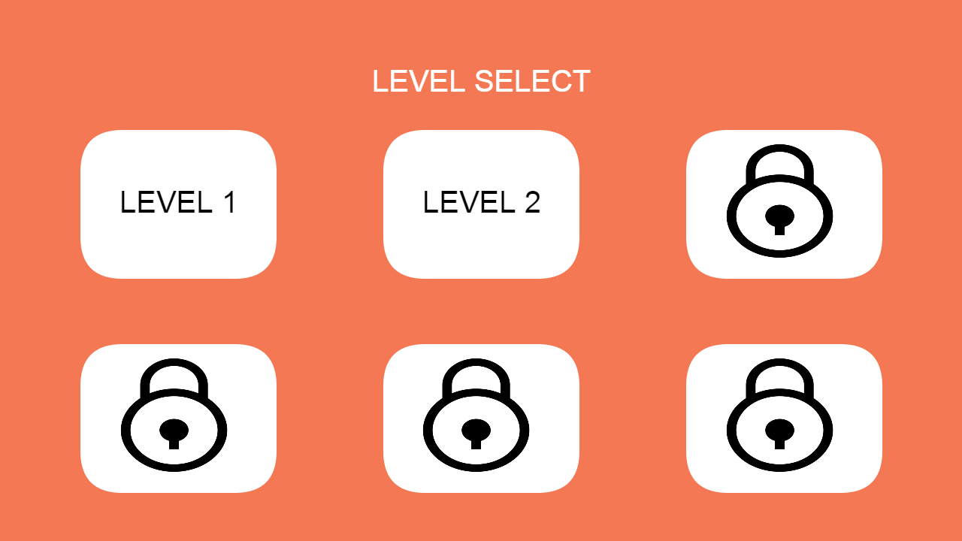
Level Select

Slide 8
Checkpoint 1

Slide 9
Past Work Summary
Minh - Watched videos on how 2D maps are created in Unity. Added tile map layout and sprites.
Huy - Researched how to move characters. Added simple movement to playable character.
Tin - Researched how enemy AI works in Unity. Added enemy sprites into the game.

Slide 10
Next Checkpoint Plan
Tin: Make enemy bots move by themselves.
Already has knowledge from previous meeting
Huy: Implement bomb mechanic script.
Is more familiar with character functionality.
Minh: Implement breakable blocks script.
Has a better understanding on map layout
Potential Roadblocks:
Enemy movements are tough to implement, maybe not even next meeting….
If bomb script doesn’t work then breakable block script will not work.

Slide 11
Grading Items

Slide 12
Meeting Attendance Sheet
2/07/2024 – Tin missed (was sick)
2/10/2024 – All members attended

Slide 13
Minh Le Contributions
Researched and started building the map for the game
Report:
In Unity there is a thing called a tile map which is a tool that stores tile assets and also creates the map. A map can easily be created by drawing out the map onto the unity grid. There are also other options such as adding C# scripts and collision components. Collision is an important component since it tells the map if the player can interact with the pieces of the map or not. C# scripts are important for implementing special behaviors for the map. I haven’t gone too deep into scripts yet, that will be for the next meeting.

Slide 14
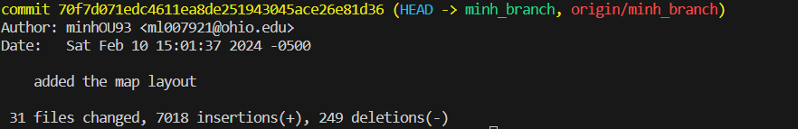
Minh Le (ml007921/minhOU93) - Commit 1
https://github.com/OU-CS3560/s24-unity3d-2/commit/70f7d071edc4611ea8de251943045ace26e81d36

Slide 15
Tin Vuong
Contributions
Began research on enemy movements and AI
Added enemy sprites
C# scripts are the way to make enemies move. There is a class called EnemyController which should be where I implement movement scripts. Prefabs are also useful to save enemy types whenever they are needed.
Commit was not merge to main because enemies disrupted the map.

Slide 16
Viet Huy Vu
Contributions
Started researching about player movements and added basic player movements
Things I learn:
KeyCode is the C# class for gathering input.
Gravity is there by default when creating player movement in Unity. Unity has a lot of extra things so a .gitignore is required to incorporate GitHub into version control for a Unity Project. I have now become better at solving conflict between git version.

Slide 17
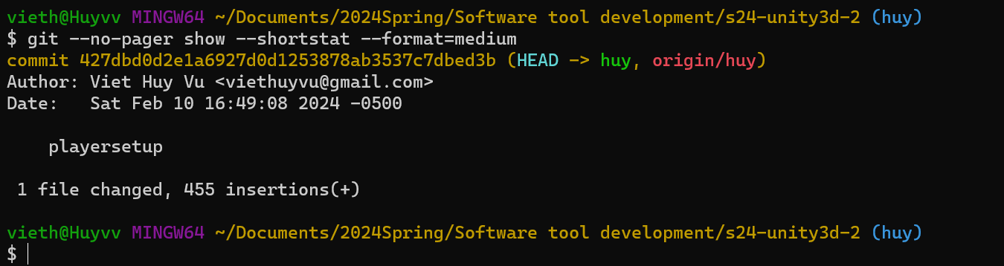
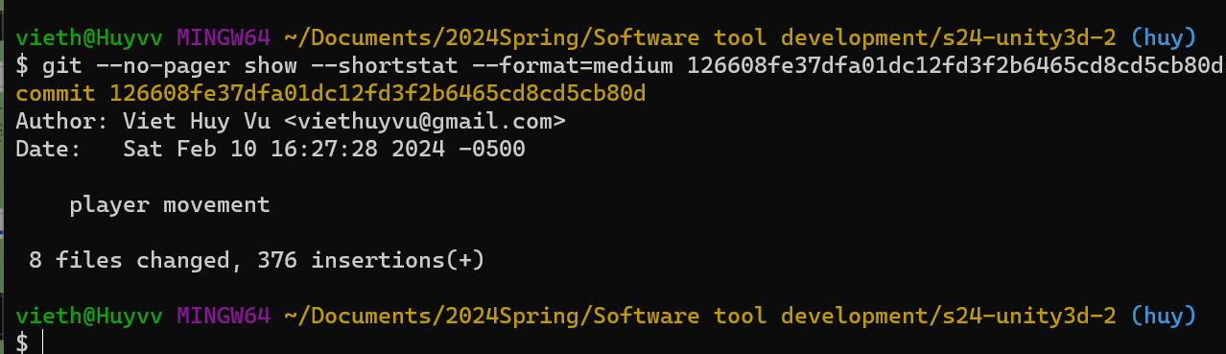
Viet Huy Vu (vv761622/viethuyvu) - Commits
playersetup · OU-CS3560/s24-unity3d-2@427dbd0 (github.com)
player movement · OU-CS3560/s24-unity3d-2@126608f (github.com)

Slide 18
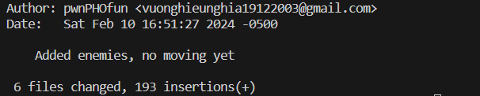
Tin Vuong (nv059721/wechicken456) - Commit 3
https://github.com/OU-CS3560/s24-unity3d-2/commit/ce7bb68aa859e557f6d7f2a95f80e18119083db6

Slide 19
Checkpoint 2

Slide 20
Past Work Summary
Minh - Added animation script, added breakable blocks.
Huy - Worked on player movement, bomb placing, explosion and death state.
Tin - Made enemies move using pathfinding library.

Slide 21
Next Checkpoint Plan
Tin: Polish enemy movement. Different enemy type
Has been working on enemies.
Huy: Finishing death state for enemy and player
Started working on death state
Minh: Re-edit sprite and assets
Has the best “art skill” in the group
Potential Roadblocks:
Art skill not the best
Trying to add more new ideas so less reference available

Slide 22
Grading Items

Slide 23
Meeting Attendance Sheet
2/07/2024 – Tin missed (was sick)
2/10/2024 – All members attended
2/16/2024 - All attended
2/25/2024 - All attended

Slide 24
Minh Le Contributions
Added breakable blocks, and global animation script
Report:
In a video I watched, they created a global animation script that could be used for any object in the game. This script basically renders sprite images by frame at a set time. For an object to use this script, the object has to reference it in their script.
Breakable blocks is done by making a prefab, and a simple script using the destroy function via Unity’s library. This prefab is used as a reference to an object that will be able to break a block. A block is broken depending on its position and matrix (to be honest it was a bit confusing….).

Slide 25
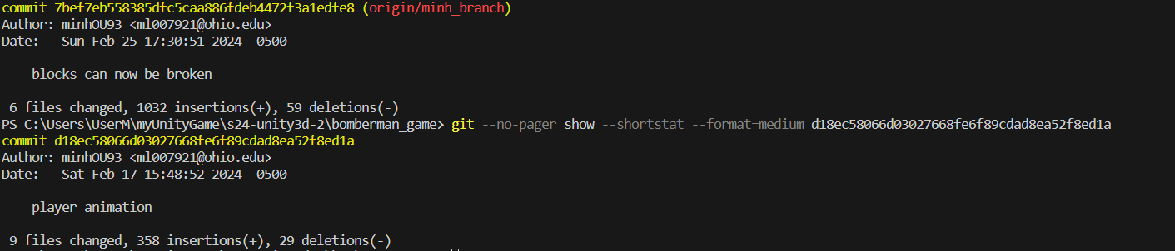
Minh Le (ml007921/minhOU93) -
Total Commits: 2
player animation · OU-CS3560/s24-unity3d-2@d18ec58 (github.com)
blocks can now be broken · OU-CS3560/s24-unity3d-2@7bef7eb (github.com)

Slide 26
Viet Huy Vu
Contributions
Finishing player movement
Placing bombs
Explosion triggered
Make player die if they were hit by the bomb
Things I learn:
Layers is a very important part of Unity. When making a game in Unity, a developer needs to be mindful about layering of render as sometimes a render just not show up because of the render order.
You can squash commit on your branch so it appears as one commit on main during merging

Slide 27
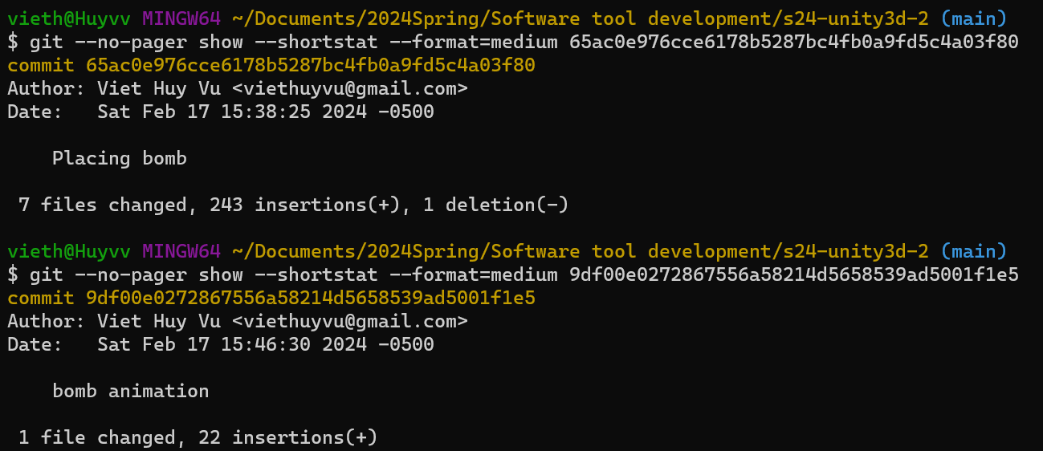
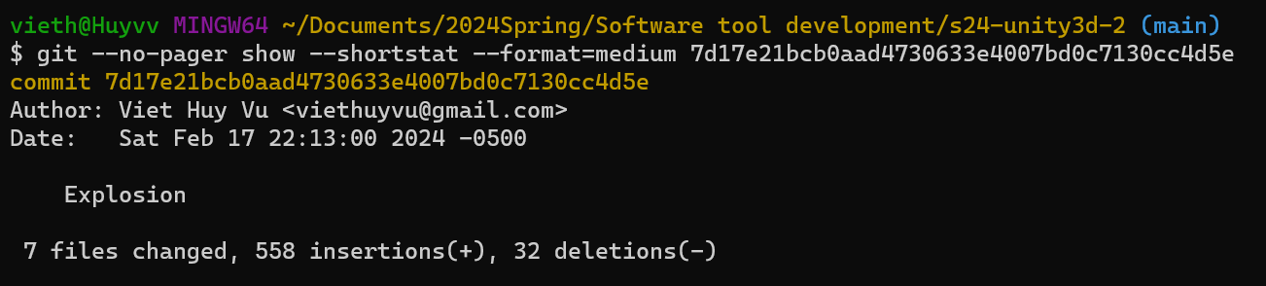
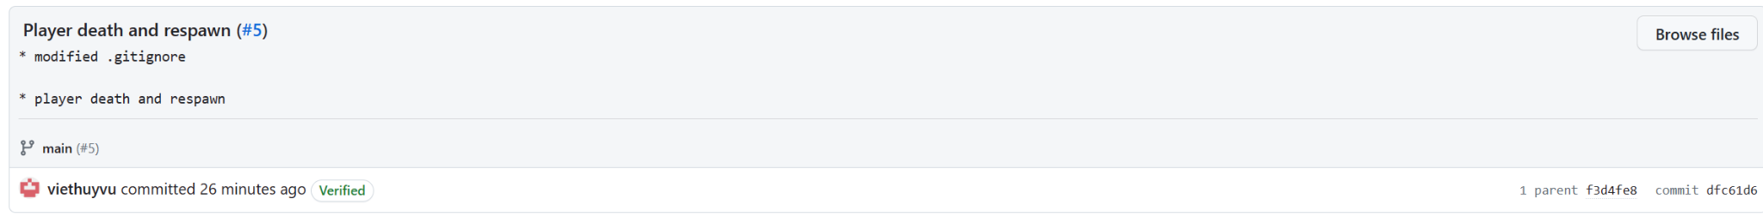
Viet Huy Vu (vv761622/viethuyvu) - Commits
Placing bomb · OU-CS3560/s24-unity3d-2@65ac0e9 (github.com)
bomb animation · OU-CS3560/s24-unity3d-2@9df00e0 (github.com)
Commits · OU-CS3560/s24-unity3d-2 (github.com)
Player death and respawn (#5) · OU-CS3560/s24-unity3d-2@dfc61d6 (github.com)

Slide 28
Tin Vuong
Contributions
Added a layer to the solid blocks so the pathfinding script can identify them as obstacles.
Finished the pathfinding script for enemies.
Learned to use the A* Pathfinding Project to make enemies move by watching a Youtube video and the project’s documentation.

Slide 29
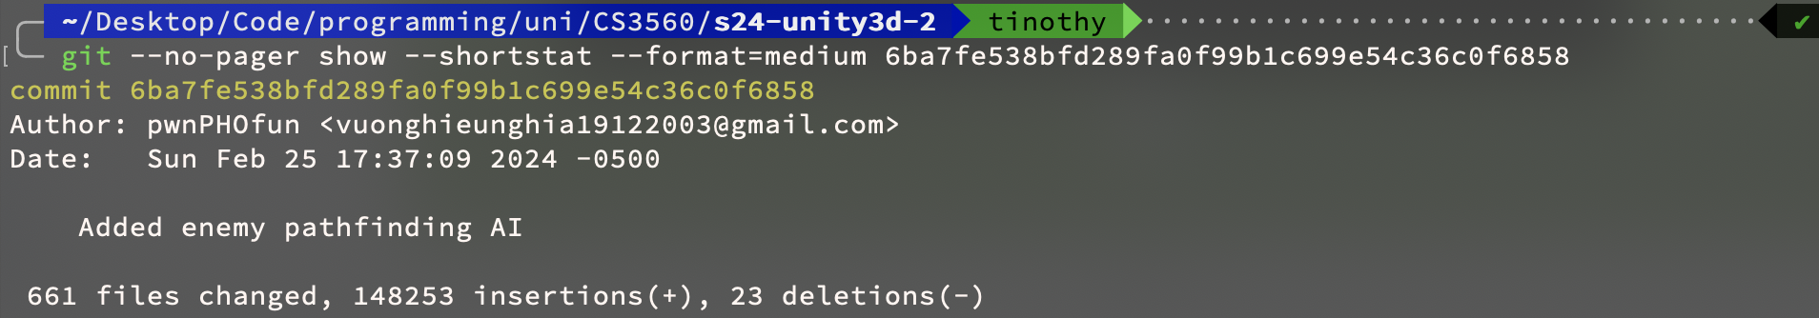
Tin Vuong (nv059721/wechicken456) - Commit 54
https://github.com/OU-CS3560/s24-unity3d-2/commit/6ba7fe538bfd289fa0f99b1c699e54c36c0f6858

