Slide 1
Webomberchicken456
team_unity_3d_2
Minh Le, Viet Huy Vu, Tin Vuong

Slide 2
About Us
Team:
Minh: Sophomore CS, C++ and Python, No experience with game engines
Tin: Sophomore CS, C++ and Python, more interested in cybersecurity but games are cool too.
Huy: Sophomore CS, C++ and Python, enjoy doing coding exercise online.
Main Operating System: Windows
Tin uses MacOS
Meeting Times: Saturday 2:00 - 5:00 P.M

Slide 3
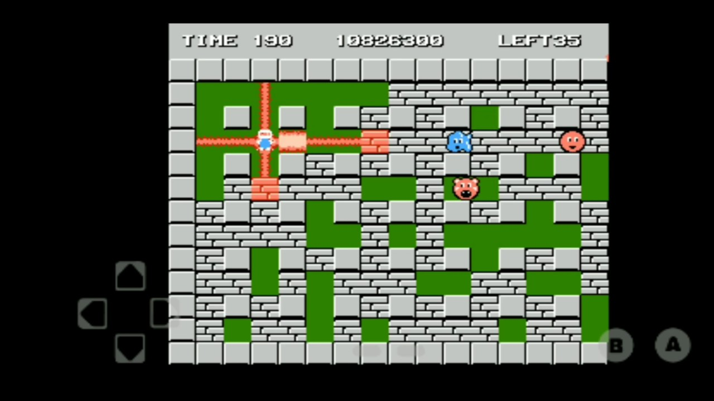
About Our Project
Bomberman Ripoff using Unity 2D engine. Bomberman is an action maze game!
Tools: Unity, Unity Shop, GitHub, Visual Studio, VS Code.
Extra Tools: Piskel (online sprite maker), FL Studio (Audio Design).
Technology Stack: Unity libraries.
End Goal: Fully playable bomberman game with multiple levels, enemies, and different power ups.
(In an ideal world: our own design texture, Soundtrack, Multiplayer, Storyline, Voice Acting, Cutscenes)

Slide 4
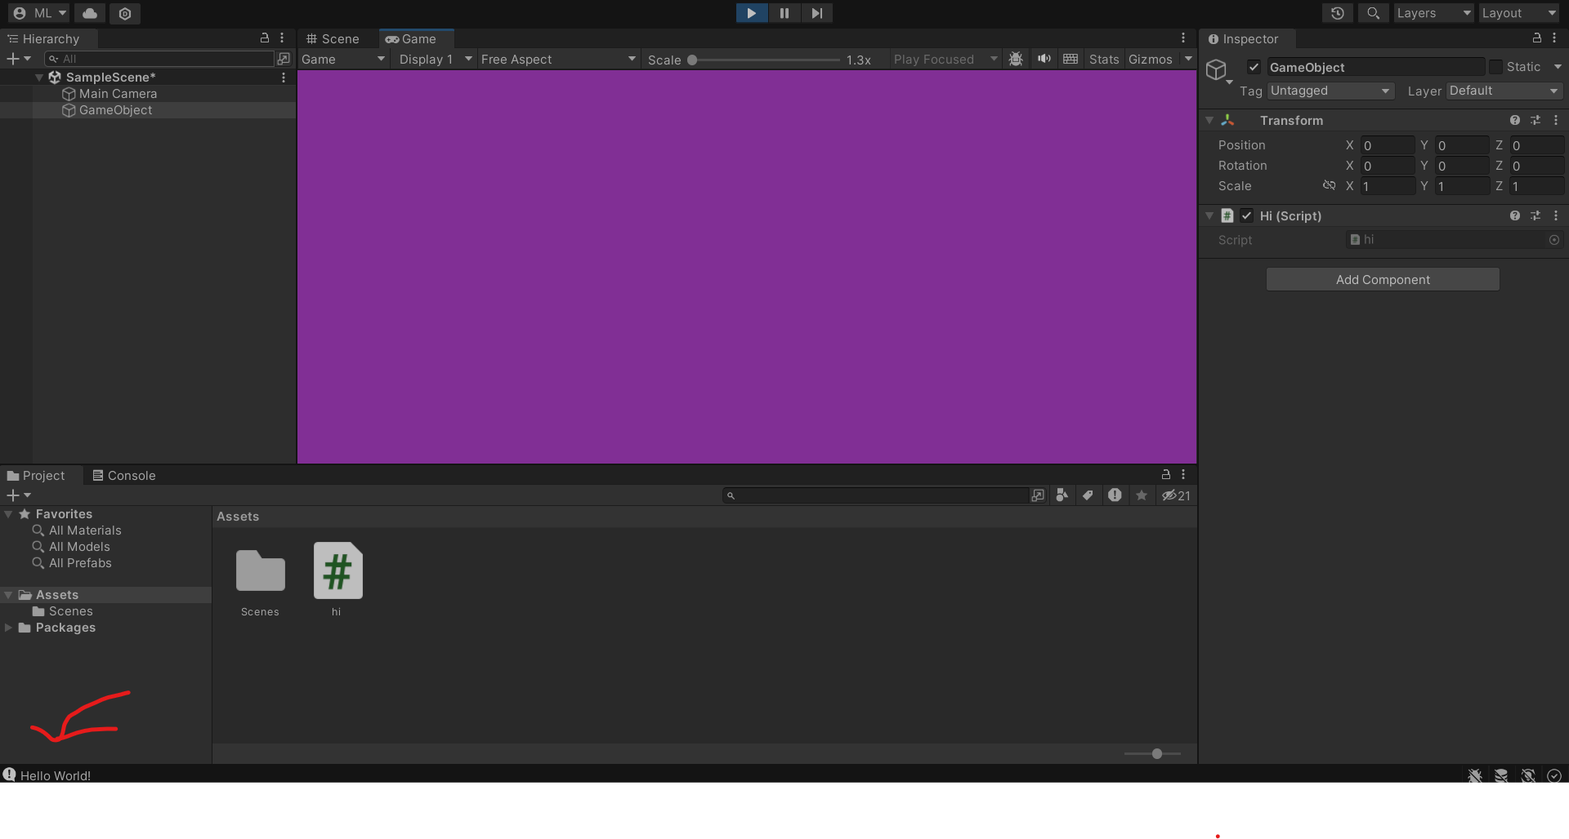
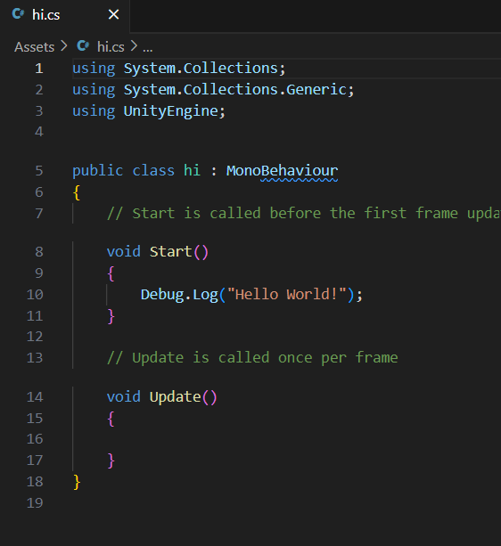
Hello World

Slide 5
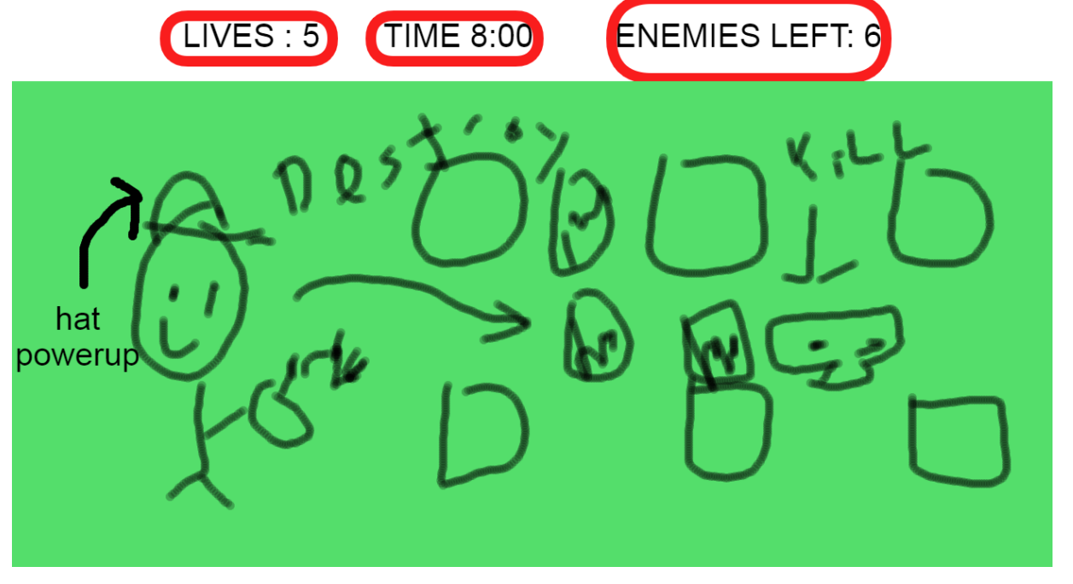
Main Game GUI

Slide 6
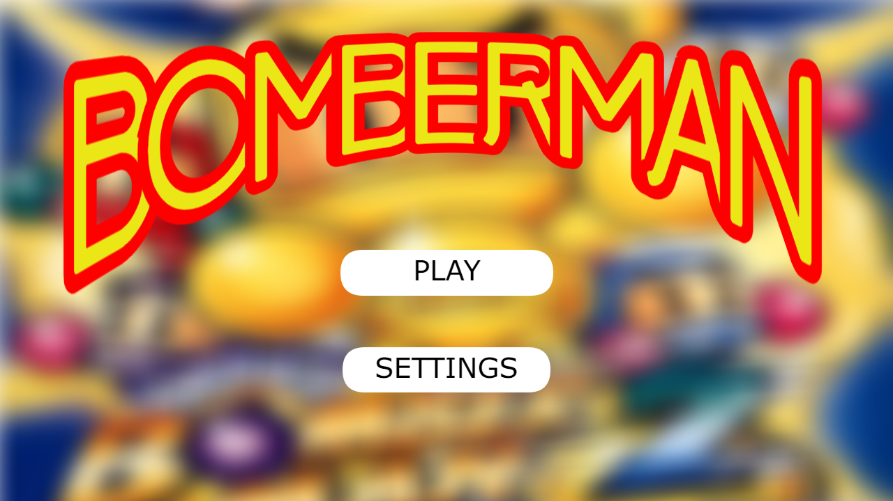
Title Screen

Slide 7
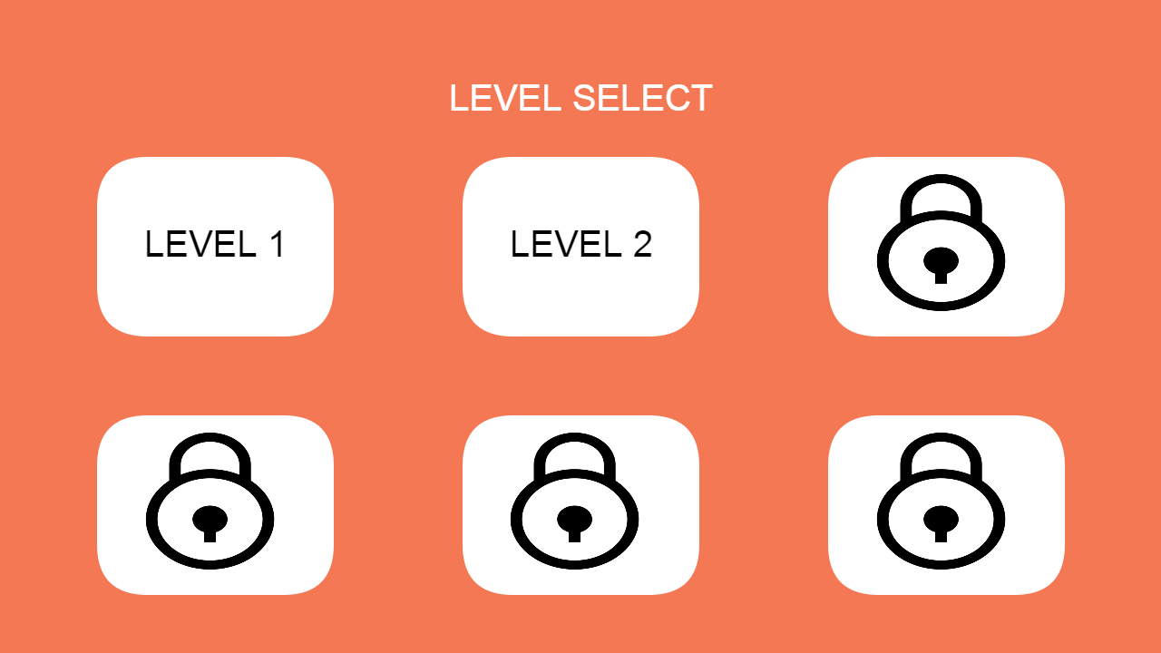
Level Select

Slide 8
Checkpoint 1

Slide 9
Past Work Summary
Minh - Watched videos on how 2D maps are created in Unity. Added tile map layout and sprites.
Huy - Researched how to move characters. Added simple movement to playable character.
Tin - Researched how enemy AI works in Unity. Added enemy sprites into the game.

Slide 10
Next Checkpoint Plan
Tin: Make enemy bots move by themselves.
Already has knowledge from previous meeting
Huy: Implement bomb mechanic script.
Is more familiar with character functionality.
Minh: Implement breakable blocks script.
Has a better understanding on map layout
Potential Roadblocks:
Enemy movements are tough to implement, maybe not even next meeting….
If bomb script doesn’t work then breakable block script will not work.

Slide 11
Grading Items

Slide 12
Meeting Attendance Sheet
2/07/2024 – Tin missed (was sick)
2/10/2024 – All members attended

Slide 13
Minh Le Contributions
Researched and started building the map for the game
Report:
In Unity there is a thing called a tile map which is a tool that stores tile assets and also creates the map. A map can easily be created by drawing out the map onto the unity grid. There are also other options such as adding C# scripts and collision components. Collision is an important component since it tells the map if the player can interact with the pieces of the map or not. C# scripts are important for implementing special behaviors for the map. I haven’t gone too deep into scripts yet, that will be for the next meeting.

Slide 14
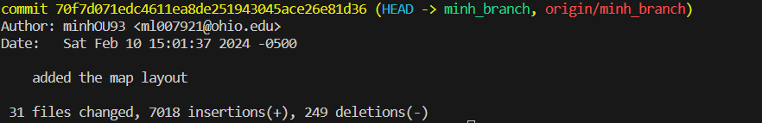
Minh Le (ml007921/minhOU93) - Commit 1
https://github.com/OU-CS3560/s24-unity3d-2/commit/70f7d071edc4611ea8de251943045ace26e81d36

Slide 15
Viet Huy Vu
Contributions
Started researching about player movements and added basic player movements
Things I learn:
KeyCode is the C# class for gathering input.
Gravity is there by default when creating player movement in Unity. Unity has a lot of extra things so a .gitignore is required to incorporate GitHub into version control for a Unity Project. I have now become better at solving conflict between git version.

Slide 16
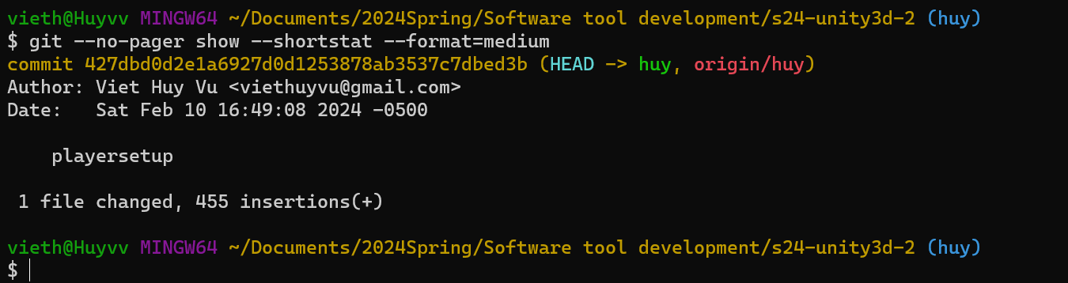
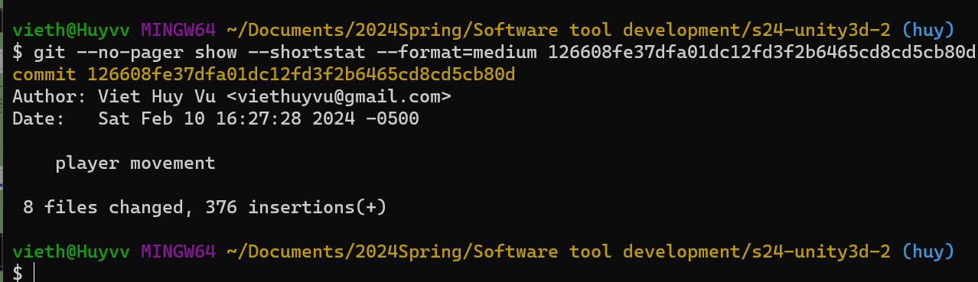
Viet Huy Vu (vv761622/viethuyvu) - Commits
playersetup · OU-CS3560/s24-unity3d-2@427dbd0 (github.com)
player movement · OU-CS3560/s24-unity3d-2@126608f (github.com)

Slide 17
Tin Vuong
Contributions
Began research on enemy movements and AI
Added enemy sprites
C# scripts are the way to make enemies move. There is a class called EnemyController which should be where I implement movement scripts. Prefabs are also useful to save enemy types whenever they are needed.
Commit was not merge to main because enemies disrupted the map.

Slide 18
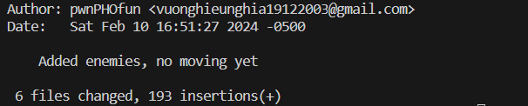
Tin Vuong (nv059721/wechicken456) - Commit 3
https://github.com/OU-CS3560/s24-unity3d-2/commit/ce7bb68aa859e557f6d7f2a95f80e18119083db6

