Slide 1
YORM
Cooper Y, Jade O, Maya R, and Dalton M

Slide 2
Overview
Meeting Times: Saturdays 12:00PM - 2:00PM
Dalton:
Macbook Pro, Mac OS
Cooper:
Macbook Pro, Mac OS
Maya:
Macbook Pro, Mac OS
Jade:
Macbook Pro, Mac OS

Slide 3
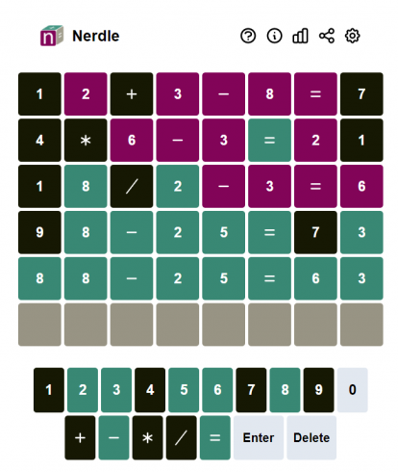
Project Information
We are planning on creating a game “Nerdle”. We plan on implementing this project using a Angular and Node.js frameworks with the end goal of being able to host the working game on GitHub Pages.
“Nerdle” allows the player to guess a math equation using a sequence of numbers and operators. Like “Wordle”, the player continues guessing until they have the correct equation.

Slide 4
Project Information
Tool Chain:
Git
Visual Studio Code
Npm
Postman
GitHub
Technology Stack:
Frontend
Angular
Typescript
Figma (for design)
Backend
Node.js
SQLite
Postman (for testing endpoints)

Slide 5
Grading Items

Slide 6
Past Work Summary
Designed Nerdle webpage in Figma (Cooper)
Researched implementation (Maya)
Installed Node.js and nvm
Installed Angular
Updated the Team README (Dalton)
Made the Checkpoint presentation and tasks for next time (Jade)

Slide 7
Meeting Attendance Sheet
02/03/2024 - All members attended
02/10/2024 - All members attended
Meeting Times: Saturdays 12:00PM - 2:00PM

Slide 8
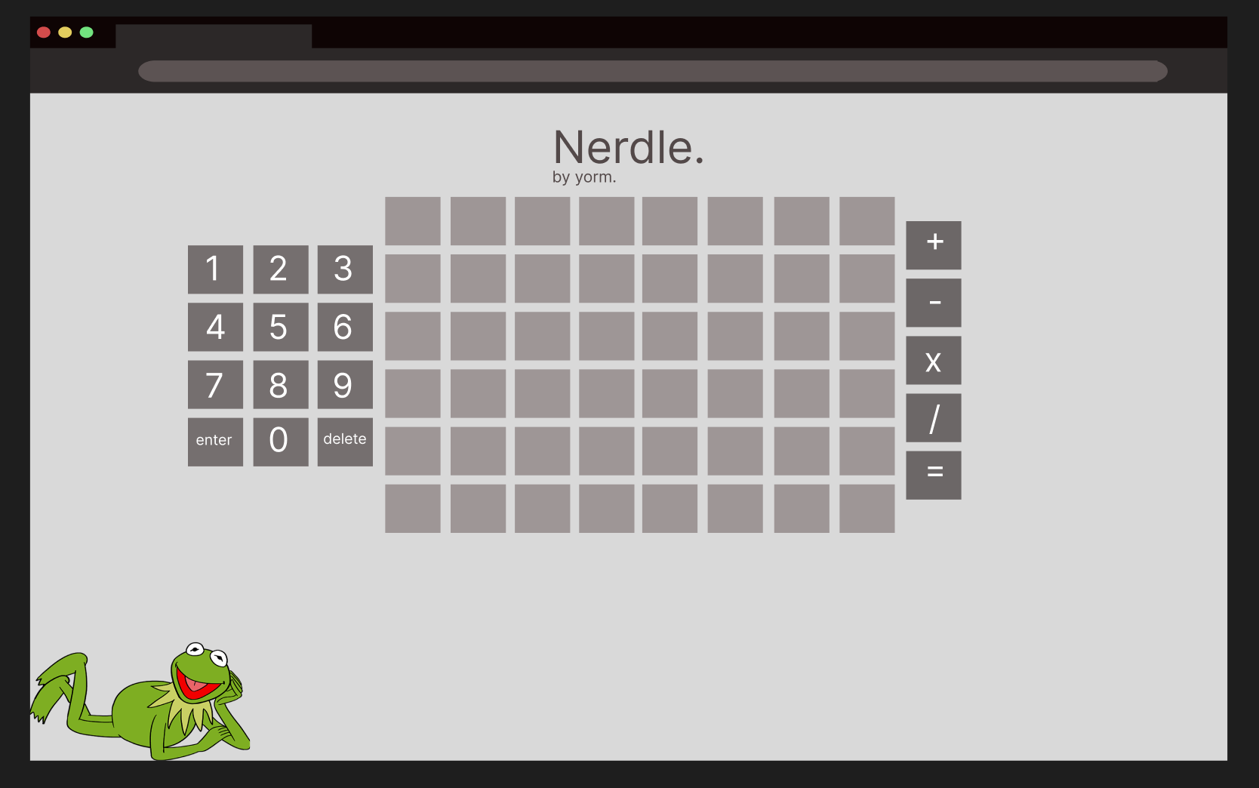
Cooper Young
Created a mockup of the Nerdle game in Figma
Gives the team a plan moving forward and when designing Angular components
Figma Link

Slide 9
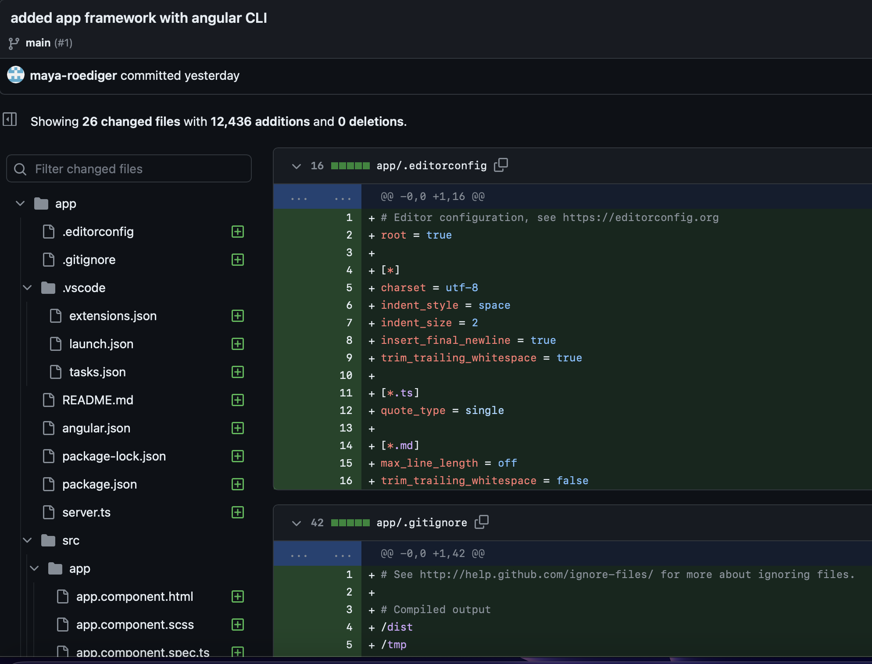
Maya Roediger
Got npm, nvm, and the Angular CLI to function
Used Angular CLI to import framework for a webapp.
Committed to Repo
Link to the entire commit

Slide 10
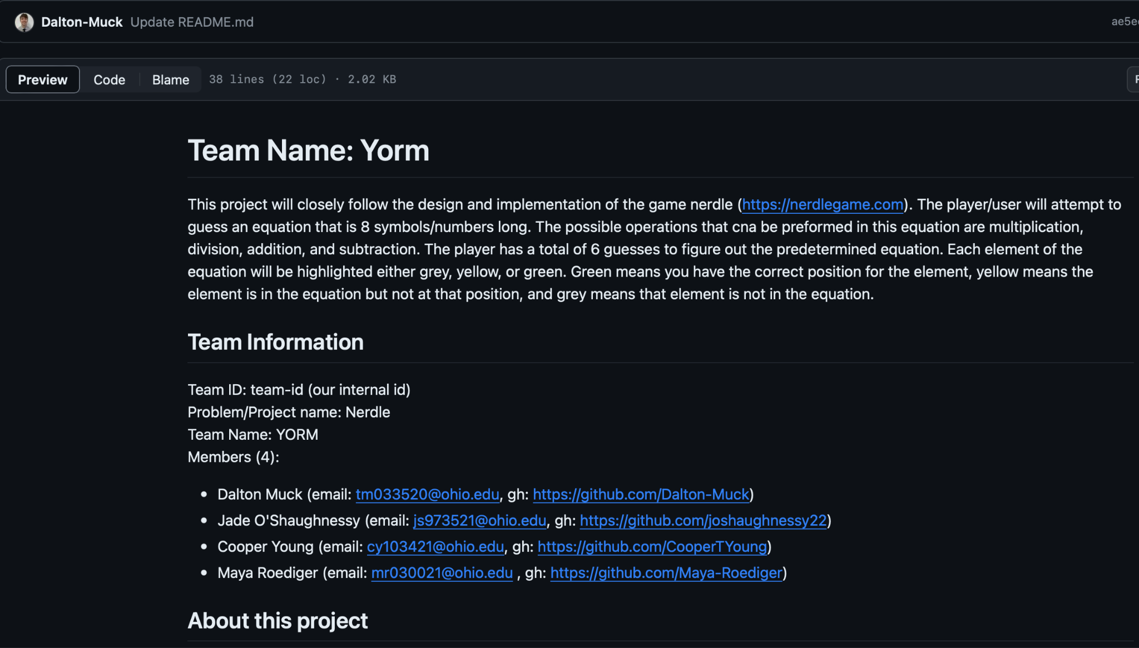
Dalton Muck
Defined team goals, tech stack, and collected team info in an official Readme
Committed to Repo
Link to the README.md

Slide 11
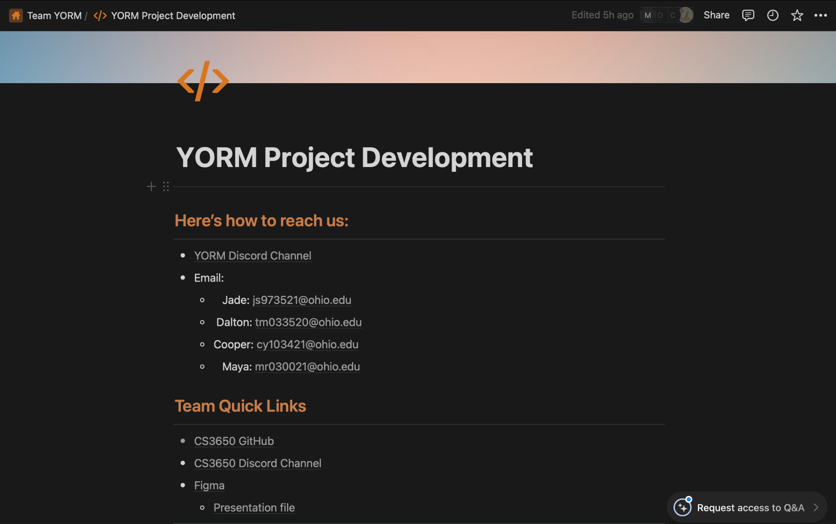
Jade O’Shaughnessy
Set up team plan on Notion
Allows us to track important links and plan tasks
Created team slides for presentation
Outlined plan for the next checkpoint.
Notion Link

Slide 12
Next Checkpoint Plan
Begin working on backend implementation with Node
Variable Storage
Using SQLite – but might not implement a database if not necessary
What do we need to store/what variables do we need the player to be able to communicate with
Page routing
Check using Postman
Validation
Also will use Postman to check return codes
Game plan Backend Services and Unit Testing implementation

