Slide 1
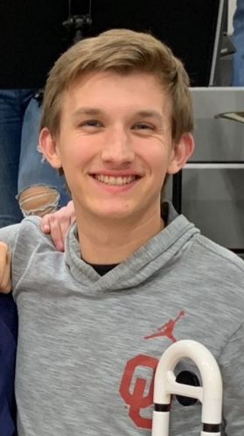
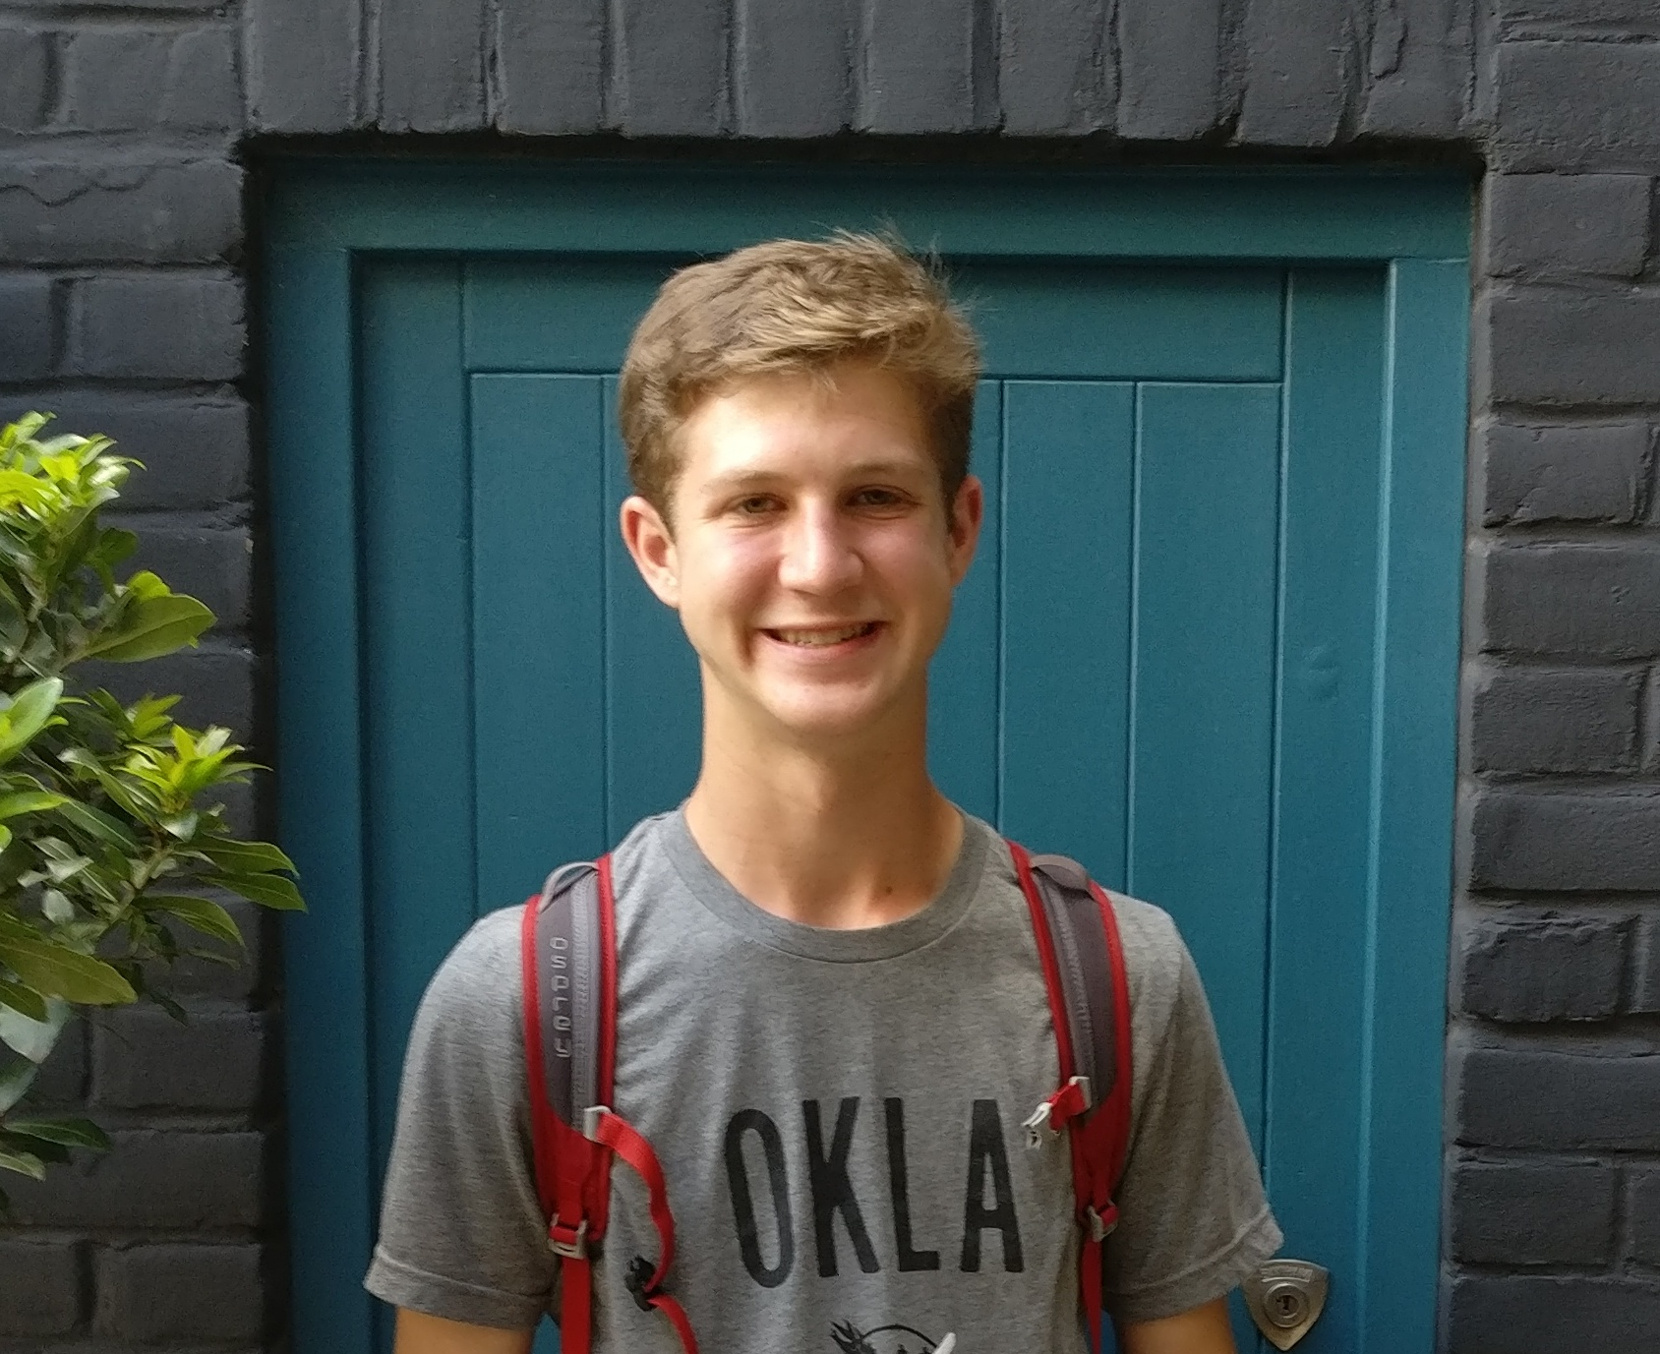
Aural Skills Training Tool
Team 18
HCI Sp20
Jacob Howey – Scottie Curtis – Jack Williams – Noah Brown – Michael Meier
arrange friendly team photo(s) in here
Ear training tool for musicians to work on their interval and pitch recognition
insert video in here

