Slide 1
Product ECO
Engineering Change Order in PLM
How to create it, what to fill, and what blocks you.
Source: METHODOLOGY Creating a Product ECO · Ref. 20061_17_01638 · v8.0 · 17/04/2024

Slide 2
THE BASICS
What an ECO is
ECO = Engineering Change Order — the PLM object that officialises a product change.
Equivalent of the FM (change sheet) in SAP / 3DCom.
It carries the change, not the geometry: approvals (RT / RAL), homologation, impacts, dates, notifications.
Type used here: ECO Type = Product (there are also Component ECOs).
No released product without an ECO — it is the gate to officialisation.
One sentence to remember: the ECO is the passport of a change.
Product ECO — PLM Methodology (Ref. 20061_17_01638 v8.0)
2 / 21

Slide 3
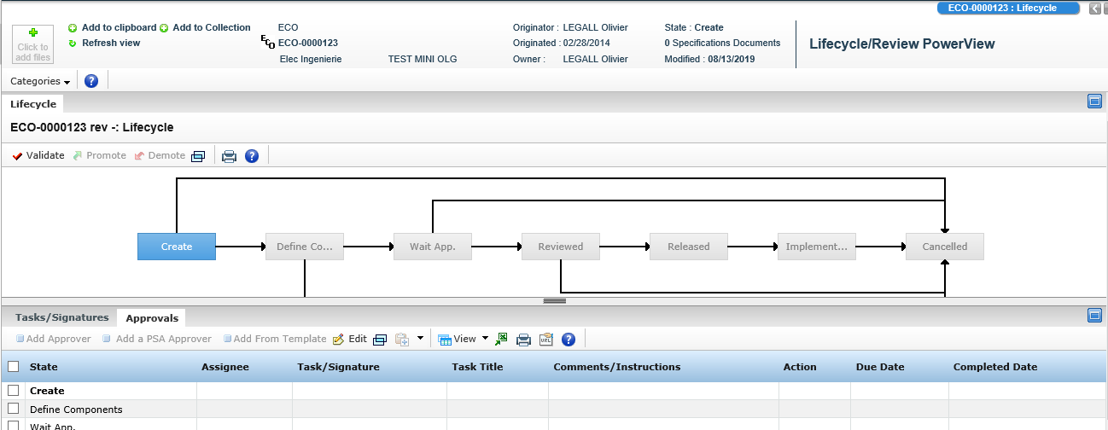
POSITIONING
Where the ECO sits
CHAIN
ECR (Design)
›
ECO
›
PDEF / PREA / DOC
›
OA / LA
›
Release
ECO lifecycle — Categories › Lifecycle: Create › Define Components › Wait App. › Reviewed › Released › Implemented (Cancelled stays reachable)
Product ECO — PLM Methodology (Ref. 20061_17_01638 v8.0)
3 / 21

Slide 4
BEFORE YOU CLICK
Prerequisites
Role: PSA_Pilote_Projet or PSA_Concepteur
Diversity and applicability contexts are defined
Expected Product (PA) created with diversity applicability
Reviewer and approval lists created and defined — RT and RAL templates must already exist.
The PDEF, PREA or DOC concerned exists
ECR in Design for a revision — or OA/LA in Create for a first release / reuse.
Missing one of these is the #1 reason a creation or a promotion fails.
Product ECO — PLM Methodology (Ref. 20061_17_01638 v8.0)
4 / 21

Slide 5
3 WAYS IN
The three use cases
UC 1
From the home page
Actions › Create Product ECO
Fill attributes › Finish
Then link it to a product, an LA or an ECR
Best for: batch creation
UC 2
From the product
Open the PDEF / PREA / DOC identity card
Categories › Linked ECO and ECR
ECOs sub-tab › Create Product ECO
Best for: creates AND links in one shot
UC 3
From the ECR
ECR must be in state Design
Categories › ECOs & ECs
Structure View › Actions › Create Product ECO
Best for: change driven by an ECR
Product ECO — PLM Methodology (Ref. 20061_17_01638 v8.0)
5 / 21

Slide 6
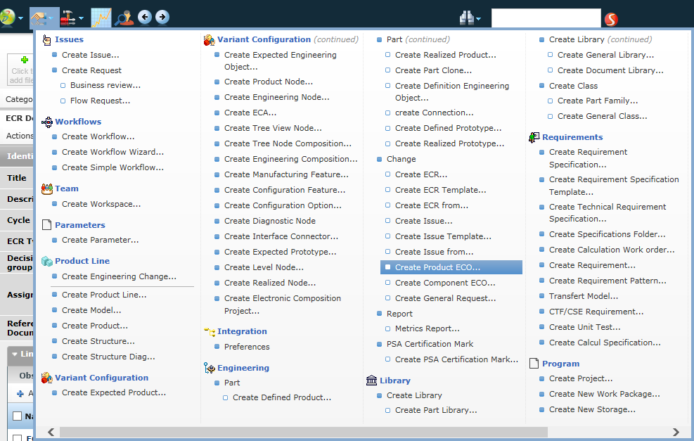
METHOD 1 · STEP 1
Actions › Create Product ECO
Home page › Actions toolbar icon.
Column Change › Create Product ECO…
Do not confuse it with Create Component ECO just below, nor with Create ECR.
From here the ECO is born unlinked — you must attach it afterwards.
Product ECO — PLM Methodology (Ref. 20061_17_01638 v8.0)
6 / 21

Slide 7
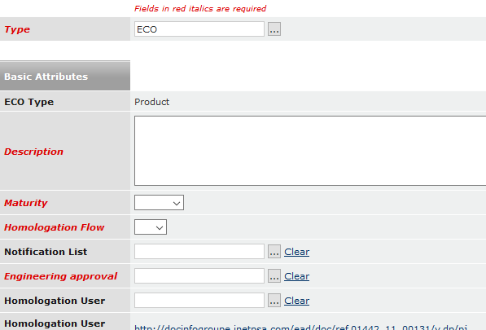
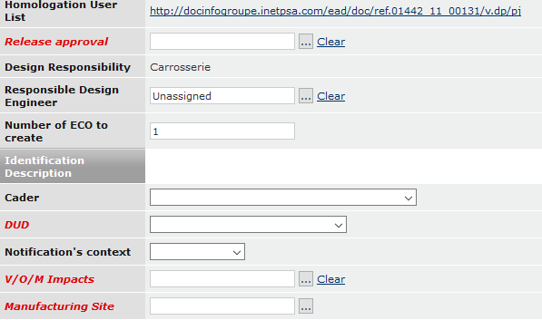
METHOD 1 · STEP 2
The creation form
BASIC ATTRIBUTES
IDENTIFICATION & IMPACTS
Type, Description, Maturity, Homologation Flow & User, Engineering approval (RT), Release approval (RAL).
Responsible Design Engineer, Number of ECO to create, Cader, DUD, Notification's context, V/O/M Impacts, Manufacturing Site.
Red italic = required to confirm the creation. Black fields can wait — but only while the ECO is in Create or Define Components maturity.
Product ECO — PLM Methodology (Ref. 20061_17_01638 v8.0)
7 / 21

Slide 8
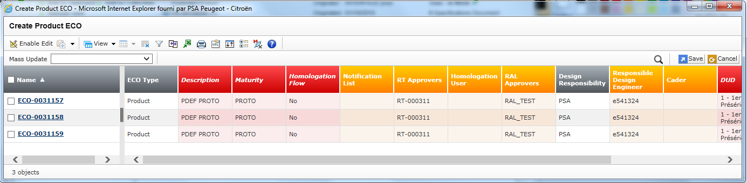
METHOD 1 · SHORTCUT
Create several ECOs in one go
Set Number of ECO to create before validating.
PLM opens a mass-update grid: same attributes, N ECO numbers.
Use Mass Update to change a column on every line, then Save.
Ideal when one change hits several parts of the same perimeter.
Product ECO — PLM Methodology (Ref. 20061_17_01638 v8.0)
8 / 21

Slide 9
THE CHECKLIST
Attributes required to release
FIELD | RULE
Description | Follow the Electricity/Electronics or Mechanical Engineering filling guides.
Due Date | PROTO or SERIE.
Homologation Flow | YES if the ECO has a PRODUCTION (SERIE) flow. Check with the Homologation Manager first.
Homologation User | Mandatory when Homologation Flow = YES. Pick the ID from the Homologation User List.
Responsible Design Engineer | Name of the component manager. Required for release.
RT Approvers | Workflow template of the technical review (RT).
RAL Approvers | Workflow template of the deliverable approval review (RAL).
CADER / DUD | Select the CADER if one exists for the release, otherwise leave blank. DUD = milestone.
Notification's context | Alerts the notification technician. Mandatory for a partner / JV project.
Product ECO — PLM Methodology (Ref. 20061_17_01638 v8.0)
9 / 21

Slide 10
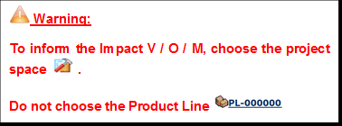
IMPACTS
V / O / M impacts & manufacturing site
Check the Project Space attribute.
Search the project name.
Select the result whose type is Project Space, then Submit.
Choose one or more manufacturing sites — they fill the Manufacturing Site field automatically.
The warning from the methodology
“No active manufacturing site in this project space” › the project space is not set up. Contact the Project Owner (RPP / RPCR); you cannot fix it from the ECO.
Product ECO — PLM Methodology (Ref. 20061_17_01638 v8.0)
10 / 21

Slide 11
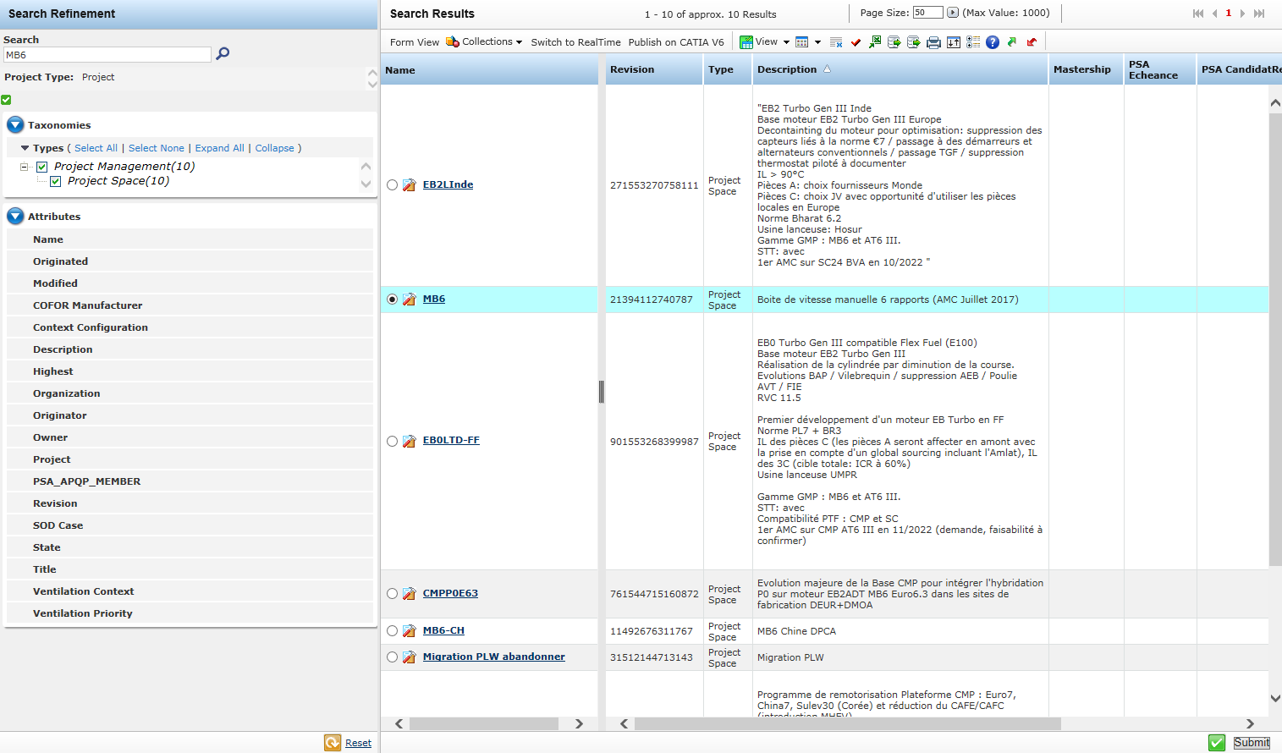
IMPACTS
Pick the project space, not the product line
Refine on Types › Project Management › Project Space.
Check the line whose Type column reads Project Space, then Submit.
Never select a Product Line (PL-000000) — impacts would be wrong.
Product ECO — PLM Methodology (Ref. 20061_17_01638 v8.0)
11 / 21

Slide 12
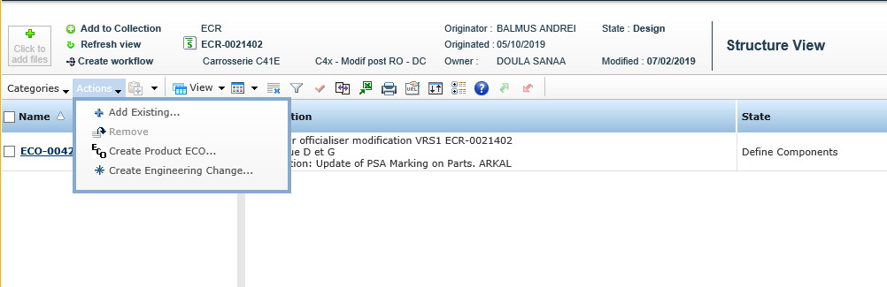
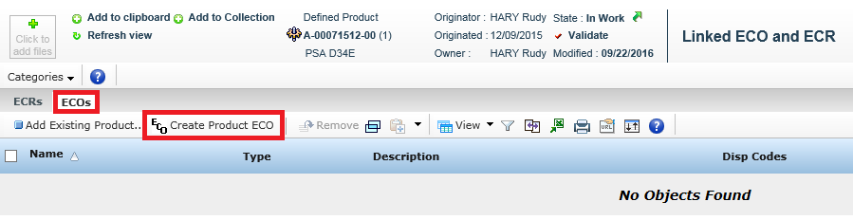
METHODS 2 & 3
Create the ECO from the object itself
UC 3 · FROM THE ECR
UC 2 · FROM THE PRODUCT
PDEF identity card › Categories › Linked ECO and ECR › tab ECOs › Create Product ECO — creates and links in one action.
ECR (state Design) › Categories › ECOs & ECs › Structure View › Actions › Create Product ECO…
Product ECO — PLM Methodology (Ref. 20061_17_01638 v8.0)
12 / 21

Slide 13
LINKING
Attach an existing ECO
TARGET | REFERENCE DOCUMENT
PDEF / PREA or DOC | MEMENTO Linking a Product to an ECO — 20061_17_01640
OA / LA (expected deliverable) | METHODOLOGY Linking an ECO to an Expected Object — 20061_16_01347
ECR | METHODOLOGY Add/Remove ECO under ECR — 20061_17_01982
Shortcut: creating the ECO from the product identity card (UC 2) does the create + link in a single action.
Product ECO — PLM Methodology (Ref. 20061_17_01638 v8.0)
13 / 21

Slide 14
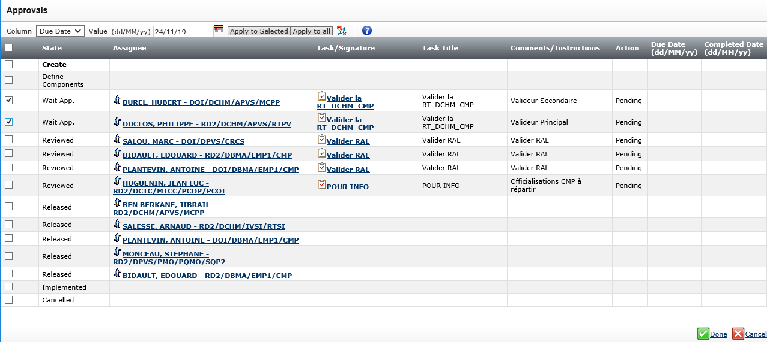
MANAGEMENT
Put a due date on the approvals
Identity card or Categories › Lifecycle › tab Approvals › Edit.
Column = Due Date, Value = dd/MM/yy, pick the day in the calendar.
Tick the RT / RAL lines › Apply to Selected (or Apply to all) › Done.
Result: every RT and RAL task carries a visible deadline.
Product ECO — PLM Methodology (Ref. 20061_17_01638 v8.0)
14 / 21

Slide 15
COLOURS
Neutral PDEF & Diversity Manager
Defining colours requires a “Neutral” PDEF.
The Diversity Manager must be informed › put his ID on the ECO:
ECO identity card › Actions › Edit Details › field Diversity Manager › search the ID › submit.
Forget it and the promotion fails — see the next slide.
No Diversity Manager ID = blocked system. Fill it at creation, not when the workflow stops.
Product ECO — PLM Methodology (Ref. 20061_17_01638 v8.0)
15 / 21

Slide 16
TYPICAL CASE
PDEF under a PA with coloured products
EVOLUTION 1
Revise the PDEF
PSA reference unchanged
No RCD alert needed
Simplest path
EVOLUTION 2
Non-interchangeable revision
PSA reference changes
Alert the RCD
Diversity Manager ID required on the ECO
EVOLUTION 3
Replace the PDEF
PSA reference changes
Alert the RCD
Diversity Manager ID required on the ECO
For Evolutions 2 and 3 the Diversity Manager receives the alert e-mail only if his ID is on the ECO — otherwise the system blocks.
Product ECO — PLM Methodology (Ref. 20061_17_01638 v8.0)
16 / 21

Slide 17
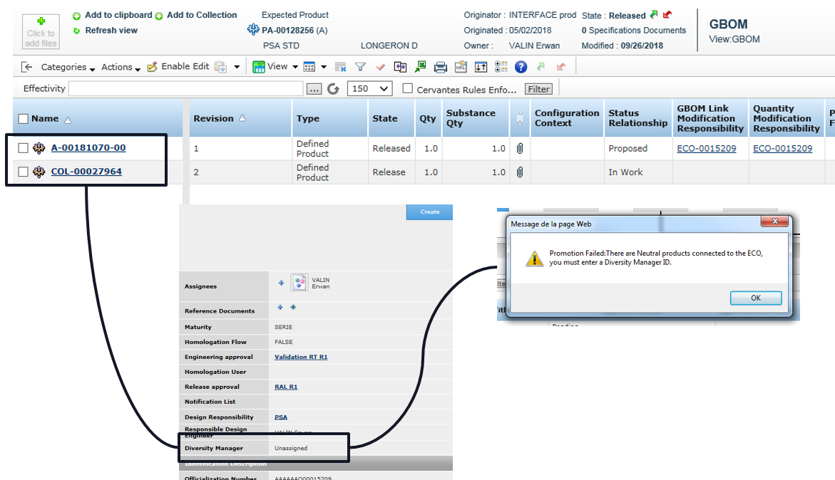
THE BLOCKER
Promotion failed: Neutral products connected
A coloured product (COL-…) sits next to the PDEF under the PA.
The ECO shows Diversity Manager: Unassigned.
Promotion is refused: “There are Neutral products connected to the ECO, you must enter a Diversity Manager ID”.
Fix: Actions › Edit Details › set the Diversity Manager, then promote again.
Product ECO — PLM Methodology (Ref. 20061_17_01638 v8.0)
17 / 21

Slide 18
TIPS
What experienced users do
Create from the product (UC 2) to avoid an orphan ECO.
Batch-create when several parts share one change.
Call the Homologation Manager first — some breakdowns are exempt from RHN flows; the approver holds the list.
Fill Notification's context on any JV / partner ECO, or the folder is never diffused.
Set the Diversity Manager as soon as colours are involved.
Fill every black field early — the window closes after Define Components.
Put due dates on RT and RAL — no date, no follow-up.
Check the ECR is in Design before hunting for the Create Product ECO action.
Product ECO — PLM Methodology (Ref. 20061_17_01638 v8.0)
18 / 21

Slide 19
TROUBLESHOOTING
Blockers and their fix
SYMPTOM | FIX
Cannot create the ECO | A red field is empty, or the role is wrong (PSA_Pilote_Projet / PSA_Concepteur).
Create Product ECO not available on the ECR | The ECR is not in state Design.
Cannot edit an attribute anymore | The ECO left Create / Define Components maturity.
No active manufacturing site in this project space | Project space not configured — contact the Project Owner (RPP / RPCR).
Promotion failed: Neutral products connected | Add the Diversity Manager ID (Actions › Edit Details).
Release refused | Missing Responsible Design Engineer, Homologation User, RT or RAL approvers.
Product ECO — PLM Methodology (Ref. 20061_17_01638 v8.0)
19 / 21

Slide 20
VOCABULARY
Decoder
ECO Engineering Change Order — officialises a change
ECR Engineering Change Request — upstream demand
PDEF Defined Product
PREA Realized Product
PA Expected Product (structure)
OA / LA Expected object / expected deliverable
DOC Document object
RT Technical review workflow
RAL Deliverable approval review workflow
V / O / M Impacts declared via the project space
CADER Vehicle or Component code
DUD Milestone (e.g. 1st pre-series vehicle)
RCD Diversity/configuration referent to alert
RPP / RPCR Project owner roles
FM Change sheet in SAP / 3DCom (ECO equivalent)
Neutral Colour-less PDEF required to define colours
Product ECO — PLM Methodology (Ref. 20061_17_01638 v8.0)
20 / 21

Slide 21
WRAP-UP
Remember 5 things
01 The ECO is the gate: no ECO, no released product.
02 Prerequisites first — role, ECR in Design, RT/RAL templates.
03 Red fields to create, black fields before Define Components ends.
04 V/O/M = Project Space, never the Product Line.
05 Colours involved › Diversity Manager ID, or the system blocks.
Full procedure and screenshots: METHODOLOGY Creating a Product ECO — Ref. 20061_17_01638 v8.0 (17/04/2024). Related: 20061_17_01640, 20061_16_01347, 20061_17_01982.
Product ECO — PLM Methodology (Ref. 20061_17_01638 v8.0)
21 / 21

