Slide 1
PDEF & PREA lifecycle
Promote, demote, prohibit, revise — EE specific
How a defined product and a realized product climb to Released, and what stops them.
Source: METHODOLOGY PDEF and PREA lifecycle management (EE specific) · Ref. 20061_15_01662 · v1.0 · ELECTRICAL SPEC

Slide 2
SCOPE
What this covers
Guide for EE professionals and designers on the lifecycle of PDEF and PREA.
Valid for the four general classes: HW, SW, CAL, DOTE.
Tool: ENOVIA V6 (PLM), role PSA_Concepteur.Elec.XXX.
The PDEF / PREA must already exist in the database — this is not a creation guide.
Everything above Approved is driven by the ECO, not by the product itself.
The source document is bilingual FR/EN and the screens are the French UI — slide 20 maps the labels.
PDEF & PREA lifecycle management (EE) — Ref. 20061_15_01662 v1.0
2 / 22

Slide 3
THE TWO LADDERS
States you must know
PDEF · DEFINED PRODUCT
In Work
›
Wait App.
›
Approved
›
Released
PREA · REALIZED PRODUCT
In Work
›
Frozen
›
Wait App.
›
Approved
›
Released
Only the PREA has a Frozen step, and only the PREA can be cancelled & revised. Both can end up Prohibited. The ECO runs its own ladder: Create › Define Components › Wait App. › Review › Released › Implemented.
PDEF & PREA lifecycle management (EE) — Ref. 20061_15_01662 v1.0
3 / 22

Slide 4
THE GOLDEN RULE
Documents move first
TO REACH THIS STATE | THE SPECIFICATION DOCUMENTS MUST ALREADY BE
PDEF → Wait App. | Wait App.
PDEF → Approved | Approved
PDEF → Released (via the ECO) | Released / Published
PREA → Frozen | Frozen
PREA → Wait App. | Wait App.
PREA → Approved | Approved
PREA → Released (via the ECO) | Published
Where to check: Categories › Specification Documents. In the State column, the green arrow promotes each document one step.
PDEF & PREA lifecycle management (EE) — Ref. 20061_15_01662 v1.0
4 / 22

Slide 5
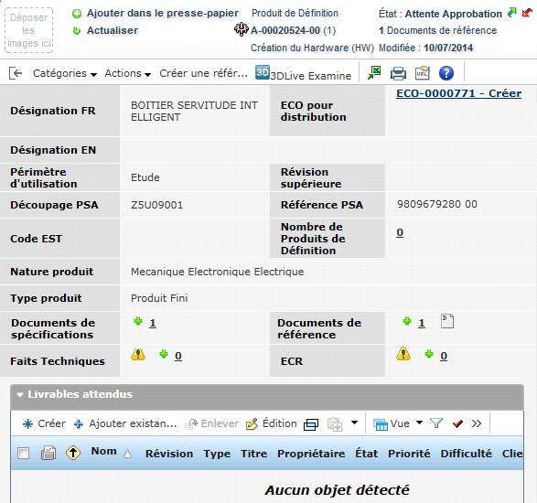
MECHANICS
Two ways to move one step
Green arrow next to the state on the identity card — fastest.
Or Categories › Lifecycle › Promote in the lifecycle window.
Going back down is the same gesture: red arrow or Demote.
Each click moves exactly one state — there is no jump to Released.
PDEF promoted to Attente Approbation (Wait App.)
PDEF & PREA lifecycle management (EE) — Ref. 20061_15_01662 v1.0
5 / 22

Slide 6
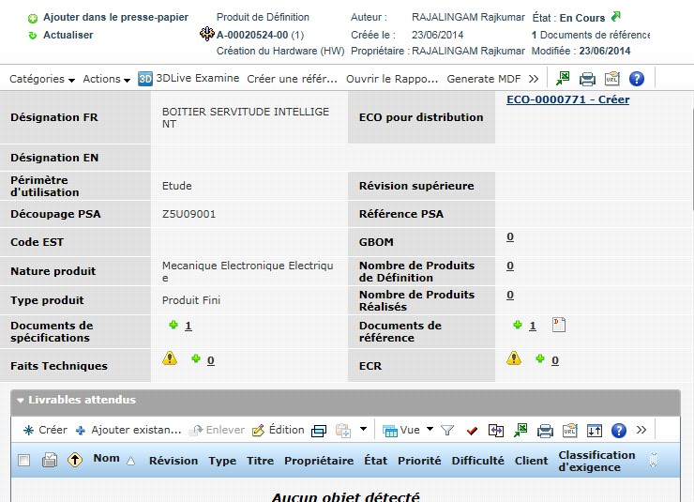
BEFORE WAIT APP.
Two things must be on the PDEF
An ECO must be linked (top right of the card). If not, create one — see the ECO methodology.
A PSA Reference must be assigned. If not, run the PSA Reference methodology.
Here the product is still En Cours (In Work) and the PSA Reference cell is empty.
Check the specification documents too — they gate the promotion.
PDEF & PREA lifecycle management (EE) — Ref. 20061_15_01662 v1.0
6 / 22

Slide 7
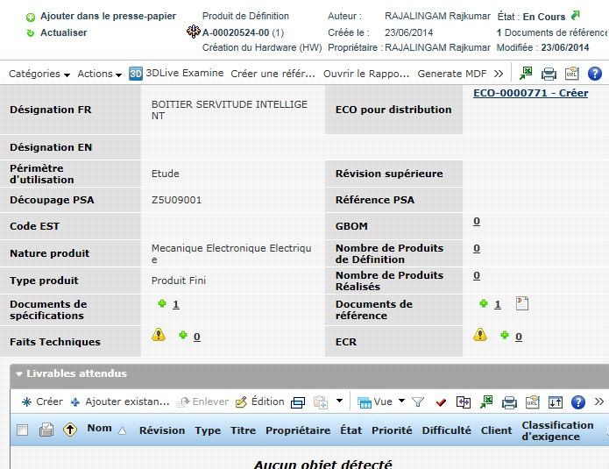
RESULT
Wait App. locks the content
Once in Wait App., no modification is possible.
To edit again: Demote back to In Work (red arrow or Categories › Lifecycle › Demote).
Demotion does not touch the specification documents — they stay where they are.
Same logic one floor up: Approved → Wait App. to reopen, or make a revision.
PDEF & PREA lifecycle management (EE) — Ref. 20061_15_01662 v1.0
7 / 22

Slide 8
RELEASE
The ECO releases the product
Open the PDEF (or PREA) in Approved and click the ECO link on the card.
On the ECO: Actions › Edit Details.
Check the three attributes that drive the workflow:
RT approvers (technical review), RAL approvers (deliverable approval), Responsible Design Engineer.
Use the “…” buttons to change a value, then Done.
PDEF & PREA lifecycle management (EE) — Ref. 20061_15_01662 v1.0
8 / 22

Slide 9
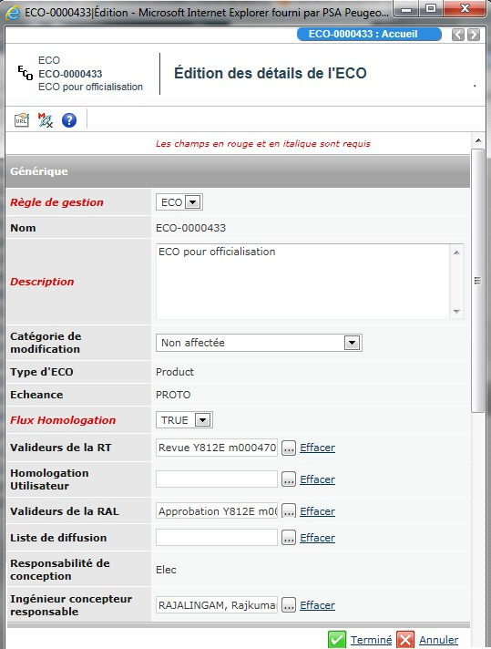
RELEASE
The three attributes to check
Valideurs de la RT — workflow template of the technical review.
Valideurs de la RAL — workflow template of the deliverable approval.
Ingénieur concepteur responsable — the designer answering for the change.
Red italic fields are required (Règle de gestion, Description, Flux Homologation).
“…” opens the picker, Effacer clears a value, Terminé saves.
PDEF & PREA lifecycle management (EE) — Ref. 20061_15_01662 v1.0
9 / 22

Slide 10
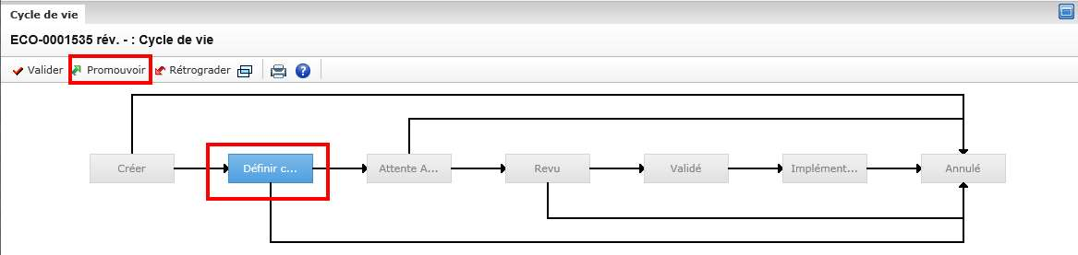
RELEASE
Climbing the ECO
Promote to Define Components — possible once project and business agree on the deliverable target dates. The designer becomes the ECO owner.
Promote again to Wait App.: the business signals the work is finished.
Allowed only if everything attached to the ECO is ready: PDEF Approved and its DOC Approved (for a PREA: PREA Approved, DOC Validated).
Check it in Categories › Affected Items and promote what is late.
The ECO ladder: Créer › Définir composants › Attente appro. › Revue › Validé › Implémenté
The ECO cannot be promoted while one attached document or product is still one floor below. That is the most common blocker at release time.
PDEF & PREA lifecycle management (EE) — Ref. 20061_15_01662 v1.0
10 / 22

Slide 11
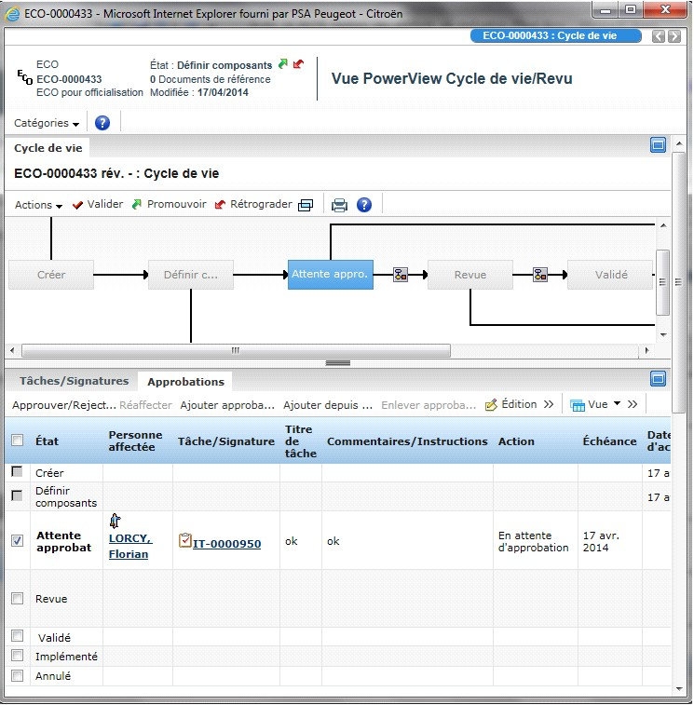
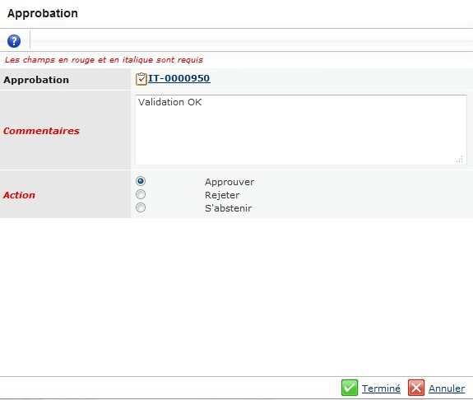
APPROVALS
RT then RAL: the two routes
LIFECYCLE › APPROVALS
THE POP-UP
Tick the state line (A), then Approve/Reject (B). The assignee appears in Tâches/Signatures; a task notification lands in his mailbox.
Add a comment, select Approuver (Approve), then Terminé (Done). The route is launched.
PDEF & PREA lifecycle management (EE) — Ref. 20061_15_01662 v1.0
11 / 22

Slide 12
APPROVALS
Who does what, in order
RT approver validates the route that takes the ECO to Wait App. — the ECO then moves to Review.
RAL approver validates the route that takes the ECO to Released.
Each one works from Categories › Lifecycle › Approvals on the ECO, never from the product.
A route waiting for a signature is marked by an icon on the ECO.
When the RAL route is approved, the ECO is Released — and so is everything it carries.
PDEF & PREA lifecycle management (EE) — Ref. 20061_15_01662 v1.0
12 / 22

Slide 13
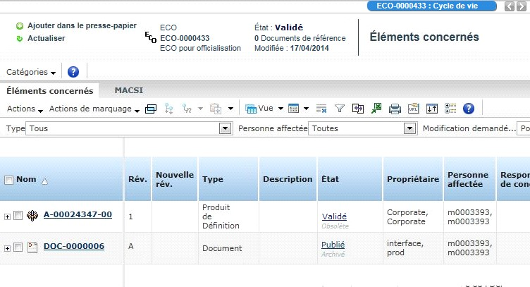
DONE
Check the result on Affected Items
On the released ECO: Categories › Affected Items.
The PDEF is Validé / Released and the specification document is Publié / Published.
The previous revision flips to Obsolete — visible under the state.
If a line is not at the expected state, the release is not finished.
PDEF & PREA lifecycle management (EE) — Ref. 20061_15_01662 v1.0
13 / 22

Slide 14
PREA SPECIFICS
What changes for a realized product
Extra first step: Frozen — reachable only when the documents are Frozen.
After Frozen, no modification: content changes need a revision.
A PREA in Wait App. or Approved cannot be revised — demote it back to Frozen first.
For Released, the attached documents must be Published.
Only the PREA offers Cancel and revise (next slide).
PDEF & PREA lifecycle management (EE) — Ref. 20061_15_01662 v1.0
14 / 22

Slide 15
PREA · REPAIR
Cancel and revise a faulty PREA
Use it to retire a faulty PSA Reference and get a new one.
Conditions: the PREA is Frozen and it is the last revision on the line.
On the PREA: Actions › Cancel and revise.
The faulty PREA becomes Cancelled; a new revision is created in In Work.
Then link the new revision to an ECO and launch the creation of its PSA Reference. The PDEF–PREA link is carried over (Categories › Referenced By).
This action is irreversible. Check the revision and the state before you click.
PDEF & PREA lifecycle management (EE) — Ref. 20061_15_01662 v1.0
15 / 22

Slide 16
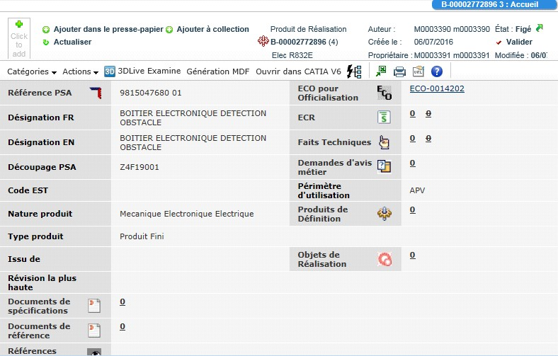
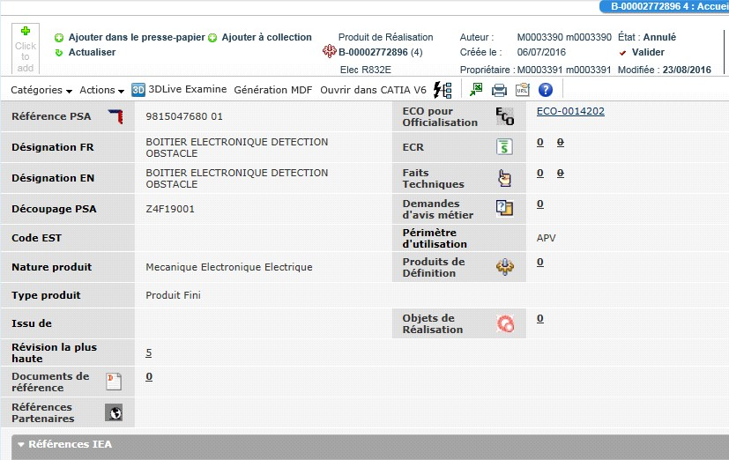
PREA · REPAIR
Before and after
BEFORE · FIGÉ (FROZEN)
AFTER · ANNULÉ (CANCELLED)
The faulty PREA, still Frozen, with its PSA Reference and its ECO pour Officialisation.
The PREA is Cancelled and Révision la plus haute points to the new revision, which starts In Work.
PDEF & PREA lifecycle management (EE) — Ref. 20061_15_01662 v1.0
16 / 22

Slide 17
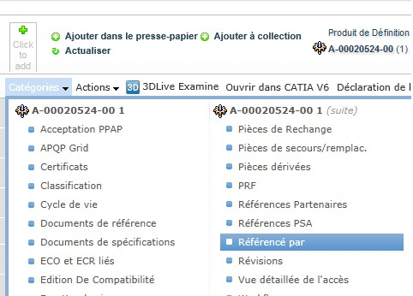
PROHIBITION · 1/2
Prepare the ECO that forbids
Open the PDEF or PREA in Released / Validated.
Categories › Referenced By to see which PA (for a PDEF) or which PDEF (for a PREA) the prohibition will hit.
Create an ECO for the prohibition and link it to the product.
Actions › Edit Details: fill the RAL approvers and the Responsible Design Engineer.
Categories › Référencé par (Referenced By)
The RT approver is not required for a prohibition — only the RAL route runs.
PDEF & PREA lifecycle management (EE) — Ref. 20061_15_01662 v1.0
17 / 22

Slide 18
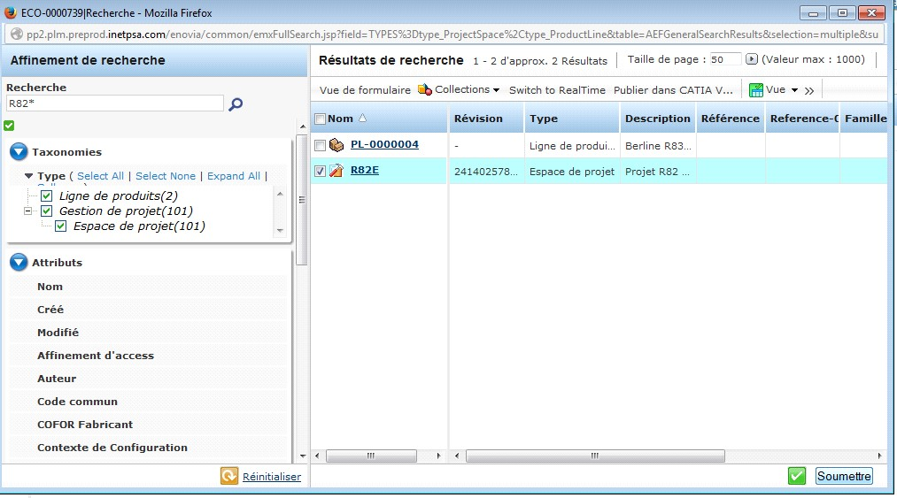
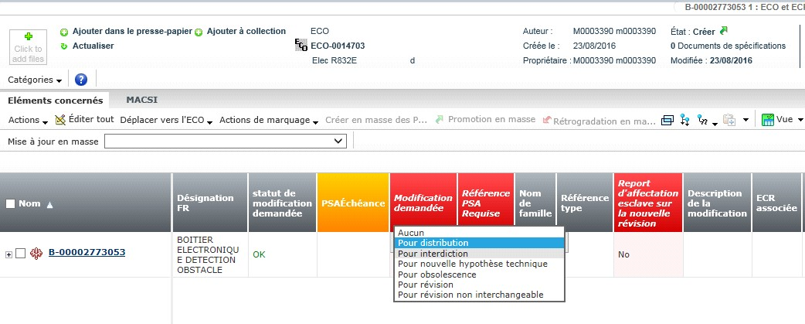
PROHIBITION · 2/2
Declare the intent, then release it
V/O/M IMPACTS › ADD EXISTING
AFFECTED ITEMS › EDIT ALL
Modification demandée (Requested Change) = Pour interdiction (For Prohibition), then Save.
Search the project and Submit — the project is then linked to the ECO.
Then Lifecycle › Promote up to Review, the RAL approver validates, the ECO turns Released and Affected Items shows the product as Prohibited.
PDEF & PREA lifecycle management (EE) — Ref. 20061_15_01662 v1.0
18 / 22

Slide 19
TIPS
What saves time
Promote the documents first, then the product — never the other way round.
Check ECO + PSA Reference before touching the state of a PDEF.
Fill RT / RAL / RDE early on the ECO; an empty route blocks the release.
Use Affected Items as your checklist before promoting an ECO.
Demote instead of forcing — demotion is free and leaves documents untouched.
Revise a PREA only from Frozen — Wait App. and Approved refuse it.
Referenced By tells you who suffers from a prohibition, before you launch it.
Cancel and revise is final — note the new revision number immediately.
PDEF & PREA lifecycle management (EE) — Ref. 20061_15_01662 v1.0
19 / 22

Slide 20
TROUBLESHOOTING
Blockers and their fix
SYMPTOM | FIX
The green arrow does nothing on the PDEF | A specification document is one state below. Promote it first.
Cannot promote the ECO to Wait App. | An attached product or DOC is not Approved yet — check Affected Items.
Cannot modify the product anymore | It left In Work. Demote it, or create a revision.
Cannot revise the PREA | It is in Wait App. or Approved — demote back to Frozen.
Cancel and revise is greyed out | The PREA is not Frozen, or it is not the last revision on the line.
Nobody signs the route | RT / RAL approvers or the Responsible Design Engineer are missing on the ECO.
PDEF & PREA lifecycle management (EE) — Ref. 20061_15_01662 v1.0
20 / 22

Slide 21
FRENCH UI
Label decoder
En cours In Work
Figé Frozen
Attente approbation Wait App.
Approuvé Approved
Validé Released / Validated
Publié Published (documents)
Annulé Cancelled
Promouvoir / Rétrograder Promote / Demote
Cycle de vie Lifecycle
Éléments concernés Affected Items
Référencé par Referenced By
Documents de spécifications Specification Documents
Modification demandée Requested Change
Pour interdiction For Prohibition
Valideurs de la RT / RAL RT / RAL approvers
Ingénieur concepteur responsable Responsible Design Engineer
Édition des détails Edit Details
Terminé / Approuver Done / Approve
PDEF & PREA lifecycle management (EE) — Ref. 20061_15_01662 v1.0
21 / 22

Slide 22
WRAP-UP
Remember 5 things
01 Documents climb first — the product follows one state at a time.
02 No PDEF promotion without an ECO and a PSA Reference.
03 Above Approved, it is the ECO (RT then RAL) that releases everything.
04 Affected Items is the truth: check it before and after.
05 PREA only: Frozen to revise, and Cancel and revise is irreversible.
Full procedure and screenshots: METHODOLOGY PDEF and PREA lifecycle management (EE specific) — Ref. 20061_15_01662 v1.0. Related: ENOVIA Glossary 20061_13_01595, PDEF/PREA management HW 20061_14_01621, SW/CAL 20061_15_01666, DOTE 20061_14_01619.
PDEF & PREA lifecycle management (EE) — Ref. 20061_15_01662 v1.0
22 / 22

