Slide 1
Fastformer: Additive Attention Can Be All You Need
Chuhan Wu, Fangzhao Wu, Tao Qi, Yongfeng Huang, Xing Xie. Aug 22, 2021 arXiv:2108.09084
Eric Rigall
Sep 14, 2021

Slide 2
Motivation
Self-attention matrix
In traditional transformer: self-attention matrix
search for long-term relationships between elements
map of every input to every output
computation complexity: quadratic to N = k*N²
Number N of key elements
Number N of query elements
If input text contains N=100 words (review ranking)
self-attention matrix: k*10000 operations

Slide 3
Motivation
Self-attention matrix
In traditional transformer: self-attention matrix
search for long-term relationships between elements
map of every input to every output
computation complexity: quadratic to N = k*N²
Number N of key elements
Number N of query elements
If input text contains N=100 words (review ranking)
self-attention matrix: k*10000 operations
If input text contains N≥50000 words (text summarization)
self-attention matrix: becomes prohibitive

Slide 4
Motivation
Self-attention matrix
In traditional transformer: self-attention matrix
search for long-term relationships between elements
map of every input to every output
computation complexity: quadratic to N = k*N²
Number N of key elements
Number N of query elements
If input text contains N=100 words (review ranking)
self-attention matrix: k*10000 operations
If input text contains N≥50000 words (text summarization)
self-attention matrix: becomes prohibitive
-> Fastformer: use of self-attention matrix with linear complexity

Slide 5
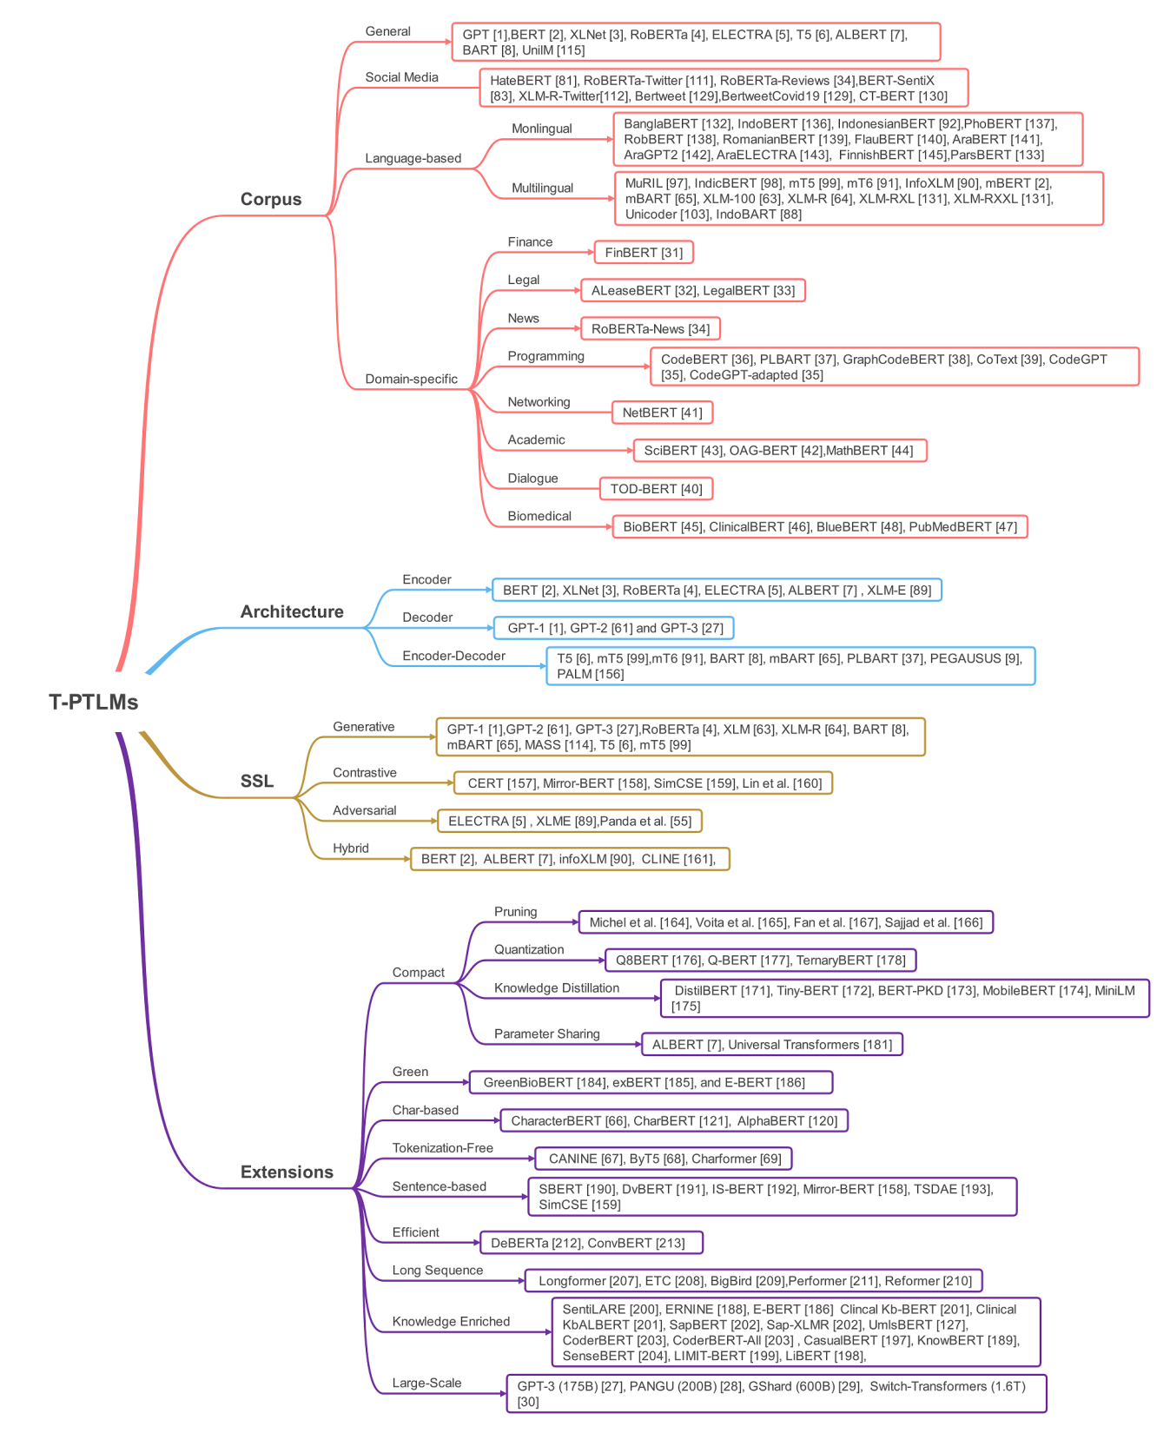
Variants
Transformers:
“Attention is all you need” (2017)
Since then, lots of variants in NLP area
Notes:
AMMUS : A Survey of Transformer-based Pretrained Models in Natural Language Processing
Katikapalli Subramanyam Kalyan, Ajit Rajasekharan, Sivanesan Sangeetha. arXiv:2108.05542, 2021 Aug 12

Slide 6
Variants
Transformers:
“Attention is all you need” (2017)
Since then, lots of variants in NLP area
We focus on only one leaf: “Long sequence” model
2020
2020
2020
2020
2019
Fastformer (2021):
Designed for long query processing
Notes:
AMMUS : A Survey of Transformer-based Pretrained Models in Natural Language Processing
Katikapalli Subramanyam Kalyan, Ajit Rajasekharan, Sivanesan Sangeetha. arXiv:2108.05542, 2021 Aug 12

Slide 7
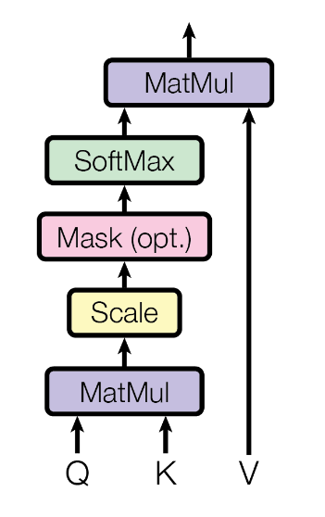
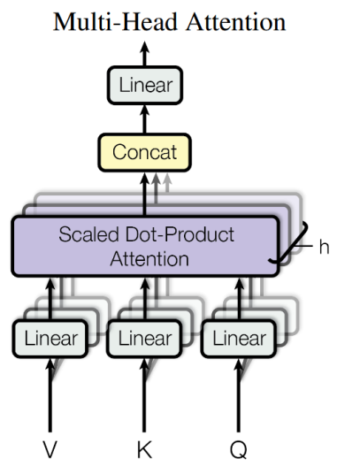
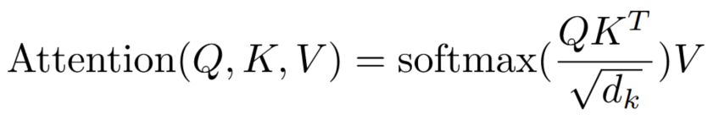
Review: Transformer
(Soft(Q*K^{T}/ )) ^{T}*V
Soft(Q*K^{T}/ )
Q*K^{T}
Query Q ^{T}
Key K ^{T}
Value V ^{T}
Input sequence

Slide 8
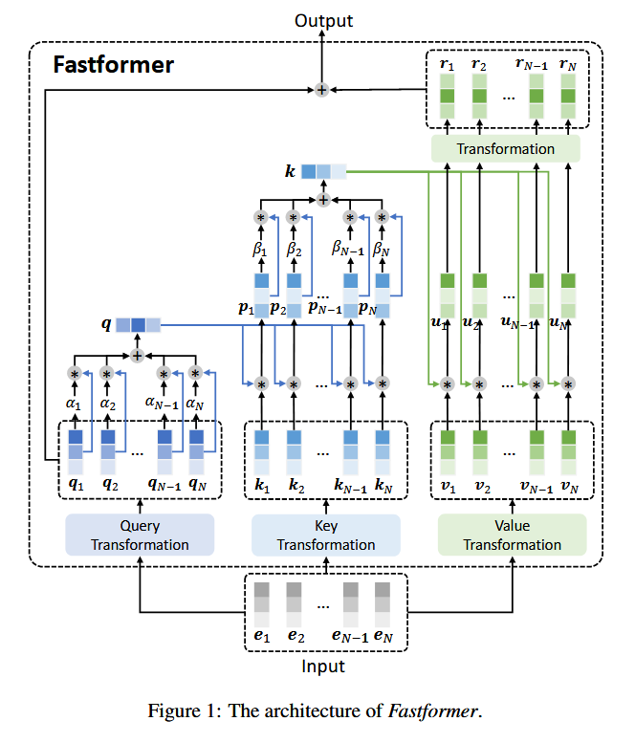
Fastformer
Weighted sum
Fully-connected network
Additive attention
Element-wise product

Slide 9
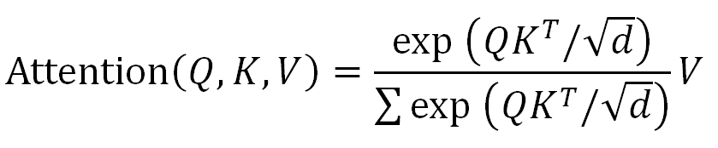
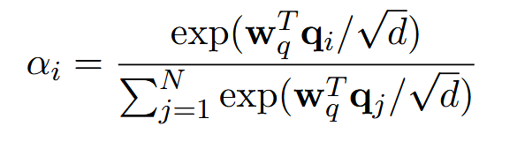
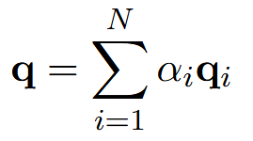

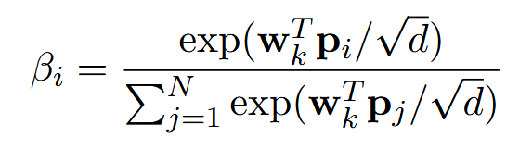
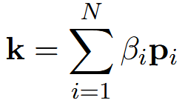



Fastformer
In transformer:
Notes:
Wq and Wk and learnable parameters, common for each q1, q2 … qN and k1, k2 … kN, respectively

Slide 10
Fastformer
In transformer:
Main differences with Transformer
In these equations:
No matrix dot-product
only vector products
Cascaded process
attention on query
element-wise product between query and key
attention on key
element-wise product between key and value
full connection of attention value

Slide 11
Fastformer
In transformer:
How the overall attention is performed ?
Attention layers output global vectors
Global vectors: essential information from attention query and key
Element-wise product between global vector and attention vectors
Analogy:
convolution kernels: one 2D or two 1D
2D:
N
N² parameters
N
2N parameters
N
1D:
N
N
x
=
N

Slide 12
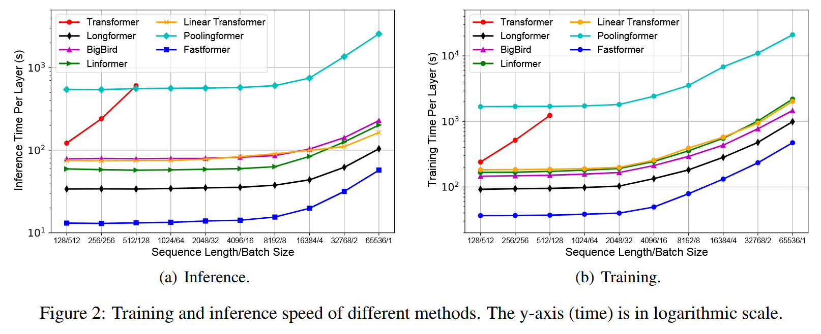
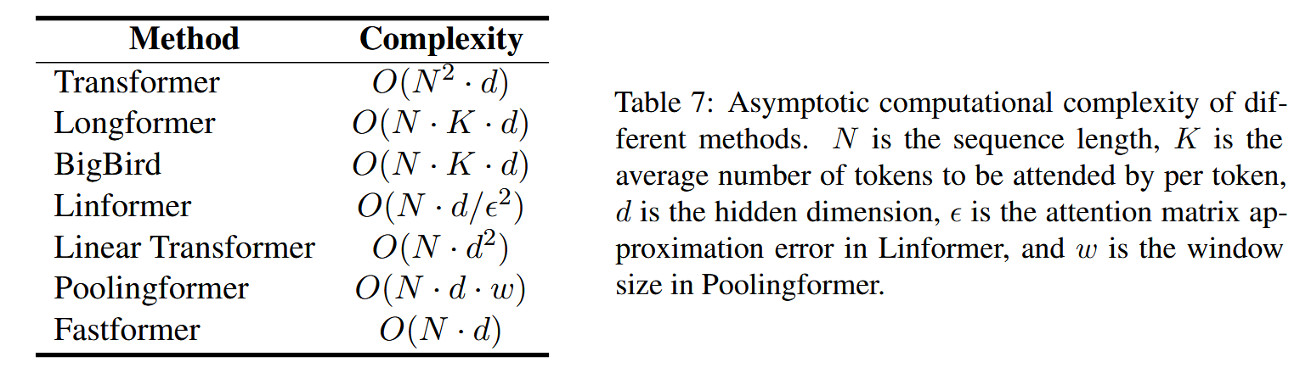
Metric comparison

Slide 13
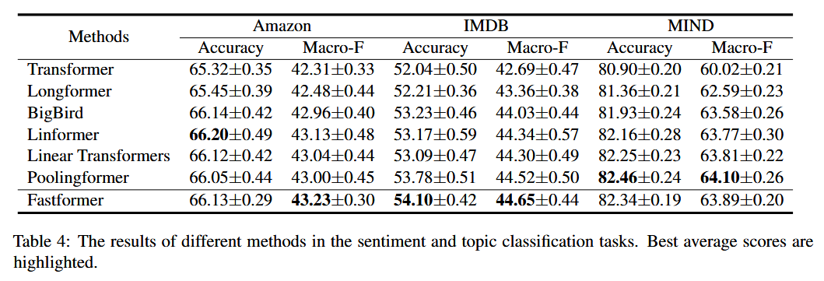
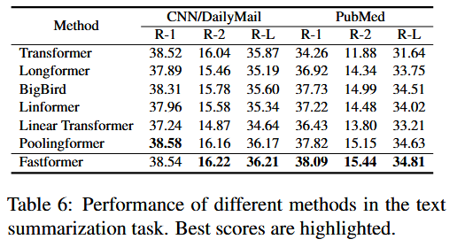
Results comparison
Notes:
Linformer (2020): approximates the self-attention operation by decomposing self-attention matrix into two low-rank matrices
-> limit computational cost of self-attention matrix operation
Poolingformer (ICML 2021): first uses small sliding windows to perform local self-attention, then employs larger windows with pooling attention to limit computations
-> sparse self-attention mechanism, reducing the self-attention computation

Slide 14
Key takeaways
Fastformer
For long sequences
Linear complexity
Architecture
Cascaded vector dot-products
Element-wise product between “global” vectors and attention vectors
Performance
Fastest inference time
Best accuracy in text summarization
Transformer
General NLP tasks
Quadratic complexity
Architecture
Single matrix dot-product
Self-attention using the full attention query and key

Slide 15
References
Chuhan Wu, Fangzhao Wu, Tao Qi, Yongfeng Huang, Xing Xie. “Fastformer: Additive Attention Can Be All You Need”. Aug 22, 2021 arXiv:2108.09084
Ashish Vaswani, Noam Shazeer, Niki Parmar, Jakob Uszkoreit, Llion Jones, Aidan N. Gomez, Łukasz Kaiser, and Illia Polosukhin. 2017. “Attention is all you need”. In Proceedings of the 31st International Conference on Neural Information Processing Systems (NIPS'17). Curran Associates Inc., Red Hook, NY, USA, 6000–6010.
Katikapalli Subramanyam Kalyan, Ajit Rajasekharan, Sivanesan Sangeetha. “AMMUS : A Survey of Transformer-based Pretrained Models in Natural Language Processing”. 2021 Aug 12. arXiv:2108.05542.

