Slide 1
Voronoi Diagrams and
Fortune’s Algorithm
Charles Zecha

Slide 2
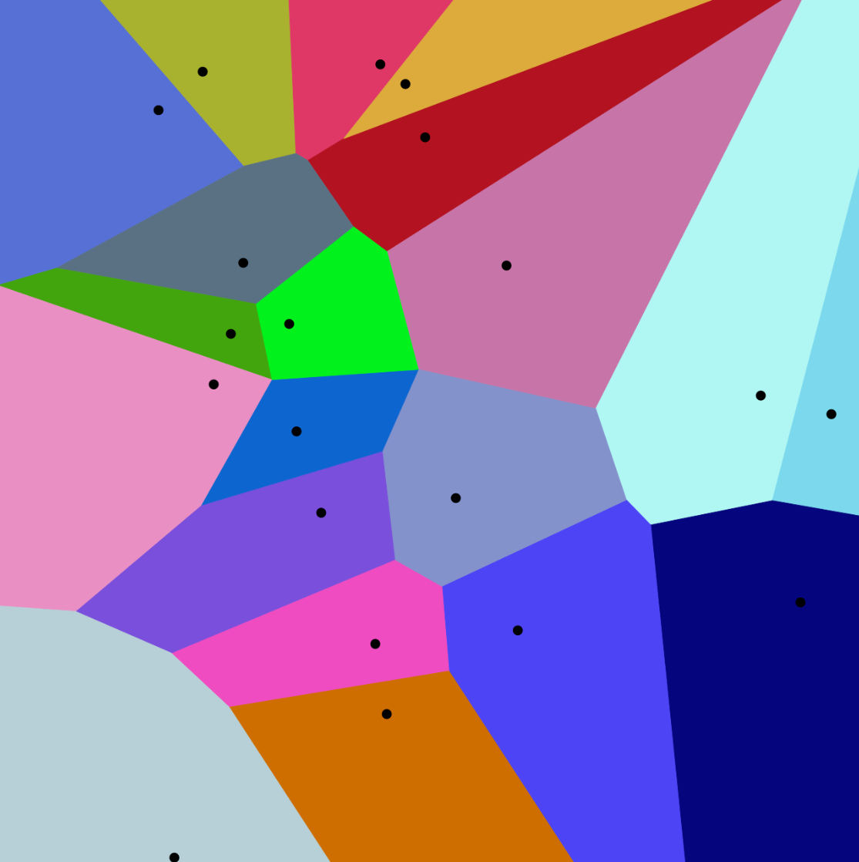
What is a Voronoi diagram?
A partition of a plane into regions, based on a finite set of seed points. Each region consists of all points of the plane that are closer to the corresponding seed point.

Slide 3
What is Fortune’s algorithm?
Fortune’s algorithm is a sweep line algorithm for creating a Voronoi diagram from a set of points in a plane using O(n log n) time and O(n) space, originally published by Steven Fortune in 1986.

Slide 4
How does Fortune’s algorithm work?
Beach Line - Binary Search Tree
Event Queue - Priority Queue
Site Events
New Arc
Circle Events
Remove Arc
Conic Sections

Slide 5
Edge Cases
Points that form a line parallel with the sweep line.
Break tie based on the coordinate perpendicular to sweep line.
Coincident points
Preprocess and reject
Floating point precision on parabola intersection and event timing
Exact arithmetic

Slide 6
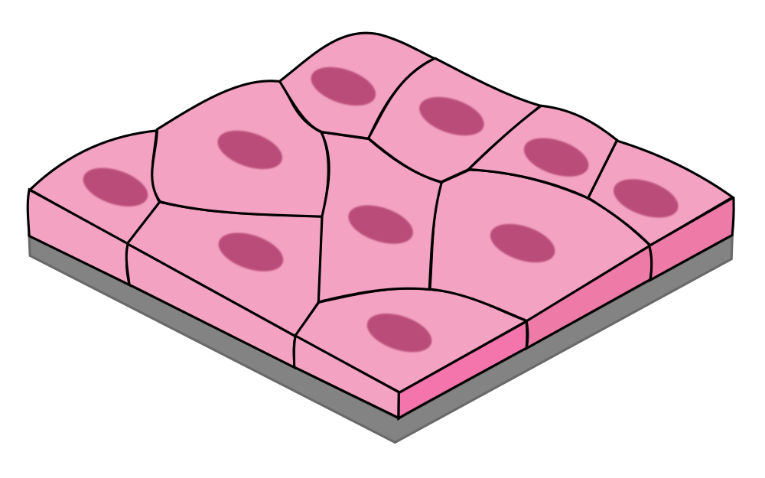
Use Cases
Voronoi diagrams are primarily used to model different things
Biology
Cells
Bone microarchitecture
Materials Science
Polycrystalline microstructures in metallic alloys
Aviation
Nearest airfield

Slide 7
Conclusion
Voronoi diagram
Fortune’s algorithm
Edge cases
Use cases

Slide 8
References
https://en.wikipedia.org/wiki/Voronoi_diagram
https://en.wikipedia.org/wiki/Fortune%27s_algorithm

