Slide 1
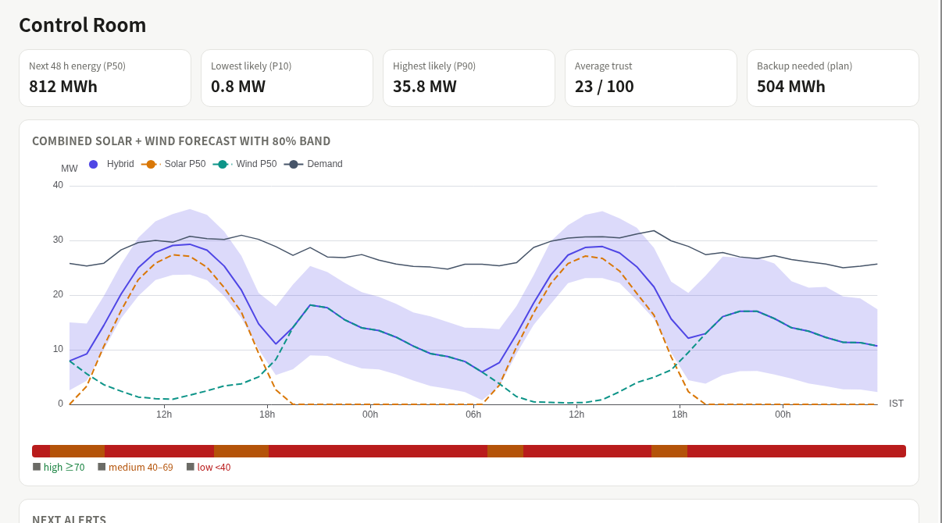
AGNITIA HACKATHON · TEAM OVERxPOWERED
TERRA
Hybrid solar + wind forecasting that turns weather uncertainty into saved rupees
48 h hourly forecast
Solar 40 MW + wind 50 MW at Dewas, MP
Calibrated uncertainty
80% band + a Trust score per hour
Forecast to decision
Alerts, battery dispatch, DSM schedule
The Control Room: 48 h combined forecast, uncertainty band, trust ribbon, alerts
90 MW
6
179
₹1.11 Cr
virtual co-located plant
models benchmarked
held-out test days
DSM penalty saved*
*Illustrative DSM rates, 179-day backtest vs persistence scheduling. Plant is a virtual digital twin at a real location, calibrated on real data. Weather data by Open-Meteo.com (CC BY 4.0).
Notes:
Intro. TERRA = forecast + trust + decision. Plant is a calibrated virtual twin; say so up front.

Slide 2
Forecast errors cost crores, 15 minutes at a time
THE PROBLEM
DSM PENALTIES, 179 TEST DAYS (₹ LAKH)
SAVED BY TERRA
1
Weather swings output
Solar and wind must be scheduled a day ahead.
₹1.11 Cr
in deviation charges (₹1,11,45,303)
2
Tolerance bands tighten
CERC DSM from 1 Apr 2026: ±5% solar, ±10% wind.
61%
3
Every miss is billed
Each 15-min block outside the band pays a deviation charge, plus fossil backup and curtailment.
lower penalties than persistence
+ ₹29.91 L backup cost
WHY TERRA WINS
Forecast to rupees
One platform: forecast, battery dispatch and a 96-block DSM schedule.
Knows when it is unsure
Calibrated 80% band and Trust score (Spearman −0.67 vs error).
Leak-free and honest
Strict 24/48 h lead mapping; every number from the eval harness.
Hybrid, ready to pilot
Solar + wind + battery together; real SCADA is a config swap.
DSM rates are illustrative placeholders (verify before quoting); tolerance bands per CERC from 1 Apr 2026.
Notes:
Money slide. Persistence solar 53.66L -> 26.65L; wind 127.98L -> 43.53L. Total 181.64L -> 70.18L, saving 111.45L = 1.11 Cr. Rates illustrative.

Slide 3
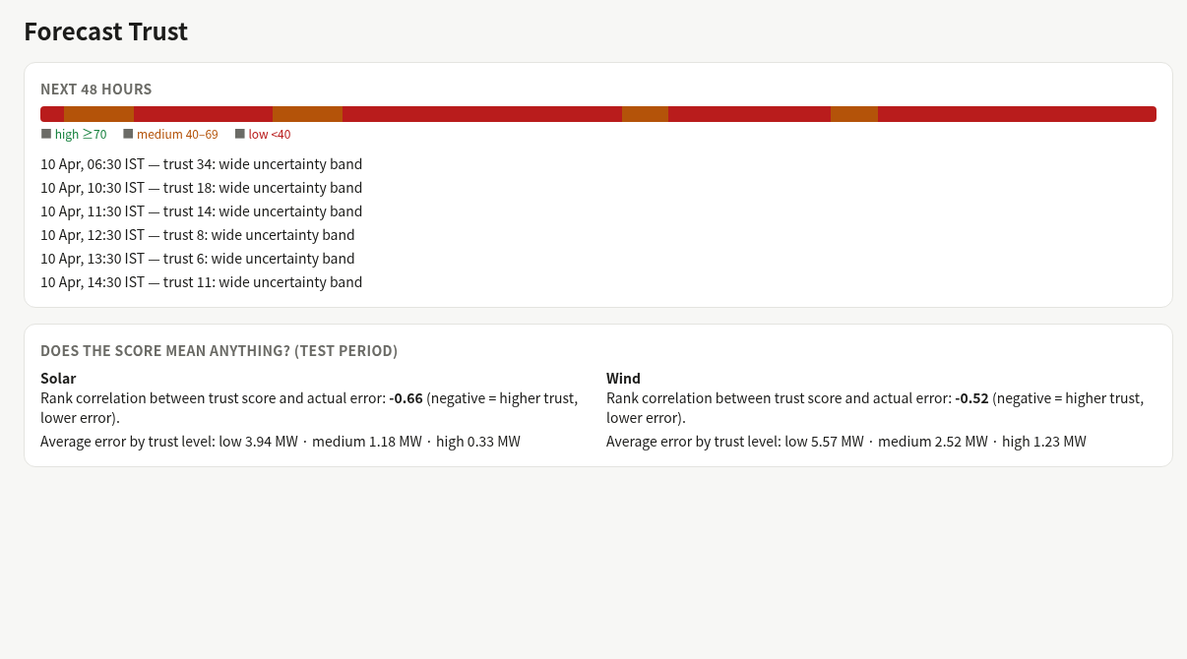
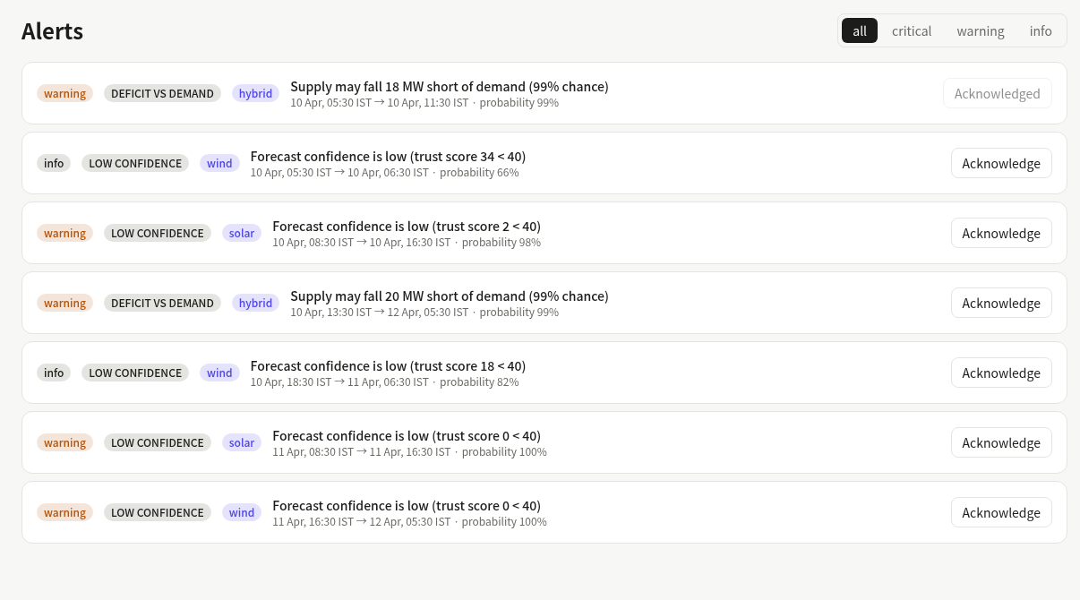
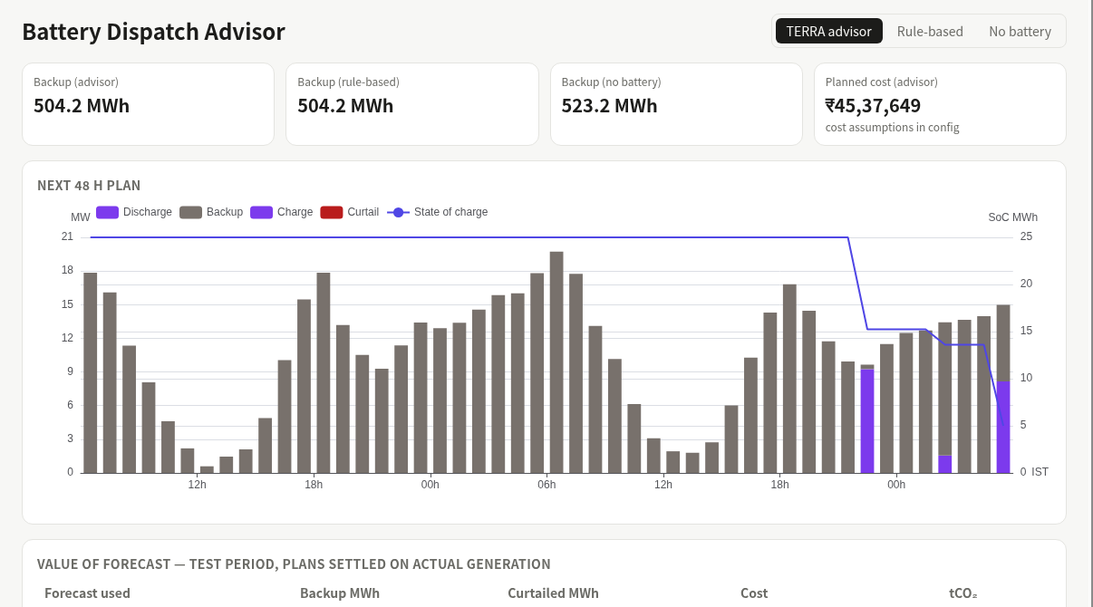
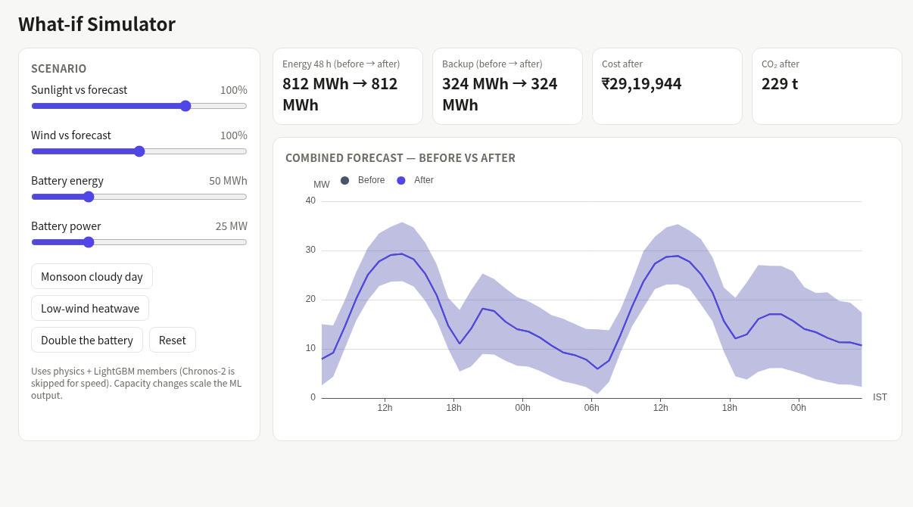
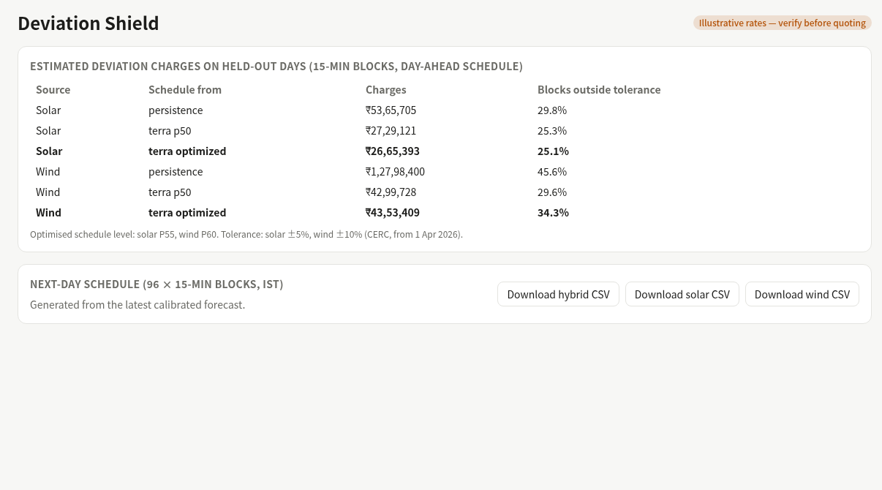
Six features that move forecast into action
Control Room
48 h forecast with band, trust ribbon, alerts
Trust Score
Tells operators when not to rely on the forecast
Smart Alerts
Low, high, ramp and demand-deficit warnings
Dispatch Advisor
LP plan cuts fossil backup and curtailment
₹ impact
What-if Simulator
Cloudy day, low wind, bigger battery: see ₹ and CO₂
₹ impact
Deviation Shield
15-min DSM schedule and charges, CSV export
₹ impact
Screenshots from the running dashboard (replay mode, issue time 10 Apr 05:30 IST). Weather data by Open-Meteo.com (CC BY 4.0).

Slide 4
Architecture: weather in, rupee decisions out
1 DATA
2 TWIN + FEATURES
3 MODELS
4 ENGINES
5 SERVE + UI
Open-Meteo: ECMWF IFS forecast + archive
Real datasets for calibration
config/*.yaml: plant, battery, DSM, costs
pvlib solar, windpowerlib wind
Realism layer: soiling, outages, curtailment
Leak-free lead map: fx1 (1–24 h), fx2 (25–48 h)
Persistence, week-mean
Physics + LightGBM quantile
Ensemble + conformal band (CQR)
Chronos-2 benchmark (Kaggle GPU)
Hybrid band, Trust, Alerts
Dispatch LP, What-if
Deviation Shield (DSM)
Impact: ₹, MWh, CO₂
FastAPI + hourly APScheduler
SQLite store, SSE live push
Next.js + ECharts, 10 pages
EVALUATION HARNESS (ml/terra/eval)
Time-based splits, no actual-weather features, MAE / RMSE / band coverage. Every number in UI and report is generated, never typed.
MONETARY OUTPUTS
Next-day DSM schedule (96 × 15-min blocks, CSV) · planned cost · backup MWh avoided · CO₂ avoided (CEA 0.705 t/MWh)
Pure-Python engines (no web code) keep the decision logic testable; the plant data source is a config swap from twin to real SCADA.

Slide 5
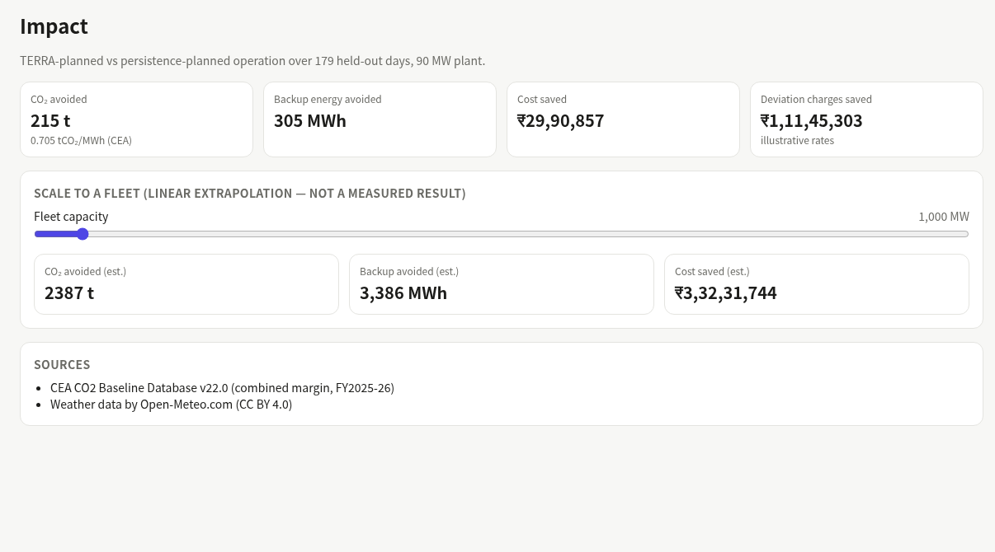
Forecast better, pay less, burn less
₹1.11 Cr
₹29.9 L
DSM charges saved*
backup cost saved
305 MWh
215 t
fossil backup avoided
CO₂ avoided
BUSINESS MODEL (HYPOTHESIS)
Pilot
Run beside a real IPP/QCA plant on SCADA data
Verify
Replace illustrative DSM rates with MPERC / CERC schedules
Scale
Chronos-2 fine-tune, wider region, live deployment
SaaS: ₹5,000 per MW per month
API tier: ₹50,000 per site per month, via QCAs
90 MW plant ≈ ₹4.5 L/month; the 179-day DSM saving is ~4× the fee
*Illustrative rates, 179-day held-out backtest vs persistence. Plant is a virtual digital twin at a real location, calibrated on real data; not operator data. Weather: Open-Meteo.com (CC BY 4.0).
Notes:
Close: forecast -> decision -> rupees. Be honest: twin plant, illustrative DSM rates, pricing is a hypothesis to validate with 3 IPPs.

