Slide 1
Full Title of Presentation
Subtitle: Template Version 2025-06-11 for AMS Presentations
James T. Kirk
Autonomous Multisensor Systems Group
Institute for Intelligent Cooperating Systems
Faculty of Computer Science
Otto von Guericke University Magdeburg
XX.XX.20XX

Slide 2
Requirements for Powerpoint Template
This Template requires Latin Modern Font “LM Sans 10”
Download and install Latin Modern OTF fonts:
Link: http://www.gust.org.pl/projects/e-foundry/latin-modern/download
Color Scheme
Blue / Red / Green / Orange

Slide 3
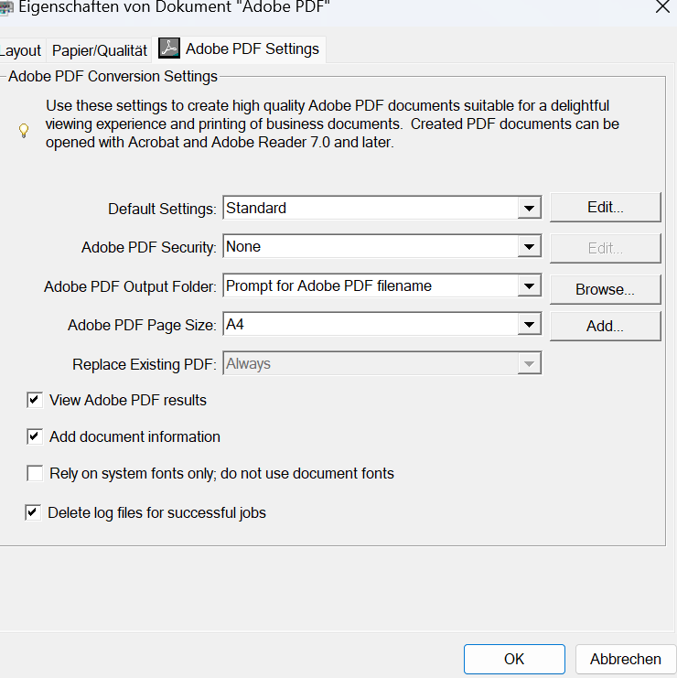
Hints
Prepare slides
Adapt title, author(s), and email address!
Adapt footer using Insert / Header & Footer
Note for PDF exports
Document fonts must be included
uncheck

Slide 4
Heading
Subtitle

Slide 5
Nice Topic
This is a new idea
  Sub idea
    Sub sub idea

Slide 6
For Handwritten Notes

Slide 7
Thank you
You can add a „thank you“ slide

Slide 8
Full Title of Presentation
Subtitle of Presentation
Thank You For Your Attention!
James T. Kirk
Web: ams.ovgu.de
Mail: NCC-1701@ovgu.de

