Slide 1
Scaling study
B757 wing finite element modeling

Slide 2
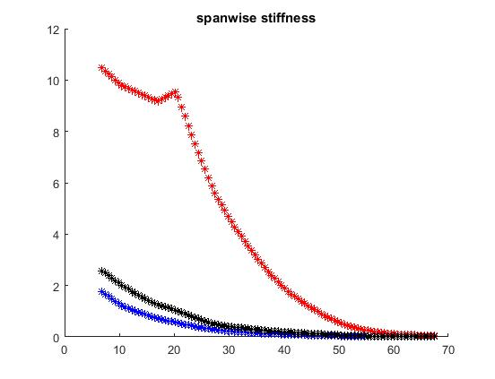
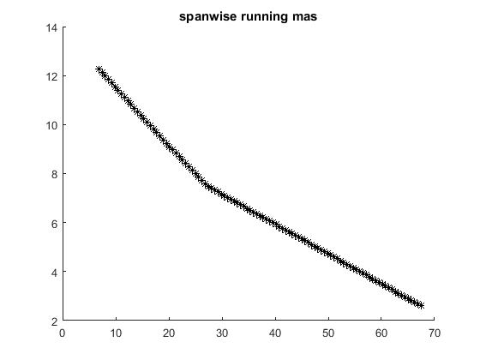
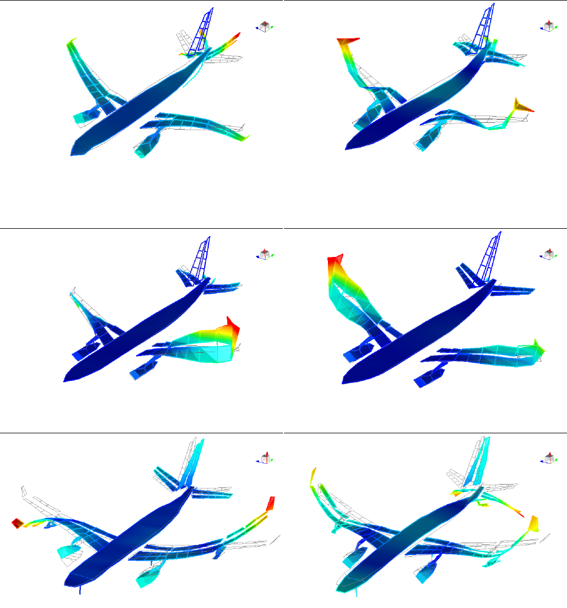
Objectives: comparisons between B757 wing with ribs and spars against same wing with voxel lattice
EI, GJ, running mass distributions - We have results for B757 with ribs and spars
Frequencies and mode shapes of beam models
Coupled aero-elastic analyses - flutter results?
Other comparisons

Slide 3
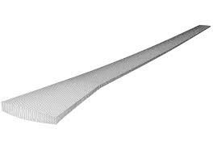
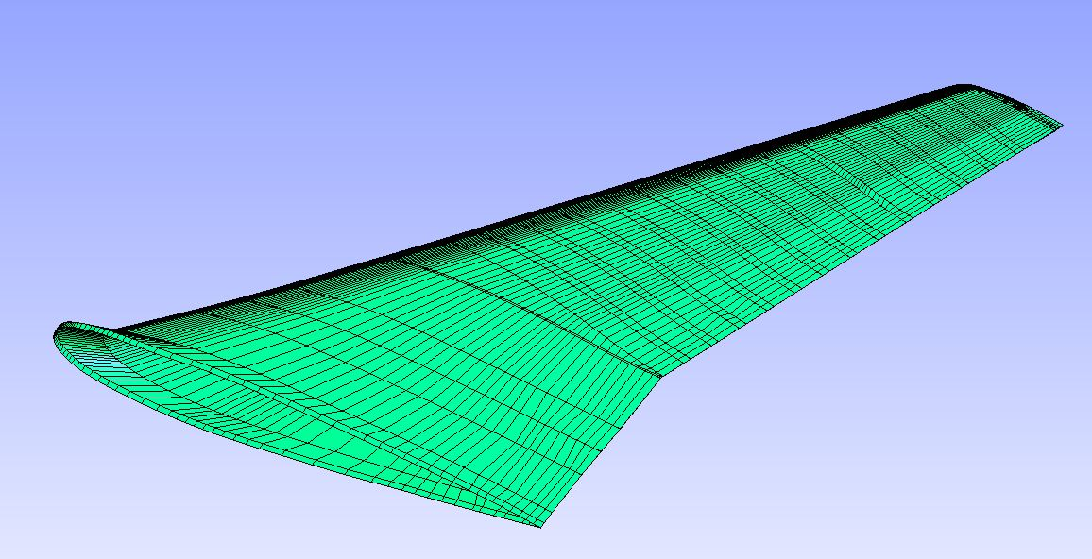
Modeling strategy and challenges
Meshing the voxel lattice substructure
Meshing wing skin
Attaching substructure to skin
Meshing is much simpler if mesh size of lattice and skin is independent
Need a method that will simplify the meshing
Static and modal analyses of 3D model
Reduce 3D wing with cuboid lattice substructure to simple beam model with EI, GJ and mass distribution along beam
Static and modal analyses of beam model
The resulting mesh will be of significant size. Can we handle it with our ABAQUS?

Slide 4
Meshing the voxel lattice substructure
We can do this now
Need to have a process for producing large mesh

Slide 5
Meshing wing skin with 3D shell elements from CAD
Extract points on wing surface at constant cross sections
Set mesh seeds on each section using same pattern
Create structured quad shell mesh by joining nodes on adjacent sections
We have done this before!

Slide 6
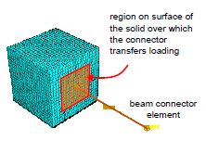
Shell/beam couplings (new work)
Voxels
Verify this modeling approach with simple model (Khanh?)
Identify boundary nodes of lattice (Joseph?)
Pair boundary nodes with nearest surface shell element (Joseph?) - Calculate connector point on wing surface (line/plane intersection calculations)

Slide 7

Mesh will be large
Simplifying lattice - 4,2 or 1 beams per leg
Simplifying shell surface - fine mesh will have shell element side proportional to voxel pitch - shell elements can be larger to reduce mesh size

Slide 8
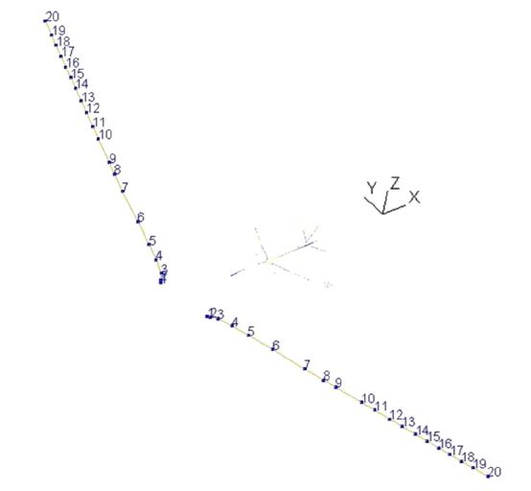
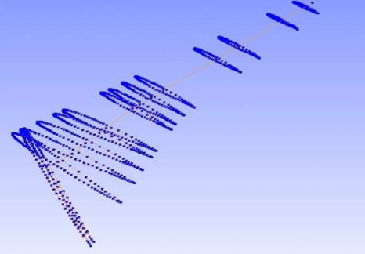
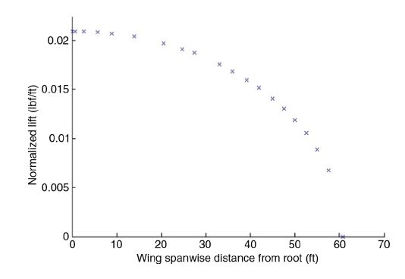
Reduce 3D wing with lattice substructure to simple beam model.
Estimated elastic axis from section centroid
Assumed spanwise relationship for EI and GJ. EI(x) = (EI)_{root}*f(x). f(x) is guesstimated. GJ(x) = (GJ)_{root}*g(x). g(x) is guesstimated.
Calculate (EI)_{root} and (GJ)_{root} from matching tip displacement of 3D model and beam model

Slide 9
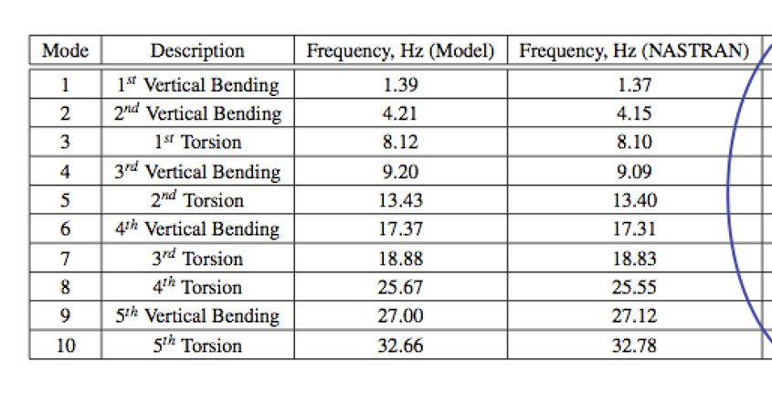
Reference results From Boeing B757 stick model

Slide 10
Data needed
Wing - material: aluminum E = 10E6 psi, Poisson’s ratio = .3 - thickness: .05 to .1 inch (best guess)
Lattice - material: graphite epoxy? - section dimension is a design parameter (base line?)

Slide 11
Tentative schedule
Select and verify beam/shell coupling modeling technique now - 7/29
Develop automated mesh building code now - 8/5
Can “our” ABAQUS handle large mesh? now - 8/1
Develop method for reducing 3D wing model to beam model now - 8/10
Working ABAQUS model (code integrations, trial analyses) 8/10
Optimization (different voxel designs) and getting results 8/11 - 8/16 - Sean: determine what optimizations to do - Joseph: make mesh generation code available to all - Khanh: build beam model and estimate (EI)_{root} and (GJ)_{root} debug and help with optimization runs

