Slide 1
Data Analysis / Visualization using an open source scientific software
Youngung Jeong
Department of Metallurgy and Materials Science and Engineering
yjeong@changwon.ac.kr

Slide 2
Goals
Successful installation of open source code
Understand the goal of data analysis and visualization
Getting familiar with ‘numerical’ computing

Slide 3
Open source data analysis tool using Python
Access to https://www.continuum.io/downloads
Find a proper version of Python – I prefer Python 2.7 (one may want to explore Python 3.6)
Over the semester, this tool will be repeatedly used
Assignments will be done using this tool.
Read also https://www.python.org

Slide 4
Short introduction
Install Anaconda Python 2.7 on your system (Use Google)
After a successful installation, launch a terminal (or shell prompt)
Make a directory where you want to work
Move in to that directory
Type below command in the terminal and you’ll find your default web-browser (Explorer, Edge, Google Chrome, Firefox, Safari … ) lauches

Slide 5
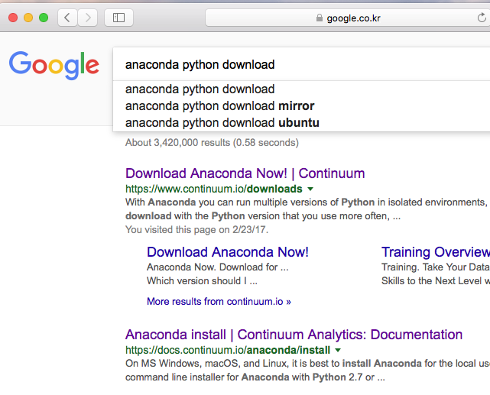
Graphical introduction
Type <anacond python download> in Google
Move to https://www.continuum.io/downloads

Slide 6
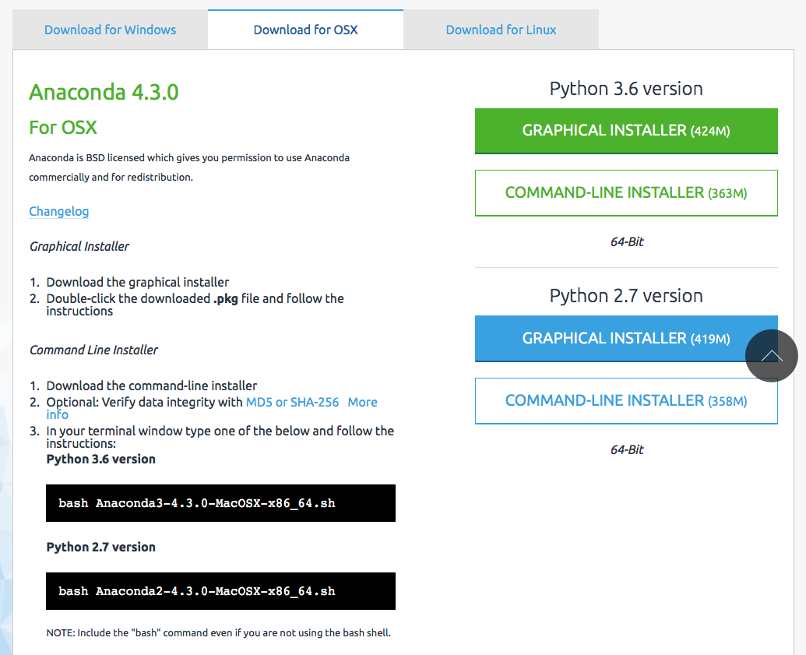
Find a proper version to download
Depending on your system (Windows, Linux, OSX … )
Then install. Anaconda python on your system

Slide 7
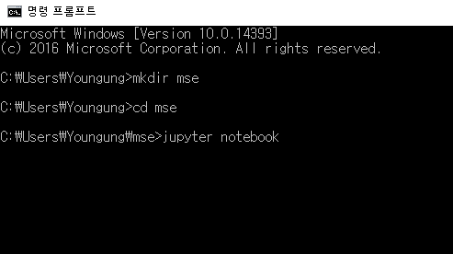
Launch Command Prompt (Windows)
명령프롬프트 실행 (command prompt or anaconda prompt)
Lauch Jupyter notebook by typing “jupyter notebook”

