Slide 1
Smashing WebGoat for Fun and Research: Static Code Scanner Evaluation
Josh Windsor & Dr. Josh Pauli

Slide 2
Introduction
In
Web applications are particularly popular
    Medical institutions
    Financial institutions
    Government institutions

Slide 3
Introduction (continued)
Securing web application is difficult
    The application can be reached by anyone
              Real/malicious users
    Application Complexity
        HTML 5
        Rich Internet Applications
        Dynamic Web Pages

Slide 4
Introduction (continued)
Whats the problem?
  Web Application Security Consortium
      Web application security statistics 2008
        13% of sites could be compromised with only the uses of automated tools.
        49% of web application contained vulnerabilities of high risk levels
        86% of sites contained vulnerabilities of medium or higher risk

Slide 5
Introduction (continued)
Web application software assurance needs to be done.
    Manual
    Scanners
      Black-box web scanners
      White-box static code scanners

Slide 6
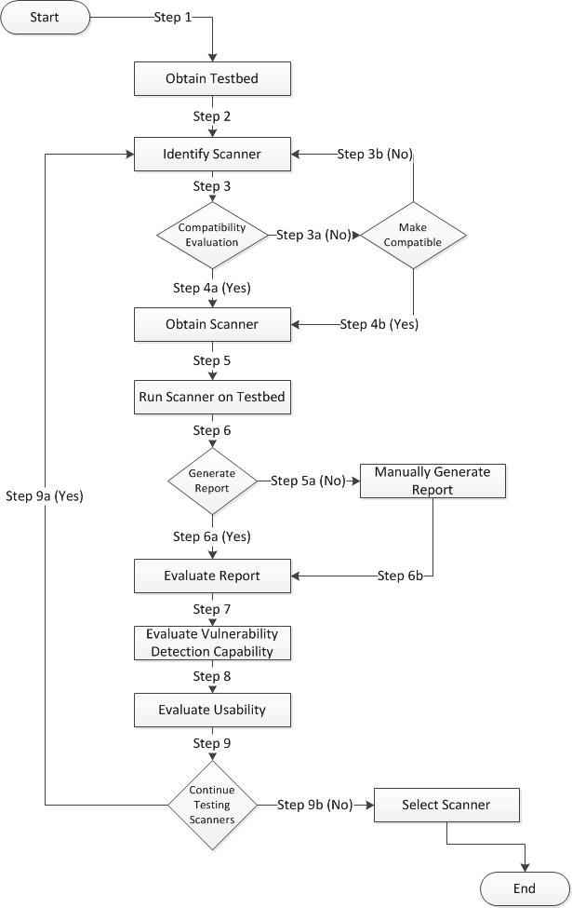
Static Code Scanner Evaluation Process
Our methodology includes different stages of evaluating a static code
Logical manner
Repeatable

Slide 7
Core Criteria and Scoring Mechanisms
Designed to leverage existing evaluation criteria.
      NIST and WASSEC
Scoring Mechanisms
      Compatibility
      Vulnerability Detection Capability
      Report Ability*
      Usability*
      Scoring

Slide 8
Core Criteria and Scoring Mechanisms (continued)
Compatibility
    System Requirements
    Application Compatibility
    Language Compatibility

Slide 9
Core Criteria and Scoring Mechanisms (continued)
System requirement
  15 possible points
    Pass/Fail
System Requirements to Run Scanner
System Specs | System Requirements | Your System | Pass/Fail | Points | Score
Operating System
Memory
Additional software /hardware
All requirements pass |  |  |  | 15
Total Score

Slide 10
Core Criteria and Scoring Mechanisms (continued)
Additional Components
      Plug-ins
Heuristics for enhancement
    Improves scanner speed
    Additional language compatibilities
    Additional vulnerabilities can be identified
    Improved report forms
    Improved ability to find vulnerabilities

Slide 11
Core Criteria and Scoring Mechanisms (continued)
Addition Components
Plug-ins | Needed (True/False) | Points | Score
Any Additional Plug-ins |  | 5
Total Score

Slide 12
Core Criteria and Scoring Mechanisms (continued)
Language Compatibility
    What languages can the scanned handle
Languages Supported by Scanner
Language | Supported (yes/no) | Points | Score
PHP |  | 3
ASP |  | 3
JSP |  | 3
ASP.NET |  | 3
Ajax |  | 3
Cold Fusion |  | 3
Python |  | 3
Visual Basic .NET |  | 3
C++/C# |  | 3
Java |  | 3
Total Score

Slide 13
Core Criteria and Scoring Mechanisms (continued)
Vulnerability detection capability
    Vulnerabilities scanner can identify
    Vulnerabilities found when ran against WebGoat
    Customized test policies

Slide 14
Core Criteria and Scoring Mechanisms (continued)
Vulnerabilities that the scanner can detect
  OWASP's Top 10 vulnerabilities
Scanner is Capable of Detecting This Vulnerabilities
Vulnerability | Can Detect (yes/no) | Points | Score
Injection |  | 1
Cross-Site Scripting(XSS) |  | 1
Broken Authentication and Session Management |  | 1
Insecure Direct Object References |  | 1
Cross-Site Request Forgery(CSRF) |  | 1
Security Misconfiguraton |  | 1
Insecure Cryptographic Storage |  | 1
Failure to Restrict URL Access |  | 1
Insufficient Transport Layer Protection |  | 1
Unvalidated Redirects and Forwards |  | 1
Total Score

Slide 15
Core Criteria and Scoring Mechanisms (continued)
Number of vulnerabilities found after scanning WebGoat
    Compared against the true set of vulnerabilities
      True vulnerabilities
      False Positives
      False Negatives

Slide 16
Core Criteria and Scoring Mechanisms (continued)
Calculating Score for scan against WebGoat
  Total points can be calculated from the false positives and false negatives
      X=number of actual vulnerabilities found by scanner
      Y=total number of vulnerabilities in WebGoat-5.3
      f=Number of false positives
      F=Total Number of Vulnerabilities found by scanner-X
    Score=((X/Y)*45)*(F/X))

Slide 17
Core Criteria and Scoring Mechanisms (continued)
Customized test policies
    Scan selected files
    Testing for selected vulnerabilities
Custom Test Policies
Customization | Allowed (yes/no) | Points | Score
Test selected files |  | 2
Test for selected vulnerability |  | 3
Total Score

Slide 18
Core Criteria and Scoring Mechanisms (continued)
Report ability
    Report type
    Customized reports
    Vulnerabilities
    Report format

Slide 19
Core Criteria and Scoring Mechanisms (continued)
Report type
    Executive
        Scan summary
    Technical
        Detailed findings
Report Details Generated by Scanner
Report Type | Generates (yes/no) | Points | Score
Executive |  | 5
Technical |  | 5
Total Score

Slide 20
Core Criteria and Scoring Mechanisms (continued)
Ability to add custom notes
    Added notes should be generated on the final report
    Ability to mark vulnerabilities status include:
      False positive
      Warning
      Confirmed
      Suppressed

Slide 21
Core Criteria and Scoring Mechanisms (continued)
Report Customization
Customization | Allowed (yes/no) | Points | Score
Add custom notes to vulnerabilities |  | 2
Ability to mark vulnerabilities |  | 2
Total Score

Slide 22
Core Criteria and Scoring Mechanisms (continued)
Vulnerability report
    CVE or CWE ID
    File and Code Line
    Severity Level
    Remediation guidance
    Code example

Slide 23
Core Criteria and Scoring Mechanisms (continued)
Report Details for Vulnerabilities Detected
Information Included | Reported (yes/no) | Points | Score
Vulnerability description |  | 5
CVE or CWE ID |  | 5
File and code line |  | 5
Severity Level |  | 5
Remediation guidance |  | 5
Code example |  | 5
Total Score

Slide 24
Core Criteria and Scoring Mechanisms (continued)
Report format
Report Format
Format | Reported (yes/no) | Points | Score
PDF |  | 2
HTML |  | 2
XLM |  | 2
Total Score

Slide 25
Core Criteria and Scoring Mechanisms (continued)
Usability
    Scanner interface
    Updates

Slide 26
Core Criteria and Scoring Mechanisms (continued)
Heuristics
    Match between system and the real world
    User control and freedom
    Consistency and standards
    Error prevention
    Flexibility and efficiency of use
    Aesthetic and minimalist design
    Help users recognize, diagnose, and recovery from errors
Scanner Usability
Scanner Name | Usability Rating (1-20) | Score
Total Score

Slide 27
Core Criteria and Scoring Mechanisms (continued)
Updates
Scanner Updates
Scanner Name | Updates(yes/no) | Points | Score
 |  | 5
Total Score

Slide 28
Case Study
Tools used
      Scanners
        CodeSecure
        Yasca
      TestBed
        WebGoat-5.3
Assumptions
    The list of vulnerabilities is the true set.

Slide 29
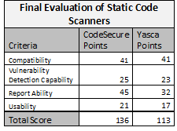
Case Study(continued)
Evaluation of each Scanner

Slide 30
Case Study(continued)
    Compatibility
      Programming Languages
              Codesecure/Yasca

Slide 31
Case Study(continued)
    Vulnerability Detection Capability
      Detection rates
        CodeSecure 41%
        Yasca 30%
                False Positive

Slide 32
Case Study(continued)
    Report Ability
        Biggest Gap

Slide 33
Case Study(continued)
    Usability
      One more heuristic followed by CodeSecure
        Freedom and control

Slide 34
Conclusion
Future Work
    Testbed
        Criteria for developing
        Levels of difficulty
    Improve methodology
        Time to run scanners
        Cost of products
        User weight score
        Tuning the scanner

Slide 35
Questions?

Slide 36
Acknowledgments
This work was supported in part by NSF under grant CNS 1004843
Special thanks to Bruce Mayhew for helping identify existing vulnerabilities in WebGoat

