Slide 1
How to Break Web Application Security
Erwin Geirnaert
Director European Operations
Security Innovation
egeirnaert@securityinnovation.com
+32478289466

Slide 2
Agenda
Security Test Checklist
Threat Modeling
Tools
Some examples

Slide 3
Security Test Checklist
You need an EXPERIENCED TESTER
Create a threat model and a test plan
Web application testing <> penetration testing
Do not rely ONLY on automated web application security scanners
Source code of the web application HELPS
Have a Security Tester Toolbox
Log everything

Slide 4
Threat modeling
Threat Modeling
“You cannot test a system until you understand the threats”
Threat modeling is the design activity to discover the threats that your application is susceptible to.
Threat modeling yields both threats and vulnerabilities and provides ways to perform security testing in order to prioritize the security fixes needed.

Slide 5
Threat modeling - Definitions
Threats are possible attacks. Vulnerabilities are security related software errors:
A threat is what an attacker might try to do to an asset or through an entry point
A vulnerability is a specific security exploit due to an unmitigated threat path

Slide 6
Threat modeling - STRIDE
Threats can be classified using the STRIDE classification:
    Spoofing – lying about identity
    Tampering – Destroying data
    Repudiation – Cleaning the steps of an attack/Denying a transaction
    Information Disclosure – Stealing valuable private data
    Denial of Service – Stopping an application from providing its basic functionality
    Escalation of Privileges – Executing code with stolen high privileges
Whenever discovering threats the analyst will always think about STRIDE elements

Slide 7
Threat modeling – Example of threats
Some threats for Web Video Recoding System
  Attacker tampers with central video storage
  Attacker sends malicious input to overrun the video recording client
  Attacker deletes temporary recordings
  Attacker remotely executes code in Video web service box

Slide 8
Threat modeling - DREAD
DREAD:
    Damage potential – what’s the extent of the damage if this vulnerability was to be exploited
    Reproducibility – how well can the finder reproduce the issue
    Exploitability – difficulty of taking advantage of the flaw for malicious purpose
    Affected users – how many or what type of users are affected by the flaw
    Discoverability – how fast can it be publicly be discovered
DREAD is used to analyze the risk of discovered vulnerabilities

Slide 9
Attack vectors for web applications
Parameter Tampering
Cookie Tampering
Cross-site Scripting
SQL Injection
Script Injection
Command Injection
Encoding Attacks
Buffer Overflows
Format-string attacks
Harvesting User IDs
Brute-forcing Accounts
Path Truncation Attacks
Hidden Path Discovery
Application Directory and File Mapping
Forceful Browsing
Source Code Disclosure
Web server vulnerability exploitation

Slide 10
Security Tester Toolbox
Tools are just a way of manipulating web applications
They are no silver bullet, a lot of false positives can be the result of automated scan
They can be really expensive
They can be useful
You need to learn how to use them and what the limitations are
Internet Explorer can do the job and for free ☺

Slide 11
Tools in the past
4 years ago, a limited list of free tools:
  Achilles: local proxy
  @Stake WebProxy: local proxy& fuzzer, in Java ☺
  WebSleuth: plugin for IE, raw requests
  Whisker: vulnerability scanner
  Nikto: vulnerability scanner
  Nessus: didn’t include web vulnerabilities yet
  But they did the job, only it required more time....

Slide 12
Commercial Fault Injection Test Tools
SPI Dynamics WebInspect
Sanctum now Watchfire AppScan
Kavado Scando
AppSecInc AppDetective for Web Apps
Cenzic Hailstorm
Security Innovation Holodeck
NT Objectives NTOSpider
Acunetix Web Vulnerability Scanner 2
Compuware DevPartner Fault Simulator
Fortify Pen Testing Team Tool
@stake Web Proxy 2.0
Burp Intruder
Sandsprite Web Sleuth
MaxPatrol 7
Syhunt Sandcat Scanner & Miner
TrustSecurityConsulting HTTPExplorer
Ecyware BlueGreen Inspector
NGS Typhon
Parasoft WebKing (more QA-type tool)

Slide 13
Open Source or Freeware Fault Injection Test Tools
WebScarab (HTTPush, Exodus)
Paros Proxy
Burp Spider
Burp Proxy
SPIKE Proxy
SPIKE
Achilles Proxy
Odysseus Proxy
Webstretch Proxy
Absinthe 1.1 (formerly SQLSqueal)
NGS SQL Injection Inference Tool (BH Europe 2005)
Internet Explorer HTMLBar Plugin
Firefox LiveHTTPHeaders and Developer Tools
Sensepost Wikto (Google cached fault-finding)
Foundstone Sitedigger (Google cached fault-finding)

Slide 14
OWASP - WebScarab
Java based: download stand-alone JAR and runtime
HTTP Proxy
Client-certificates
Session analysis
Raw request
Spider
Custum plugins: BeanShell

Slide 15
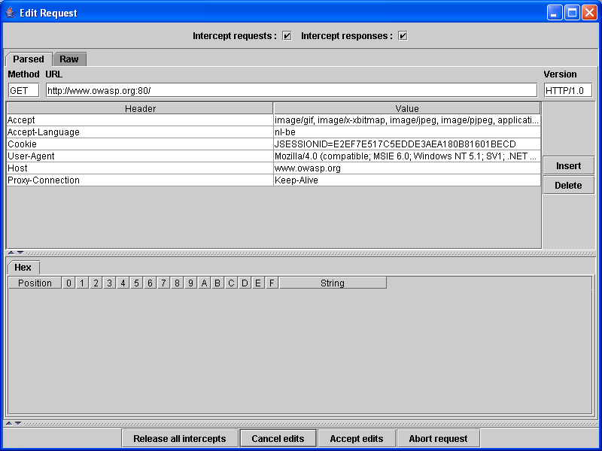
OWASP – WebScarab - Interceptor

Slide 16
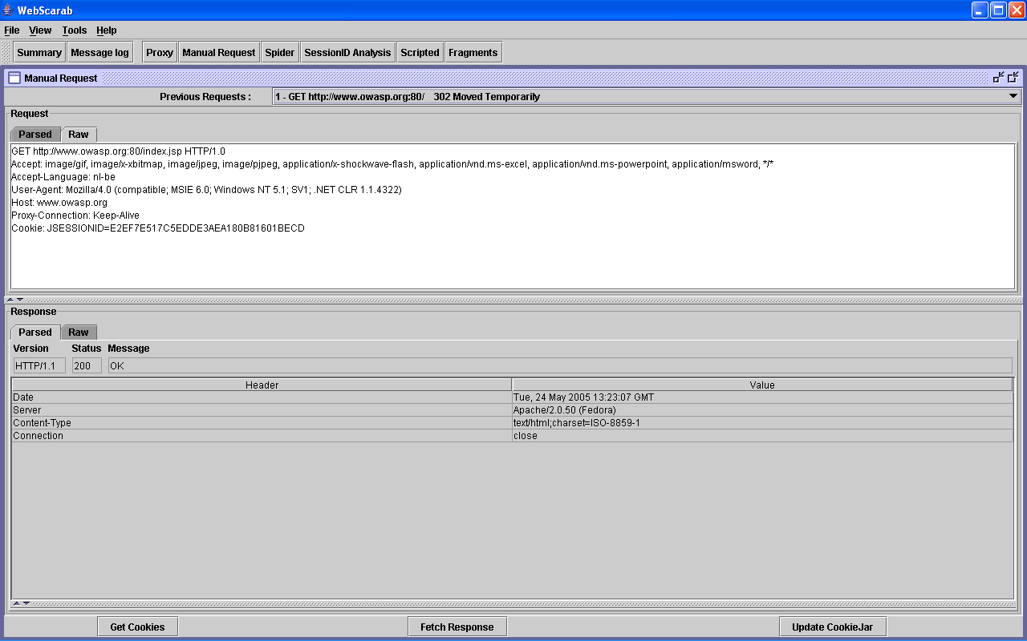
OWASP – WebScarab – Raw Request

Slide 17
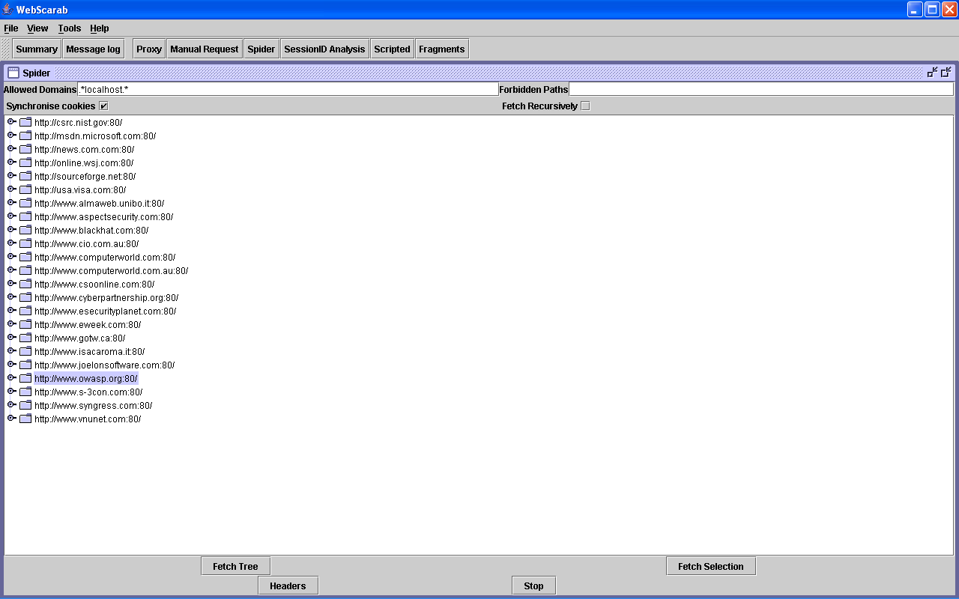
OWASP – WebScarab - Spider

Slide 18
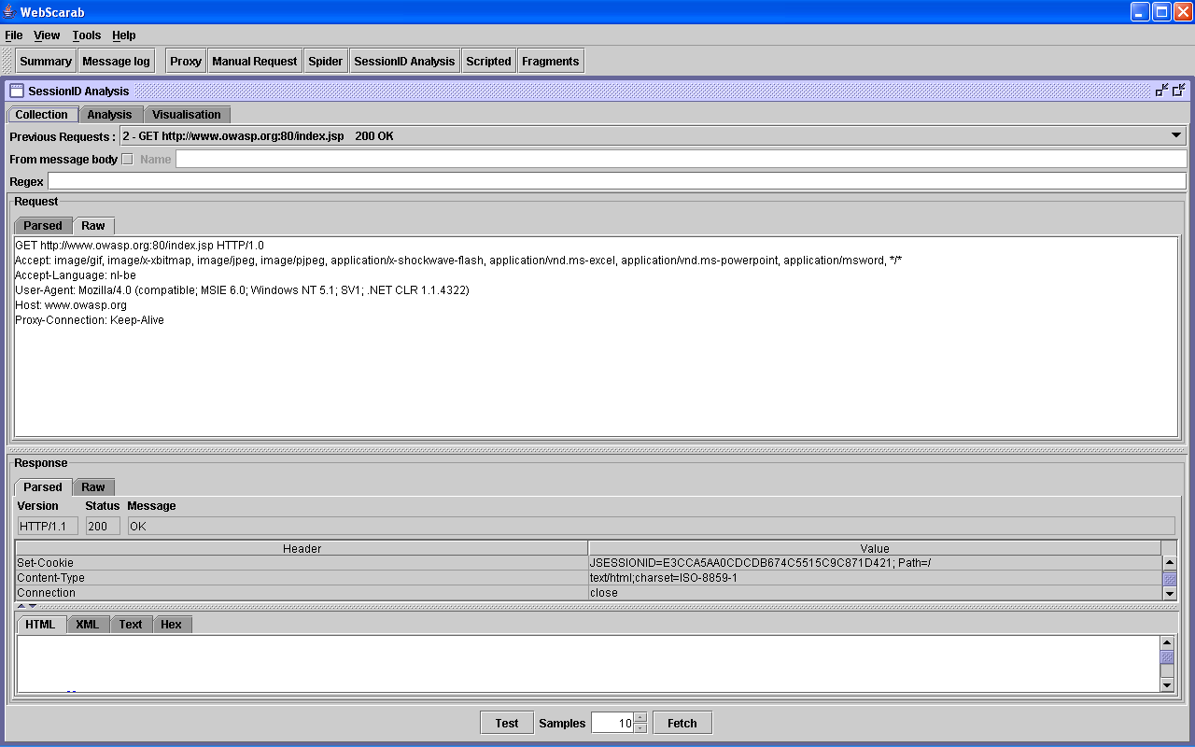
OWASP – WebScarab – SessionID Analysis

Slide 19
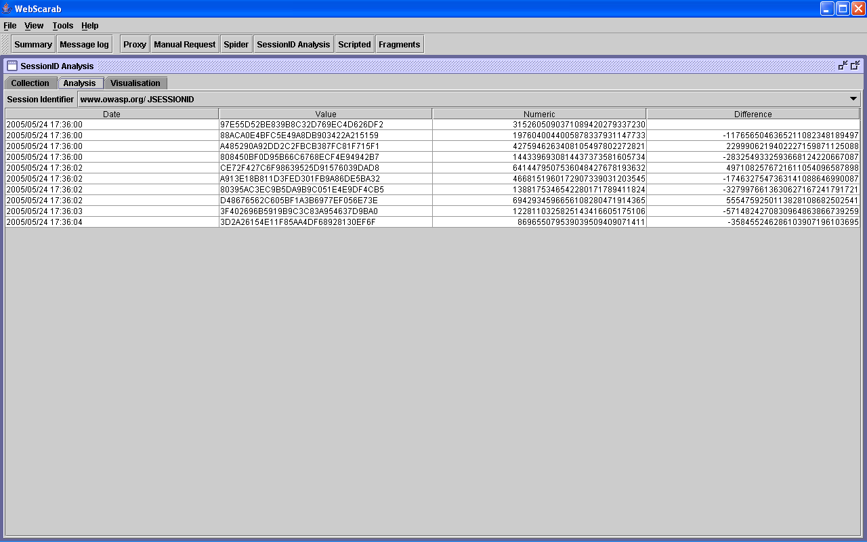
OWASP – WebScarab – SessionID Analysis

Slide 20
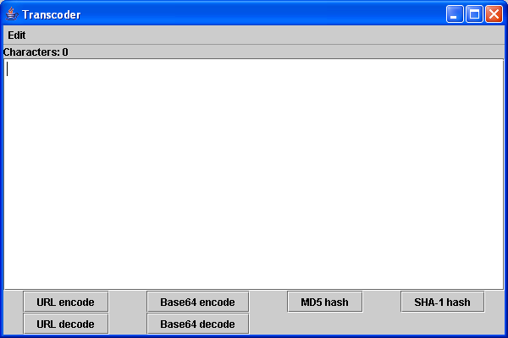
OWASP – WebScarab – Transcoder

Slide 21
Some examples
Parameter tampering
Cross-site-scripting
Hidden fields
SQL Injection
Error messages
Google ☺

Slide 22
That’s it…
Any Questions?
Thank you!

