Slide 1
OWASP: An Introduction
Sebastien Deleersnyder
CISSP
May, 2005
sdl@ascure.com

Slide 2
Agenda
Introduction
OWASP
OWASP Projects
Belgium Chapter
(Web)AppSec Resources

Slide 3
Agenda
Introduction
OWASP
OWASP Projects
Belgium Chapter
(Web)AppSec Resources

Slide 4

Introduction
Sponsor this evening:
  www.ascure.com
Call for additional sponsors
  Chapter meeting places & catering
  Support for local projects
OWASP cannot recommend the use of products, services, or recommend specific companies

Slide 5
Introduction
Program for this evening:
18h00 - 18h45:
  Sebastien Deleersnyder, Ascure
  OWASP Introduction
19h00 - 19h45:
  Erwin Geirnaert, Security Innovation
  How to Break Web Application Security
20h00 - 20h45:
  professor Frank Piessens, KU Leuven
  How to Build Secure Web Applications

Slide 6
Agenda
Introduction
OWASP
OWASP Projects
Belgium Chapter
(Web)AppSec Resources

Slide 7
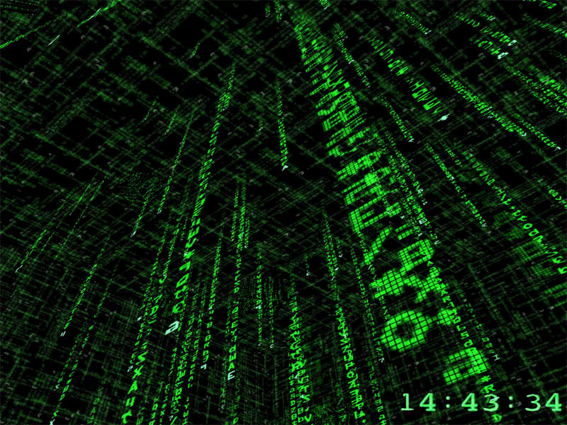
Software Is A Black Box
Complex
  Millions of lines of code
  Leaky abstractions
  Massively interconnected
Compiled
  Difficult to reverse engineer
  Different on every platform
Legal Protections
  No peeking
  We’re not liable

Slide 8
Application Security Is In Its Infancy
Nobody understands
Nobody cares
Snake oil rules
No proof anything works
No metrics
One application at a time
Getting easier to write bad code
We can’t even stamp out buffer overflows
Formal Modeling
Process Assurance
Penetrate and Patch
Manual Code Review
Static Analysis
Developer Training
Top Ten Lists
Programming Books
Bugtraq
Common Criteria
Certification
Peer Review
Guidelines
Penetration Test Tools
Vulnerability Scanning
Proxy Solutions
… and more

Slide 9
Enter OWASP
OWASP is dedicated to finding and fighting the causes of insecure software
People
Projects
International
Community
“Charitable Open Source”

Slide 10
What is OWASP?
Open Web Application Security Project
  Non-profit, volunteer driven organization
    All members are volunteers
    All work is donated by sponsors
  Provide free resources to the community
    Publications, Articles, Standards
    Testing and Training Software
    Local Chapters & Mailing Lists
  Supported through sponsorships
    Corporate support through financial or project sponsorship
    Personal sponsorships from members

Slide 11
What is OWASP?
What do they provide?
  Publications
    OWASP Top 10
    OWASP Guide to Building Secure Web Applications
  Software
    WebGoat
    WebScarab
    .NET Projects
  Local Chapters
    Community Orientation

Slide 12
Looking for a second breath
OWASP finally achieved 501c3 status in Dec.
  Charitable not-for-profit
OWASP needs more contributors
  We should provide everything contributors need
  Better infrastructure
  Project management
  Technical editing
OWASP needs funding
  Need full time director

Slide 13
OWASP Roadmap for 2005
Continue to deliver on existing projects
Gather requirements from industry
Find a full time director
New projects
  OWASP Standard – minimum criteria for people, process, and technology
  OWASP Legal – guidance on contracts, gov’t regulations, RFP language
  J2EE – guidelines, methodologies, tools
  Web Services – guidelines, methodologies, tools
  OWASP Training Course

Slide 14
Agenda
Introduction
OWASP
OWASP Projects
Belgium Chapter
(Web)AppSec Resources

Slide 15
OWASP Current Status
WebGoat
WebScarab
DotNet
Validation
oLabs
Local Chapters
International
Conferences
Legal
Guide
Papers
Testing
Metrics
AppSec FAQ
Top Ten
ISO17799
Great
Great
Great
Great
Great
Great
No Progress
Great
No Progress
No Progress
No Progress
No Progress
Excellent
No Progress
Great
Great
Notes:
WebGoat – new lessons, new volunteers
WebScarab – lots of new features, tie-in to WebGoat
DotNet – new forums, tools, and guide
Validation – seeking volunteers
oLabs – no attention to these old tools
Local Chapters – exploding (42 worldwide, ~600 members)
International – Translations in 6 languages
Conferences – 2nd conference next one in Washington DC October 11-12 05
Legal – new project, much interest
Guide – version 2 under serious development
Papers – people contributing their work
Testing – Working on phase 2
Metrics – No recent activity
AppSec FAQ – not actively updated
Top Ten – widely adopted and referenced, but not updated
ISO17799 – possible new lead from Italian Chapter

Slide 16
OWASP Testing Project
Create a "best practices" testing framework
"low level" testing guide to find issues
Phase 1 released Dec 2004
  The scope of what to test
  Principles of testing
  Testing techniques explained
  The OWASP testing framework explained
Currently 2nd phase ongoing (TOC)
Lead by Daniel Cuthbert

Slide 17
WebScarab Project
Tool for anyone involved with HTTP-based applications (e.g. web applications)
Key features
  Full visibility into the HTTP protocol
  Also supports HTTPS (incl client certs)
  Persistent audit trail can easily be reviewed
Primary uses
  Security analysis
  Application debugging
Lead by Rogan Dawes

Slide 18
Conferences
Previous Conference
  UK April 05 – Royal Holloway
Next Conference
  US Oct 05 – NIST Washington DC

Slide 19
Agenda
Introduction
OWASP
OWASP Projects
Belgium Chapter
(Web)AppSec Resources

Slide 20
Belgium Chapter -What do we have to offer?
Quarterly (?) Meetings
Mailing List
Presentations & Groups
Open forum for discussion
Meet fellow InfoSec professionals
Create (Web)AppSec awareness in Belgium
Local projects:
  Dutch & French Top 10 / Guide ?

Slide 21
Belgium Chapter – House Rules
Free & open to everyone
Language
  English preferred
  Native language: no problem!
No vendor pitches or $ales presentations
Respect for different opinions
No flaming (including M$ bashing)

Slide 22
Next Chapter Meetings program proposal
Short OWASP intro
Presentation on one specific topic
Follow-up
  Open discussion on topic (with panel?)
  Split up per topic + feedback into group

Slide 23
OWASP Local Chapters
Next Meeting: Sep + Dec 2005
Topics:
  ?
Location:
  ?

Slide 24
Agenda
Introduction
OWASP
OWASP Projects
Belgium Chapter
(Web)AppSec Resources

Slide 25
Resources Online
OWASP Project Mailing lists
Secure Coding List
WebAppSec@securityfocus.com
websecurity@webappsec.org (WASC)
  Low signal-to-noise ratio
www.threatsandcountermeasures.com

Slide 26
Resources - Blogs
Michael Howard's Web Log
Keith Brown Blog
T&C BLOGS
  Mark Curphey
  Michael Silk
  …

Slide 27
Resources Hard Copy
IEEE Security & Privacy (bimonthly)
Security Engineering – Anderson
Building Secure Software – Viega & McGraw
Exploiting Software : How to Break Code – Hoglund & McGraw
Writing Secure Code – Howard & Leblanc
Enterprise Java Security – Pistoia, et al
Securing Web Services with WS-Security – Rosenberg & Remy

Slide 28
That’s it…
Any Questions?
http://www.owasp.org/local/belgium.html
sdl@ascure.com
Thank you!

Slide 29

Subscribe to Chapter mailing list
Keep up to date!
Post your (Web)AppSec questions
Contribute to discussions!

