Slide 1
Web Application Firewalls:
Panel Discussion
Sebastien Deleersnyder
CISSP
Feb, 2006
sdl@ascure.com

Slide 2
Agenda
Panel Introduction
WAF Primer
Panel Discussion

Slide 3
Agenda
Panel Introduction
WAF Primer
Panel Discussion

Slide 4
Panel Introduction
Philippe Bogaerts, BeeWare
Jaak Cuppens, F5 Networks
Tim Groenwals, Agfa Gevaert
Lieven Desmet, K.U.Leuven
David Van der Linden, ING
Notes:
present yourself shortly + how do you or your organisation use the Top 10 ?

Slide 5
Agenda
Introduction
WAF Primer
Panel Discussion

Slide 6
Network Firewalls Do Not Work
Firewall
Application
Web
Client
Web
Server
Database
Server
Application
HTTP(S) Traffic
Port 80 (443)

Slide 7
Enter Web Application Firewall Era
HW/SW that mitigates web application vulnerabilities:
  Invalidated Input
  Parameter tampering
  Injection Flaws
  …

Slide 8
Web Application Firewalls
They understand HTTP/HTML very well
They work after traffic is decrypted, or can otherwise terminate SSL
Prevention is possible

Slide 9
Topologies
Network-based:
  Protects any web server
  Works with many servers at once
Web server-based:
  Closer to the application
  Limited by the web server API

Slide 10
WAF functionality
Rule-based:
  Uses rules to look for known vulnerabilities
  Or rules to look for classes of attack
  Rely on rule databases
Anomaly-based:
  Attempts to figure out what normal operation means

Slide 11
WAF Protection Strategies
Negative security model:
  Deny what might be dangerous.
  Do you always know what is dangerous?
Positive security model:
  Allow what is known to be safe.
  Positive security model is better.

Slide 12
Vendors
MOD-Security
Beeware IntelliWall
Citrix NetScaler Application Firewall (Teros)
DenyAll rWeb
F5 TrafficShield (Magnifire)
Imperva SecureSphere
Netcontinuum
Breach BreachGate WebDefend
…
eEye SecureIIS
Microsoft URLScan
WAF?
CheckPoint Application Intelligence?
MS ISA Server?
Dead:
Kavado InterDo
Watchfire AppShield (Sanctum)
Ubizen DMZShield

Slide 13
Agenda
Introduction
WAF Primer
Panel Discussion

Slide 14
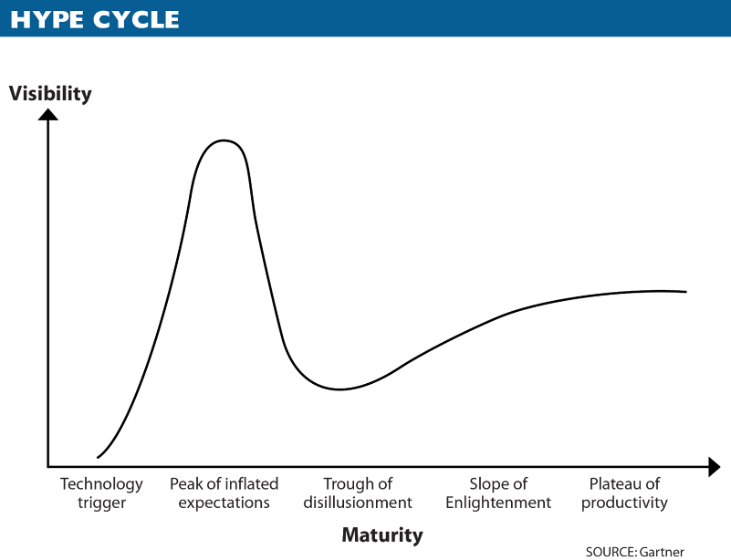
How mature are WAFs?
Notes:
What are the 5 phases of a Hype Cycle?
1. "Technology Trigger"
The first phase of a Hype Cycle is the "technology trigger" or breakthrough, product launch or other event that generates significant press and interest.
2. "Peak of Inflated Expectations"
In the next phase, a frenzy of publicity typically generates over-enthusiasm and unrealistic expectations. There may be some successful applications of a technology, but there are typically more failures.
3. "Trough of Disillusionment"
Technologies enter the "trough of disillusionment" because they fail to meet expectations and quickly become unfashionable. Consequently, the press usually abandons the topic and the technology.
4. "Slope of Enlightenment"
Although the press may have stopped covering the technology, some businesses continue through the "slope of enlightenment" and experiment to understand the benefits and practical application of the technology.
5. "Plateau of Productivity"
A technology reaches the "plateau of productivity" as the benefits of it become widely demonstrated and accepted. The technology becomes increasingly stable and evolves in second and third generations. The final height of the plateau varies according to whether the technology is broadly applicable or benefits only a niche market.

Slide 15
Panel Discussion
What do WAFs protect you from? What not?
Where do you position WAFs in your architecture?
What WAF functionality do you really need?
How to reduce TCO?
Who administrates a WAF within the organisation?

