Slide 1
Web server attacks in Belgium – statistics from year 2005
Hillar Leoste
Apr, 2006
allabert@gmail.com

Slide 2
Agenda
About Zone-H and defacements
Statistics

Slide 3
What is Zone-h.org
• News, advisories and opinions, provided from recognized IT security
news sites, trusted product vendors and pro-active members of zone-h
international community
• Statistics of most recent digital attacks, surveys and detailed analyses,
presented in our regular reports
• Worth-to-read articles, describing new developments in the IT security
world
• Interviews with leading IT Security industry experts, accompanied by an
opportunity to discuss different topics in specialized forums and IRC
chatrooms
• Ongoing evaluations of current digital threats and short-time prognosis
• Case and motivation studies of digital incidents.
• Daily newsletters
• Free Security services: daily “early warning” bulletin + InfoSec pager

Slide 4
What is Zone-h.org
Disclaimer:
Zone-h neither: condones, promotes, and/or participates in attacks that
are recorded within our database. It is however in a unique position that
such attacks are freely reported to our organization.
Zone-h catalogues several useful pieces of information for each intrusion
including the timestamp of the attack, software version of the webserver,
the operating system, motivation of the attacker, and reported technical
details of the intrusion methodology.

Slide 5
Defacement
Defacement is an attack against webpage, replacing the main (usually) page with attackers page.
Reasons:
Political (hacktivism) – Mohammed cartoosns, G8, war in Iran, conflict between Israel and Palestine, etc
Best defacer
Fun
Challenge

Slide 6

Defacement

Slide 7
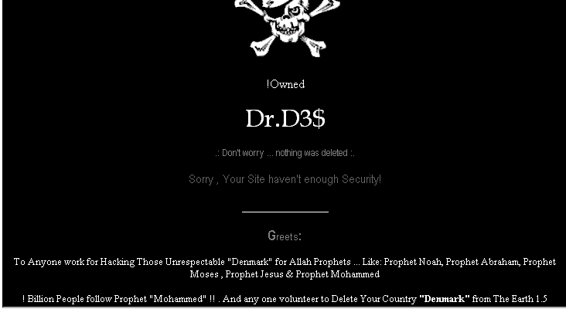
Defacement

Slide 8
Statistics 2005 for .be
Total defacements : 2889
Jan 401
Feb 320
Mar 160
Apr 297
May 354
Jun 189
Jul 274
Aug 268
Sep 85
Oct 137
Nov 205
Dec 199

Slide 9
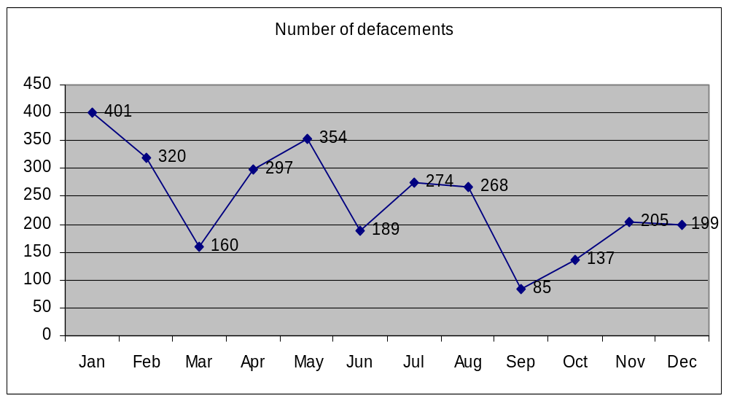
Statistics 2005 for .be

Slide 10
Statistics 2005 for .be
By OS:
Linux 1824 63 %
Windows 919 32 %
BSD 53 1 %
Mac 46 1 %
Solaris 20 1 %
Tru64 17 1 %
Unknown 10 1 %
By webserver:
Apache 1918 66 %
IIS 913 31 %
Roxen 38 1 %
Unkown 17 0.5 %
Lotus-Domino 1 0.5 %
WebSTAR 1 0.5 %
Zeus 1 0.5 %

Slide 11
Statistics 2005 for .be
By attack type:
File inclusion 1090
Passwords 327
Other web app bug 303
SQL Injection 276
Not available 225
FTP server intrusion 127
Web server intrusion 122
MITM 86
Other server intrusion 57
Web server ext. module 57
Radmin panel attacks 52
DNS attacks 52
URL poisoning 19
Known vuln. 19
SSH server intrusion 16
Mail server intrusion 15
Telnet server intrusion 14
Shares 8
Firewall attacks 8
0day 6
RPC server intrusion 5
Brute force 3
Misconfig 2

Slide 12
Statistics 2005 for .be
By apps:
forum 222
guestbook/gastenboek/gastje 95
foto/photo 13
blog 12
bb2 10
nuke 3
gallery 3

Slide 13
Statistics 2005 for .be
?

