Slide 1
Learn Python the Hard way
Matt Parsons, CISSP, MSM, CWASE
OWASP Dallas
http://learnpythonthehardway.org/

Slide 2
Setup
Mac OS X
OSX: What You Should See
Windows
Windows: What You Should See
Linux
Linux: What You Should See
Warnings for Beginners

Slide 3
Mac OS X
Go to http://www.barebones.com/products/textwrangler/ with your browser, get the TextWrangler text editor, and install it.
Put TextWrangler (your editor) in your dock so you can reach it easily.
Find your Terminal program. Search for it. You will find it.
Put your Terminal in your dock as well.
Run your Terminal program. It won't look like much.

Slide 4
Mac OS X
In your Terminal program, run python. You run things in Terminal by just typing the name and hitting RETURN.
Hit CTRL-Z (^Z), Enter, and get out of python.
You should be back at a prompt similar to what you had before you typed python. If not, find out why.
Learn how to make a directory in the Terminal.
Learn how to change into a directory in the Terminal.
Use your editor to create a file in this directory. You will make the file, "Save" or "Save As...," and pick this directory.
Go back to Terminal using just the keyboard to switch windows.
Back in Terminal, see if you can list the directory to see your newly created file.

Slide 5
OSX: What You Should See
Here's me doing the above on my computer in Terminal. Your computer would be different, so see if you can figure out all the differences between what I did and what you should do.
Last login: Sat Apr 24 00:56:54 on ttys001 ~ $ python Python 2.5.1 (r251:54863, Feb 6 2009, 19:02:12) [GCC 4.0.1 (Apple Inc. build 5465)] on darwin Type "help", "copyright", "credits" or "license" for more information. >>> ^D ~ $ mkdir mystuff ~ $ cd mystuff mystuff $ ls # ... Use TextWrangler here to edit test.txt.... mystuff $ ls test.txt mystuff $

Slide 6
Windows
Go to http://notepad-plus-plus.org/ with your browser, get the Notepad++ text editor, and install it. You do not need to be the administrator to do this.
Make sure you can get to Notepad++ easily by putting it on your desktop and/or in Quick Launch. Both options are available during setup.
Run PowerShell from the Start menu. Search for it and you can just hit Enter to run it.
Make a shortcut to it on your desktop and/or Quick Launch for your convenience.
Run your Terminal program. It won't look like much.

Slide 7
Windows
In your Terminal program, run python. You run things in Terminal by just typing the name and hitting Enter.
If you run python and it's not there (python is not recognized..). Install it from http://python.org/download.
Make sure you install Python 2, not Python 3.
You may be better off with ActiveState Python especially when you do not have Administrative rights
If after you install it python still isn't recognized then in PowerShell enter this:
[Environment]::SetEnvironmentVariable("Path", "$env:Path;C:\Python27", "User")
Close PowerShell and then start it again to make sure Python now runs. If it doesn't, restart may be required.

Slide 8
Windows
Type quit() and hit Enter to exit python.
You should be back at a prompt similar to what you had before you typed python. If not, find out why.
Learn how to make a directory in the Terminal.
Learn how to change into a directory in the Terminal.
Use your editor to create a file in this directory. Make the file, Save or Save As... and pick this directory.
Go back to Terminal using just the keyboard to switch windows. up if you can't figure it out.
Back in Terminal, see if you can list the directory to see your newly created file.
Warning
If you missed it, sometimes you install Python on Windows and it doesn't configure the path correctly. Make sure you enter [Environment]::SetEnvironmentVariable("Path", "$env:Path;C:\Python27", "User") in PowerShell to configure it correctly. You also have to either restart PowerShell or your whole computer to get it to really be fixed.

Slide 9
Windows: What You Should See
> python ActivePython 2.6.5.12 (ActiveState Software Inc.) based on Python 2.6.5 (r265:79063, Mar 20 2010, 14:22:52) [MSC v.1500 32 bit (Intel)] on win32 Type "help", "copyright", "credits" or "license" for more information. >>> ^Z > mkdir mystuff > cd mystuff ... Here you would use Notepad++ to make test.txt in mystuff ... > <bunch of unimportant errors if you istalled it as non-admin - ignore them - hit Enter> > dir Volume in drive C is Volume Serial Number is 085C-7E02 Directory of C:\Documents and Settings\you\mystuff 04.05.2010 23:32 <DIR> . 04.05.2010 23:32 <DIR> .. 04.05.2010 23:32 6 test.txt 1 File(s) 6 bytes 2 Dir(s) 14 804 623 360 bytes free > You will probably see a very different prompt, Python information, and other stuff but this is the general idea.

Slide 10
Linux
Linux is a varied operating system with a bunch of different ways to install software. I'm assuming if you are running Linux then you know how to install packages so here are your instructions:
Use your Linux package manager and install the gedit text editor.
Make sure you can get to gedit easily by putting it in your window manager's menu.
Run gedit so we can fix some stupid defaults it has.
Open Preferences and select the Editor tab.
Change Tab width: to 4.
Select (make sure a check mark is in) Insert spaces instead of tabs.
Turn on "Automatic indentation" as well.
Open the View tab and turn on "Display line numbers."

Slide 11
Linux
Find your Terminal program. It could be called GNOME Terminal, Konsole, or xterm.
Put your Terminal in your dock as well.
Run your Terminal program. It won't look like much.
In your Terminal program, run python. You run things in Terminal by just typing the name and hitting Enter.
If you run python and it's not there, install it. Make sure you install Python 2 not Python 3.
Type quit() and hit Enter to exit python.
You should be back at a prompt similar to what you had before you typed python. If not, find out why.
Learn how to make a directory in the Terminal.
Learn how to change into a directory in the Terminal.
Use your editor to create a file in this directory. Typically you will make the file, Save or Save As..., and pick this directory.
Go back to Terminal using just the keyboard to switch windows. Look it up if you can't figure it out.
Back in Terminal see if you can list the directory to see your newly created file.

Slide 12
Linux what you should see
$ python Python 2.6.5 (r265:79063, Apr 1 2010, 05:28:39) [GCC 4.4.3 20100316 (prerelease)] on linux2 Type "help", "copyright", "credits" or "license" for more information. >>> $ mkdir mystuff $ cd mystuff # ... Use gedit here to edit test.txt ... $ ls test.txt $ You will probably see a very different prompt, Python information, and other stuff but this is the general idea.

Slide 13
Warnings for Beginners
You are done with this exercise. This exercise might be hard for you depending on your familiarity with your computer. If it is difficult, take the time to read and study and get through it, because until you can do these very basic things you will find it difficult to get much programming done.
If a programmer tells you to use vim or emacs, just say "no." These editors are for when you are a better programmer. All you need right now is an editor that lets you put text into a file. We will use gedit, TextWrangler, or Notepad++ (from now on called "the text editor" or "a text editor") because it is simple and the same on all computers. Professional programmers use these text editors so it's good enough for you starting out.
A programmer may try to get you to install Python 3 and learn that. Say, "When all of the Python code on your computer is Python 3, then I'll try to learn it." That should keep them busy for about 10 years.

Slide 14
Warnings for Beginners
A programmer will eventually tell you to use Mac OSX or Linux. If the programmer likes fonts and typography, he'll tell you to get a Mac OSX computer. If he likes control and has a huge beard, they'll tell you to install Linux. Again, use whatever computer you have right now that works. All you need is and editor, a Terminal, and Python.
Finally, the purpose of this setup is so you can do three things very reliably while you work on the exercises:
Write exercises using your text editor, gedit on Linux, TextWrangler on OSX, or Notepad++ on Windows.
Run the exercises you wrote.
Fix them when they are broken.
Repeat.
Anything else will only confuse you, so stick to the plan.

Slide 15
Exercise 1: A Good First Program
Remember, you should have spent a good amount of time in Exercise 0 learning how to install a text editor, run the text editor, run the Terminal, and work with both of them. If you haven't done that, then do not go on. You will not have a good time. This is the only time I'll start an exercise with a warning that you should not skip or get ahead of yourself.
Type the following text into a single file named ex1.py. This is important as Python works best with files ending in .py.

Slide 16
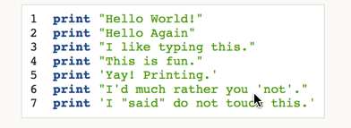
Exercise 1: A Good First Program

Slide 17
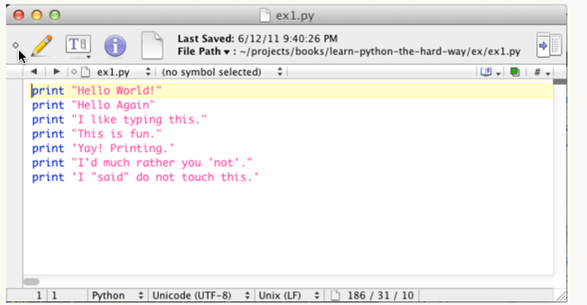
Exercise 1: A Good First Program

Slide 18
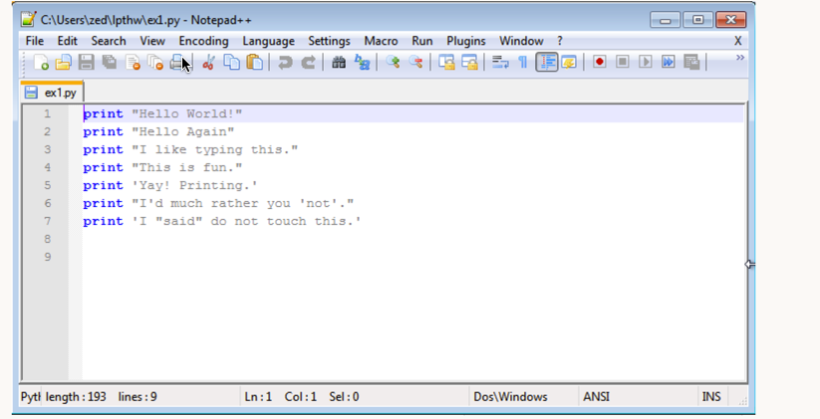
Exercise 1: A Good First Program

Slide 19
Exercise 1: A Good First Program
Don't worry if your editor doesn't look exactly the same; the key points are:
Notice I did not type the line numbers on the left. Those are printed in the book so I can talk about specific lines by saying, "See line 5..." You do not type those into Python scripts.
Notice I have the print at the beginning of the line and how it looks exactly the same as what I have above. Exactly means exactly, not kind of sort of the same. Every single character has to match for it to work. But, the colors are all different. Color doesn't matter, only the characters you type.
Then in Terminal run the file by typing:
python ex1.py If you did it right then you should see the same output I have below. If not, you have done something wrong. No, the computer is not wrong.

Slide 20
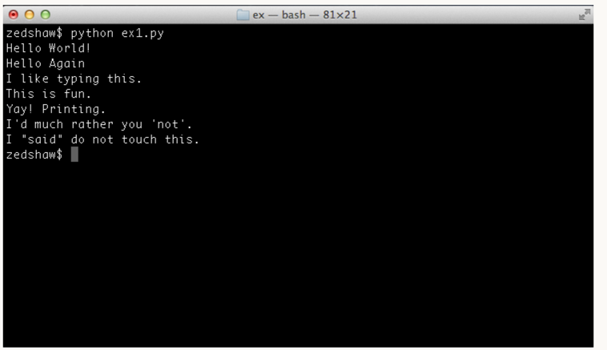
Exercise 1: A Good First Program

Slide 21
Exercise 2: Comments and Pound Characters
Comments are very important in your programs. They are used to tell you what something does in English, and they also are used to disable parts of your program if you need to remove them temporarily. Here's how you use comments in Python:

Slide 22
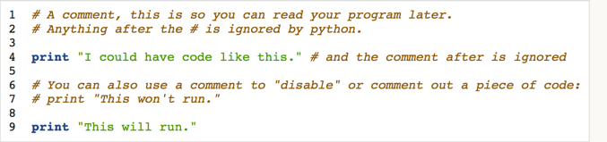
Exercise 2: Comments and Pound Characters

Slide 23
Exercise 2: Comments and Pound Characters
What You Should See
$ python ex2.py I could have code like this. This will run.
Again, I'm not going to show you screenshots of all the Terminals possible. You should understand that the above is not a literal translation of what your output should look like visually, but the text between the first $ Python ... and last $ lines will be what you focus on.

Slide 24
Exercise 3: Numbers and Math
Every programming language has some kind of way of doing numbers and math. Do not worry: programmers lie frequently about being math geniuses when they really aren't. If they were math geniuses, they would be doing math, not writing ads and social network games to steal people's money.

Slide 25
Exercise 3: Numbers and Math
This exercise has lots of math symbols. Let's name them right away so you know what they are called. As you type this one in, say the names. When saying them feels boring you can stop saying them. Here are the names:
+ plus
- minus
/ slash
* asterisk
% percent
< less-than
> greater-than
<= less-than-equal
>= greater-than-equal
Notice how the operations are missing? After you type in the code for this exercise, go back and figure out what each of these does and complete the table. For example, + does addition.

Slide 26
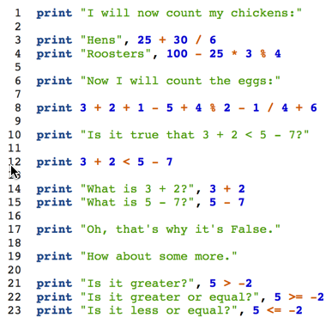
Exercise 3: Numbers and Math

Slide 27
Exercise 3: Numbers and Math
$ python ex3.py I will now count my chickens: Hens 30 Roosters 97 Now I will count the eggs: 7 Is it true that 3 + 2 < 5 - 7? False What is 3 + 2? 5 What is 5 - 7? -2 Oh, that's why it's False. How about some more. Is it greater? True Is it greater or equal? True Is it less or equal? False

Slide 28
Exercise 4: Variables And Names
Now you can print things with print and you can do math. The next step is to learn about variables. In programming a variable is nothing more than a name for something so you can use the name rather than the something as you code. Programmers use these variable names to make their code read more like English, and because they have lousy memories. If they didn't use good names for things in their software, they'd get lost when they tried to read their code again.
If you get stuck with this exercise, remember the tricks you have been taught so far of finding differences and focusing on details:
Write a comment above each line explaining to yourself what it does in English.
Read your .py file backward.
Read your .py file out loud, saying even the characters.

Slide 29
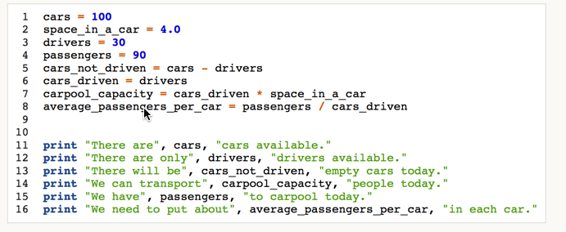
Exercise 4: Variables And Names

Slide 30
Exercise 4: Variables And Names
What You Should See
$ python ex4.py There are 100 cars available. There are only 30 drivers available. There will be 70 empty cars today. We can transport 120.0 people today. We have 90 to carpool today. We need to put about 3 in each car.

Slide 31
Conclusion
Python Setup
A good first program
Comments
Numbers and Math
Variables and Names
Where to Learn more
http://learnpythonthehardway.org/

Slide 32
Thanks
Matt Parsons, CISSP, MSM, CWASE
mparsons@parsonisconsulting.com

