Slide 1
Tour of OWASP’s projects
Andy Lewis
alewis@owasp.org
February 15th, 2012

Slide 2
OWASP Tools and Technology
Automated Security Verification
Secure Coding
AppSec Management
Vulnerability Scanners
Static Analysis Tools
AppSec Libraries
Code Review Guide
Penetration Testing Tools
Code Review Tools
Reporting Tools
Guards and Filters
AppSec Education
Flawed Apps
Learning Environments
AppSec Tutorials
SiteGenerator
Security Architecture
ESAPI
Fuzzing
Manual Security Verification
ESAPI Reference Implementation
ModSecurity Core RuleSet
Notes:
In terms of OWASP Tools and Technology, our coverage is a bit spotty, but we’re actively working to remedy that.
We have a lot of tools for automated verification, but we lag behind the commercial tools a bit here. We have 3 SoC projects to build better static and dynamic tools, so look for some advances here.
Our manual verification tools are quite good, with WebScarab listed as one of the most popular security tools anywhere.
In the security architecture area, we do not have a lot of tools or technology, although the Enterprise Security API is an important part of this key area.
We have a number of tools to encourage security coding, including several appsec libraries and many guards and filters.
Our appsec management tools are fairly weak, although the OWASP Report Generator shows some promise
And in the AppSec Education area, the WebGoat tool has been very successful, although this region is yellow because we can and should do more in the education areas.

Slide 3
OWASP Body of Knowledge
Guidance and Tools for Measuring and Managing Application Security
Guide to Application Security Testing and Guide to Application Security Code Review
Verifying Application Security
Managing Application Security
Guide to Building Secure Web Applications and Web Services
Core Application Security Knowledge Base
Projects
Chapters
AppSec Conferences
Acquiring and Building Secure Applications
Application Security Tools
Tools for Scanning, Testing, Simulating, and Reporting Web Application Security Issues
Research to
Secure New
Technologies
AppSec Education and
CBT
Research Projects to Figure Out How to Secure the Use of New Technologies (like Ajax)
Principles
Threat Agents, Attacks, Vulnerabilities, Impacts, and Countermeasures
OWASP Community Platform
(wiki, forums, mailing lists)
Web Based Learning Environment and Guide for Learning Application Security
OWASP Foundation 501c3

Slide 4
Top level view

Slide 5
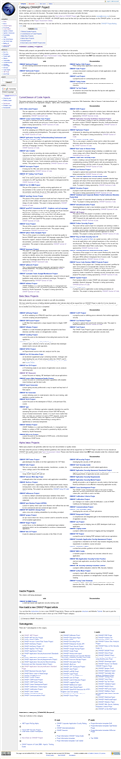
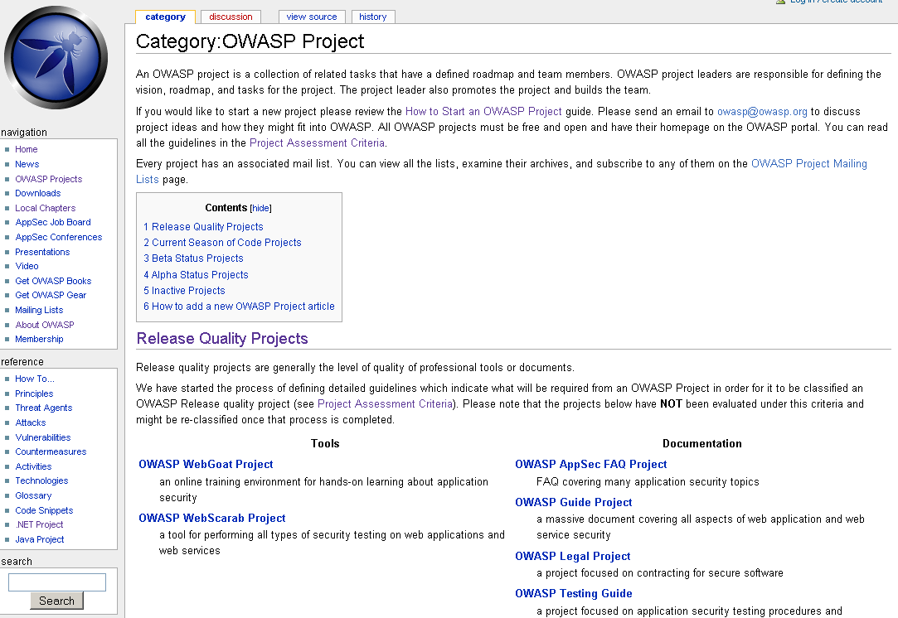
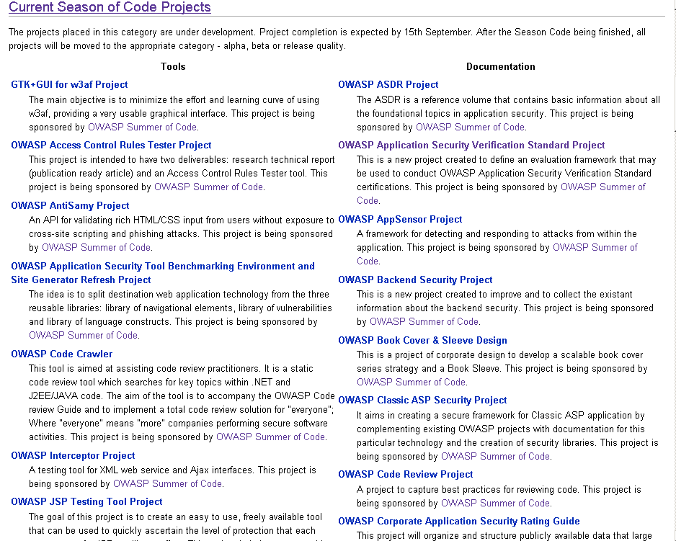
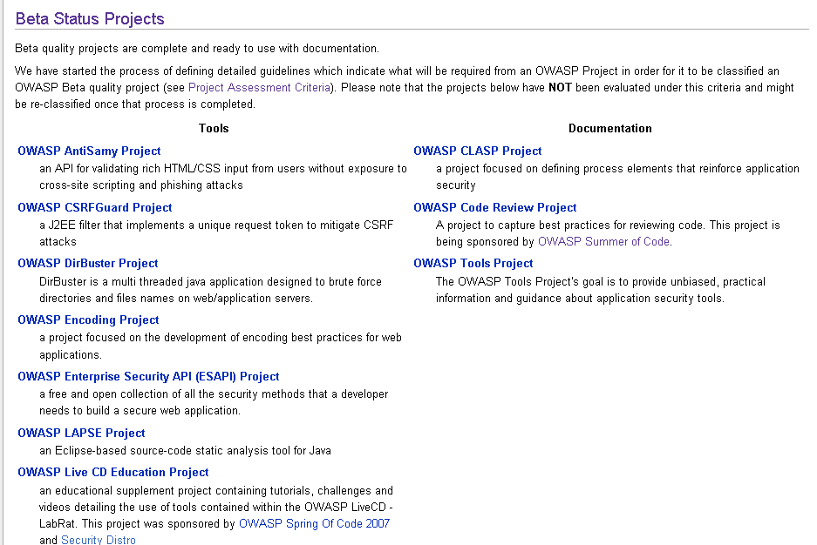
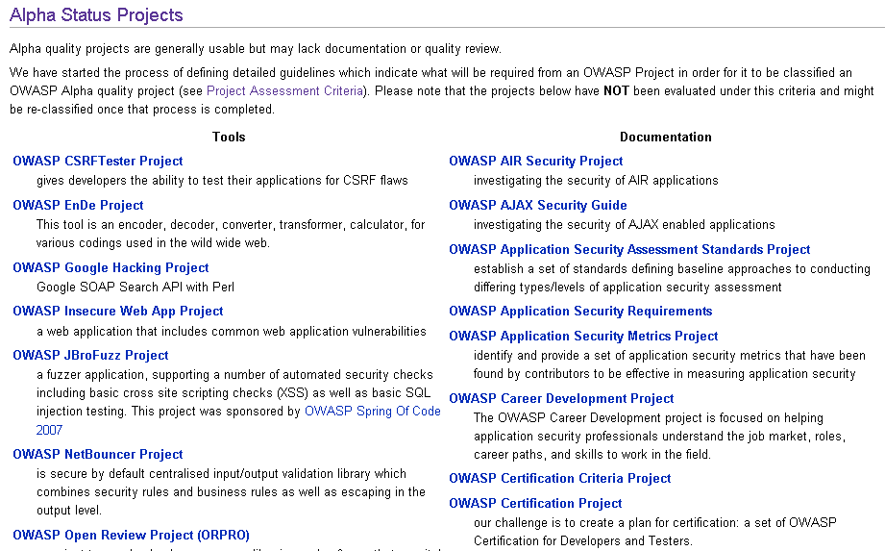
There are a lot of OWASP projects

Slide 6
OWASP projects by numbers
Total Projects: >100
Tools: ~61
Documentation: ~77
Code: ~14
“Unknown category”: ~40

Slide 7
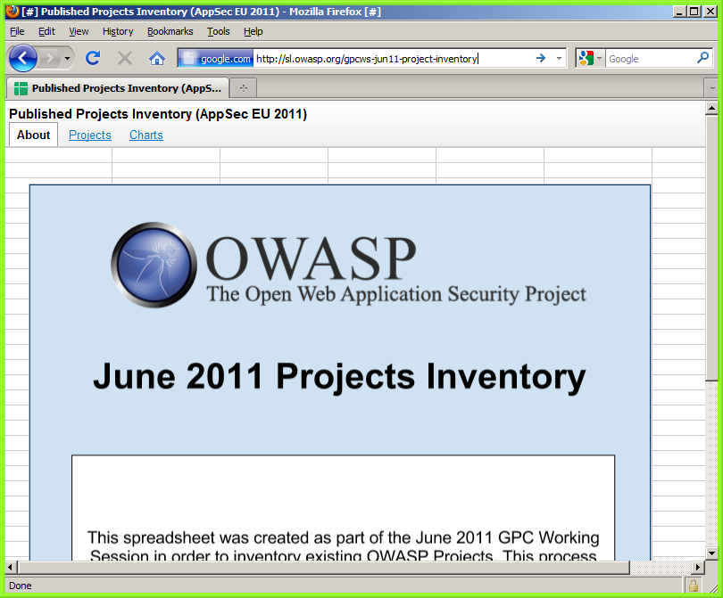
The Inventory

Slide 8
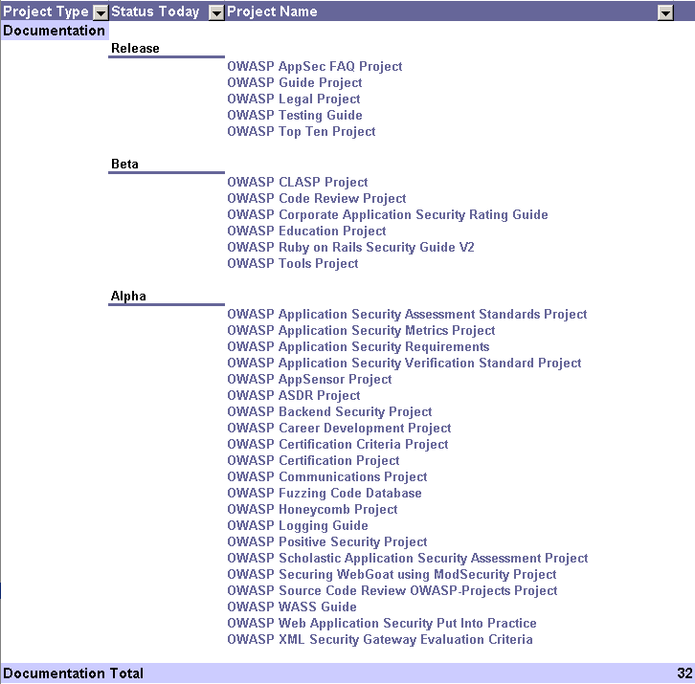
Documentation projects

Slide 9
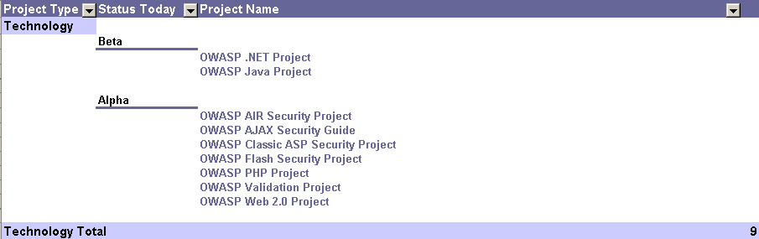
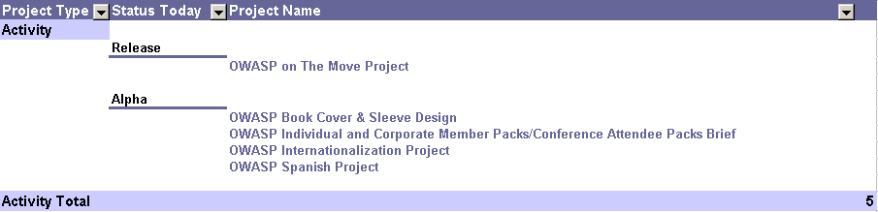
Activities, Technologies

Slide 10
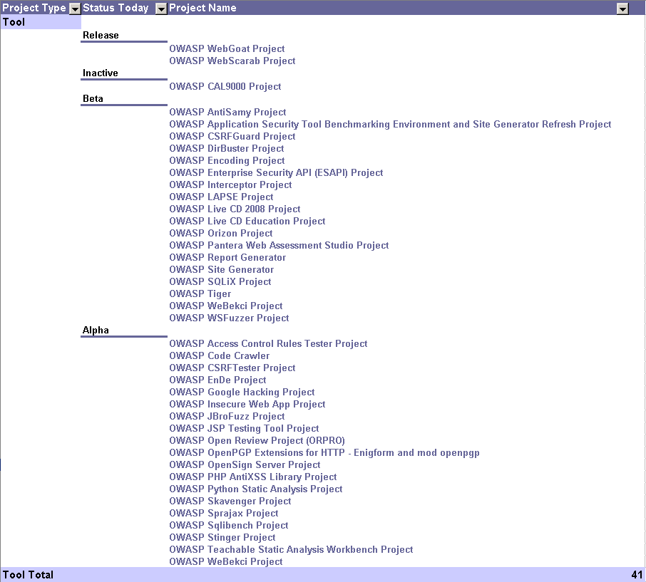
Tools

Slide 11
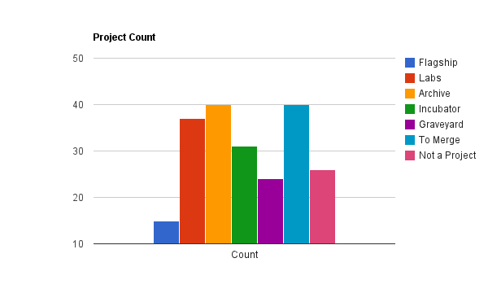
A Different View

Slide 12
10 Projects you should know about

Slide 13
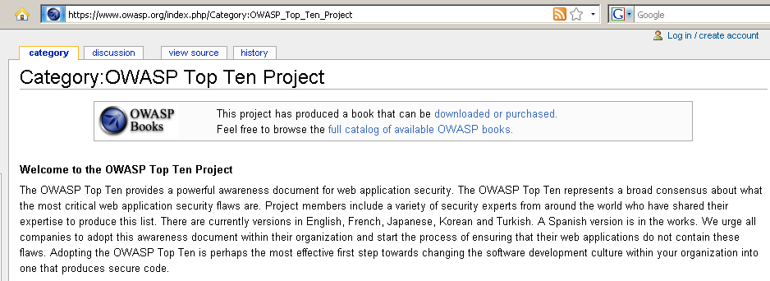
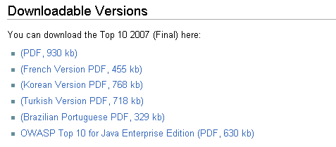
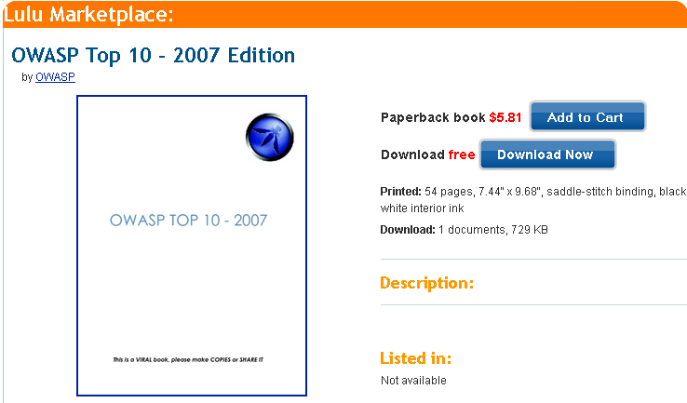
1) OWASP Top 10 (Release Quality)

Slide 14
Top 10 - 2010
A1-Injection | Injection flaws, such as SQL, OS, and LDAP injection, occur when untrusted data is sent to an interpreter as part of a command or query. The attacker’s hostile data can trick the interpreter into executing unintended commands or accessing unauthorized data.
A2-Cross Site Scripting (XSS) | XSS flaws occur whenever an application takes untrusted data and sends it to a web browser without proper validation and escaping. XSS allows attackers to execute scripts in the victim’s browser which can hijack user sessions, deface web sites, or redirect the user to malicious sites.
A3-Broken Authentication and Session Management | Application functions related to authentication and session management are often not implemented correctly, allowing attackers to compromise passwords, keys, session tokens, or exploit other implementation flaws to assume other users’ identities.
A4-Insecure Direct Object References | A direct object reference occurs when a developer exposes a reference to an internal implementation object, such as a file, directory, or database key. Without an access control check or other protection, attackers can manipulate these references to access unauthorized data.
A5-Cross Site Request Forgery (CSRF) | A CSRF attack forces a logged-on victim’s browser to send a forged HTTP request, including the victim’s session cookie and any other automatically included authentication information, to a vulnerable web application. This allows the attacker to force the victim’s browser to generate requests the vulnerable application thinks are legitimate requests from the victim.
A6-Security Misconfiguration | Good security requires having a secure configuration defined and deployed for the application, frameworks, application server, web server, database server, and platform. All these settings should be defined, implemented, and maintained as many are not shipped with secure defaults. This includes keeping all software up to date, including all code libraries used by the application.
A7-Insecure Cryptographic Storage | Many web applications do not properly protect sensitive data, such as credit cards, SSNs, and authentication credentials, with appropriate encryption or hashing. Attackers may steal or modify such weakly protected data to conduct identity theft, credit card fraud, or other crimes.
A8-Failure to Restrict URL Access | Many web applications check URL access rights before rendering protected links and buttons. However, applications need to perform similar access control checks each time these pages are accessed, or attackers will be able to forge URLs to access these hidden pages anyway.
A9-Insufficient Transport Layer Protection | Applications frequently fail to authenticate, encrypt, and protect the confidentiality and integrity of sensitive network traffic. When they do, they sometimes support weak algorithms, use expired or invalid certificates, or do not use them correctly.
A10-Unvalidated Redirects and Forwards | Web applications frequently redirect and forward users to other pages and websites, and use untrusted data to determine the destination pages. Without proper validation, attackers can redirect victims to phishing or malware sites, or use forwards to access unauthorized pages.

Slide 15
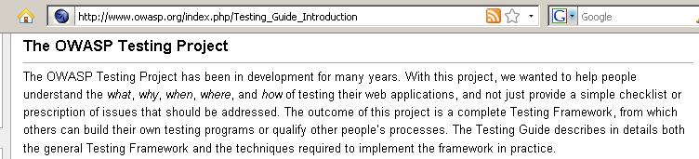
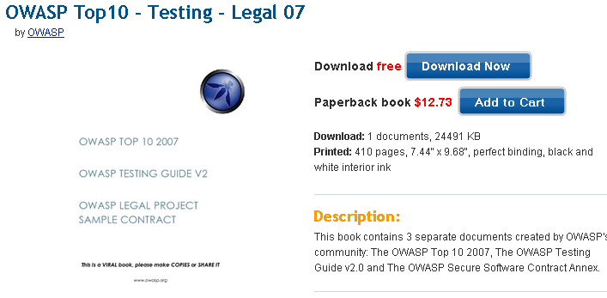
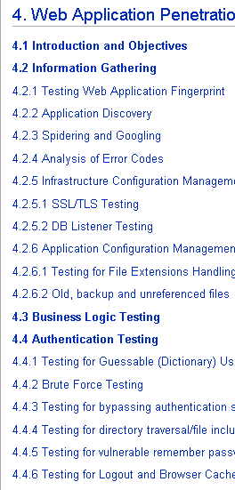
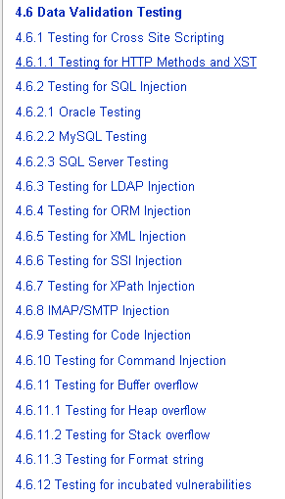
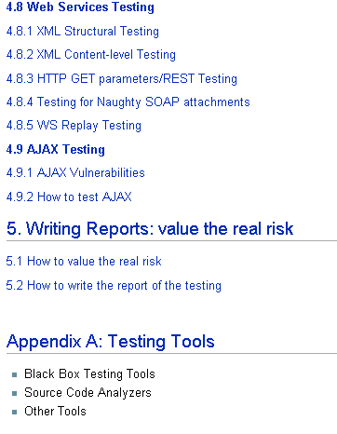
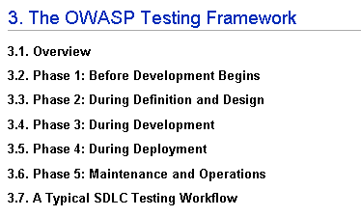
2) OWASP Testing Guide v2 (Release Quality)

Slide 16
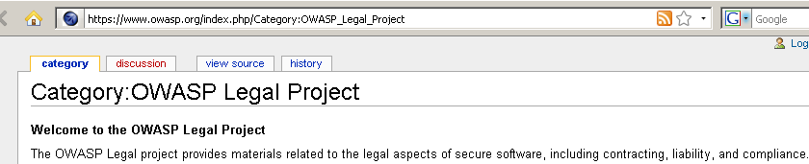
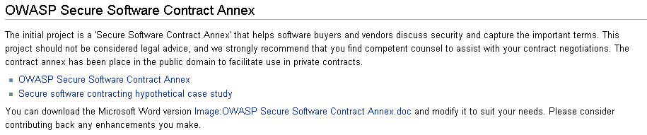
3) Legal Project (Release Quality)

Slide 17
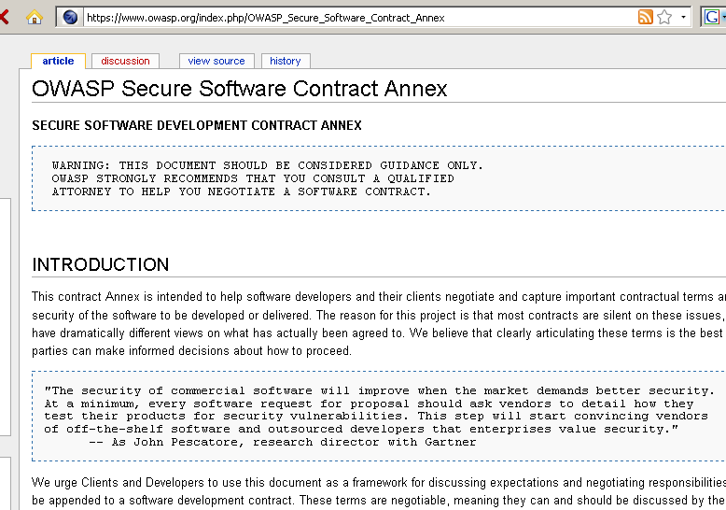
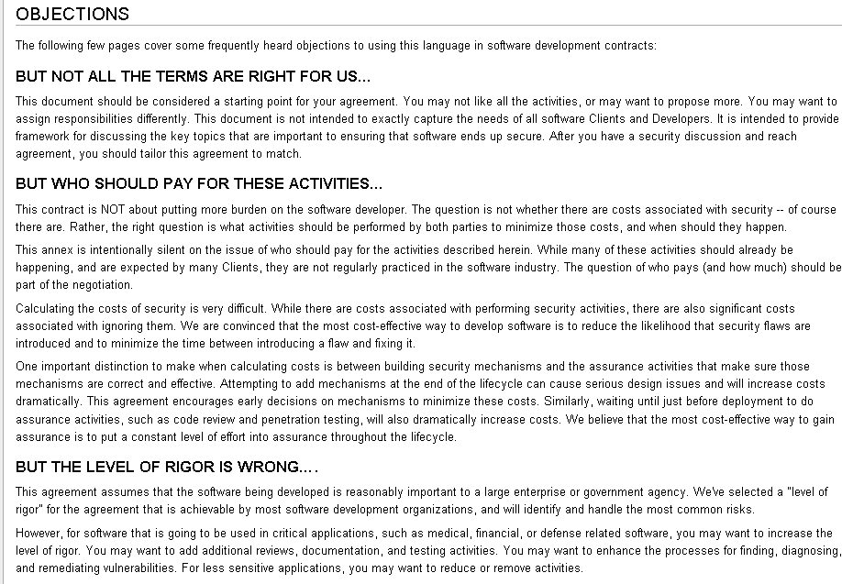
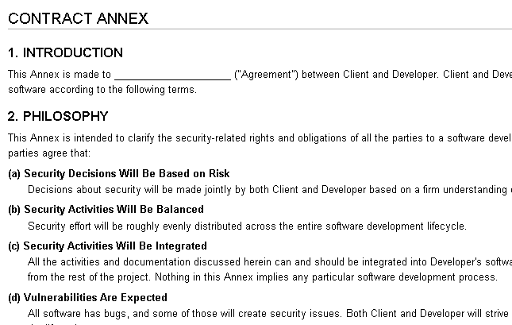
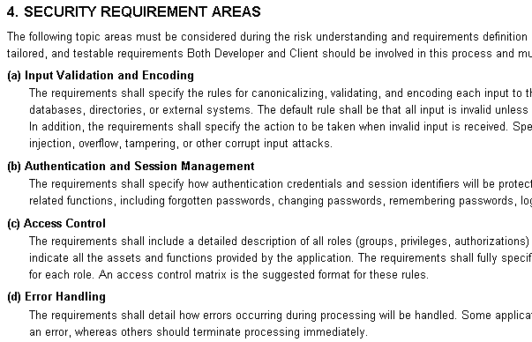

Slide 18
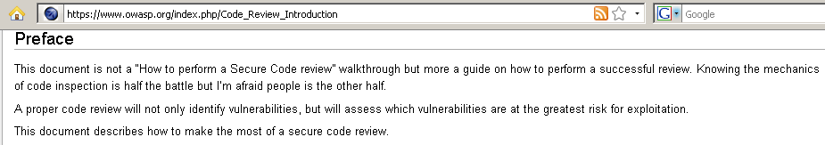
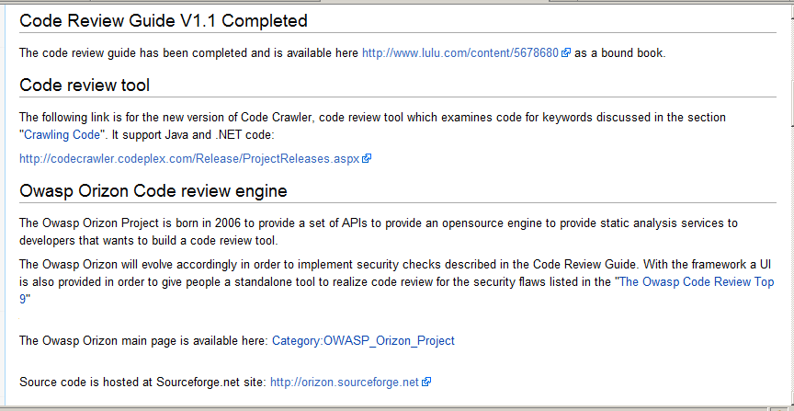
4) Code Review (Release Quality; v2 soon)

Slide 19
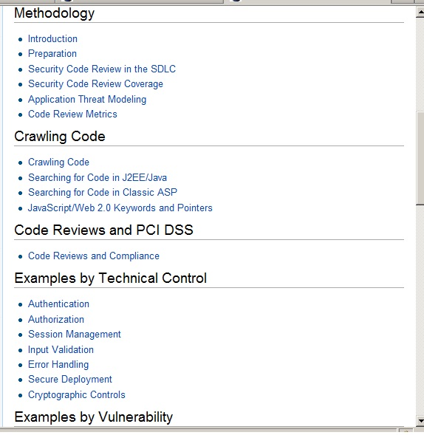
Code Review Guide TOC Snippet

Slide 20
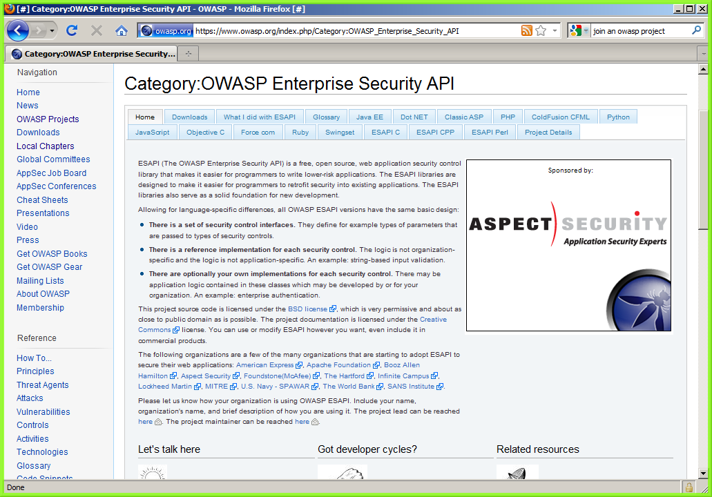
5) ESAPI (Beta+ Quality)

Slide 21
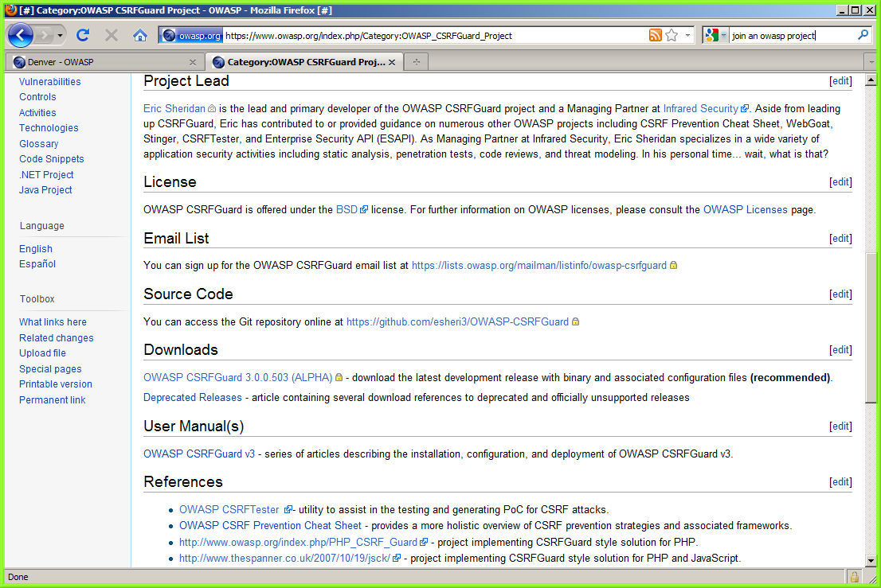
6) CSRFGuard

Slide 22
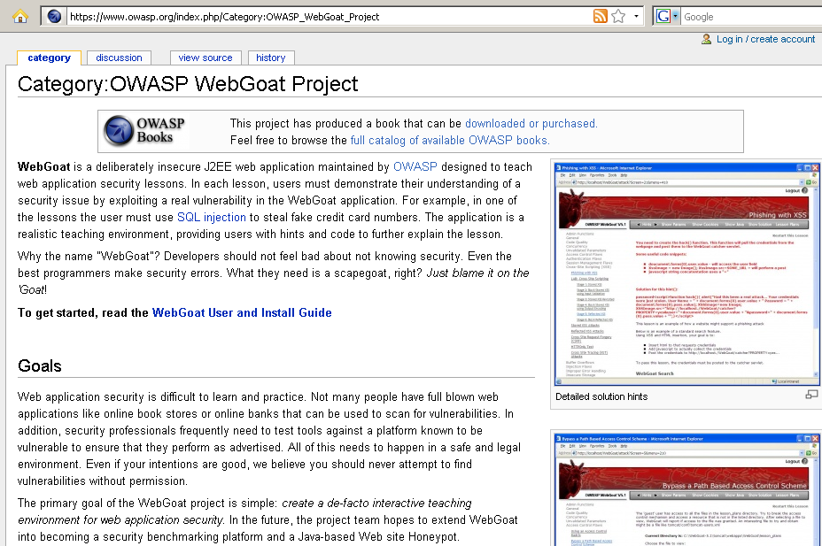
7) Web Goat (Release Quality)

Slide 23
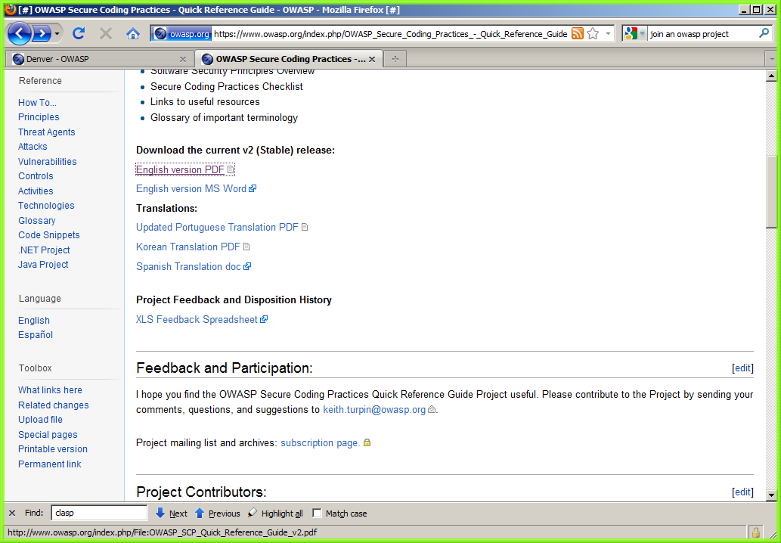
8) OWASP Secure Coding Practices Quick Reference Guides (Release Quality)

Slide 24
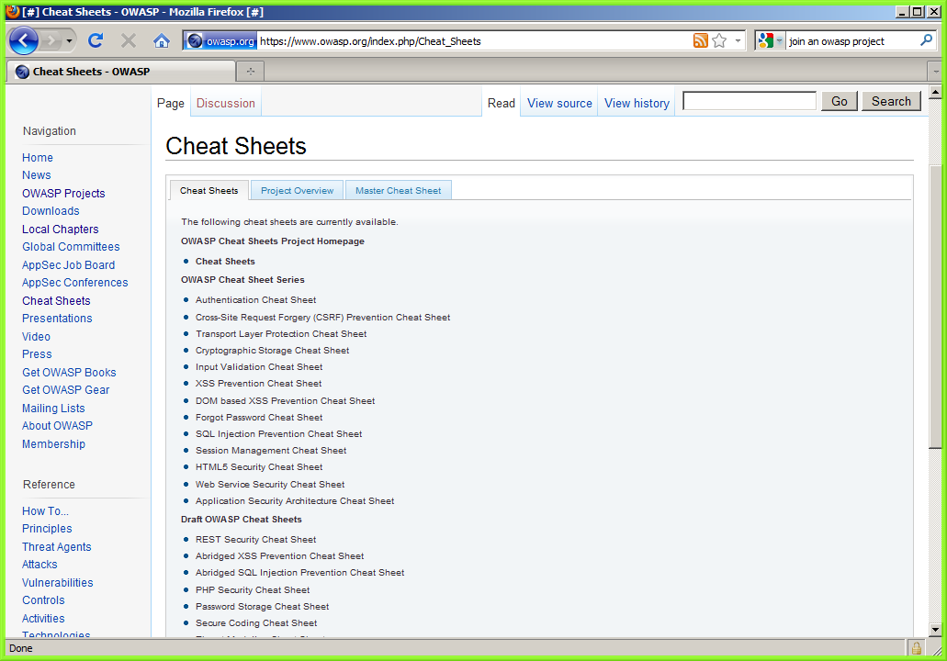
Bonus: Cheatsheets

Slide 25
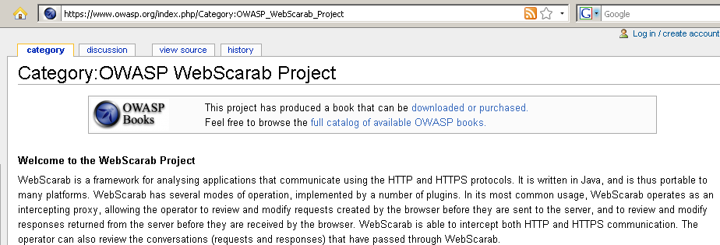
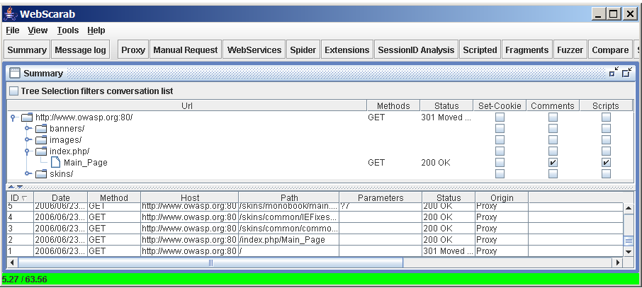
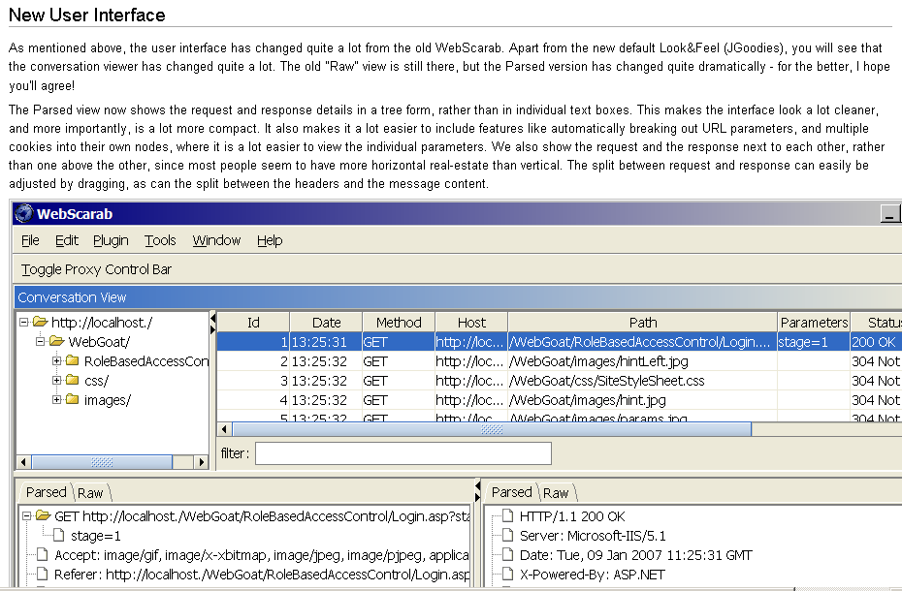
9) WebScarab (Release Quality)

Slide 26
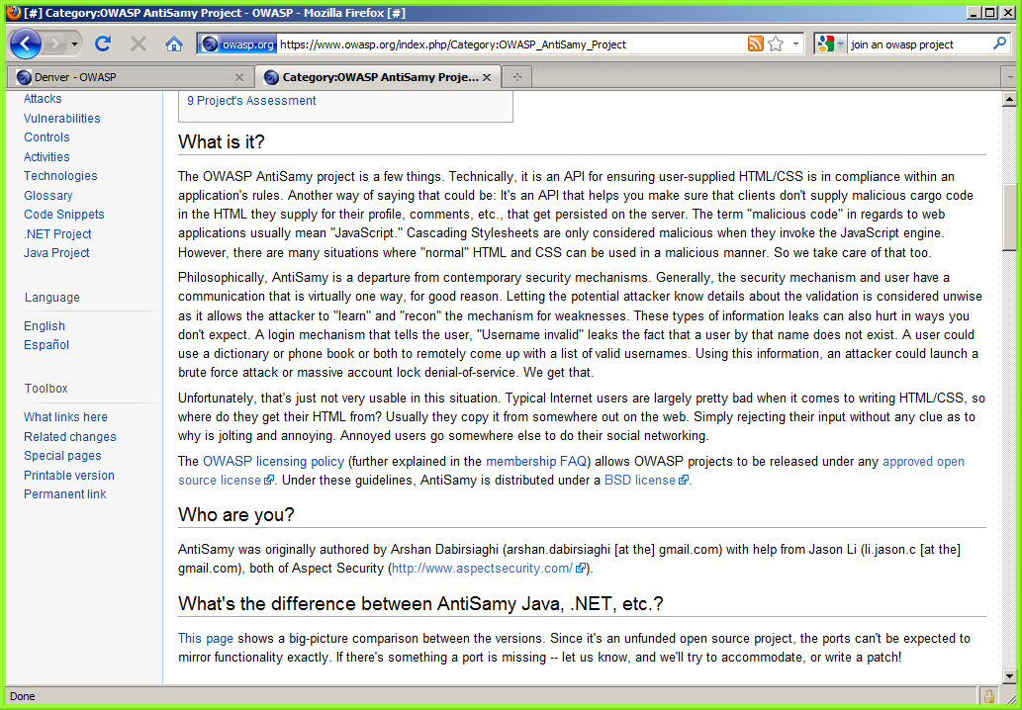
10) AntiSamy (Release)

Slide 27
Other great projects
ZAP (Zed Attack Proxy)
Toolsmith tool of the year for 2011!
Fork of Paros Proxy
ASVS (Application Security Verification Standard)
App PenTest, Vulnerability Assessment, and Architecture Review Guidelines
SAMM/OpenSAMM
Software Assurance Maturity Model
OWASP AppSec Tutorial Series
Joomla Vulnerability Scanner

Slide 28
The Big List http://sl.owasp.org/gpcws-jun11-project-inventory

Slide 29

Questions and Answers
Did I mention SnowFROC? www.snowfroc.com

