Slide 1
Using Cyber Threat Intelligence to Enhance Security
Presented by Kevin Tongs, Technical Account Manager EMEA
FireEye iSIGHT Intelligence

Slide 2
Using Cyber Threat Intelligence to Enhance Security
What is Intelligence?
Why is Cyber Threat Intelligence important?
Leveraging Cyber Threat Intelligence
Enhance security technologies
Streamline processes
Improve security programs
Example
Questions

Slide 3
What is Intelligence?

Slide 4
Cyber Threat Intelligence - Definition
Intelligence is information that has been collected, processed and disseminated with the purpose of:
Reducing the degree of uncertainty about an adversary, potential adversary, situation or threat, which may be experienced by decision makers.
So they can make informed, reasoned, and timely decisions.

Slide 5
Cyber Threat Intelligence - Definition
Not to be confused with:
“Information is unprocessed data of every description that may be used in the production of intelligence. It is normally collected by individual sensors, systems or capabilities.”

Slide 6
The Intelligence Cycle – Simple Version
Direction
Collection
Processing
Dissemination
Notes:
So how do we get intelligence? Where does it come from? Here is the intelligence cycle; four main stages, broken down into various sub-stages. We will look at each of these in turn

Slide 7
The Full Intelligence Cycle
Check databases
Requests for Information
Intelligence Requirements (Standing and Priority)
Collection Plan
Tasks
Task Collection
Requestor/User
Direction
Collection
Processing
Dissemination
Intelligence
Information & Intelligence
(Time) Critical Intelligence

Slide 8





Cyber Threat Intelligence Production Formal Process Yields Rich, Contextual Threat Intelligence
Direction and Collection
Analysis
Dissemination
Feedback &
Clarification
?
i
Intelligence
Requirements
requested
from Client
Intelligence Requirements created based on Clients, Sectors and Adversaries
Requirements
prioritized
by analysts,
matched to
current
holdings then
passed to global
research teams
Collection
planning and tasking of
global research teams
Requirements
collected by global research teams and returned to
Fusion Centre
Processing and exploitation
to standardize
multiple
information
sources ready for analysis
Analysis of
information and production of reporting for clients
Fully fused,
corroborated,
cross-referenced
and edited
multi-source
Intelligence
reporting
disseminated to
clients
Client feedback,
refinement of Intelligence
product

Slide 9
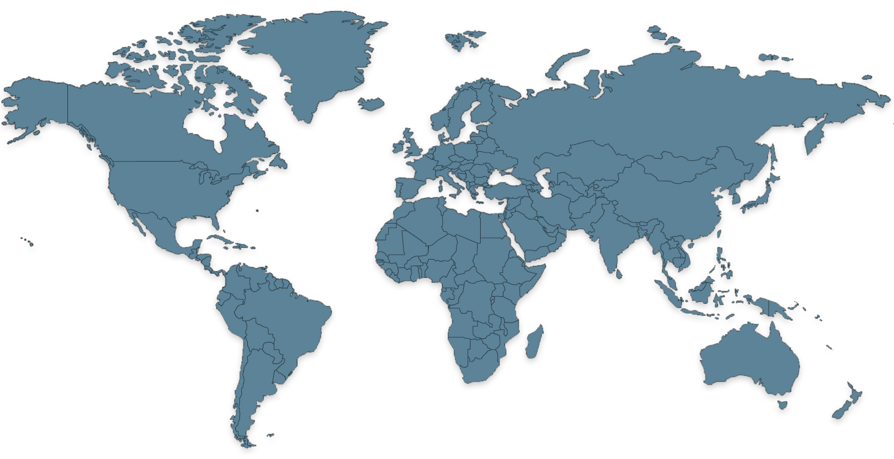





Global/Local Collection
300+ intelligence Professionals, 29 Languages, 18 Countries
Global Insights
Global Reach
ADVERSARY FOCUSED
GLOBAL COLLECTION
CONTEXTUAL
MULTIPLE DELIVERABLES
PARTNERSHIP
ACTIONABLE
Amsterdam, Netherlands
Canada
United Kingdom
Kiev, Ukraine
Idaho Falls, ID
Chantilly, VA
Spain
Germany
Bucharest, Romania
Dallas, TX
Cyprus
Beijing, China
Japan
Hawaii
Pune, India
Taipei, Taiwan
Philippines
Malaysia
Brazil
Argentina
Sydney, Australia
New Zealand

Slide 10
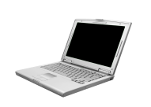

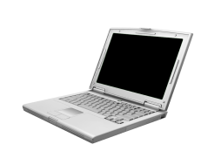
Cyber Threat Intelligence Process
Collection
Global Intelligence Gathering
Collection systems and research team create raw observables…
Malware
Marketplace
Human
Vulnerability
Internet
utilized to create tagged, categorized “wires” or research elements…
Common Data Model (ensures consistency)
Analysis
Campaigns
Attack Methods
which flow to analytical tools to enrich, prioritize, rate and synthesize our knowledge into…
Actors
Linked Observables
Through Analytical
Data Persistence
Dissemination
Deliverable Formats
HTML or plain-text via email
Portal access with advanced search capability
XML delivery
Indicator CSVs linked to intelligence context
API access
Partner Integrations
Content management System
coordination, deduplication, topic selection, production, storage and retention of sources
finished intelligence which is produced and delivered in many formats to the customer.

Slide 11
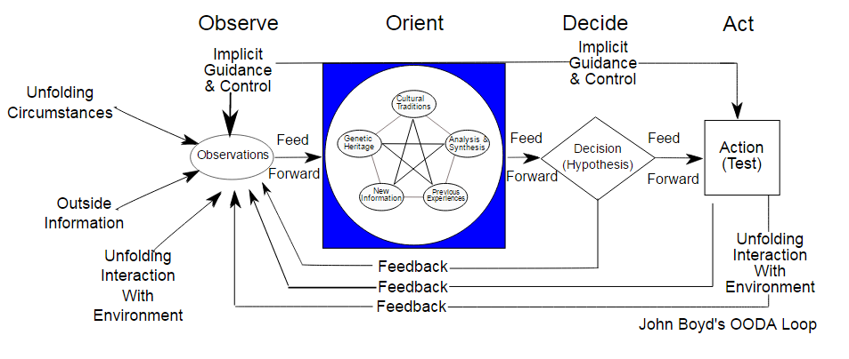
The OODA Loop observe, orient, decide, act
By Patrick Edwin Moran - Own work, CC BY 3.0, https://commons.wikimedia.org/w/index.php?curid=3904554
Decision-making cycle of observe, orient, decide, and act
Applied to strategic level combat operations
Commercial operations and learning processes
Favours agility over raw power in dealing with human opponents
Get inside opponents decision cycle to gain advantage

Slide 12
Why is Cyber Threat Intelligence important?

Slide 13




Cyber Threat Joins the Risk List
Key Risks
Political
Reputation
Environmental
Cyber
Supply Chain
Market
Financial
Natural Disasters
Regulatory
Credit
Ethics
State Conflicts

Slide 14
Leveraging Cyber Threat Intelligence

Slide 15
Benefit to Multiple Intelligence Consumers
Strategic
Operational
Tactical
CISO
&
Executive
Security Operations Center
(SOC)
Network Operations
Threat Intelligence
Team
Incident Response
Team
Systems/Endpoint
Operations

Slide 16
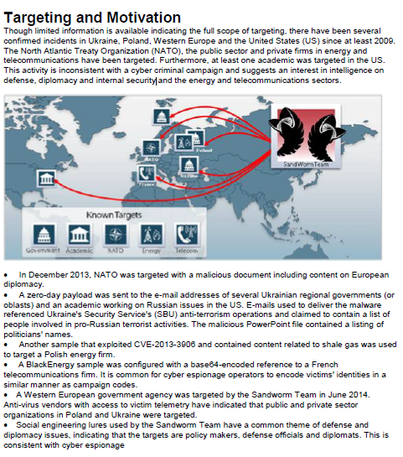




Cyber Threat Intelligence Delivery
ThreatScape Intelligence
Technologies
Standards
Consumers
Executive Summary
Executives
MySIGHT Portal
HTML
PGP
Newscaster Team has been implicated in a recent campaign affecting multiple industries through strategic website compromises and other social engineering vectors. …
Search
Risk, Intel, Fraud
Email
PDF
TXT
Context
SMS
… multiple watering holes recently observed on websites associated with a Middle Eastern petroleum firm, UK-based Lloyds Bank and Kronos Incorporated, a workforce management provider, were carried out by Newscaster Team.
… the domain emilymarsden.serveblog.net historically resolved to 45.32.68.241 which shares a C&C IP with an identified Meterpreter sample (MD5: 99bce83e77383f50fcc3fa67266ca646).
Browser plugins
Incident Response
Standard Formats
ThreatScape® API
STIX
XML
SOC
Data
ThreatScape®
SNORT
File Name: ywtdzsv7.dll
File Size: 3584
Identifier: Attacker
MD5: d7fbb66bbbb8256ecc645a59c7a25db7
Packer: Microsoft Visual C# / Basic .NET
SHA1: 6b34cd7f2d9193744ae3ed4f7df17bbcde0b38db
SHA256: 806d8a705d1b58409e11bcc881fd283310071dc1bcd964f05280505d87f46338
Type: PE32 executable for MS Windows (DLL) (console) Intel 80386 32-bit Mono/.Net assembly
Fuzzy Hash: 24:etGSgoMkT11e/0euTglCA3/qa8NX/XWbdPtkZfo7MXIJKN5SVHmh61FmI+ycuZhx:6g
CSV
JSON
Tech Security Controls
API
Notes:
From left to right this diagram enumerates how our finished ThreatScape intelligence can be delivered across your organization from business executives down to your security technologies. Our high-fidelity threat intelligence and our dissemination model are designed to ensure that our intelligence is truly ACTIONABLE across your organization.
Our team continues to help mature key standards associated with the technical dissemination of Cyber Threat Intelligence including important contributions to the STIX effort which was specifically designed by MITRE.
What is a Snort rule?
Rules are a different methodology for performing detection, which bring the advantage of 0-day detection to the table. Unlike signatures, rules are based on detecting the actual vulnerability, not an exploit or a unique piece of data. Developing a rule requires an acute understanding of how the vulnerability actually works.

Slide 17
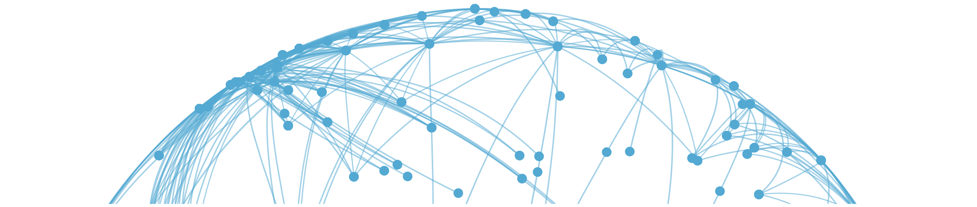
Actionable Threat Intelligence
ACROSS THE INFRASTRUCTURE
ThreatScape® API
SIEM/Log Management
Threat Intelligence Platform (TIP)
Endpoint Protection
Network Protection
IR/ Forensics Investigations
Analytics/GRC
ACTIVITY
Event Prioritization
Threat Data, Indicator Aggregation, Common Platform
Protection for Enterprise Endpoints
Visibility and Protection Across Enterprise Networks
Hunt for Issues Remediate
& Attribute
Analyze Incidents
(Who, Why)
Patch Management
VALUE
Shrink The Problem
Manage All Threat Data and Sources in a Single Interface
Stop Attacks at the Point of Entry
Alert and Block Threats, Detect Attacks in Progress
Improve Decisions
Who/Why Attack
Brief Executives
Improve Decisions
Prioritize Most
Critical Patches
Notes:
Add more color/feels plain
Globe shows richness, multi-faceted intel (Maybe globe behind the product name/API)
Remove the ThreatScape Logo for now
Replace org chart lines with arrows/dotted lines/something more dynamic

Slide 18
Intelligence-Led Security
– From the Outside In
Attack Surface
Attack Methodology
Threat Sources
Indicators
Indicators,
Tags, Actors
Credit Card Data
A/V
Tor
Anonymity
Intrusion Teams
Cyber Espionage
Documents
Access Logs
Comms
Organized Crime
Cyber Crime
Scaling
Intellectual Property
IDS
Malware
Hacktivism
Activist Groups
IPS
Watering Hole
PII
Botnet
Enterprise IT
SEIM
Insiders
C2
Direct Intrusion
User Logins
DLP
Phishers
DDoS
Operational Control
Exfil
Exfiltration
Bot Herders
Mobile Computing
Spam
Filter
Drop
Social Engineering
System Availability
Insider Threat
Black
Hats
Industrial control sys
Exploit
Notes:
Security Information taken from the “Attack Surface” is not Threat Intel…

Slide 19
Intelligence-Led Security
= Indicators Linked to Context
Cyber Threat Intelligence
Indicators/IOCs
Context
Malicious Files
(hashes/signatures)
Motivation/Intent
Actors
Cyber Crime
(Money)
Bad Domain
Attribution
Espionage
(Information)
Bad IP Address
Targets
Hacktivism
(Influence)
Phishing Lures
Campaigns
Registry Settings
TTPs, Methods/Playbooks
Destruction
(Kinetic Impact)

Slide 20
Relevant to the Organisation
Report to the CEO, version 1
Report to the CEO, version 2
Last month we detected and blocked two cybercrime attacks linked to a criminal organization in Eastern Europe that has been targeting POS systems at mid-sized retailers. Our actions:
• Prevented the theft of 10 million customer credit card numbers
• Avoided $78 million in lost revenue and the costs that would have been incurred for notifying customers of the data breach, cleaning up infected systems, and paying regulatory fines and legal fees.
Last month we:
Reviewed 1,452,134 log entries
Detected 423,132 viruses
Blocked 2,028,43 connections
Closed 3,095 incident tickets
Information v Cyber Threat Intelligence

Slide 21
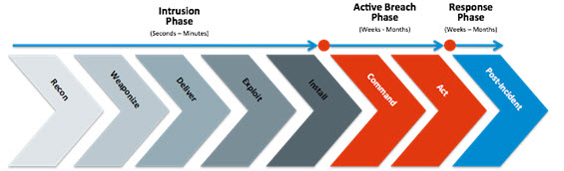
Lockhead Martin Kill Chain
Increasing cost/consequence and difficulty to stop attack

Slide 22
Example

Slide 23


Advanced Signals of POS Targeting
Early Warning
Preparation
Infection Point
April 18, 2011
Intel-377199
November 1, 2011
Intel-480807
November 24, 2011
(Intel-495303)
March 19, 2012
(Intel-549025)
June 15, 2012
(Intel-575086)
January 3, 2013
(Intel-712383)
May 30, 2013
(Intel-827504)
July 17, 2013
(Intel-877630)
2011
2012
2013
Brazilian actors modify POS terminals, install in Sao Paulo stores
German actor arrested for possession of skimming equipment
Actors selling skimming software targeting POS Malware
Actor advertising POS terminal manipulation software
Observed increases in POS malware use in Brazil
Suggestion actors turning to POS malware over skimmers because it can increase profitability and security
…POS Malware with RAM Scraping functionality advertised…
Notes:
iSIGHT provided significant reporting on the change in Cyber Crime tactics from “skimmers” and more manual card data theft to the more automated POS malware used in many of the 2014 campaigns.

Slide 24
POS Malware Proliferation
Feb (1)
Mar (2)
Apr (4)
May(1)
Jul(1)
Aug (1)
Oct (1)
Dec (2)
Feb (4)
Mar (3)
Apr (2)
Jun (3)
Jul(1)
Aug (1)
Sept. (5)
Oct (1)
Nov (5)
2013
2014
2015
Dexter
VSkimmer
Expansion of RAM Scraper Sales
POSRam
Decebal
JackPOS
Javelin POS
POS Malware and Card Shop Operations
Backoff
POS Ops Lifecycle
BlackPOS
Alina
TECHNICAL INDICATORS
Command and Control
HTTP Headers
Registry Changes
Memory Analysis
OPERATIONAL THREAT INDICATORS
Infrastructure Support
Sale of Tools and Illicit information
Actor Profiles
Notes:
Cyber Threat Intelligence providers that are closely monitoring the adversary landscape and looking over the horizon can find and contextualize indicators so that the Operational security teams can detect and respond better…

Slide 25

Aims of Cyber Threat Intelligence
Enable proactive, risk-based resource allocation
Shrink the problem
Improve prioritization
Enhance security technologies
Streamline processes
Improve response - OODA
Enhance executive communications
Connect security with business

Slide 26
Questions
iSIGHT Partners
The Cyber Threat Intelligence Experts

Slide 27
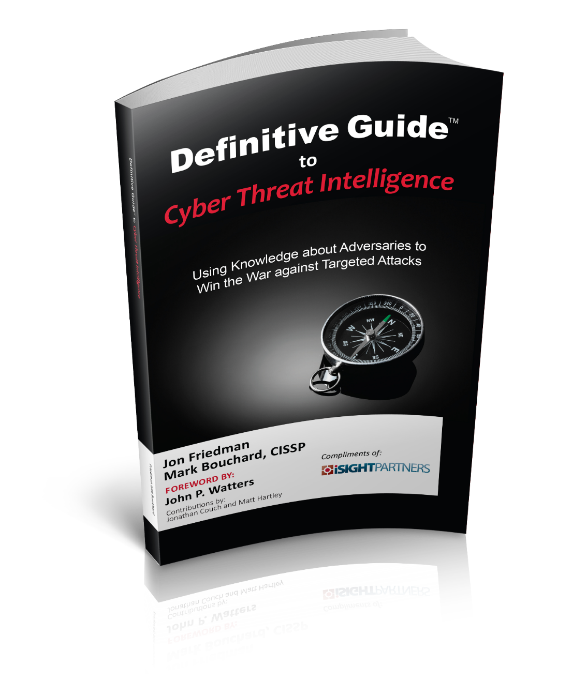
Please take a copy
Available to download at: http://info.isightpartners.com/definitive-guide

