Slide 1
Security Compliance for Developers Are we Certified… or Certifiable?
Andy Ward
Independent Software All-rounder
andy@thewardhouse.net
@andy_ward
24 March 2015
Notes:
Against a background of increasing threats and hacks, with more and more of our personal lives and business processes conducted online, it's never been more important to ensure our software is secure and robust. But how do you prove it? These days, reassuring your customers takes more than an SSL padlock, and some marketing spiel mentioning 'banking grade encryption'!
After a quick reminder of "what's the worst that can happen...", Andy will introduce some of the security Compliance and Certification systems that help you 'walk the walk', and provide confidence that your system has its security in good hands, before looking at what it means for developers and engineering teams.

Slide 2
Who am I
Previously:
20+ years in industry, cross-platform dev
Dev Team Lead at Leighton/4Projects & Sage
CTO @ 4Projects, Global EA @ Viewpoint/4P
Currently:
Working on my start-up…

Slide 3
Outline
Why comply? Why not?
Lessons from recent history
a.k.a. What’s the worst that can happen?
Who are the we defending against?
Compliance Standards
Making sense of the acronyms
Cloud support for Compliance standards
Dissecting ISO27000
Government Compliance
What it means for you

Slide 4
Why Comply?

Slide 5

You have 20 seconds to comply…
Notes:
I can never mention compliance without thinking of the Robocop scene,
Compliance sounds scary. Authoritarian, bureaucratic and Big brotherish.

Slide 6
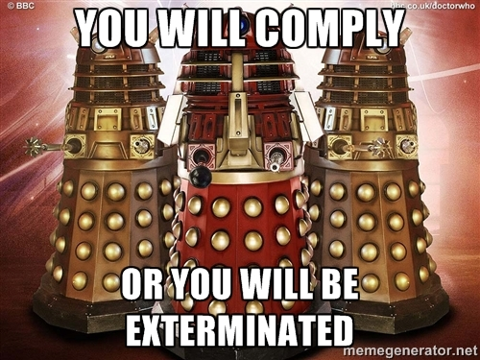
Notes:
Alternatively it comes over as slightly futile and perhaps even laughable
“You want us to do _what_?”…
But hopefully at the end of this session you will see where the value lies and we’ll get you thinking about the broader information security concepts we considering as we build important online services

Slide 7
Some Definitions
Compliance (n)
1. the act of conforming, acquiescing, or yielding.
2. a tendency to yield readily to others, especially in a weak and subservient way.
3. conformity; accordance
“in accordance with established guidelines, standards, or legislation.”

Slide 8
Some Definitions
Certified(adj)
1. having or proved by a certificate
2. guaranteed; reliably endorsed
3. legally declared insane.
We want this
Not this!

Slide 9
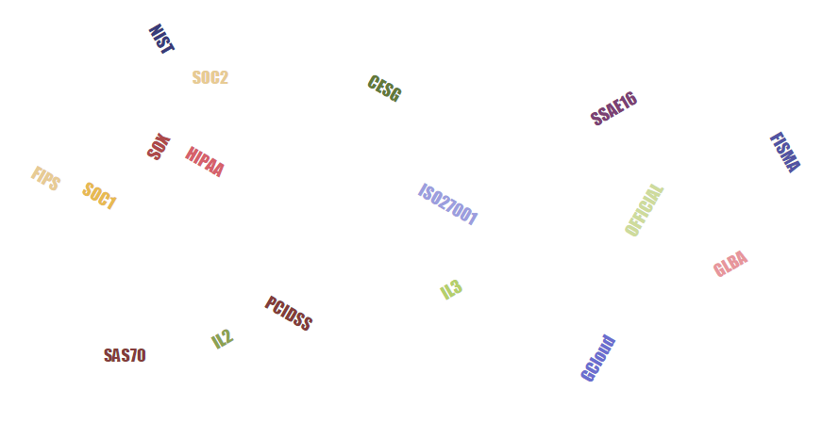
The great thing about standards…
… is that there are so many to choose from

Slide 10
Why would businesses go for Compliance?
Regulatory requirements
Contractual obligations / market need
Protecting your business
Protecting personal/commercial data
Improve service levels & expenses
Certification/
Accreditation usually required
A ‘Compliant’ system may be enough
Notes:
Certification vs Compliance.
You can have a compliant system that’s not certified.

Slide 11
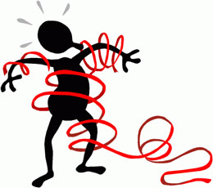
Why you might avoid certification
Admin Expense & overhead
Impact on Agility
No need / ROI
However… Good security practices are possible without Regulation!

Slide 12

Just don’t ignore what’s behind Compliance…
“in accordance with established guidelines, standards, or legislation.”

Slide 13
Some lessons from recent history
What’s the worst that can happen?

Slide 14

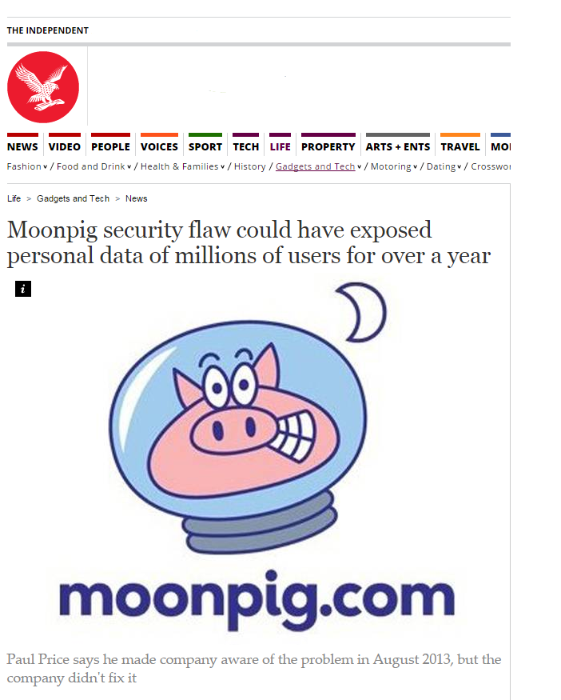
Jan 2015 – Broken Authentication
3 million users details leaked
Including partial CC#
Unpatched for over a year

Slide 15
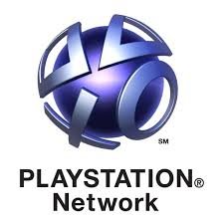
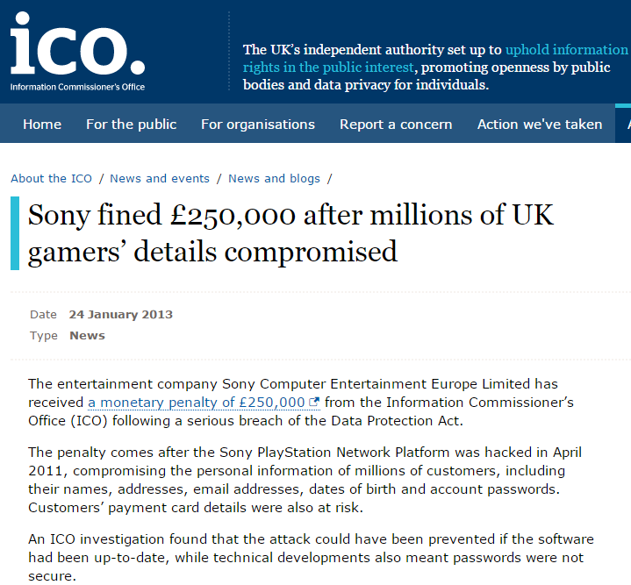
April 2011 – Security Mis-configuration
77 million accounts compromised
Personally identifiable info & passwords
3 days offline
Class action law suits

Slide 16

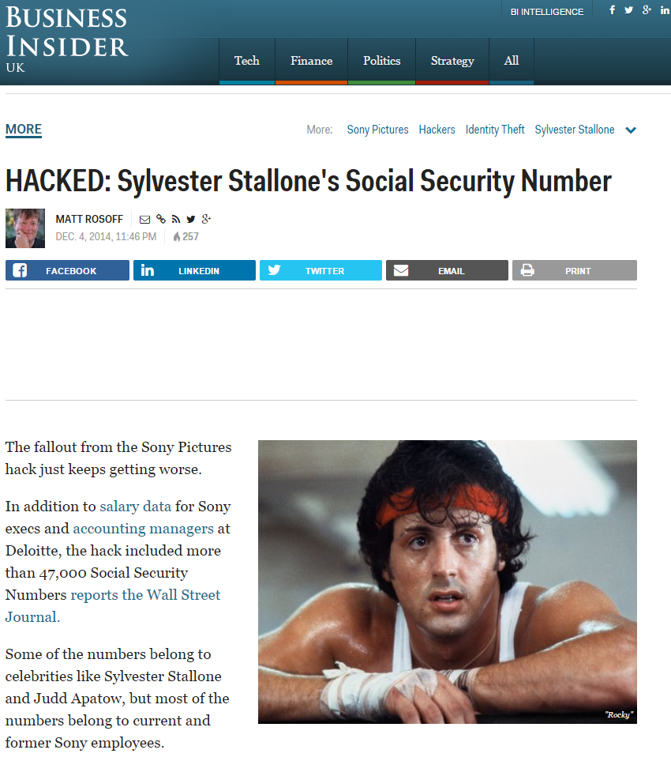
Dec 2014 – Broken Access Control
Personal details of 47000 leaked
Including Rambo ☺
Confidential emails
100TB+ of data
Major IP leak
Data Loss
Estimated $15m cost
Exec resignations
State sponsored?

Slide 17

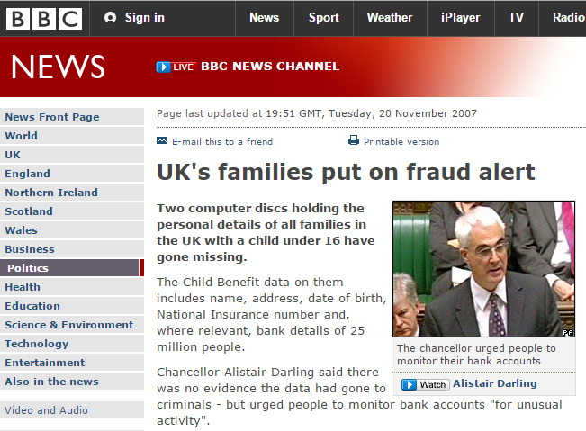
Nov 2007 – Sensitive Data Exposure?
A local story…
25m personal details potentially leaked
Large volumes of confidential data un-encrypted
Huge political embarrassment

Slide 18
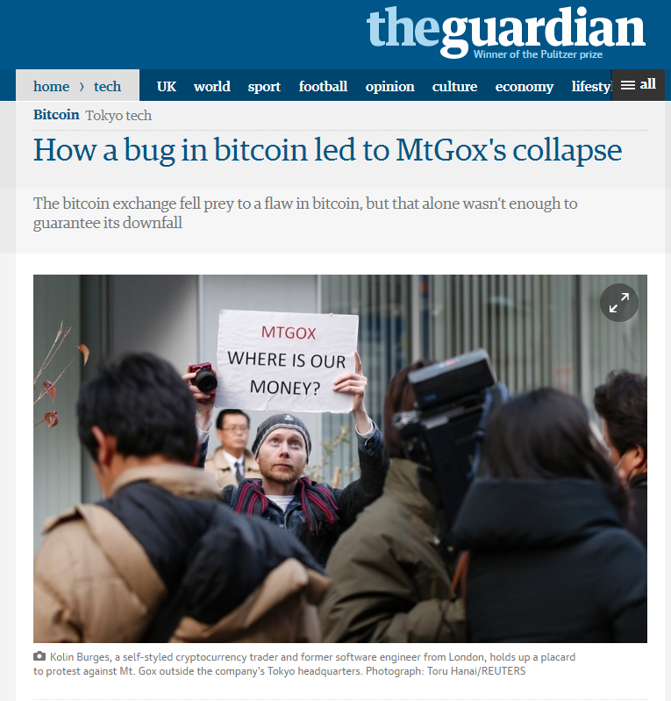
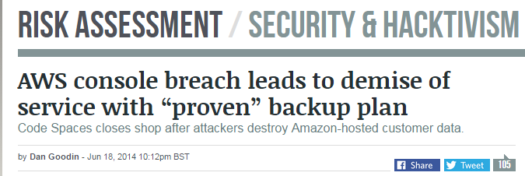
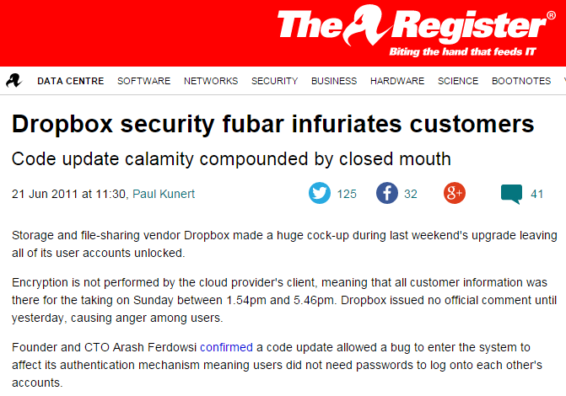
And so many others…

Slide 19
Who are we defending against – “Agents”
Hackers
Malware authors
Organised Criminals
Activists / Media
Competitors
Foreign Intelligence
Domestic Intelligence
Malicious Users
Malicious Employees
Nature & Environment
Ourselves
Accidents
Carelessness
Bugs

Slide 20
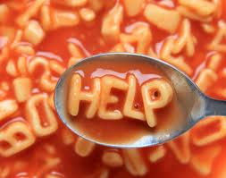
Compliance Standards
Making sense of the acronyms

Slide 21
A Layered Security Strategy
Policies, Procedures, Awareness
Physical
Perimeter
Internal Network
Host
Application
Data
Don’t stop here!
Notes:
Strength in depth
Compliance can be at different layers of this stack.

Slide 22
Information Security – CIA Triad
Confidentiality
Integrity
Availability
Information Security
Notes:
the preservation of confidentiality (ensuring that information is accessible only to those authorized to have access), integrity (safeguarding the accuracy and completeness of information and processing methods) and availability (ensuring that authorized users have access to information and associated assets when required)
Confidentiality: Controlling sensitive data, meeting legislation need, ensuring privacy. Controlling IP. Segregation of clients. Data Soverignty
Integrity: Is Change managed correctly. Are changes logged? Can we avoid corruption and data loss.
Availability: Is the info there when I need it. Is it fast and reliability available

Slide 23
“System Scope” is all important
Component / Sub-system
Data Centre
Application / Service
Service Provider (Your Organisation)
Entire End-User System (multiple systems)
Scoped to cover your customers systems

Slide 24




Regulatory Standards *
Acronym | Full name | Area regulated
PCI/DSS | Payment Card Industry Data Security Standard | Credit Card Fraud. 4 Conformance levels L1-L4
DPA | Data Protection Act | Protection of personal data
DPD | EU Data Protection Directive | Protection of personal data (EU) & safe harbour.
SOX | Sarbanes–Oxley | Corporate Auditing and Accountability / Responsibility
HIPAA | Health Insurance Portability and Accountability Act | Electronic healthcare records
* Selected
Notes:
Data Protection Act 1998
Computer Misuse Act 1990
Freedom of Information Act 2000
Obscene Publications Act 1959
Human Rights Act 2000
Telecommunications (Lawful Business Practice)(Interception of Communications) Regulations 2003;
Privacy and Electronic Communications Regulations.
Bribery Act 2010
EU Privacy Directive May 2012 (Cookie law)
Regulation of Investigatory Powers Act 2000
Copyright, Designs & Patents Act 1988;
Companies Act 1989;
Consumer Protection Act 1985;
Public records Act 1958 & 1967;
Communications Act 2003;
Official Secrets Act 1911, 1920 & 1989;
Electronic Commerce Act 2000;
Electronic Commerce (EC Directive) Regulations 2002;

Slide 25
Operations Standards
Acronym | Full name | Area covered
ISO27001:2013 | Information technology— Security techniques — Information security management systems — Requirements | Specifies an Information Security Management System for an Organisation
SOC 1,2,3 | Service Operation Controls | Control of financial information for a service organisation
FIPS | Federal Information Processing Standard | Standards for encryption, document processing
G-Cloud | UK Government G-Cloud | Digital marketplace for services with framework accreditation
OWASP ASVS | Application Security Verification Standard | Testing & procuring Web applications

Slide 26
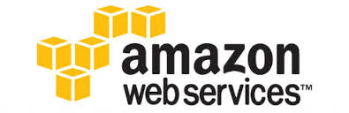


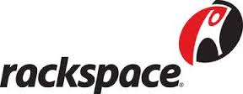
Cloud support for major standards
Provider | PCI-DSS | ISO 27K | SOC | G- Cloud
 | L1 | Yes | 1,2,3 | Yes | http://aws.amazon.com/compliance/
 | L1 | Yes | 1,2 | Yes | http://azure.microsoft.com/en-us/support/trust-center/compliance/
 | - | Yes | 1,2,3 | No | https://support.google.com/work/answer/6056694?hl=en
 | - | Yes | 1,2,3 | Yes | http://www.rackspace.co.uk/about-us/security
Notes:
AWS: http://aws.amazon.com/compliance/
Azure : http://azure.microsoft.com/en-us/support/trust-center/compliance/
Rackspace: http://www.rackspace.co.uk/about-us/security
Google: https://support.google.com/work/answer/6056694?hl=en

Slide 27
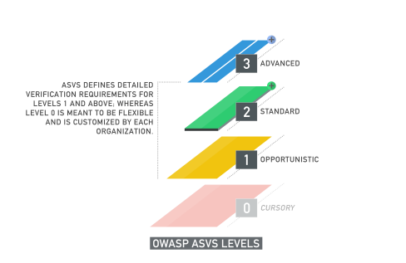
OWASP ASVS – Verification Levels
Please check out OWASP Application Security Verification Standard
https://www.owasp.org/images/5/58/OWASP_ASVS_Version_2.pdf

Slide 28

ISO27001
Notes:
SO/IEC 27001 (ISO 27001:2013) is the international Standard that describes best practice for an information security management system (ISMS). Accredited certification to ISO 27001 demonstrates that an organisation is following international information security best practices.

Slide 29
ISO27K
Information Security Management System
A family of InfoSec Management Standards
30+ separate documents : mostly guidelines
International Standard, published by ISO
Recognised widely - increasingly in the USA
Applicable to any Industry
Broad in scope and Non-prescriptive
But Clear on requirements
Foundation for many other more prescriptive InfoSec standards like PCI-DSS.
Notes:
Previously known as BS7799
Latest version ISO27001:2013

Slide 30
ISO 27001 Controls
Systems Dev Acquisition & Maintenance
Incident Management
Compliance Management
Security Organisation Management
Asset Management
Physical & Environmental Security
Business Continuity Management
Security Policy Management
Operations Security
Access Control
Cryptography
Human Resources Security
Communications Security
Supplier Relationships
Information
Confidentiality
Integrity
Availability
Risks
114 Controls
Across 14 Domains
Notes:
Most controls in Operations and Systems dev. Also Access Control and Physical Environment
Information Security policy Management
Policies
Review and Approval
Security Organisation Management
Management Commitment
Roles
Confidentiality
Human resources security
controls that are applied before, during, or after employment.
Education
Asset management
Hardware, software, systems, roles, fixed assets
Acceptable Usage Policy
Access Controls and managing user access
Credential Management
User Management
Lock screens and Clear Desks
Cryptographic technology
Key Management
Correct Usage
Physical security
Entry Controls
Public Access
Environmental threats
Equipment security
Operational Security
Operating Procedures
Segregation of Duties
Change Management
Backup & patching
Capacity Management
Secure Comms and data transfer
Network access
Remote working
Secure Acquisition, dev and support of systems
Correct Processing / Validation
Change Control
Vulnerability Management
Outsourcing
Security for Suppliers & 3rd parties
Non-Disclosure Agreements
Incident Management
Reporting Incidents
Procedures
Learning
Evidence
Business Continuity / DR
Process
Risk Assessment
Planning
Testing
Compliance
Internal Requirement / policies
External factors / laws
Legislation
IPR
Auditing

Slide 31
ISO27001
Emphasis on Risk Assessment and ‘Treatment’ through ‘Controls’
Living Documented Policies
Record Keeping
Continuous Internal Auditing
Annual External Accreditation by 3rd party

Slide 32
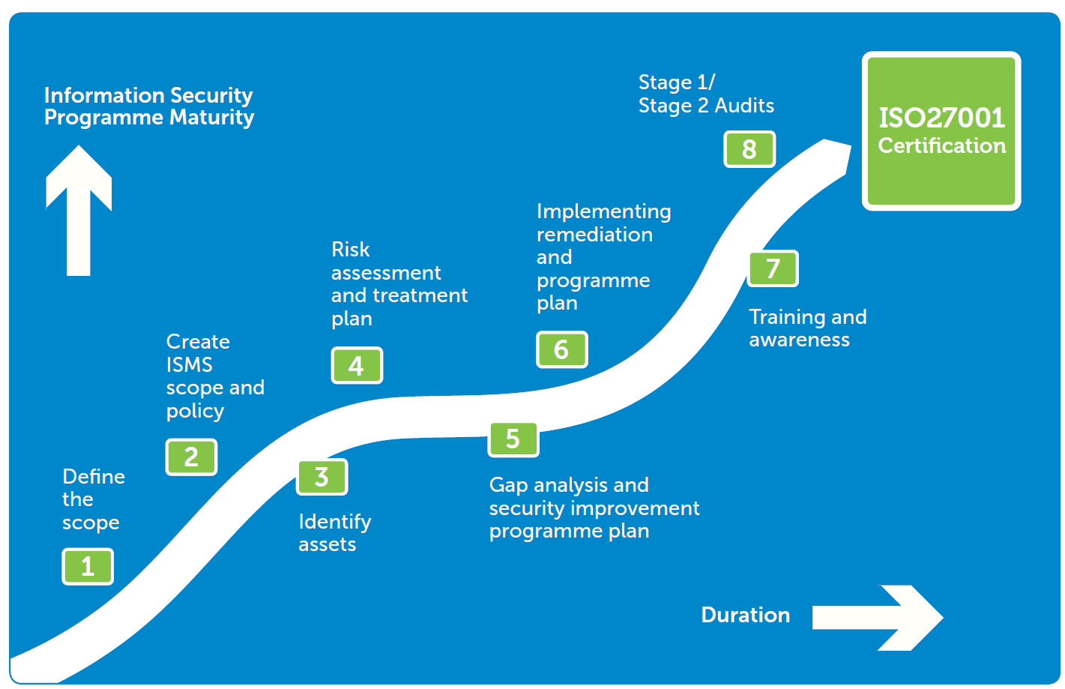

Slide 33
Some concerns you might have
“This is an IT job”
“It’s all about writing policies and procedures”
“We’ll get lost in all those documents”
“ISO 27001 will only make our job more difficult”
“It will take forever to implement”
“We do it only because of the certification”
Notes:
“This is an IT job” – this is wrong because security is everyone’s job – e.g., everyone needs to protect his or her laptop / information
“It’s all about writing policies and procedures” – this is wrong because the point is not in writing documents, but in applying them in practice – e.g., if the procedure says that backup needs to be done daily even for laptops, then this is something that everyone needs to do
“We’ll get lost in all those documents” – wrong because we will write only the documents that are really needed – we will try to keep the number of documents to a minimum; besides, we will present you with the documents before they are published
“ISO 27001 will only make our job more difficult” – this standard may require some new things from you, but it will help you with other things – e.g., implementation of ISO 27001 will decrease the number of IT incidents, meaning that employees in the IT department won’t have to lose time on resolving those incidents; also, it will decrease the chance of someone abusing your account and performing fraud (for which you would be held accountable)
“It will be implemented in 2 months” – this is wrong because implementation of ISO 27001 requires changes in behavior, and we cannot make several changes at the same time (imagine if we published 20 new policies and procedures in a single day). This is why these documents need to be introduced gradually
“We do it only because of the certification” – certification is one of our goals, but not the only one… [go to the next slide]

Slide 34
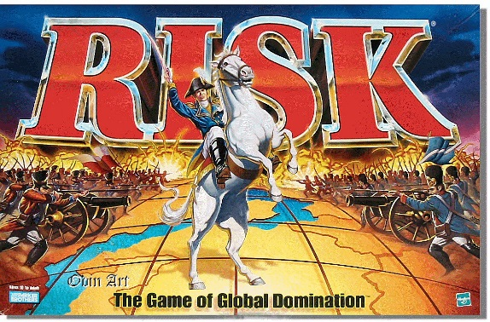
Government Compliance

Slide 35
UK Gov Security Information Classifications
IL: Impact Level – measure of Risk using CIA
OFFICIAL
SECRET
TOP SECRET
UNCLASSIFIED ‘IL1’
PROTECT ‘IL2’
RESTRICTED ‘IL3’
CONFIDENTIAL ‘IL4’
TOP SECRET ‘IL6’
SECRET ‘IL5’
Notes:
IL scheme being replaced. Confusion due to classification of Info and systems.
https://www.gov.uk/government/uploads/system/uploads/attachment_data/file/251480/Government-Security-Classifications-April-2014.pdf
OFFICIAL
The majority of information that is created or processed by the public sector. This includes routine business operations and services, some of which could have damaging consequences if lost, stolen or published in the media, but are not subject to a heightened threat profile.
SECRET
Very sensitive information that justifies heightened protective measures to defend against determined and highly capable threat actors. For example, where compromise could seriously damage military capabilities, international relations or the investigation of serious organised crime.
TOP SECRET
HMG’s most sensitive information requiring the highest levels of protection from the most serious threats. For example, where compromise could cause widespread loss of life or else threaten the security or economic wellbeing of the country or friendly nations.

Slide 36

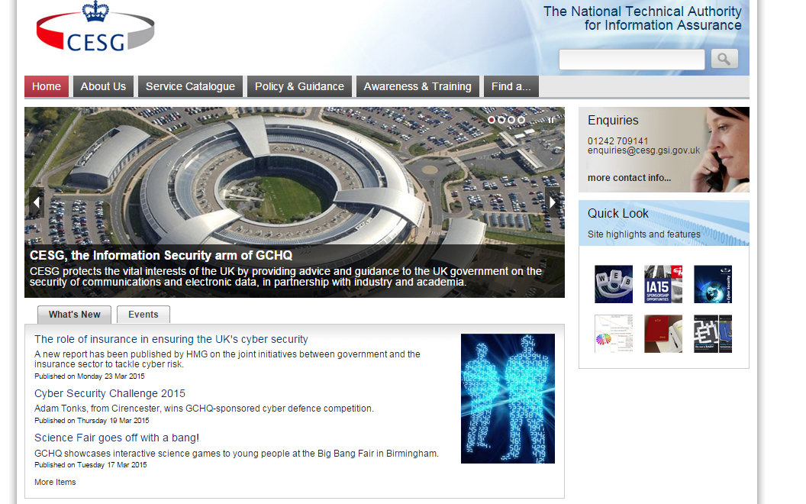
Selling to Public Sector
Security & Assurance is overseen by CESG
Under-pinned by ISO27001
Seek assistance of a CLAS consultant

Slide 37
G-Cloud aka Digital Marketplace
A market-place for SMEs to offer services to UK Gov
Single Accreditation to sell to all UK Pub Sector
Aka Live Assertions
Simpler than direct accreditation with customer
Notes:
https://www.digitalmarketplace.service.gov.uk/

Slide 38
What does it mean for me?

Slide 39
What’s it mean to me as an Engineer?
More Security awareness & training
Access systems & Password policies
Separation of duties
More rigour in selection of vendors & 3rd parties
More documentation of processes
Systems for record-keeping – e.g. Change Management
Independent Penetration Tests
Audits and Auditors

Slide 40
Questions

Slide 41
The 27K Series – Selected dead trees
Standard | Purpose
27000 | Overview and Vocabulary
27001 | Security Techniques - Information security management systems — Requirements.
27002 | Code of practice for information security management
27003 | Implementation Guidance
27004 | Measurement
27005 | Risk Management
27018 | Protecting personal Info in the Cloud
27032 | Guidelines for Cybersecurity
Notes:
See http://en.wikipedia.org/wiki/ISO/IEC_27000-series

Slide 42
114 Controls across 14 domains
Information Security policy Management
Security Organisation Management
Human resources security
Asset management
Access Controls and managing user access
controls that are applied before, during, or after employment.
Hardware, software, systems, roles, fixed assets
Cryptographic technology
Physical security
Operational Security
Secure Comms and data transfer
Operating Procedures
Change Management
Backup & patching
Network access
Remote working
Secure Acquisition, dev and support of systems
Change Control
Vulnerability Management
Security for Suppliers & 3rd parties
Incident Management
Business Continuity / DR
Compliance
Internal Requirement / policies
External factors / laws
Policies
Management Commitment
Review and Approval
Roles
Confidentiality
Acceptable Usage Policy
Education
Entry Controls
Public Access
Environmental threats
Equipment security
Segregation of Duties
Capacity Management
Credential Management
User Management
Lock screens and Clear Desks
Correct Processing / Validation
Key Management
Non-Disclosure Agreements
Learning
Evidence
Process
Procedures
Reporting Incidents
Risk Assessment
Planning
Testing
IPR
Auditing
Correct Usage
Outsourcing
Legislation

