Slide 1
Databases:
A class break by design!
Is there a class defense?
Dr Steve Moyle
Founder/CTO Secerno
E: steve.moyle@secerno.com
T: +44 7801749587
Edinburgh Chapter
February 2008

Slide 2
“Sensitive customer information is like asbestos. We've been building housing with it for years and only recently discovered its toxic when airborne”.
  Andrew Jaquith
  Yankee, September 2007

Slide 3
“In my opinion, database security is riddled with holes and it’s the biggest problem we face in IT today.
Database attacks offer the biggest potential for fraudulent activity and damage to companies’ reputations and customer confidence”.
  David Litchfield, Managing Director NGSS
  Keynote, Black Hats Conference
  Las Vegas, August 2006

Slide 4

Databases: The class break by design! Is there a class defense?
Outline
Class breaks
  Database principles
  The infinite language space
Class Defenses
  Informed Security
  Automatic unique language subspace

Slide 5
Databases … the good news
Ubiquitous persistent storage → fielded in millions of systems
Skills availability
Standards based → common language
Long history
Multi featured
Aggregated storage of valuable data

Slide 6
Ubiquitous persistent storage
How many fielded systems?
  $14 billion database market in 2005 [Source: Gartner 2005]
  135,166,473 “up” web sites [Source: Netcraft September 2007]
How many “unknown” systems?
  Products built on a database that the owner knows nothing about
Persistent storage
  Microsoft was rumoured to have considered it as an alternative component of their operating system for its file-store

Slide 7






Mature market
Marketplace of alternatives
  “simple” for customers to switch ☺
Database skill sets
  DBAs
  Applications Development
  …
  (But what about database security?)
Very stable technology
80% budget spent “keeping the lights on”
  Difficult to start again with a “clean sheet”
Competition is good for customers as it drives standardisation → but standardisation leads to a single point of failure

Slide 8
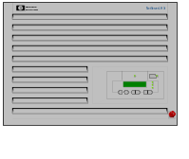
Aggregated data – aggregating risk
Databases are one of many components in complicated systems
Abstracting complexity into large components obfuscates security issues
Evolution of data usage
  Data processing systems → Client-server → … → SOA
  How many legacy database systems secure in yesteryear are wrapped to deliver SOA?
Web Application
Business
Application
Logic
Database
Customer
Web
Browser
Web
Server
Firewall

Slide 9
Databases … the not so good news
Ubiquitous persistent storage → fielded in millions of systems → every one has got one
Skills availability → every one knows how they work
Standards based → common language
Long history → old fashioned
Multi featured → vast vulnerability surface
Aggregated storage of valuable data → all eggs in a single basket

Slide 10
Class Breaks

Slide 11
Class breaks
What is a “class break?” In network security jargon, that’s what happens when one breach leads to a whole new “class” of attacks on various systems, using similar methods.
[Source: http://www.doubletongued.org/index.php/citations/class_break_1/]
"Technological advances bring with them standardization, which also adds to security vulnerabilities, because they make it possible for attackers to carry out class breaks: attacks that can break every instance of some feature in a security system.
Class breaks mean that you can be vulnerable simply because your systems are the same as everyone else’s. And once attackers discover a class break, they’ll exploit it again and again until the manufacturer fixes the problem (or until technology advances in favor of the defender again).“
[Source: Bruce Schneier, “Beyond Fear“, 2003, pp 93-4]

Slide 12
Classic class break
Combining control and data channels
"For decades, phone companies have been fighting against class breaks. In the 1970s, for example, some people discovered that they could emulate a telephone operator’s console with a 2600-Hz tone, enabling them to make telephone calls for free, from any telephone....”
[Source: Bruce Schneier, “Beyond Fear“, 2003, pp 93-4]

Slide 13
Lessons from history
What can go wrong when combining static data & dynamic control in the one channel?
Microsoft Word
  Words/Paragraphs + Word Basic Macros
  → Macro viruses
Web browsers
  Static Web pages + JavaScript
  →Cross-site scripting (XSS)
Databases
  Valuable data + Data Control Language, Data Manipulation Language
  → SQL Injection, …
Remote Database Control

Slide 14
Principles of databases
History
  Original research due to Ted Codd in the 1960s
    Codd’s 12 rules for defining a fully relational database
    [Source: E.F. Codd, : "Is Your DBMS Really Relational?", ComputerWorld, 1985]
The “breakthrough” → everything is a relation (i.e. a table of records)
Everything is accessed by the same language
  Structured Query Language is the most popular computer language used to create, modify, retrieve and manipulate data from relational database management systems.

Slide 15
Codd’s Principles: Rule #4
Codd’s 12 rules for defining a fully relational database
  Rule 4: Dynamic On-line Catalog Based on the Relational Model
  The database description is represented at the logical level in the same way as ordinary data, so authorized users can apply the same relational language to its interrogation as they apply to regular data.

Slide 16
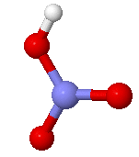
Database Class break – Component #1
Database nitric acid (nitro)
Combining control and data channels
To be a relational database it must combine data and control in the same …
  Physical channel (the network)
  Logical channel (the language)

Slide 17


The Language space
How many sentences are allowed in a language?
How many SQL statements can we write?
Can we index an infinite space?

Slide 18
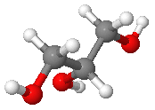
Database Class break – Component #2
Database glycerine
Consider the Database as a scripting engine
SQL is a powerful, common, standard scripting (a.k.a. macro) language.
What functionality can be achieved with a modern database?
  Data access (e.g. read)… yes
  Data manipulation (e.g. write) … yes
  … operating system interaction … sure
  …
  Anything that is computable (?)

Slide 19
The database vulnerability surface
The infinite language space
Application programming errors
inappropriate setup
  E.g. Over provisioning, ACL
+
+
= …

Slide 20
How does an application talk to the database?
Assembling a Normal SQL statement
  SELECT * from dvd_stock where [catalog-no] = 'PHE8131' and location = 1
The parameters in the statement come from user input (e.g. a web browser). The application layer accepts the values for catalog-no and location (‘PHE8131’, ‘1’) and pastes them into the pre-canned query template.
SELECT * from dvd_stock where
[catalog-no] = ' ' and location =
PHE8131
1

Slide 21
Database answers
Results from a Normal query.
Statement:
SELECT * from dvd_stock where [catalog-no] = 'PHE8131' and location = 1
Output:
Star Trek - The Next Generation Season 2 39.35 15
Star Trek - The Next Generation Season 3 39.35 12
Star Trek - The Next Generation Season 4 39.35 13
Star Trek - The Next Generation Season 5 39.35 17

Slide 22
Assembling an abnormal SQL statement:
SQL Injection
Instead of inputting a sensible value for catalog-no in the web browser the user enters
' union select name, id, 0 from sysobjects where xtype='U';--
which the application layer pastes into the pre-canned query template.
SELECT * from dvd_stock where [catalog-no] = '
'union select name, id, 0 from sysobjects where xtype='U';--
' and location =
1

Slide 23
Codd’s Achilles heal
Using "union" in the select returns meta-data about the tables within the database.
Statement:
SELECT * from dvd_stock where [catalog-no] = '' union select name, id, 0 from sysobjects where xtype='U';--' and location = 1
Output:
adult_display 1269579561 0
anonemail 1285579618 0
card_prefix 1301579675 0
catalog 1317579732 0
catalog_redirects 1349579846 0
certs 1365579903 0
country 1381579960 0
director 1397580017 0
directorlink 1413580074 0
dvd_customers 1429580131 0
dvd_orderitems 1461580245 0
dvd_orders 1445580188 0
dvd_stock 1477580302 0
dvd_users 1493580359 0
:
(Slide B-03)

Slide 24
“Airborne” Sensitive Customer Information
Credit card detail records.
Statement:
SELECT * from dvd_stock where [catalog-no] = '' union select cardNo, customerId, 0 from DVD_Orders --' and location = 1
Output:
4511222233334444 11853 0
4612345678901234 11853 0
4675883388338833 11588 0 4514861356415750 11204 0

Slide 25
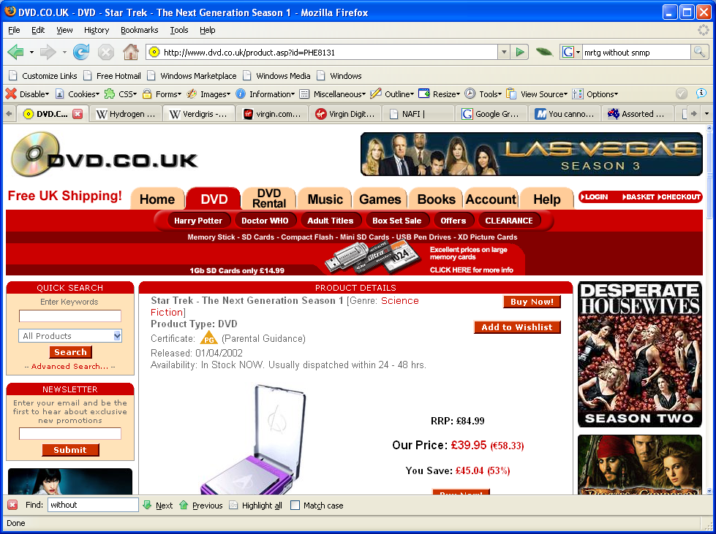
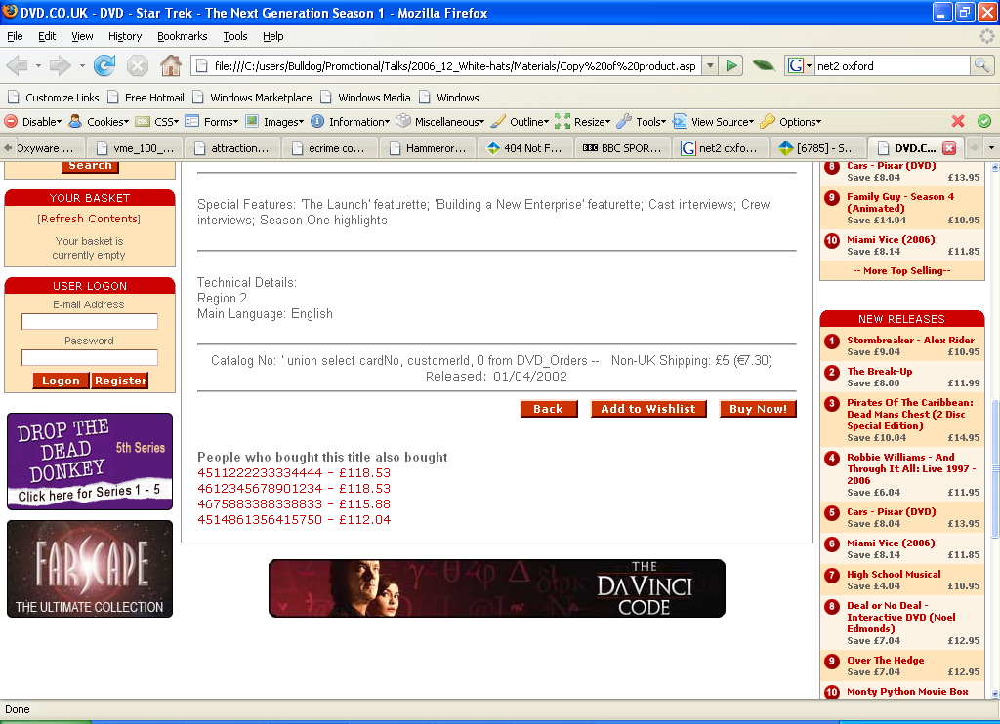
What does the attacker actually see?
' union select cardNo, customerId, 0 from DVD_Orders --

Slide 26
How did this situation occur?
Developers love adding features … but … do they ever delete features?
We can define developers (from the perspective of application security) as:
  Vulnerability Surface Expansion Engineers

Slide 27
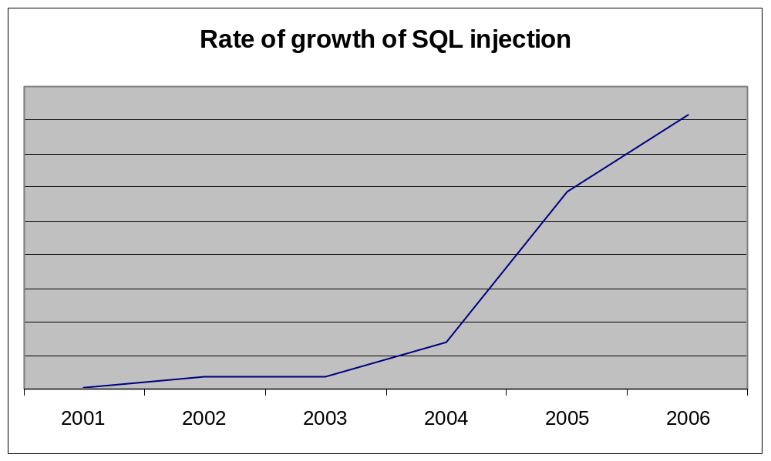
External Attack – It’s Personal
SQL injection remains a serious type of attack affecting databases, with 250% year on year growth (MITRE).

Slide 28
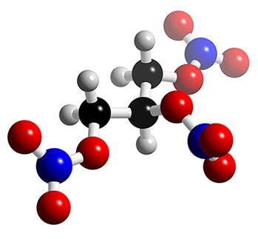

Codd’s principles and the infinite language space
Database nitro-glycerine
The same language is used to interact with meta-data as data
The SQL language allows infinite statements to be accepted
How does one defend in an infinite space?

Slide 29
Class Defenses

Slide 30
Defending Class Breaks
Schneier’s view:
  “manufacturer fixes the problem (or until technology advances in favor of the defender again).”
But …
  Manufacturers have (or nearly have) fixed their end!! …
What “technology advances favor the defender”?

Slide 31
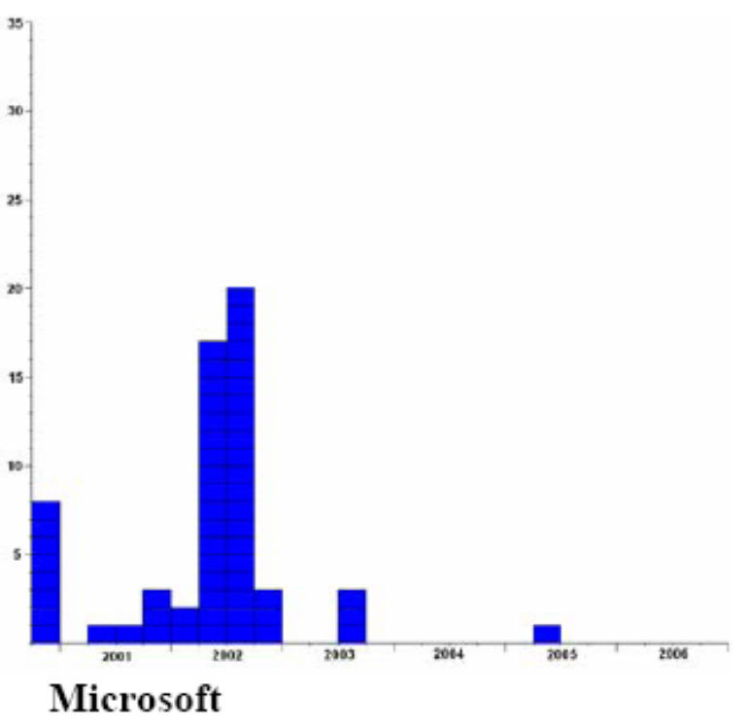
Can patching really help?
Microsoft SQL Server users …
Number of
Published
Vulnerabilities
[Source: David Litchfield Which database is more secure? Oracle vs. Microsoft,
21st November 2006]
Year

Slide 32
Class defenses
What is a “class defense?”
An approach that leads to a whole new “class” of defenses on various systems, using similar methods.
[Source: Steve Moyle, RSA Europe, October 2007]

Slide 33
Defending in an infinite language space
How does one defend in an infinite space?
… By defining the sub-set of the space that is normal for the system in its (unique) context [still potentially infinite]
How does one define the appropriate language subspace? ….

Slide 34
“Legal” SQL vs. Normal behaviour
How hard is it to stop hacking?
It is hard to define normal SQL behaviour because it is application specific.
Sinister queries, previously observed
The space of legal SQL is infinite
Previous
Where we have observed the system
New behaviour
Novel queries, not previously observed
Do you want your databases answering these queries?

Slide 35
Separation of control
S
Q
L
Data Definition Language:
Meta Data
Developers/DBAs only
Application: Previous
Data Manipulation Language:
Queries
Data Control Language:
Access Permissions
Never applications

Slide 36
How does one define the appropriate language subspace?
|
NOT
Pre-defined black lists ☹
  Unique database deployment contexts cannot be foreseen
  Error rates unacceptable
User defined white lists ☹
  Impractical to expect application owners to program all situations in advance
Regular expressions ☹
  Too crude to adequately define the intent of a programming language [Chomsky, 1956, 1959]

Slide 37
Syntax versus Semantics
We don’t like union in this context
SELECT * from dvd_stock where [catalog-no] = '' union select cardNo, customerId, 0 from DVD_Orders --' and location = 1
Can search for the string union in the hope it will be a keyword … unless there are references to “union bank” etc. which will trigger a false positive
… the developer has actually programmed
SELECT lastname from boys union SELECT lastname from girls
But … what about
uni/* */on
… which is semantically equivalent?
... or
u/* */nion
…
char(117,110,105,111,110)

Slide 38
Grammatical Clustering – A class defence for databases
Controlling computer behaviour requires the understanding of the conversations between components
… a language approach combined with machine learning is the only effective way to do it
Motivation
  Language transmits intent
  Malicious intent transmitted by language too
  Attackers thwarted by context dependent unique tripwires
  Only by understanding unique systems at the language level is this achievable efficiently

Slide 39
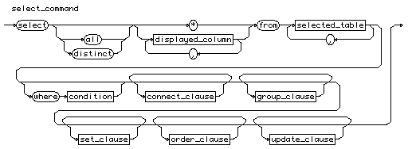


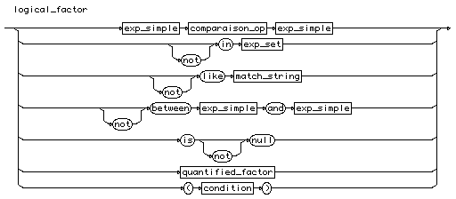
Ingredients for Grammatical Clustering
Language (SQL)
Observed Statements
SELECT Blob2 FROM catalog WHERE [catalog-no] = '0141318090';
SELECT Blob2 FROM catalog WHERE [catalog-no] = '0141317388';
SELECT Blob2 FROM catalog WHERE [catalog-no] = '0747573603';
SELECT Blob2 FROM catalog WHERE [catalog-no] = '0747573611';
SELECT Blob2 FROM catalog WHERE [catalog-no] = '074757362X';
SELECT Blob2 FROM catalog WHERE [catalog-no] = '0747573638';
SELECT Blob2 FROM catalog WHERE [catalog-no] = '0747569401';
SELECT * from dvd_stock where [catalog-no] = 'HEADHPS2' and location = 1
SELECT * from dvd_stock where [catalog-no] = 'HEADHPS2' and location = 2
SELECT Blob2 FROM catalog WHERE [catalog-no] = '074754624X';
SELECT Blob2 FROM catalog WHERE [catalog-no] = '0747551006';
SELECT Blob2 FROM catalog WHERE [catalog-no] = '0747561079';
SELECT Blob2 FROM catalog WHERE [catalog-no] = '0747568979';
SELECT * from dvd_stock where [catalog-no] = 'PHE8131' and location = 1
SELECT Blob2 FROM catalog WHERE [catalog-no] = '0747545723';
SELECT * from dvd_stock where [catalog-no] = 'PHE8131' and location = 2
SELECT Blob2 FROM catalog WHERE [catalog-no] = '0747554560';
SELECT COUNT(*) AS fullCount FROM catalog WHERE ((title LIKE '%gotcha%' )) AND Status = 1 AND NOT [art-type] = 7 AND NOT [art-class] = 'XXX'
SELECT * from dvd_stock where [catalog-no] = 'PHE8214' and location = 1
SELECT N'Testing Connection...'
SELECT * from dvd_stock where [catalog-no] = 'PHE8214' and location = 2
EXECUTE msdb.dbo.sp_sqlagent_get_perf_counters
SELECT * FROM prodtype WHERE [art-class] = 'XXX'
SELECT * FROM certs WHERE [cert-type] = '18'

Slide 40
Outputs from Grammatical Clustering
1
<column>
*
blob2
[cert-type]
euroexchangerate
[catalog-no]
Hometext
:
:
location
= ‘18
<table>
certs
catalog
dvd_users
:
:
dvd_stock
prodtype
<column>
*
blob2
[cert-type]
euroexchangerate
[catalog-no]
Hometext
:
:
location
<column>
*
Blob2
[cert-type]
euroexchangerate
[catalog-no]
Hometext
:
:
location
FROM
WHERE
= ‘PHE1831’ and
SELECT
= 1
2
SELECT * FROM certs WHERE [cert-type] = '18‘
SELECT * from dvd_stock where [catalog-no] = 'PHE8131' and location = 1

Slide 41

Extract the database language space used and build security control policy
Automatic extraction of the actual language space used providing rich context dependent knowledge
Build precise control policies based on live measurements
Policies precise enough to determine
SELECT * from dvd_stock where [catalog-no] = '' union select cardNo, customerId, 0 from DVD_Orders --' and location = 1
is anomalous …
… without needing to trigger an explicit block list

Slide 42
Results
Attack detection & prevention [Yes – BLOCKING!]
  Database misuse → internal/external …
Understanding of application behaviour
  vulnerabilities are all lurking in the application layer
Knowledge feedback loop to all
  Audit/compliance
  Operations
  Development
  …

Slide 43
Conclusions
Databases are massively vulnerable to class attacks by design
Caused by their underlying principles and technology and multiplied by their ubiquity and the appalling quality of applications development
Defending databases requires a strong understanding of what they should normally be doing (and restricting it)
Techniques from machine learning and computational linguistics provide an approach that can be used as a “class defense”

Slide 44
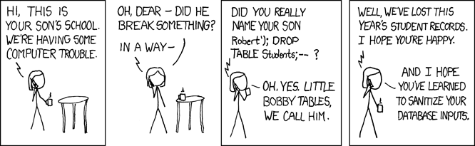
Questions?
Dr Steve Moyle
Founder/CTO Secerno
E: steve.moyle@secerno.com
T: +44 7801749587

