Slide 1
Welcome to
OWASP Day 2007
Jeff Williams
OWASP Foundation Chair
jeff.williams@owasp.org
Notes:
Hi – my name is Jeff Williams. I’ve been working in application security for over a decade, and I volunteer my time as the Chair of OWASP.
I’m thrilled to welcome you to our very first OWASP DAY. The OWASP Community is thriving, and almost 20 chapters around the world have organized day-long events this week to focus on application security. All the presentations will be available on the OWASP website where everything is free and open to everyone.
If you have questions or comments about OWASP, please feel free to contact me and I’ll try to get them answered for you.

Slide 2
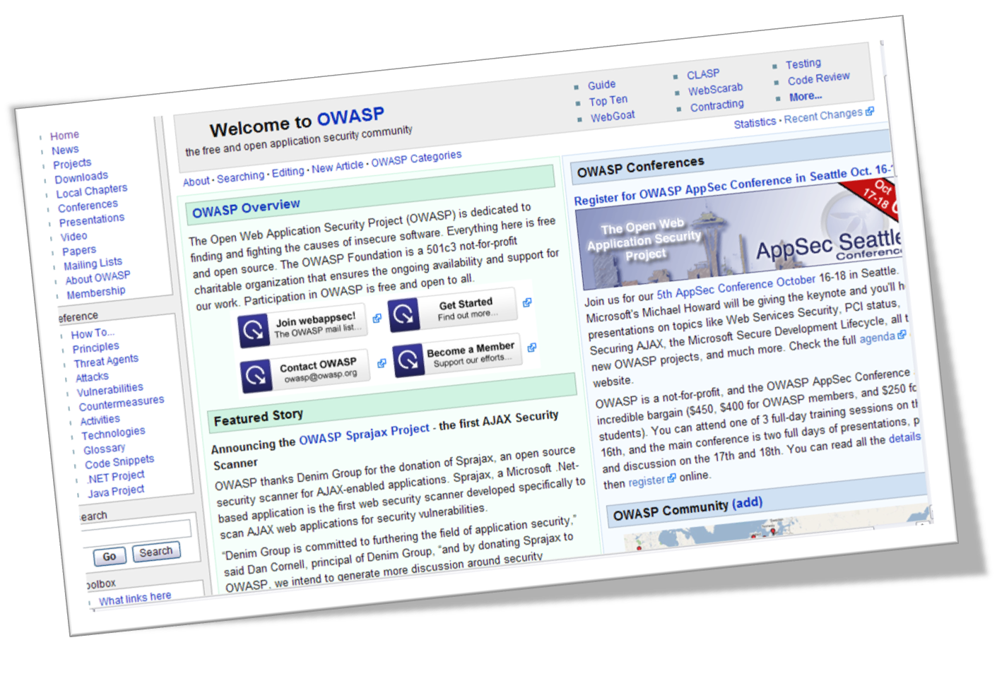
Making Application Security Visible
Notes:
At the core, OWASP is a just a community of people passionate about application security. We all share a vision of a world where you can confidently trust the software you use. Unfortunately, the current software market doesn’t encourage security – that’s something we’re trying to change. One of our primary missions is to make application security visible so that people can make informed decisions about risk.
You’ll find lots of free and open source tools, documents, basic information, guidelines, presentations, video, and blogs at OWASP to help you get started. You’ll also find a rich community of people on our mailing lists, participating in our local chapters, and attending our conferences to help you.

Slide 3


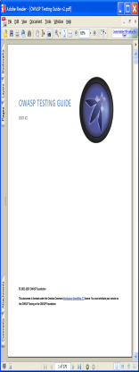







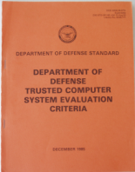








OWASP Is Alive!
2009
…
2007
2005
2003
2001
Notes:
OWASP plays a special role in the application security ecosystem. We’re a vehicle for sharing knowledge and best practices across organizations.
We have been very careful to limit commercial influence on what we do. Many people employed by vendors participate, but only as individuals. We are entirely volunteer and have very low expenses, so we award 100% of our membership funds as grants back to promising application security projects.
Application security is moving very quickly and we’re working hard to tackle the newest, most difficult problems.
Do you have a bookshelf of security books? When’s the last time you opened them? They don’t have answers to today’s problems because they’re dead.
When they say, “print is dead” they don’t mean it’s out of style – it’s static not living!
Think of OWASP as a process for translating security principles to the latest technologies and getting them to developers fast
It’s an evolving growing living thing

Slide 4
OWASP by the Numbers
420,000 page views per month
15,000 downloads per month (SF alone)
10,000 members on mailing lists
2,600 wiki users
1,500 wiki updates per month
95 chapters worldwide
75 individual memberships
38 tool and documentation projects
28 corporate/educational memberships
25 new projects funded
0 employees

Slide 5
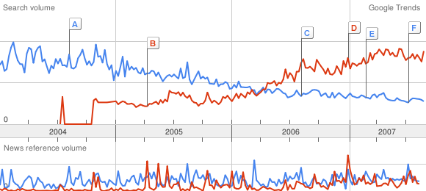
Thank You
Google Trends Data for:
● Buffer overflow
● XSS
Notes:
We’re only just starting to scratch the surface of application security. There’s a huge amount of work to do.
Despite all the efforts of all the great people involved in OWASP, the world’s software is most likely getting less and less secure. As we increase our interconnections and use more and more powerful computing technologies, the likelihood of introducing vulnerabilities increases exponentially.
After 30 years, we’re finally starting to see the decline of the buffer overflow. We didn’t get smarter about software development, we’re just switching to platforms that don’t encourage buffer overflows. After a decade, we’re still seeing widespread XSS problems. And we’re introducing new technologies faster much faster than we can secure them. Things like Web Services, Ajax, Flex, Air, Silverlight, and JFX come right to mind.
Whatever the internet becomes, OWASP can play a key role in making sure that it is a place we can trust.
Thank you all for your participation in OWASP – I’m looking forward to working with all of you.

