Slide 1
The OWASP Testing Guide
Jeff Williams
OWASP Chair
jeff.williams@owasp.org

Slide 2
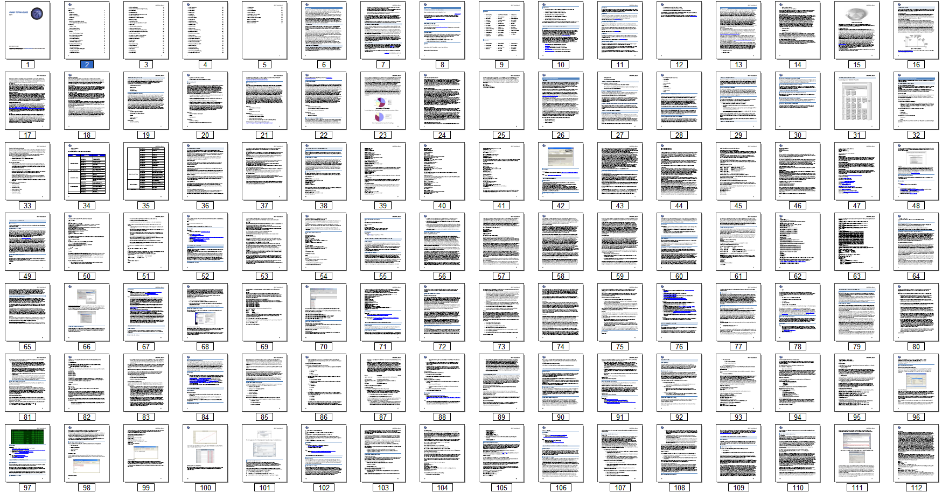
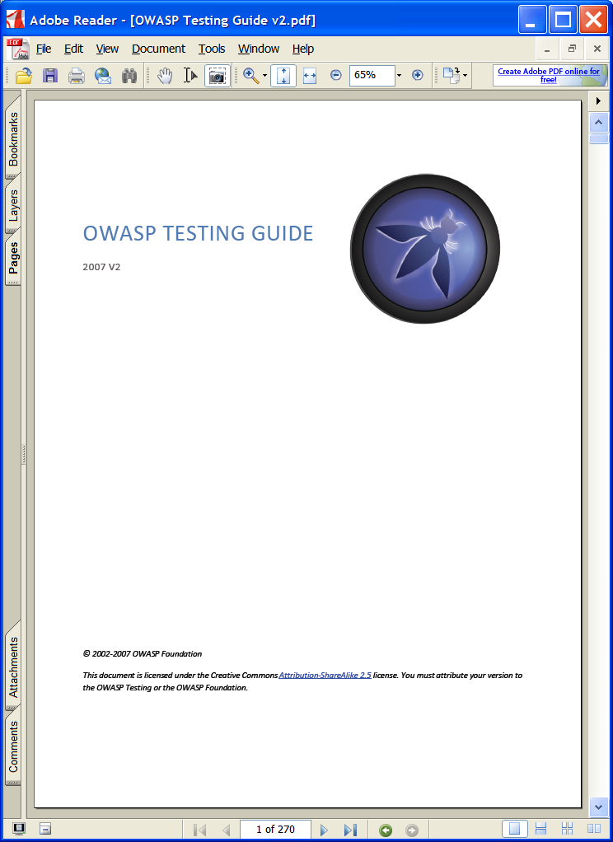
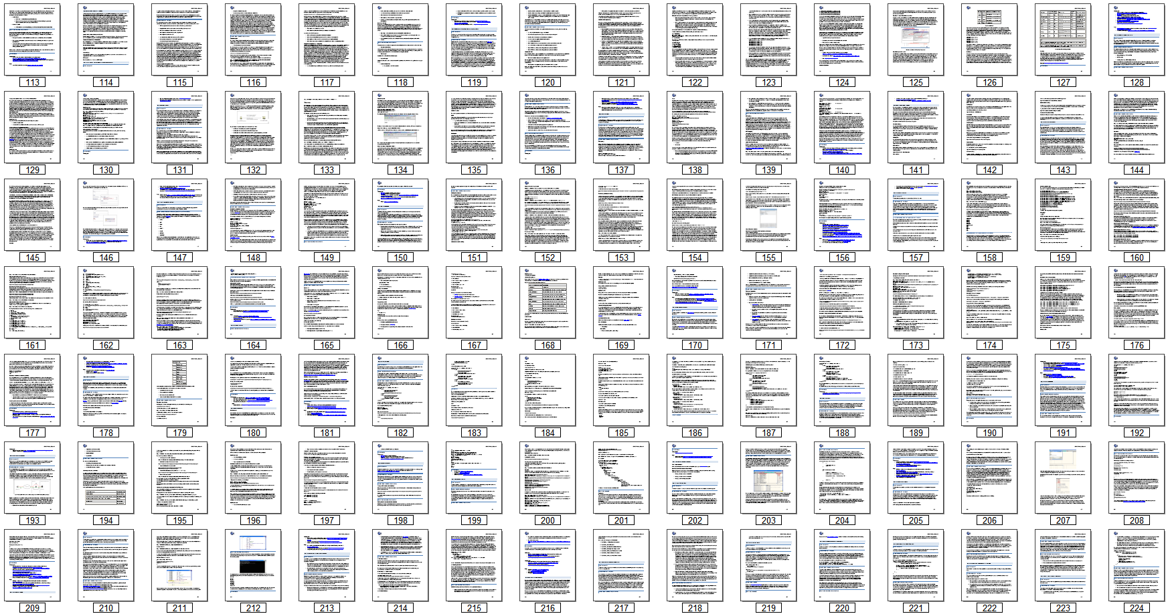
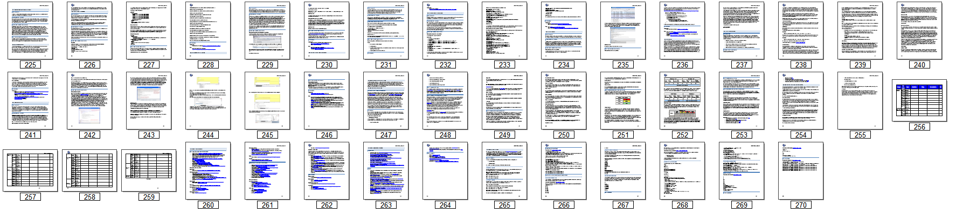
What Is the OWASP Testing Guide?
A book…
http://www.owasp.org/index.php/Testing_Guide
Notes:
Facts about the DOCUMENT:
Free PDF file and website
270 pages
Basic guideline for performing web application security testing
Covers the most serious attacks and vulnerabilities
Sort of an encyclopedia of testing procedures
Not complete…more on this later

Slide 3
What Is the OWASP Testing Guide?
Part of an appsec body of knowledge…
Testing Principles
Testing Process
Custom Web Applications
  Black Box Testing
  Grey Box Testing
Risk and Reporting
Appendix: Testing Tools
Appendix: Fuzz Vectors
Information Gathering
Business Logic Testing
Authentication Testing
Session Management Testing
Data Validation Testing
Denial of Service Testing
Web Services Testing
Ajax Testing
Notes:
The Guide Contents
A series of articles on the most common web application security problems
Some process information, but not much…
The world desperately needs a body of knowledge on application security. One important piece of this body of knowledge is about application security testing.

Slide 4
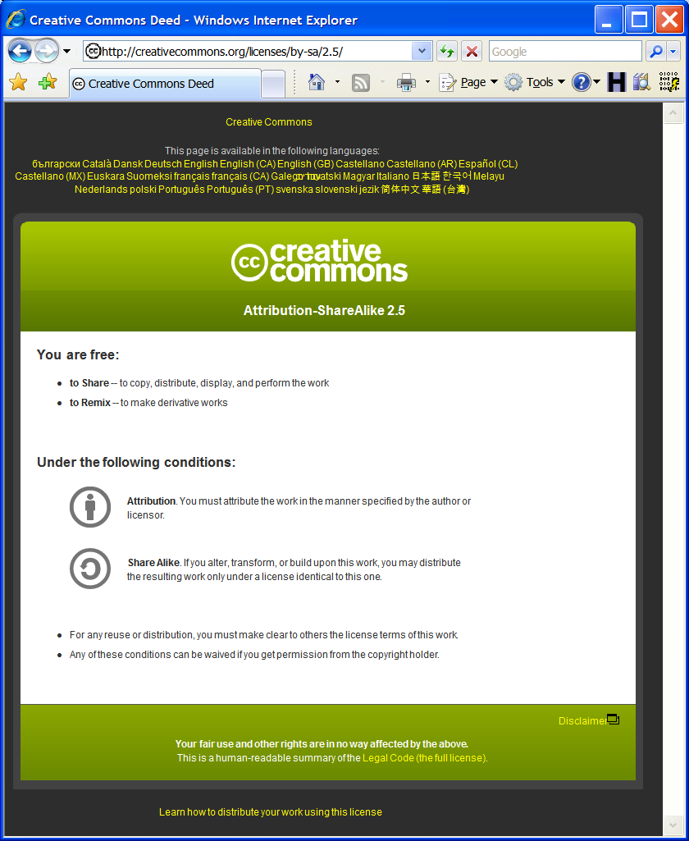

What Is the OWASP Testing Guide?
Free and open…
Notes:
Freedom
Free as in “free beer” is important to reach enough people
Free as in “free speech” is important so nobody can ever take it away
Anyone and everyone can participate and contribute
OWASP is not about recognition – it represents a collective work
Security shouldn’t be a black art

Slide 5
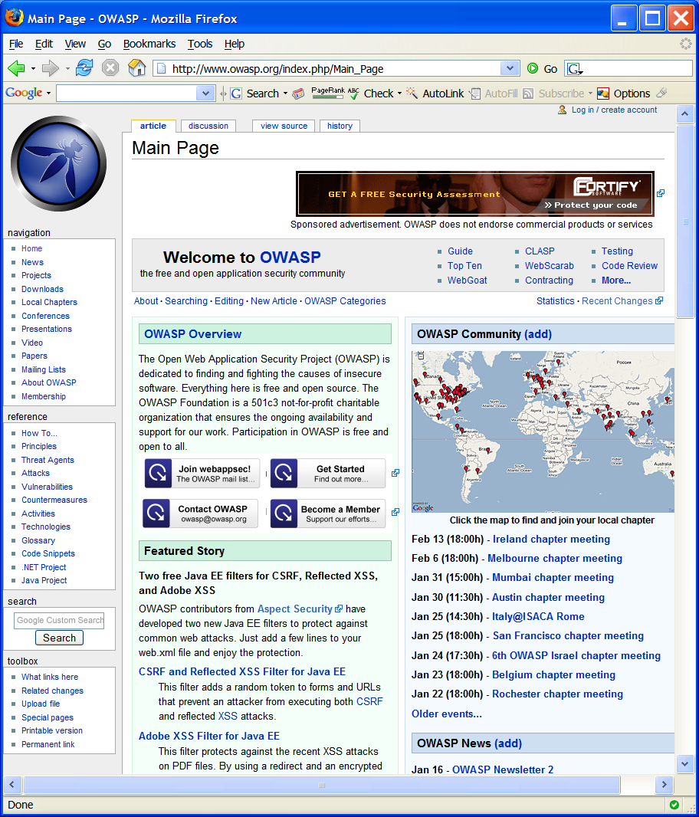
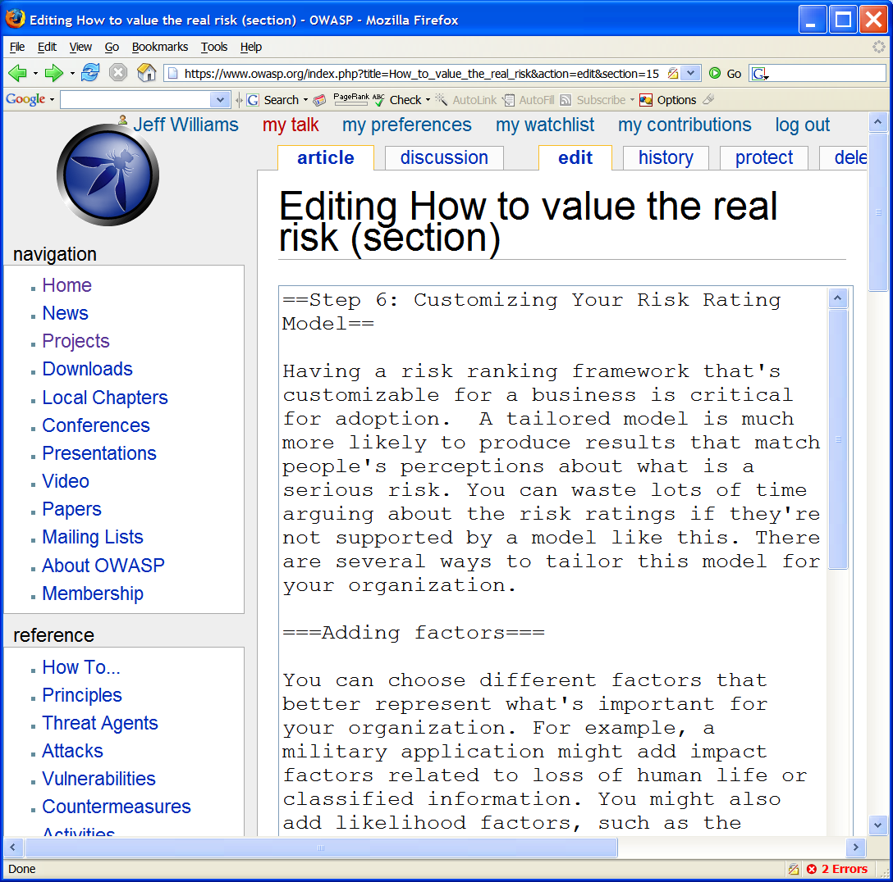
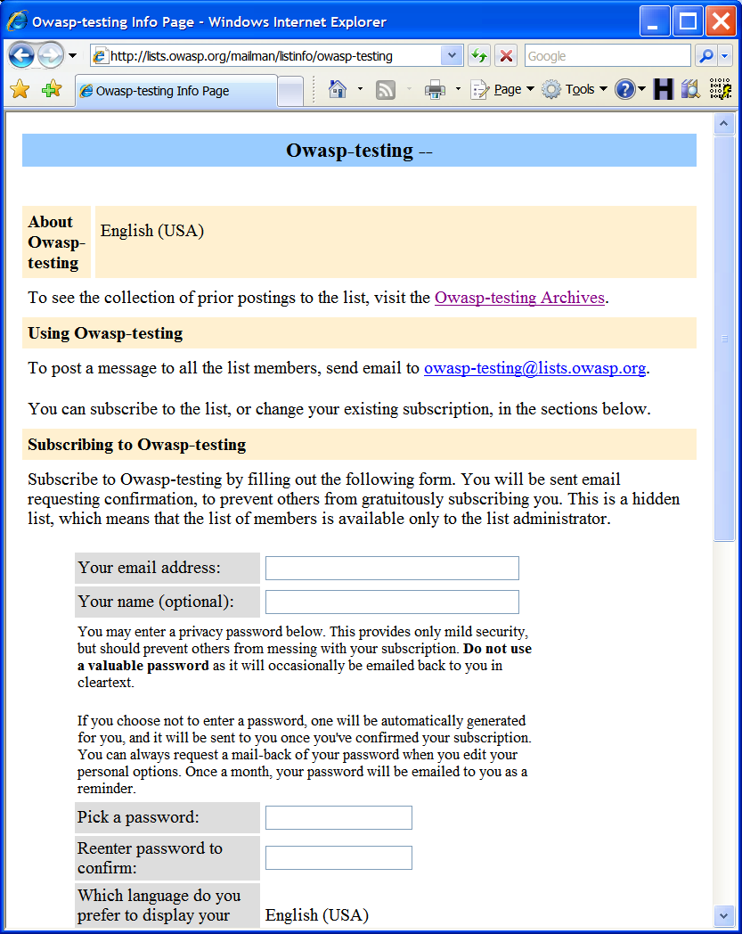
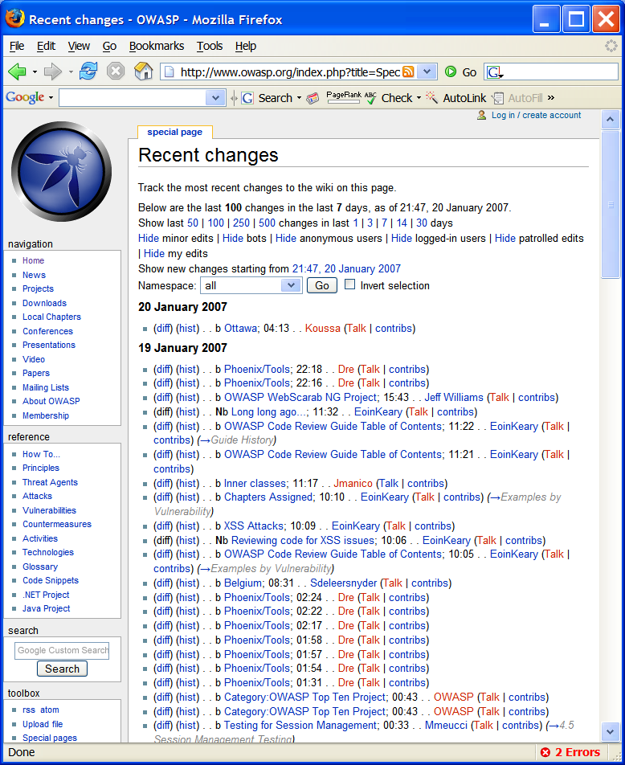
What Is the OWASP Testing Guide?
A project…
Notes:
Facts about the PROJECT
Over 100 contributors and reviewers
Built entirely online
Mailing list
We use MediaWiki – the same software Wikipedia uses. Anyone can create an account and edit. A complete history of all changes is kept.
How does it work? There’s a leader who organizes a team and builds an outline, he puts out requests for people to write articles. Then later, he searches for reviewers to review the work. There are arguments, opinions, and the group works towards consensus in a decentralized way. In general, we follow the Wikipedia guidelines to drive the process, but we definitely encourage conflict.
Defacement is extremely rare – only 3 or 4 incidents in the history of the project

Slide 6









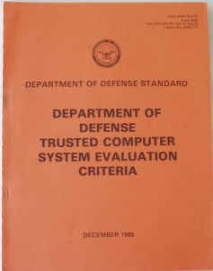








What Is the OWASP Testing Guide?
Alive…
2011
2010
2009
2008
2007
Notes:
The Testing is alive…
When they say, “print is dead” they don’t mean it’s out of style – it’s static not living! Do you have a bookshelf of security books? When’s the last time you opened them? They don’t have answers to today’s problems because they’re dead.
It’s a process for translating security principles to the latest technologies and getting them to developers fast
It’s an evolving growing living thing

Slide 7

The Wisdom of Crowds
Diversity of opinion
Decentralization
Aggregation
Independence
Notes:
The Wisdom of Crowds
Only works if you have diversity, independence, and decentralization
There are four key qualities that make a crowd smart
It needs to be diverse, so that people are bringing different pieces of information to the table.
It needs to be decentralized, so that no one at the top is dictating the crowd's answer.
It needs a way of summarizing people's opinions into one collective verdict (not split-the-difference)
And the people in the crowd need to be independent, so that they pay attention mostly to their own information, and not worrying about what everyone around them thinks.
Experts, no matter how smart, only have limited amounts of information. They also, like all of us, have biases. It's very rare that one person can know more than a large group of people, and almost never does that same person know more about a whole series of questions. The other problem in finding an expert is that it's actually hard to identify true experts. In fact, if a group is smart enough to find a real expert, it's more than smart enough not to need one.
The wisdom of crowds isn't about consensus. It really emerges from disagreement and even conflict. It's what you might call the average opinion of the group, but it's not an opinion that every one in the group can agree on. So that means you can't find collective wisdom via compromise.
Knowledge management systems must provide a way to aggregate knowledge without centralizing decision making or creating cascades

Slide 8
Trusting the Testing Guide
Is the information complete and accurate?
  We create tracking pages on various dimensions
  Constantly reviewed and updated
  It is being applied extensively to real applications
How can I be sure?
  Lots of passionate experts involved
  You can verify that it is “alive”
  You can compare it objectively to tools or alternatives
What is the alternative?
Notes:
Is this just “Digital Maoism”? - http://www.edge.org/3rd_culture/lanier06/lanier06_index.html
The collective is more likely to be smart when it isn't defining its own questions, when the goodness of an answer can be evaluated by a simple result (such as a single numeric value,) and when the information system which informs the collective is filtered by a quality control mechanism that relies on individuals to a high degree.
The fact is that we’re not totally relying on the wisdom of crowds.
What are you going to trust?
A commercial book written by a single author?
A standard built by a group of people paid by their companies to be working group members?
A government agency?

Slide 9

What Is the OWASP Testing Guide?
A puzzle piece…
Testing
Guide
Tools
Honeycomb
Threat Agents
Code Review
Guide
Business Impacts
Vulnerabilities
Business
Impact
Vulnerability
System Impacts
Countermeasures
Building
Guide
Asset
Countermeasure
Attacks
Attack
Notes:
It’s one piece…
of an experiment…
for building an application security knowledgebase…
That is critical to achieving trustworthy applications

Slide 10

What Is the OWASP Testing Guide?
An experiment…
?
☒
☒
☒
☒
Notes:
There have been lots of ideas for building a useful security body of knowledge over the years. I’ve been directly involved with writing Rainbow Series Guidance, developing Federal and Common Criteria requirements, starting a TTAP lab, and I wrote quite a bit of the Systems Security Engineering Capability Maturity Model. None of these ideas have taken hold.
But there is a huge body of knowledge out there in lots of hidden nooks and crannies that needs to be organized, sorted, culled, formatted, and most importantly brought into the sunshine. The idea of the OWASP Testing Guide and the other OWASP projects is to get this information into the sunshine where everyone can use and share it for free.
But we’re realistic – even assuming that our efforts work – there’s no guarantee that having an excellent knowledgebase about application security will change anything. But I continue to believe that everyone involved wants to do this right and would do so if they knew how.

Slide 11

What’s Not In the Testing Guide…Yet
Guidance on…
  Scoping
  Prioritizing
  Tailoring
  Tracking
  Metrics
Integration…
  Requirements
  Threat Modeling
  Architecture
  Implementation
  Testing
  Deployment

Slide 12
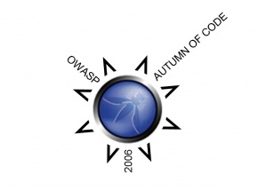
OWASP Foundation - Autumn of Code Grants
WebScarab NG $5,000
Live CD $5,000
CAL9000 $5,000
SiteGenerator and ORG $5,000
Pantera $3,500
Webgoat $3,500
Testing Guide $3,500
OWASP .NET Tools $3,500
OWASP Website $3,500

Slide 13
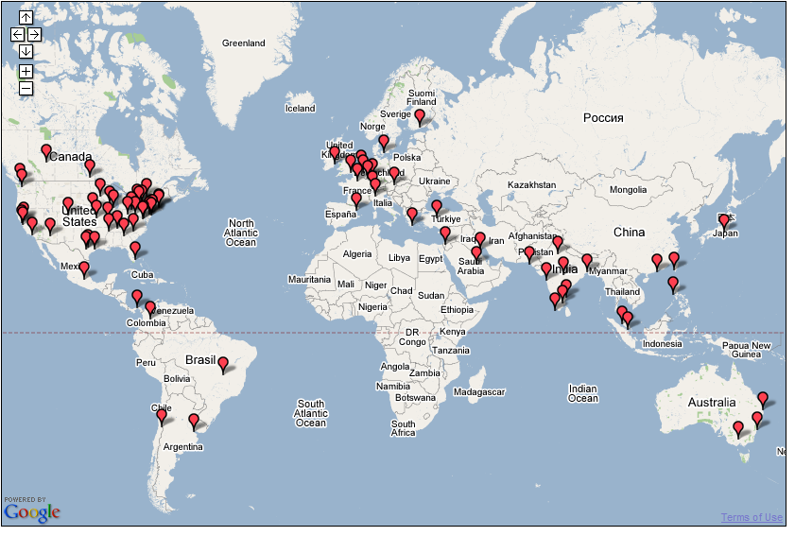
Join Us
The OWASP Spring of Code starts soon!
Notes:
OWASP Worldwide
5,000 chapter and project members around the world

