Slide 1

E-Waste?
In this Economy?
Setting up a home-based testing lab on the cheap

Slide 2


whoami
Chris Shepherd, OSCP
Pentester @ Xanthus Security
~ 10 Years Pentesting
  Background in Software Development and Network Admin; Many hats.
  Lifelong interest in security.
Privacy Advocate
Avid Homelabber
Challenge Developer @ CyberSci
@fennix@infosec.space

Slide 3
In everyone’s pocket right now is a computer far more powerful than the one we flew on Voyager, and I don’t mean your cell phone—I mean the key fob that unlocks your car.
- Dr. Richard Terrile, Research Scientist, NASA JPL

Slide 4
Curriculum Soapboxae
The state of personal computing in 2026.
Why do this for (to?) yourself?
The key parts of a home-based test lab.
Example setup: Proxmox-based Hacklab.
Making it practical: investigating the Notepad++ breach.

Slide 5

Personal Computing in 2026

Slide 6
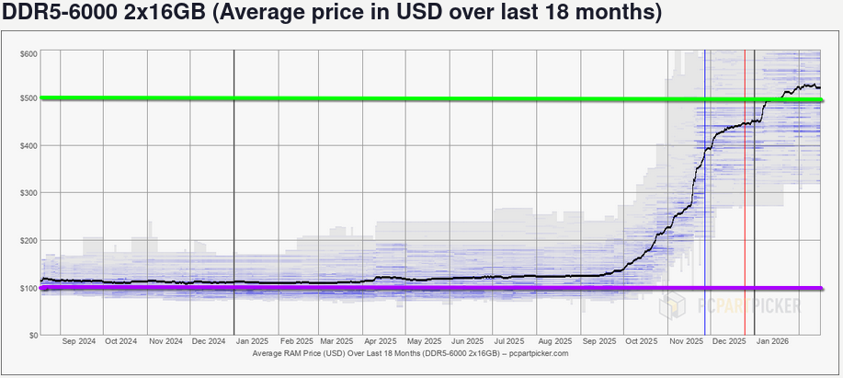
Personal Computing in 2026
Source: https://pcpartpicker.com/trends/price/memory/

Slide 7

DDR4 WILL SAVE US!
Source: https://pcpartpicker.com/trends/price/memory/
Notes:
It’s not just RAM either, other parts are starting to have price increases because of material supplies.

Slide 8



But wait! There’s more!

Slide 9
There’s an answer!
Old hardware isn’t useless in 2026 or inherently less safe.
  Despite what some vendors insist.
Save money! Have an old laptop or desktop PC kicking around?
Save a landfill, adopt a laptop today!
  Cue the Sarah McLachlan.
  Bad screen = headless like any other server.
Cast-off or older mini-PCs are also great as a first homelab server.

Slide 10
Ok but why?
It’s more accessible than you might think!
  Probably more accessible than it ever has been.
Cloud pricing is creeping up.
  AWS t2.micro is $8.50USD for 1C 1GB, which means a quad-core laptop or all-in-one with 4GB of RAM is a whopping $34USD/mo in value.
Having a lab to set up and experiment in is a great career booster.
For pentest work, a dedicated separate test setup can be critical.
  Especially for mobile app testing. Record everything the app does when it connects to wifi!
Interested in de-Googling? This is a common pathway to that.

Slide 11
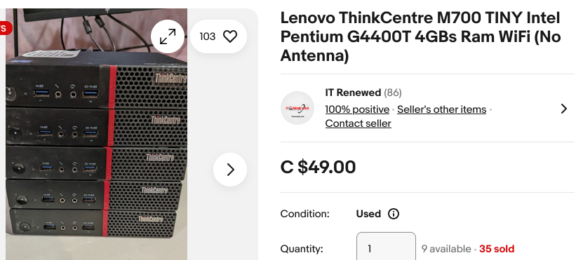
What if I don’t have a totally cool tech closet that in no way makes my family and friends afraid I’m secretly a hoarder? How cheap can this really be?
Liquidators often get inventories of units in bulk as orgs upgrade (right).
  (right) From 2016: 2C 2.9GHz CPU, 4GB DDR3
Screen-damaged laptops can be found for cheap too.
  Pay attention to storage! Lots of sellers remove HDDs from “for parts” systems.
  Damaged screens are also great to look for if you want a cheap testing phone.
Free is best if you can get it though.
Notes:
Beware shipping on auction sites!

Slide 12
No E-Waste, Save $$$
This model of processor was released in the fall of 2012.
This system was bought shortly thereafter and lived as a desktop.
Later this year it’s going to turn 14.
  It’s seen probably 4-5 different OSes, definitely > 10 versions of Debian alone.
  It’s had a lot of other parts around it change but the core is still there.
  It just works.
Notes:
Re: discarding things: this is underrated in situations where you have limited resources on-hand.

Slide 13
The key parts to a homelab
A rough plan.
  Can be as simple as “Make it Go”, or a complicated multi-page architecture diagram.
A system you can write USB sticks from, plus a USB stick.
A Host System.
  The laptop you saved from landfill while listening to Sarah MacLachlan.
Your personal equivalent of Elbow Grease.

Slide 14
Sales pitch over!
Start with a plan, even a simple / rough one.
I like to begin with simple “I want” or “I’d like” language.
  “I want to learn more about PostgreSQL.”
  “I’d like to learn about network scanning tools like Nessus.”
  “I want to learn more about enterprise Java.”
  “I’d like to see how the Notepad++ compromise actually worked.”
Look at what that needs in terms of memory and CPU.
  A good default is to assume most software these days wants / needs 2 Cores and 4-8GB of RAM as a minimum. Some can make do with way less and some require more.

Slide 15
Containerization vs Virtualization
Virtualization is can bring you a ton of features containers lack and offer.
  (virtual) Hardware separation of your systems.
  Simple to discard everything when you’re done.
  To get good performance often requires specific BIOS flags be enabled and support from the CPU. Very old systems lack that support.
Containerization is much simpler but may miss features depending on your goals.
  More difficult / annoying to configure and truly separate networking, which is important for certain kinds of work.
  You’re likely already familiar with at least docker if not podman.
  You don’t have to worry about hardware support for most things since it’s just running inside the host OS.
Notes:
Re: discarding things: this is underrated in situations where you have limited resources on-hand.

Slide 16



Let’s build a test lab!
Requirements:
  I want virtualization, because I want networking to be simpler to understand.
  I need core network components, so my test subjects can be appropriately monitored.
  I’d like to be able to connect mobile devices to the system for monitoring too.
  I want to be able to have a test subject system that will be isolated from everything else.
The result:

Slide 17
The (often) scary parts
Network Services are critical to building a pentest lab.
  DNS, DHCP, Etc.!
OPNsense is an all-in-one virtual router solution.
(Optional) Pi-hole isn’t just for Raspberry Pis anymore.
  You can run it on any Linux.
For more advanced requirements, use toothy elder services.
  BIND9, ISC DHCPd, etc.

Slide 18
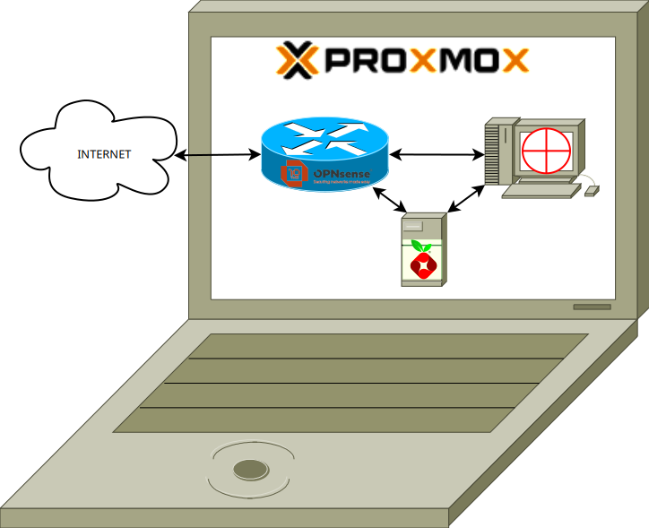
Example Setup: Proxmox Hacklab
Step 0: IS proxmox going connect to the network and/or Internet?
  You don’t actually need the host to be online for some kinds of testing, it’s highly dependent on your goals.
  In this case, I do want it to connect because I want to explore the Notepad++ vuln.
Step 0.5: (Optional) Make a diagram!
  Can help inventory the VMs we want.
Notes:
When first starting out there can be a lot to keep track of.

Slide 19

Our Test Subject
Meet today’s test subject:
  Lenovo T14 Gen 1, 6 Core CPU, 32GB of RAM, from 2020
  Has upgrades over stock, incl. the amount
  of RAM plus a 1TB NVME SSD.
  The stickers add performance too.
  These upgrades aren’t necessary.
This is my old daily driver laptop.
  Avoided recycling or landfill, and will have
  a new job going forward - portable test lab!
Notes:
When first starting out there can be a lot to keep track of.

Slide 20
Example Setup: Proxmox Hacklab
Start by obtaining and installing Proxmox onto our device via USB.
  On newer systems UEFI requirements can be a PITA. See your BIOS’ manual for details.
  On most older hardware this should just work 99.99999% of the time.
Once it’s installed, we need to create our Virtual network.
  Two devices: One real one fake / virtual.
    Real one: that’s our bridge to the outside / Internet.
    Fake one: essentially a virtual internal network device that will be the virtual network.

Slide 21
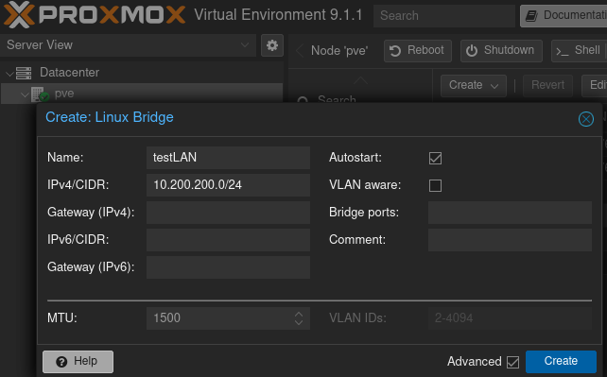
Proxmox Hacklab Networking
Create an extra network bridge and call it testLAN.
  This bridge will basically be our fake switch.
  Using a silly network range here, you can use whatever you prefer as long as it doesn’t conflict.

Slide 22
Example Setup: Proxmox Hacklab
Once adapters are created, create our OPNsense Virtual Machine.
  Download OPNsense ISO file, then upload it to Proxmox.
  Define the OPNsense VM as having 1 CPU Core, 1GB of RAM.
  Pick the install media as the OPNsense ISO file.
  Because this is a router, we need two adapters - WAN and LAN.
    Add the bridge (usually the default) which will act as the WAN (upstream / to internet).
    Add our second network adapter which will act as the LAN (virtual network switch).
    Label these properly if you can; it saves headaches later.
Create VM.
Once created, start VM and use the Console to perform the install.

Slide 23
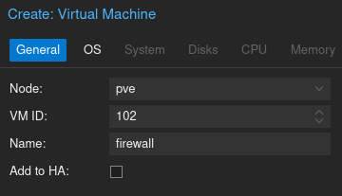
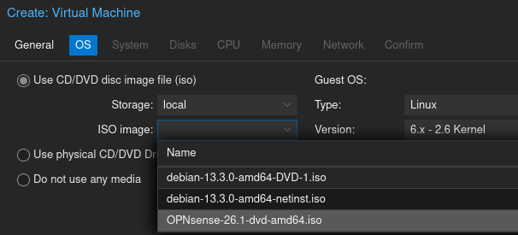
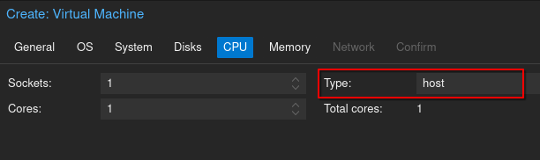
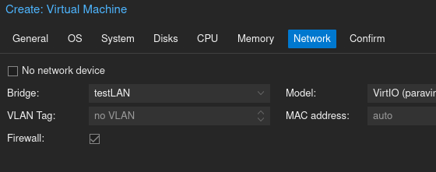
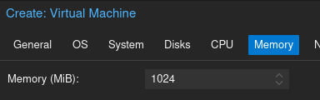
Creating the Firewall VM

Slide 24
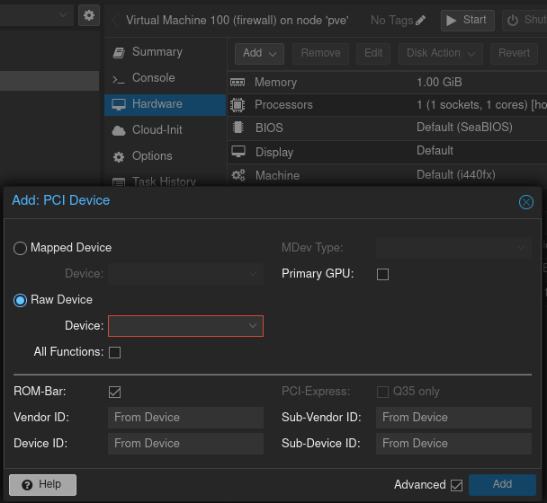
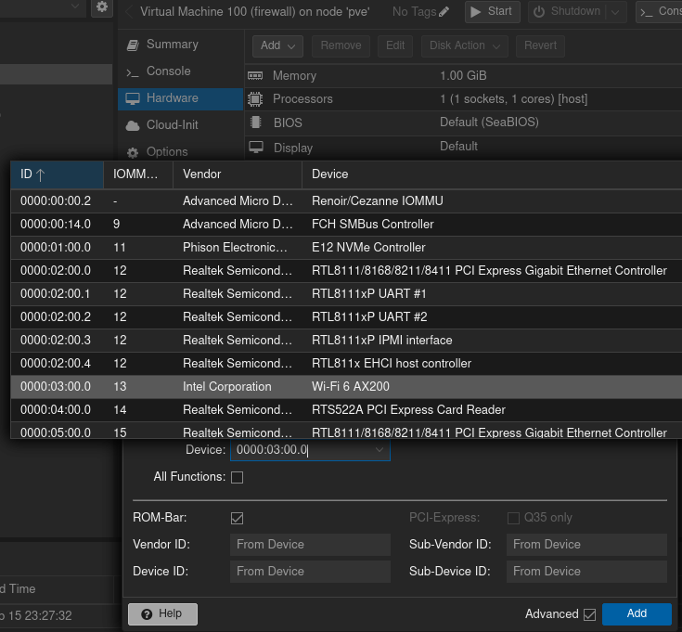
(Optional) Proxmox Hacklab - WLAN
A
Once the VM is created for our firewall node, we can add a wireless network too using our laptop’s Wi-Fi.
In the VM’s Hardware section, add a new PCI Device (A). Choose the Raw device option and pick the Wi-Fi adapter (B).
B

Slide 25
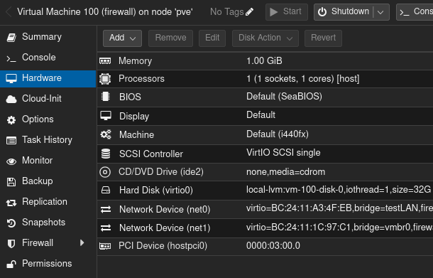
Firewall Created
ENORMOUS Asterisk!
OPNsense is FreeBSD based.
FreeBSD is not Linux when it comes to Wi-Fi support.
  My particular adapter is not supported on OPNsense right now.
  We can work around this by making an “Access Point” VM running Linux.
  YMMV but many older devices do work on OPNsense.
LAN
WiFi
WAN

Slide 26
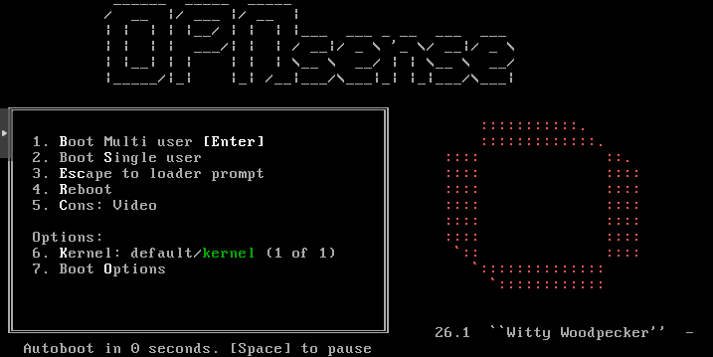
Start and install OPNsense
Start the Virtual Machine and perform the installation steps.
Many guides online for all kinds of setups.
  For our purposes most of the defaults are fine.
  Ensure networks are configured as you want.

Slide 27
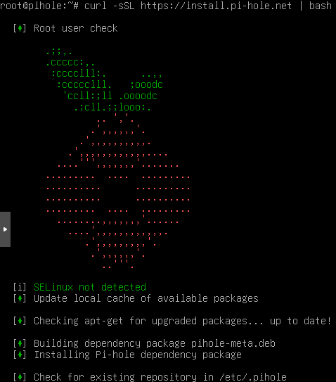
(Optional) Pi-hole setup
Create our Pi-hole virtual machine.
  Download Debian ISO (or your distribution of choice), upload to Proxmox.
  Create VM with 1 CPU Core, 1GB RAM.
  Set our only network adapter to be on the LAN.
    The Pi-hole should have a static IP Address.
      My suggestion is DNS servers be .2 (and .3) on the LAN.
  Start the VM, install Debian.
    SSH into Debian, then use the really terrible curl | sh method of installing Pi-hole.
    Honestly, in 2026… <rambling continues>

Slide 28
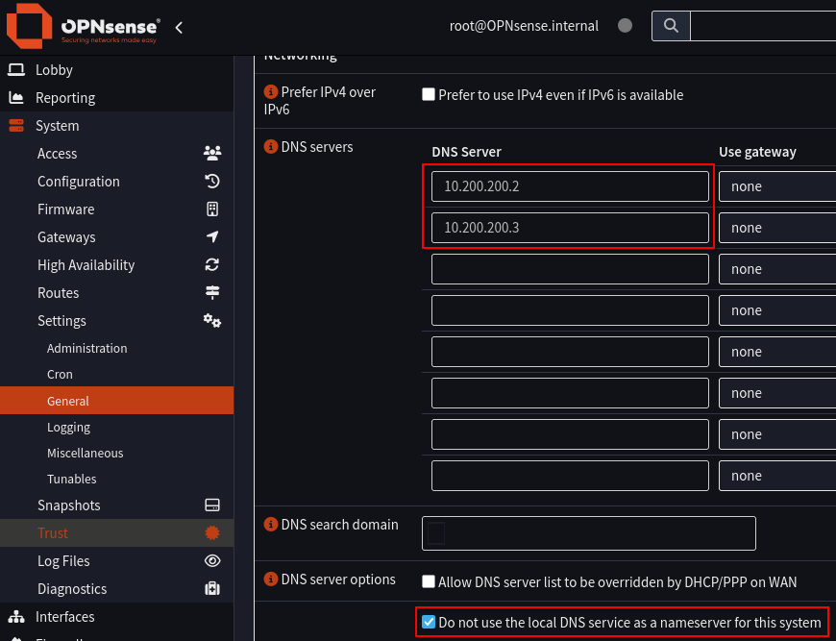
Set OPNsense DHCP to use Pi-Hole
Configure OPNsense to use Pi-Hole as DNS for all DHCP clients. This way new systems will automatically pick this.
  You can optionally use firewall/routing rules to force all DNS traffic to the Pi-hole.
  You can also block known DoH (DNS over HTTPS) and DoT (DNS over TLS) sites, which forces fallback to traditional DNS in many apps.

Slide 29
Test System Setup
We are set up! Now we need our test / victim system(s).
In our case today, I’ll be using a trial version Windows 10 VM to test the Notepad++ MITM / lack of code signing vulnerability.
  This system will use DHCP and let OPNsense give it whatever address.
In other cases, you now have a system you can create and set up any number of other test systems meeting whatever your needs are.
Go PLAY!

Slide 30
Let’s explore the Notepad++ Vuln
What was the problem?
  Attackers hijacked Notepad++ on the server side, so TLS looked fine.
    The real servers were serving the updates.
  Malicious updates were added and fed to some unknown number of users downloading updates via this middle path they had hijacked.
  Because there were no code signing checks, bad updates could go out and update installations without anyone noticing.
    It seems attackers did not have access to any of the code signing mechanisms, so they couldn’t sign their malicious updates.
    Typically, having the TLS validation to the official site / hosting is one layer of defense.
Worth noting, many Linux distributions use HTTP for transferring updates but rely on code signing as the actual primary defense.

Slide 31
Faking the real site
We can’t pretend to be the real Notepad++ website.
  Certificate Authorities (CAs) won’t sign us a cert for their domain.
  I’m only interested in the Notepad++ vulnerability itself.
Create our own Certificate Authority using Easy-RSA.
  Well documented in official docs, just make sure you set subjectAltNames!
Import our CA Cert to Windows’ Trusted Root CA store.
Profit

Slide 32
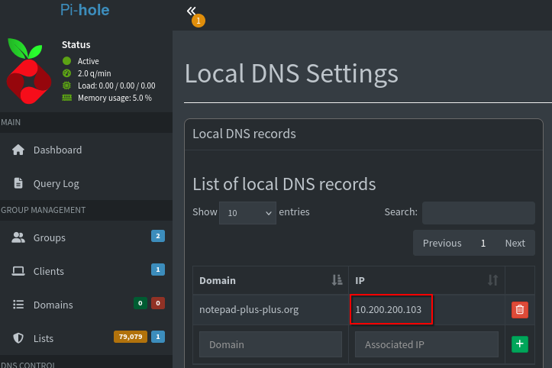
Hijack DNS for notepad-plus-plus.org
Configure Pi-Hole to override the DNS for the official site.
  Point it at our own attacker system that will feed a malicious payload to Notepad++.
On our attack system, add the real N++ IP to /etc/hosts.
  Otherwise we’re just trying to continually connect to ourselves.

Slide 33
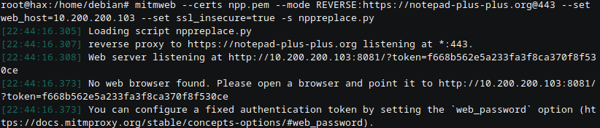
mitmproxy
Mitmproxy is a tool designed to do pretty much this kind of attack.
Launch it with a key and cert signed by our custom CA that is trusted by the Windows system.
Also specify a script file we’ll use to override the update XML.

Slide 34
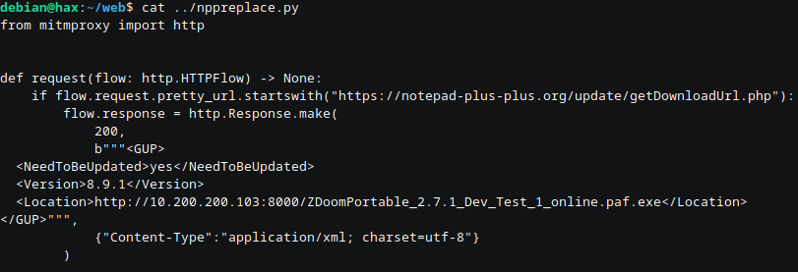
Our malicious script
Simple script, just return our own XML instead of the real deal.
The URL pointed to is just a simple http.server serving up our payload.

Slide 35
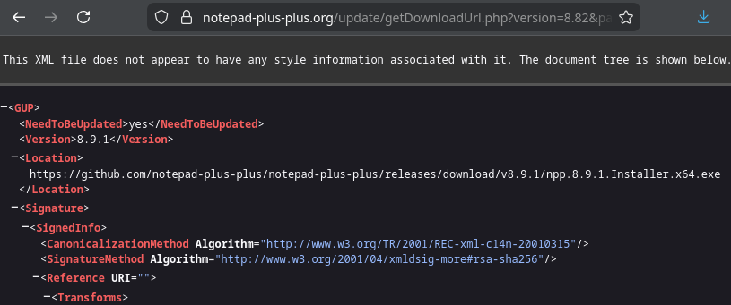
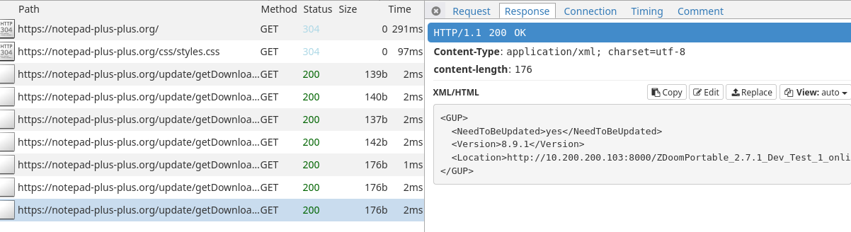
What it should look like
The real XML file without our alterations vs the altered response

Slide 36
Watch the Magic Happen

Slide 37
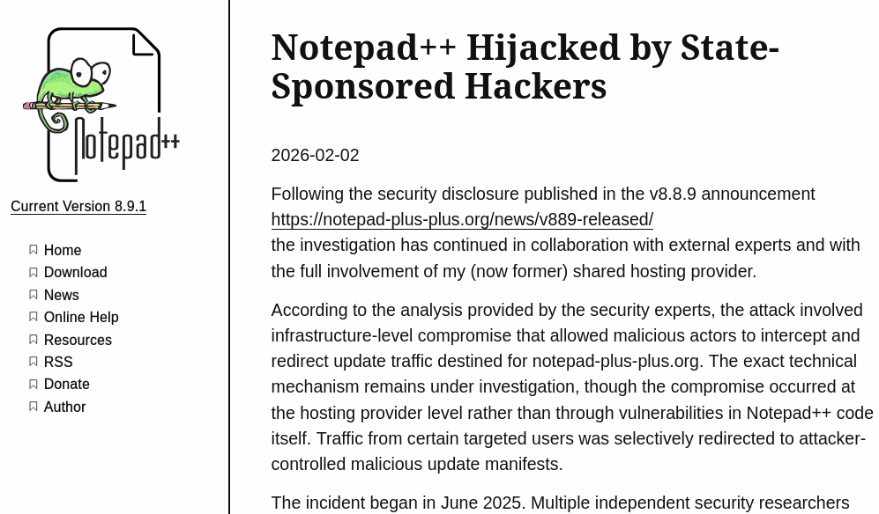
Kudos to the Notepad++ Team
Bad situation, clear messaging.
Transparent about recommendations and steps taken.
Only gripes:
  Time to report this after discovery.
  Time to actually fix code signing issue.

Slide 39
Appendix: Quick Linux Wireless AP
Install Debian (using Debian 13 / Trixie in our example)
Run the following as root:
  apt update && apt install -y bridge-utils hostapd wireless-tools net-tools
To identify which network device is your wireless adapter:
  iwconfig
  Usually named like "wlp" or "wls" followed by a number.
Run the following to figure out which device is your "wired" adapter:
  ip a
  Usually named like "eth" or "ens" followed by a number.

Slide 40
Appendix: Quick Linux Wireless AP (2)
We need to bridge the “wired" adapter so that our system will give clients access through it and act like a real access point.
To create the bridge and link it, run the following:
  brctl addbr br0
  brctl addif br0 eth0 # replace eth0 with the "wired" adapter name you determined earlier.
  ip link set br0 up

Slide 41
Appendix: Quick Linux Wireless AP (3)
Edit the config file /etc/hostapd/hostapd.conf as follows:
  interface=wireless0
  channel=11
  bridge=br0
  hw_mode=g
  ssid=TESTLAB.INTERNAL
  wpa=2
  wpa_passphrase=YouMiss100%OfTheShotsYouTake
  In the above, replace wireless0 with the device name you identified from iwconfig.
  SSID can be replaced with whatever wireless network name you want, same as wpa_passphrase.
Start the hostapd service with: systemctl start hostapd
Enjoy the Wi-Fi!

