Slide 1
OWASP Ottawa
Public Service Announcements (PSAs)
July 2018

Slide 2
Be Awesome
Become an OWASP Member!
Get perks
Support your community
Support your chapter
https://www.owasp.org/index.php/Individual_Member

Slide 3
Government of Canada
Announced New National Cyber Security Strategy and the Creation of the Canadian Centre for Cyber Security
Hit your favorite search engine for further details (IN18-003)

Slide 4
Want to present at OWASP Ottawa?
Want to share your knowledge of an AppSec topic?
Lightning talks (15 mins)
Middle talks (30 mins)
Full presentation (1 hour)
Contact: garth.boyd@owasp.org
@garthoid

Slide 5
OWASP Project News
Watch the OWASP Glue project for an imminent release
@OwaspGlue

Slide 6
OWASP News
Checkout the OWASP Blog for other news:
https://owasp.blogspot.ca/

Slide 7
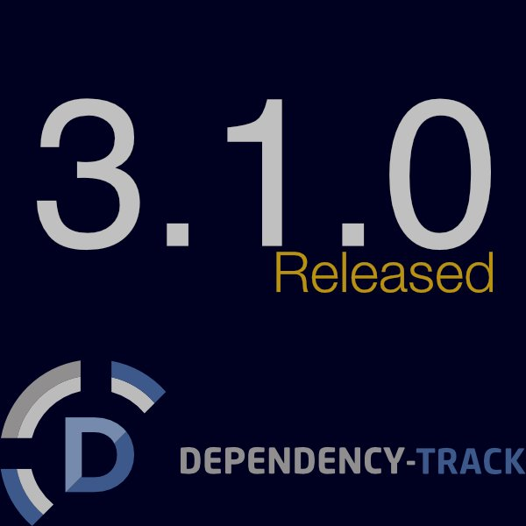
OWASP
Project News
dependencytrack.org

Slide 8


OWASP Ottawa
@OWASP_Ottawa
owaspottawa.slack.com
(Join via: owaspottawa.herokuapp.com)

Slide 9
Be Awesome
Become an OWASP Member!
Get perks
Support your community
Support your chapter
https://www.owasp.org/index.php/Individual_Member

Slide 10
OWASP Ottawa
Please update your Meetup RSVP ahead of the chapter meetings!

Slide 11
August 2017 Meetup Announcement
Thursday, August 16, 2018, 5 pm
Azure Cloud Security Workshop
To Participate:
A laptop running any modern operating system (Mac OS, Windows, Linux)
Modern web browser (Safari, Edge, Chrome, FireFox)
Wi-fi and internet
An activated Azure Trial. Please activate your trial in before coming to the workshop. The workshop will not wait if you have not activated your trial.
(meetup page contains trial information at https://www.meetup.com/OWASP-Ottawa/events/252937188/)

Slide 12
Gainfully Employed?
Seeking someone with M4dSk1llz?
Got M4dSk1llz and seeking a job?
Then talk on the #jobs channel on the OWASP Ottawa Slack.
Profit.

Slide 13
Todays Meetup Slack Channel
#meetup-19-07-2018
Ask a question
Provide feedback
Chill
Share

Slide 14
Be Awesome
Become an OWASP Member!
Get perks
Support your community
Support your chapter
https://www.owasp.org/index.php/Individual_Member

Slide 15
Lightning Talk - EFail
Dave presents a quick presentation on a PGP vulnerability called
EFail
The presentation covers how it works and how to perform the exploit

Slide 16
Presentation
Living off the Land
Sunny talks about the technique of using legitimate system tools for carrying out malicious activity

Slide 17
Presentation
Dependency Check - An OWASP Project
Vandana presents an introduction to and an understanding of OWASP Dependency Check
Use cases
Components
reports

