Slide 1

OWASP Application Security Verification Standard
– Web Application Edition
Mike Boberski (Booz Allen Hamilton)
boberski_michael@bah.com
Jeff Williams (Aspect Security)
jeff.williams@aspectsecurity.com
Dave Wichers (Aspect Security)
dave.wichers@aspectsecurity.com
12/08

Slide 2

The Challenges…
There is a huge range in coverage and rigor available in the application security verification market!
Consumers have no way to tell the difference between:
  Someone running a grep tool, and
  Someone doing painstaking code review and manual testing!
There are differences in coverage and rigor between types of tools, between tools and manual techniques, and between types of manual techniques!

Slide 3

The Philosophy of ASVS
Any standard that provides a basis for the verification of web applications should be application-independent.
Any standard should be life-cycle model independent.
Any standard should define requirements that can be applied across applications without special interpretation.
Any such standard also needs to be commercially-workable and can’t be overly burdensome!

Slide 4

The Design of ASVS
The standard should define levels of application security verification.
The difference in coverage and level of rigor between levels should be relatively linear.
The standard should define functional verification requirements that take a white-list (i.e. positive) approach.
The standard should also be tool and technique procedure independent!

Slide 5

What questions does ASVS answer?
How much trust can be placed in a web application?
What features should be built into security controls?
How do I acquire a web application that is verified to have a certain range in coverage and level of rigor?
ASVS can answer these questions for applications ranging from minimum risk applications, to critical infrastructure applications.

Slide 6

Where can I get a copy of ASVS, and talk to people using ASVS?
You can download a copy from the ASVS Project page:
  http://www.owasp.org/index.php/ASVS
You can send comments and suggestions for improvement using the project mailing list:
  See “Mailing List/Subscribe” link on project web page.
  Tell us how your organization is using the OWASP ASVS. Include your name, organization's name, and brief description of how you are using the ASVS
Tip: Subscribe to the OWASP ASVS mailing list!
Owasp-Application-Security-Verification-Standard@lists.owasp.org

Slide 7
What is the status of the ASVS as an OWASP standard?
Web Application Edition of ASVS
  It is the first OWASP standard.
  Its current official release version is Beta.
Web Service Edition of ASVS
  It is under development and not yet available for release.
Future Editions of ASVS
  Additional languages, additional technologies (perhaps Cloud computing for example)

Slide 8
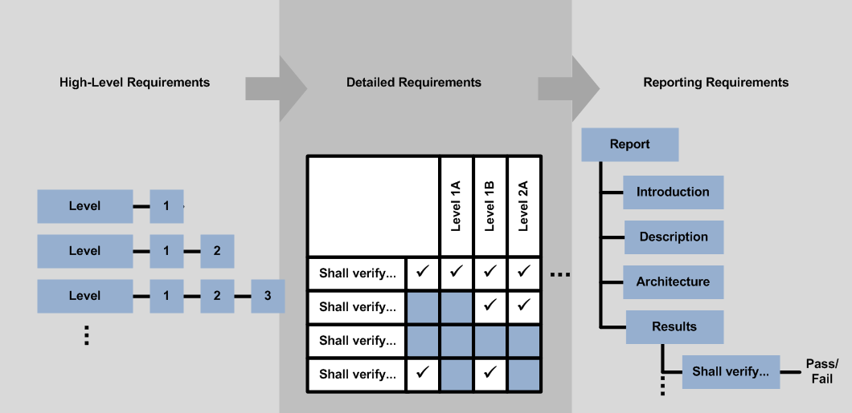
An Overview of ASVS
“Verification Levels” section
“Verification Requirements” section
“Verification Reporting Requirements” section

Slide 9
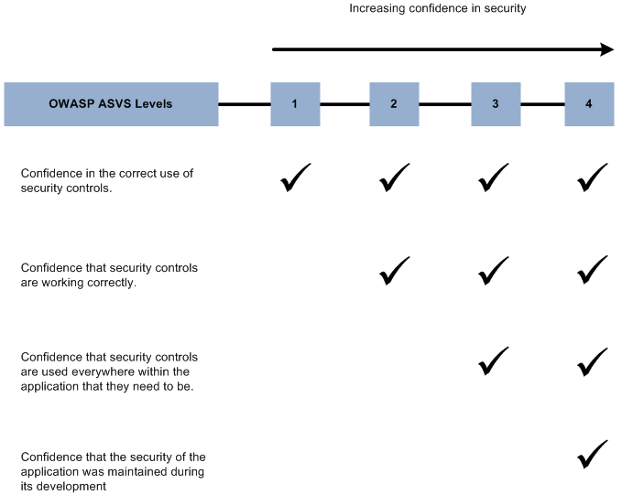
What are ASVS verification levels?

Slide 10
Level Definitions
Level 1 – Automated Verification
    Level 1A – Dynamic Scan (Partial Automated Verification)
    Level 1B – Source Code Scan (Partial Automated Verification)
Level 2 – Manual Verification
    Level 2A – Penetration Test (Partial Manual Verification)
    Level 2B – Code Review (Partial Manual Verification)
Level 3 – Design Verification
Level 4 – Internal Verification

Slide 11

How do I get started using ASVS?
Buyer and seller: agree how technical security requirements will be verified by specifying a level from 1 to 4,
Perform an initial review of the application to be verified,
  Minimum: Perform an ASVS Level 1 security architecture review!
Develop a verification plan and a project schedule,
Using ASVS requires planning and in that respect is just like any other testing exercise!

Slide 12

How do I get started using ASVS? (continued)
Perform a verification according to ASVS level requirements,
Present findings, develop a remediation strategy, and develop a strategy to add verifications into the SDLC, and
Re-verify after fixes are made (repeat as necessary).
Tip: don’t scare people when you present your findings! Be specific. Propose a specific fix or a workaround, if able.

Slide 13


Questions?

