Slide 1


Ajin Abraham
Automated Mobile Application Security Testing with
Mobile Security Framework

Slide 2

About Me
Security Engineering @
Next Gen Runtime Application Self Protection (RASP)
Author of OWASP Xenotix XSS Exploit Framework, Mobile Security Framework.
Teach Security via https://opsecx.com
Blog about Security: http://opensecurity.in

Slide 3
The Takeaways
A FREE and Open Source Security Tool for Mobile App Security Assessment.
Mobile App Pentesters/Mobile Malware Analysts - How to make your job easier with MobSF.
Developers – Build secure mobile Apps identifying vulnerabilities at all stages of development. (SDLC Integration)
Web Pentesters – REST API Fuzzer capable of detecting vulnerabilities like SSRF, XXE, IDOR etc.

Slide 4

Agenda
What is MobSF?
MobSF Architecture
Static Analyzer
Dynamic Analyzer
Web API Fuzzer
Static Analysis
Static Analysis & some Statistics
Top Indian and European Bank Mobile Apps
Top Indian and European Wallet Mobile Apps
Observations
Dynamic Analysis
Dynamic SSL Testing
Exported Activity Tester
Challenges in Dynamic Analysis
Dynamic Analysis on Custom VM/ Rooted Android Device.
Web API Fuzzer
Vulnerabilities API Fuzzer detects.
Explains the API Fuzzer Logic.
Conclusion

Slide 5



What is MobSF?
Mobile Security Framework is an open source mobile application (Android/iOS) automated pentesting framework capable of performing end to end security testing of mobile Apps.
Android
iOS

Slide 6

Hosted in your environment. Your application and data is never send to the cloud.

Slide 7
MobSF Architecture

Slide 8

Static Analyzer
INPUT
OUTPUT
REPORT
Mobile Security Framework

Slide 9
Demo
Static Analysis & Report Generation

Slide 10
Static Analysis & Some Statistics
Static Analysis on Top Financial Apps - Criteria
SSL bypass in Native Code
SSL bypass in WebView
Weak Crypto
Remote Web View Debugging
Hardcoded Secrets

Slide 11
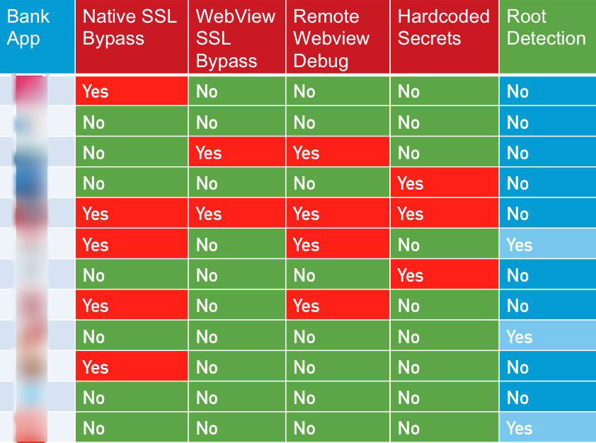
Top Indian Bank Apps Analyzed

Slide 12
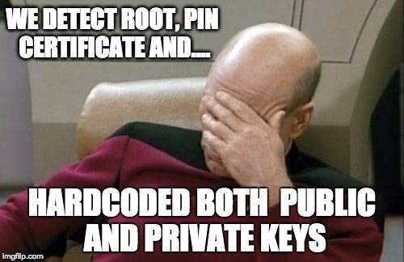
Face palm

Slide 13
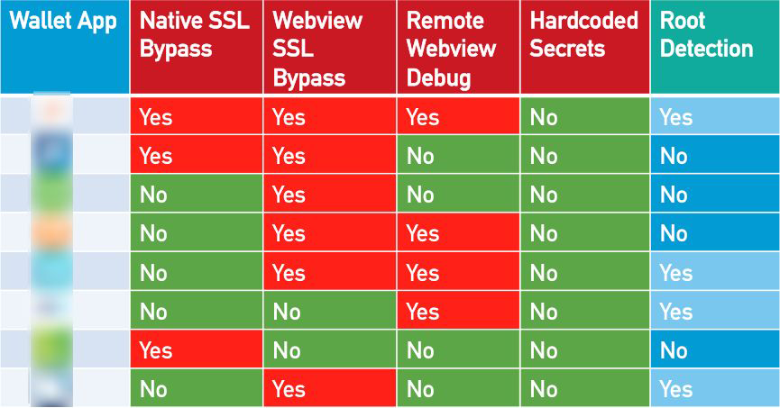
Top Indian Wallet Apps Analyzed

Slide 14
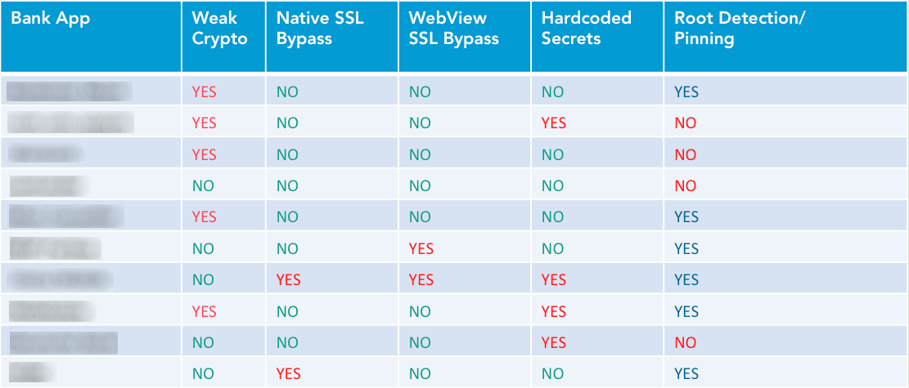
Top EU Bank Apps Analyzed

Slide 15
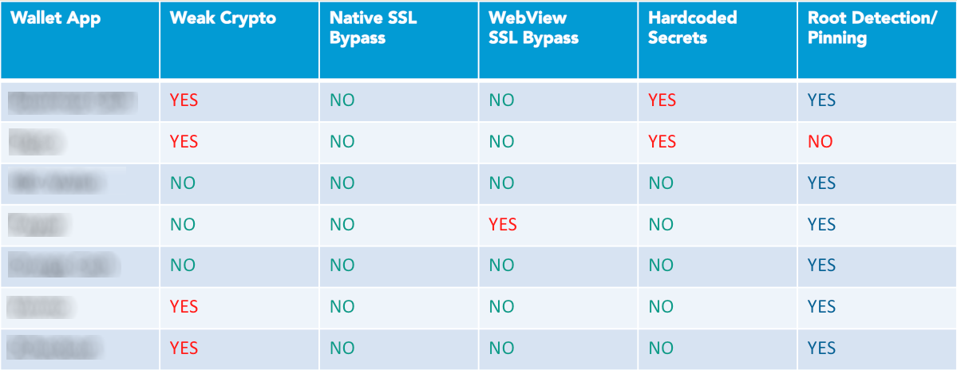
Top EU Wallet Apps Analyzed

Slide 16
Observations
State of Mobile App Security, Not evolved as Web Security.
Most common issue are:
Indian Apps: SSL Bypass in (Both Native Code and WebView)
European Apps : Weak Crypto and Hardcoded Secrets
SSL Error bypassed in WebViews are really really bad.

Slide 17
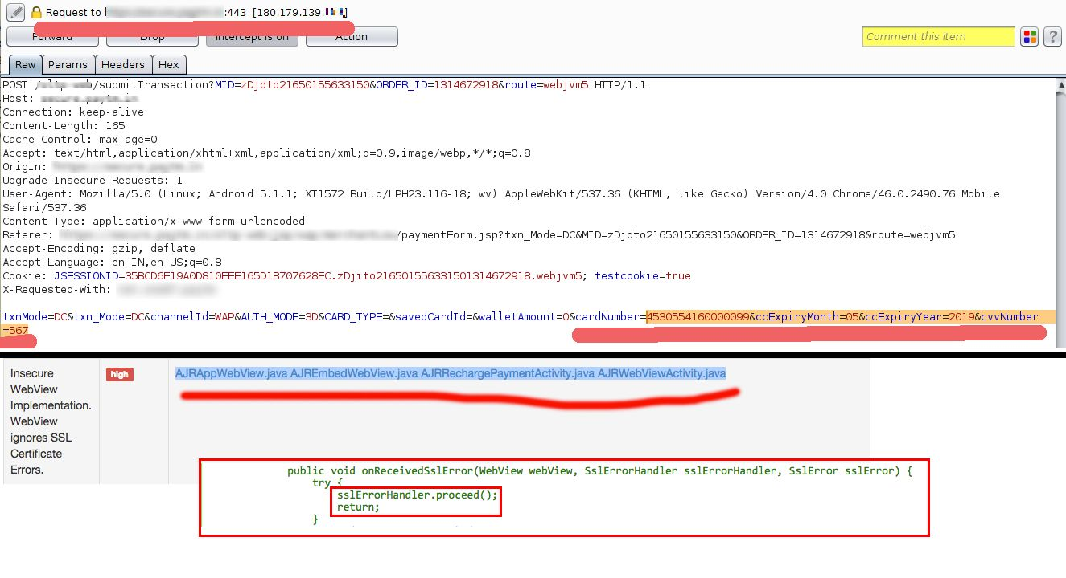
Real-world Exploitation

Slide 18

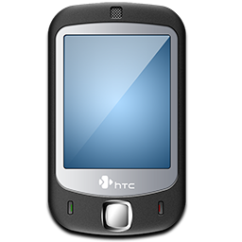
Dynamic Analyzer
OUTPUT
INPUT
Android VM
Or
Android Device
REPORT
Mobile Security Framework

Slide 19
Dynamic Analyzer - Architecture
Dynamic Analyzer
Install and Run APK
Android VM/Device
Invoke Agents in VM
Results
AGENTS
Agent Collected Information
Application Data
Start HTTP(S) Web Proxy
HTTP(S) Proxy
HTTP(S) Traffic

Slide 20
DEMO (LockX)

Slide 21
Dynamic SSL Testing
Dynamically verify if SSL connections are securely implemented.
Disable JustTrustMe and Remove MobSF Root CA.
If you can still access the decrypted HTTPS Web Traffic then that means the app is bypassing SSL errors.

Slide 22
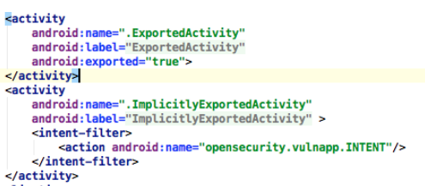
Exported Activity Tester
Android Exported Activities.
DEMO

Slide 23
Challenges in Dynamic Analysis
Some Android Apps are built with security in mind.
Anti VM Detection
Anti Root Detection
Anti MITM with Certificate Pinning.
Missing Libraries/Dependencies
Some Apps / Malwares have sophisticated methods to detect Virtual Machines.

Slide 24
How to deal with these Challenges
API overriding with Xposed Framework
Anti VM Detection Bypass –> Android Blue Pill
Anti Root Detection Bypass -> RootCloak
Anti MITM Certificate Pinning Bypass -> JustTrustMe
APK smali Patching, Custom Xposed Module
For sophisticated apps and malware, Use a real device for dynamic analysis.

Slide 25
Dynamic Analysis on Device
MobSFy Script – Convert your VM/ Device to support MobSF Dynamic Analysis
Documentation here: https://github.com/ajinabraham/Mobile-Security-Framework-MobSF/wiki/2.-Configure-MobSF-Dynamic-Analysis-Environment-in-your-Android-Device-or-VM

Slide 26
Web API Fuzzer
Select
Web Request DB
Login API
Pin API
Register API
Logout API
Select Scope URLs of Scan
Select Scope Vulnerabilities
OUTPUT
Web API Fuzzing Logic
REPORT

Slide 27
Fuzzing REST APIs
Why most web scanners suck at API Testing?
We have knowledge about the application and generic API routes (Login, Logout, Register).
So we use more of Whitebox approach than Blackbox approach.
Detects vulnerabilities like IDOR, SSRF and XXE.

Slide 28
What We Detect
XXE
SSRF
IDOR
Directory Traversal or Path Traversal
Logical and Session Related
API Rate Limiting

Slide 29
How we Detect

Slide 30
SSRF & XXE
API Server
Fuzz
Web API Fuzzer
Poll
MobSF Cloud Server
Cloud Server: APITester/cloud/cloud_server.py

Slide 31
Insecure Direct Object Reference (IDOR)
Without Credentials.
With multiple user credentials (needs two login attempts)
Request with Auth Header/ Cookie
API Server
Web API Fuzzer
Request without Auth Header/ Cookie
API Server
Request with User1’s Auth Header/Cookie
Web API Fuzzer
Repeat the Request with a User2’s Auth Header/Cookie

Slide 32
Session Related Checks
Access Resource with Auth Header/Cookie
Web API Fuzzer
API Server
Calls Logout API
Access Resource with expired Auth Header/Cookie

Slide 33
Rate Limiter
API Server
Web API Fuzzer
Brute force Login API and Register API

Slide 34
Other Checks
Security Headers and Info Gathering
Directory/ Path Traversal

Slide 35
DEMO

Slide 36
What's Coming Soon?
Windows App Security Analyzer.
iOS App Dynamic Analysis with Device.
API Fuzzer to support detection of SQLi and RCE.
Export Proxy logs to BurpSuite/IronWASP/ZAP

Slide 37
Useful Links
Source: https://github.com/ajinabraham/Mobile-Security-Framework
Issues: https://github.com/ajinabraham/Mobile-Security-Framework/issues
Documentation: https://github.com/ajinabraham/Mobile-Security-Framework-MobSF/wiki
Video Course: https://opsecx.com/index.php/product/automated-mobile-application-security-assessment-with-mobsf/

Slide 38


QA
Thanks & Credits
Sachinraj Shetty
Kamaiah Nadavala
Bharadwaj Machiraju
Yashin Mehboobe
Anto Joseph
Tim Brown
Thomas Abraham
Graphics/Image Owners
@ajinabraham
ajin25@gmail.com

