Slide 1
How to be Agile in Security Testing Projects
Security Project Management
Notes:
"Order or disorder depends on organization" wrote Sun Tzu centuries ago. Organization in managing Security Testing project is fundamental. Actually, the rise of Agile methodologies for IT Software Development and the continue Business Changes produces challenging deadlines for Deployment and for Security Testing. But because Security requirements have to be considered as a Must and have to be fulfilled or the software – often – will not have the “go” for production if there are vulnerabilities. The Secure Software Development Life cycle and the Team have to adapt to specific needs and planned accordingly defining priorities, skills and a sound Business Case for Security Testing. The role of the Project Manager - or Team Leader – is crucial. Practices like micro-management not work and it is counterproductive with skilled Penetration Testers. Project Manager has to be a servant leader and a facilitator who enables the Testers to work smoothly, facilitate the communication and remove impediments for the testing (and bureaucratic work) in order to meet the Security goals. The workshop will describe - by examples - how to combine Agile Project Management methodologies such as the DSDM Agile Project Framework tailored for Security Testing projects blending the OWASP Testing Guide, TOP 10 and other de-facto standards for IT and Information Security. Covering different aspects of the management of a Penetration Test such as the Business Case, Estimates, Risks and Quality.

Slide 2

whoami # Simone Onofri
Security Business Consultant at Hewlett Packard Enterprise
Director at DSDM Consortium
Volunteer: OWASP (Author TG v4), CoderDojo…
Certs: PRINCE2®, Agile Project Management®, ITIL, Certified ScrumMaster®, ISO 27001…

Slide 3
About us here
You «offer» Penetration Testing Services
(Provider/Supplier)

Slide 4
About us here
You «receive» Penetration Testing services?

Slide 5
About us here
Something else?

Slide 6
Agenda
What is Agile in Security Project Management
The process and how to be Agile
Embed Security in Agile Software Development Lifecycle
Q&A

Slide 7
Agile Security PROJECT MANAGEMENT

Slide 8

What is Agile
“Agile” is an umbrella term for several iterative and incremental methodologies. Is a mindset and a style of working where requirements and solutions evolve through collaboration. Agile promotes adaptive planning, evolutionary development and delivery, a timeboxed, iterative approach and encourages rapid and flexible response to change.

Slide 9

Quote from Sun Tzu
“Order and disorder depends on organization”

Slide 10
What is Project Management
The planning (adaptively), delegating (at the lower level as possible), monitoring-control (without micro-manage) of all aspects of the project, and the motivation of those involved, to achieve the project objectives within the expected performance targets (e.g. time, cost, quality, scope, benefits and risks), delivering proper business product (what?)
(Inspired from PRINCE2® definition)

Slide 11
Question time
?
Question: which is the typical business product of a Web Application Penetration Test?
Scenario: Security Assessment is the process of determining how effectively an “entity” (e.g. Web Application) meets specific security objectives.
Hint: what the final customer will have at the end of the activities?
(Security Assessment definition inspired by NIST SP800-115)

Slide 12
Which is the typical business product of a Web Application Penetration Test?

«Document the Test Results
To conclude the testing process, it is important to produce a formal record of what testing actions were taken, by whom, when they were performed, and details of the test findings. It is wise to agree on an acceptable format for the report which is useful to all concerned parties, which may include developers, project management, business owners, IT department, audit, and compliance.»
OWASP Testing Guide v4 - Introduction

Slide 13
Why Agile in Security Testing?
Enviormental factors:
Nowaday Software Developmnet is already Agile.
Work is often on a fixed deadline, fixed budget and we still need to deliver results without compromising quality.
Specific Testing factors:
Security Testing is Agile «by definition».
We canot have info «by design» of testing project (e.g. Black-Box).
Often we will explore from the first technical stage (OTG-INFO-001/010).
 

Slide 14
How be Agile in Security Testing
Transparency and communication between customer and supplier
Use Agile techniques to solve common issues.
Planning Poker for collaborative planning
Timeboxing for managing time
MoSCoW for managing priorities
Integrate Security in Agile Development

Slide 15
An Agile Security Testing Project

Slide 16
Apply a PM structure to Security bieing Agile
Feasibility
Foundation
Evolutionary
Post-Project
RFP / Tender
High-level requirements to estimate (e.g. number of applications and size).
Getting business cases.
Define output.
Proposal accepted
Planning and technical requirements definition
Sign the necessary documentation (e.g. NDA/Authorization*Jail free).
Technical Requirements verification
Technical activity
Writing Reports...
Presents results.
Depth analysis
Retesting activity
….

Slide 17
Top tips - Feasibility
In the feasibility phase the issue is to known the Business Case of the Customer: Why needs a PT? Often there are:
Compliance: e.g. laws and regulamentations (e.g. ISO 27001, Bank laws, PCI-DSS).
Risk Management to protect the enterprise (e.g. known vulnerabilities first to the attackers can exploit them).
Define what is the business product (the report), and the structure, of the final output of the project.

Slide 18
Top tips - Reporting
Is often suggested that the report will have different levels for different audience.
Executive Summary
Methodology and Tools
Technical Summary
Technical Details (exploits, TOP 10 mapping, CVSS v2…)
Specific needs? Be Agile!

Slide 19
Question time
?
Scenario: You are asked to test a Web Application, using OWASP Testing Guide. The application should be 20-40 dynamic pages with 2 different profiles.
Questions: who have to do the estimate? Other requirements to ask?
Notes:
Application is under development but should be 20-40 dynamic pages with two user levels.

Slide 20
Top tips – Estimates!

Ask for a lot of information as possible: technology used,
Who? Technical guys/girls!!!
Active/Idle time? People are active often about 80%
Report warning the writing of the report can take about half the time of technical activies
Remote/on-site Travel time?
Specific timeframe? As a risk reduction and possibility to run automatic tools H24.
Project Management Time/Meetings/Writing?

Slide 21
Agile is your friend
«We have a BrightRay™ Portal with 2 custom portlets and one for payment of membership via SecurePaymentGatewy™ portlet»
The Team Lead said to testers. Think about the estimate and pick a card from your deck, wait to show to not influence others.

Slide 22

Planning Poker – first hand
13
13
Tester #2
5
Tester #1
Tester #3
13
Tester #4

Slide 23
Agile is your friend
Team Lead sees that one tester is not aligned to the others, he/she can has important info to share with others, Tester #3 «I tested BrightRay™ few weeks ago and already automated the procedure for IG (portlets ids enumeration) and have a set of evil portlets for exploitation and post-exploitation» Tester #1 said «this is a good news. From my side I lost a lot of time with SPM portlet because of sophisticated defenses in place.

Slide 24
Planning Poker – second hand
13
8
Tester #2
5
Tester #1
Tester #3
5
Tester #4

Slide 25
Foundations – Top tips
Prepare a document with Scope, Rules of Engagements, Limitations, Communication Management Strategy (remember Transparency).
Prioritize activities in particular if we are timeboxed (we have an pre-defined and fixed amount of time e.g. to get a fixed price), in order to get suitable and useful results. Better a workshop with Supplier/Customer

Slide 26
Project Variables
Waterfall approach
Agile approach
Functionalities
Cost
Time
Fixed
Quality
Quality
Time
Cost
Funcionalities
Can vary
Notes:
What is the meaning is a Sec project?
- Functionalityies: how wide (e.g. functionalities to test), how deep (e.g. only proping, post exploitation, priviledges escalation….)
- Quality: Which test we can work on it?

Slide 27
What to prioritize?

We have:
Vulnerabilities
Functionalities / Components
Specific «Evil» Use Cases
And Combine in a Matrix
Y axis – Functionalities
X axis - OWASP TOP 10
Think also about:
When and how to go deep?
When to do manual and automatic activity?
False Positive Management
Take care of vulnerabilities who have a wide application impact.

Slide 28
How to prioritize MoSCoW
Level | Importance | Effect if not met | Effort
Must | Vital | Project will fail. | 60%
Should | Imporant | Not wiil not fail, but challanged | 20%
Could | Desirable | Contingency | 20%
Won’t | Out of scope | May be a next PT | --

Slide 29
Wasp in MoSCoW
 | Injection | Auth/SM | XSS | IDOR | Security Misconfig.
Payment Functionality | Must | Must (auto) | Must (AutoScan™), Should (man) | Must (man) | Must (AutoScan™)
Registration | Must (AutoScan™), Could (man) | Could | Must (AutoScan™), Should (man) | Could | Must (AutoScan™)
Authentication | Must (AutoScan™), Should (man) | Control itself | Must (AutoScan™), Should (man) | Could | Must (AutoScan™)
Private Content portlet | Must (AutoScan™), Should (man) | Must (man) | Must | Must (man) | Must (AutoScan™)
Priorities
Exploitation: No
False Positive Management: High (Must), Medium (Should)

Slide 30
Timeboxing – top tips
Investigation
(effort 10-20%)
Refinement
(effort 60-80%)
Consolidation
(effort 10-20%)
Kick-Off
Close-Out
Kick-off: define objective
Investigation: do initial test and find quick-wins
Refinenement: the big testing work
Consolidation: stop starting, start finishing
Close-out: met with customer about the job done

Slide 31
An Agile SSDLC

Slide 32
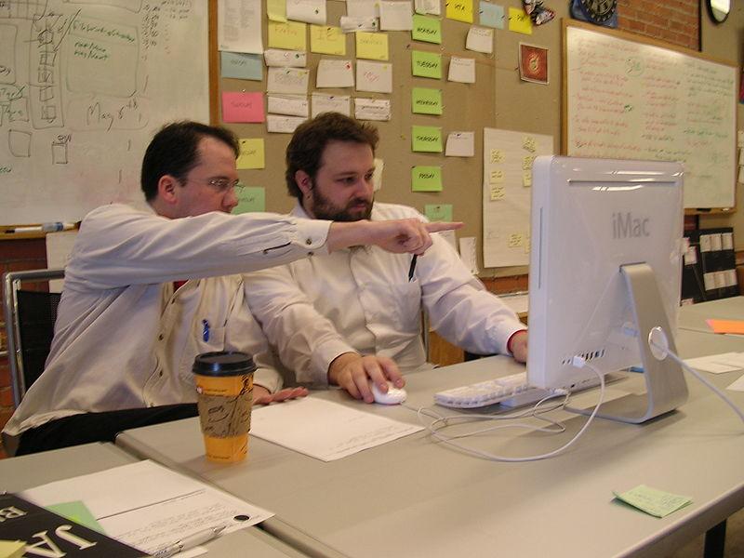
Embedding Security in Agile SSDLC
In some cases, the customer has already an Agile process for SDLC. How Agile can be secure?
Security Testing is still needed for final testing at least (even if my team is competent, it is goof to ask for a Technical Advisor
Implement a Definition of Done / Acceptance Criteria for Security
Implement Evil User Stories
Pair Programming with Developers and Security Experts
Image from Wikipedia, Lisamarie Babik

Slide 33
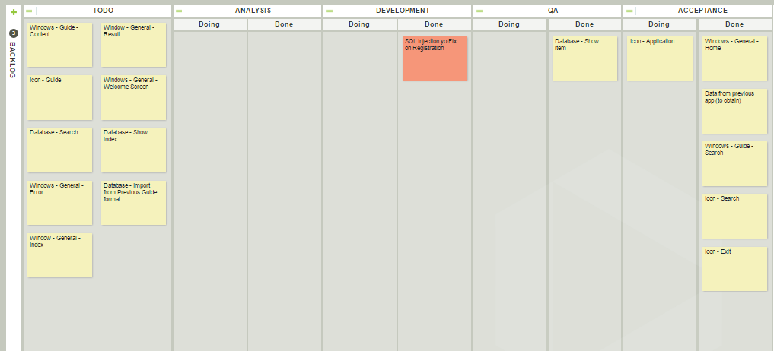
Be Agile, and Lean… how to manage the Vulnerabilities
All todos are blocked (red is present on the Kanban). Now is the time to ask to the Penetration Tester team to Retest.

Slide 34
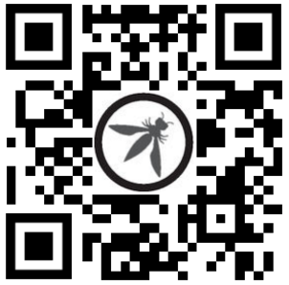
Thank you
Trust the QR Code…
(linkedin, will publish slides)
Simone Onofri
simone@onofri.org
https://onofri.org/

