Slide 1


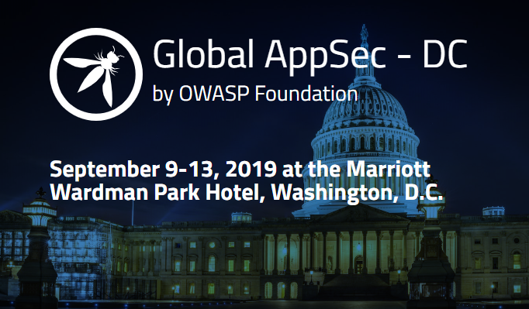
OWASP CORE VALUES
OPEN: Everything at OWASP is radically transparent from our finances to our code.
INNOVATION: OWASP encourages and supports innovation and experiments for solutions to software security challenges.
GLOBAL: Anyone around the world is encouraged to participate in the OWASP community.
INTEGRITY: OWASP is an honest, truthful, vendor neutral and global community.
Join the community
at www.OWASP.org
About OWASP
The Open Web Application Security Project (OWASP) is an open source community dedicated to enabling organizations to develop, purchase, and maintain applications and APIs that can be trusted. At OWASP, you'll find free and open:
• Application security tools
• Complete books on application security testing, secure code development and review
• Presentations and videos
• Community Project Support
• Standard security controls, libraries and cheat sheets
• Extensive conferences worldwide
www.OWASP.org
Projects
The OWASP Top 10
Exposes the top vulnerabilities and their risks + fixes. Gathered from data of hundreds of organizations and over 100,000 real-world applications.
Vulnerable Applications
Security Shepherd: Great app for understanding vulnerable web apps with built-in optional CTF platform and lessons.
WebGoat: OWASP classic JAVA vulnerable site with lessons, all solutions can be found in YouTube videos. NodeGoat also available for Node.js.
OWASP Juice Shop: Probably the most modern and sophisticated insecure web application. Written in Node.js, Express and Angular.
Pen testing tools to ‘hack’ my apps and test for vulnerabilities
OWASP ZAP: an attack proxy, crème de la crème tool for hacking your site.
OWTF: A complete pen testing, framework which includes test cases and it’s aligned with the latest security standards.
OWASP Amass: In-depth DNS Enumeration and Network Mapping.
Libraries to protect your Application
AppSensor: Intrusion detection and automated response for your site.
OWASP HTML Sanitizer: JAVA lib which lets you include HTML authored by third-parties in your web application while protecting against XSS.
CRSFGuard: Protect your site against CRSF attacks.
OWASP Guidelines and Static Analysis tools:
Code Review Guidelines: How to Check and review your code for common vulnerabilities.
O2 Platform: Strong Static Analysis tool which can also be a very powerful prototyping and fast-development tool for .NET
Main Chapters
Bay Area
Washington DC
Northern Virginia
Los Angeles
Germany
Orange County
Denver
San Diego
London
Japan
New Zealand
Austin
Stockholm
Poland
Israel
Montreal
Chapters
Currently 221 Active Chapters Globally in the following regions:
USA - 67 Active Chapters
Canada - 6 Active Chapters
Caribbean - 2 Active Chapters
Latin America - 23 Active Chapters
Europe - 57 Active Chapters
Asia/Pacific - 28 Active Chapters
Middle East - 26 Active Chapters
Africa - 11 Active Chapters
Virtual - 1 Active Chapters
Upcoming Training and Conference:

