Slide 1
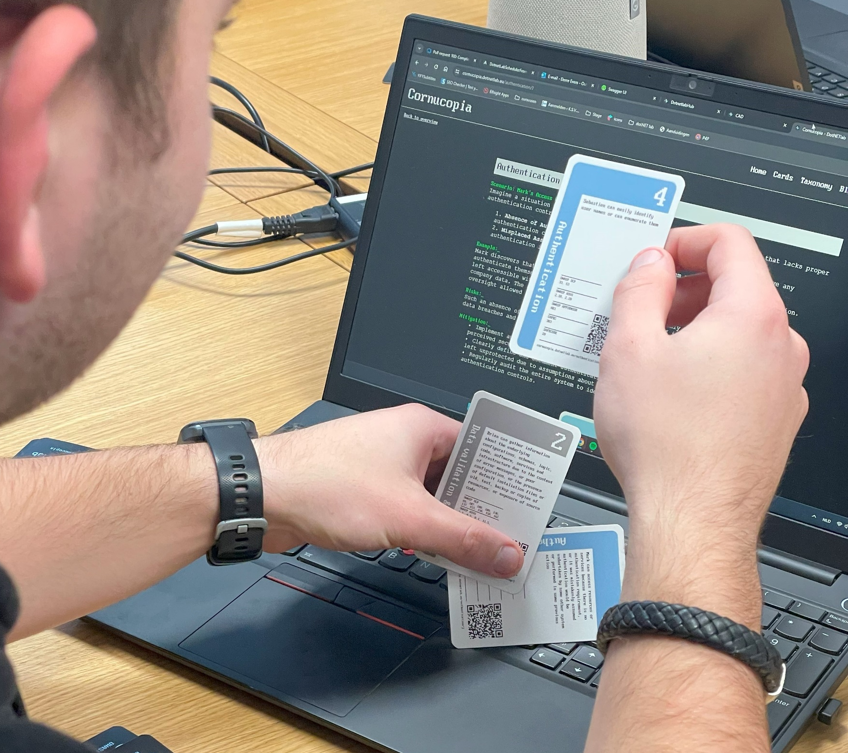



OWASP Cornucopia and Scrum
A strategic approach to introduce threat modeling in an Agile development process

Slide 2
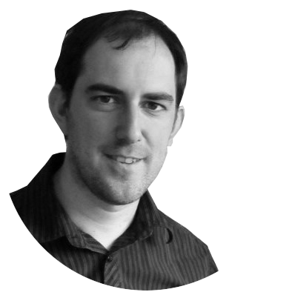



Ive Verstappen
Jef Meijvis
www.linkedin.com/in/iveverstappen
https://www.linkedin.com/in/jef-meijvis/

Slide 3
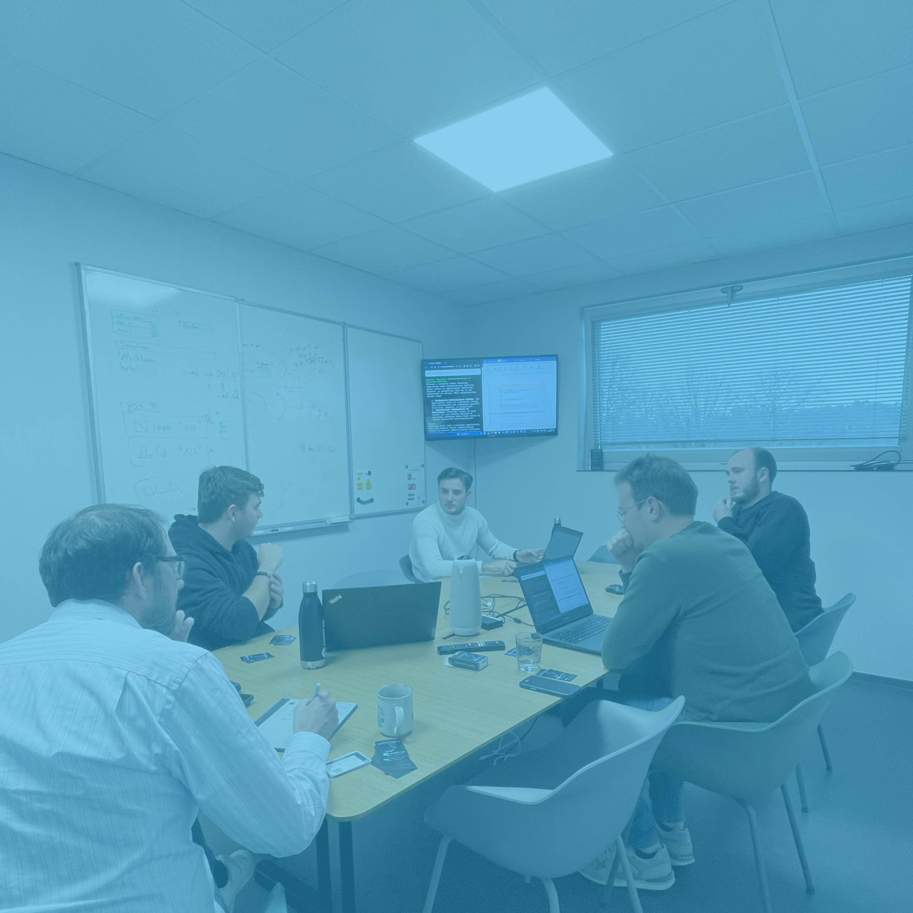
Agenda
OWASP Cornucopia
Scrum
Integrating Cornucopia & Scrum
Real world experience

Slide 4
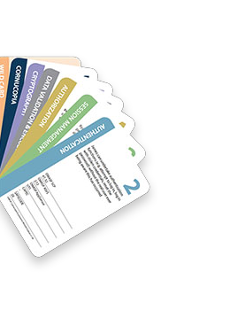

Cornucopia
OWASP
Originally created by Colin Watson
Grant Ongers
Threat modeling card game
Based on Microsoft Elevation of Privilege (EoP)
Gamification of cybersecurity

Slide 5
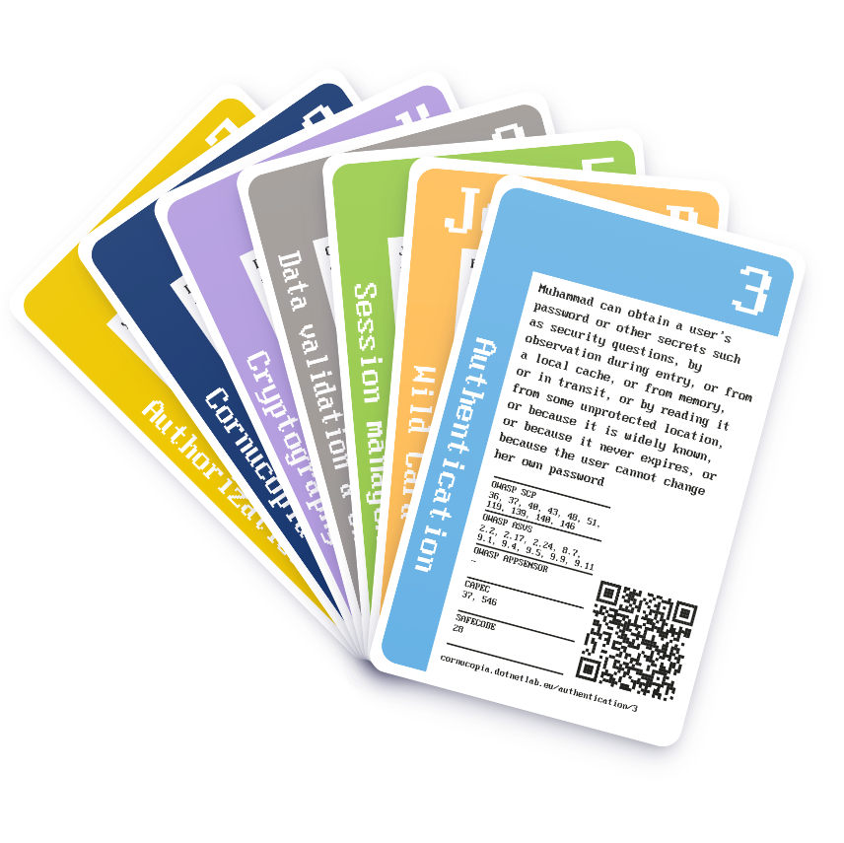
Cornucopia
How to play
Get players involved in a software project
Developers
Architects
…
Scope can be an application, feature, …
Take a subset of the full deck of cards

Slide 6

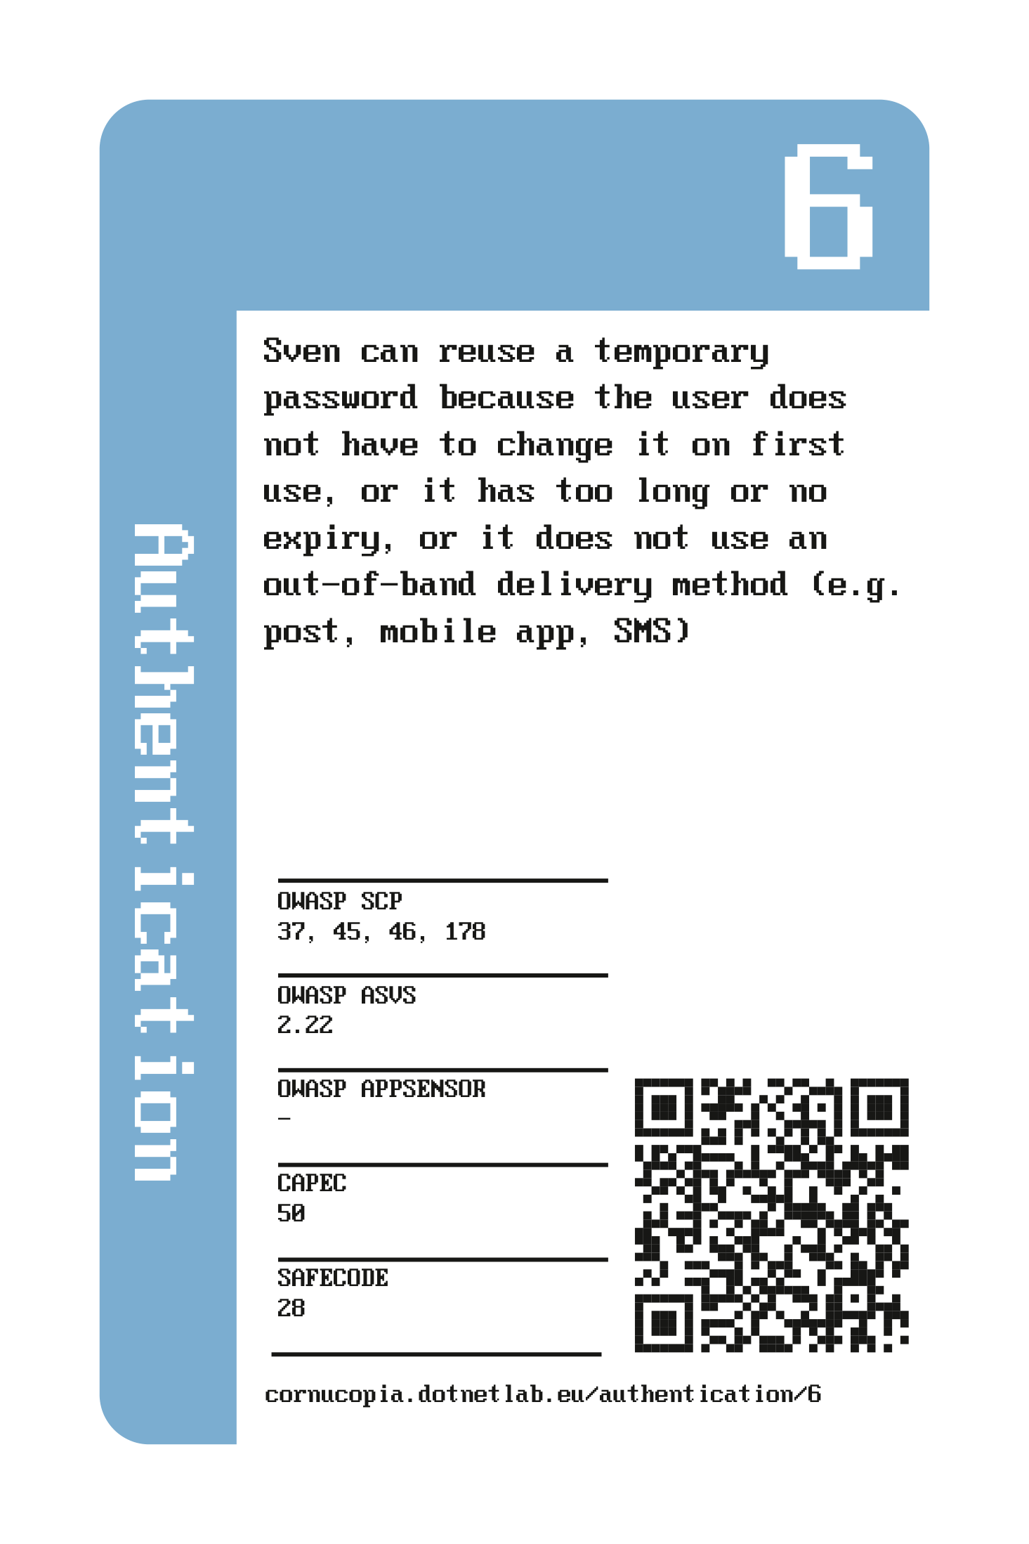
Cornucopia
How to play
Value
Description
Suit
Mappings

Slide 7
Cornucopia
How to play
Play: the players take turns to select a card
Describe: the player describes the possible attack using the card played
Convince: the other players have to be convinced that the attack is valid
Score: award points for a successful attack
Follow suit: the next player has to select a card from the same suit
Winner: the player with the most points
Follow up: each valid threat should be recorded and acted upon

Slide 8
Cornucopia
Addition
QR Code

Slide 9
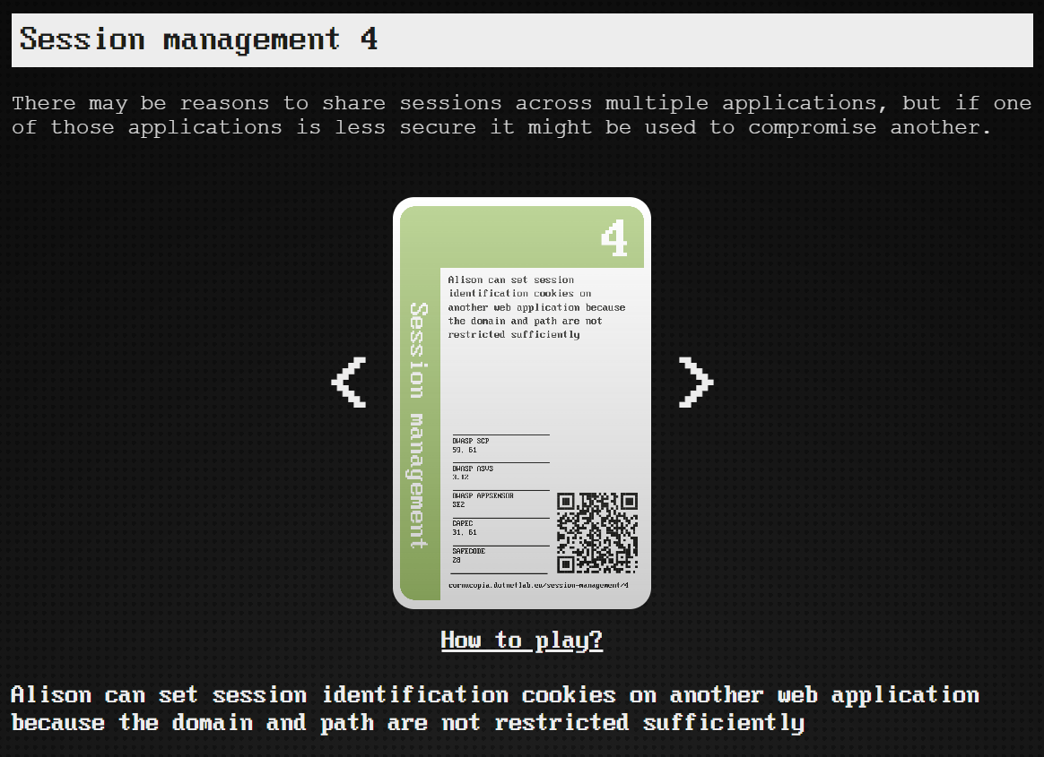
Website
Online card browser
How to play
Mappings
Attack descriptions
Taxonomy
Blog
Comment section

Slide 10

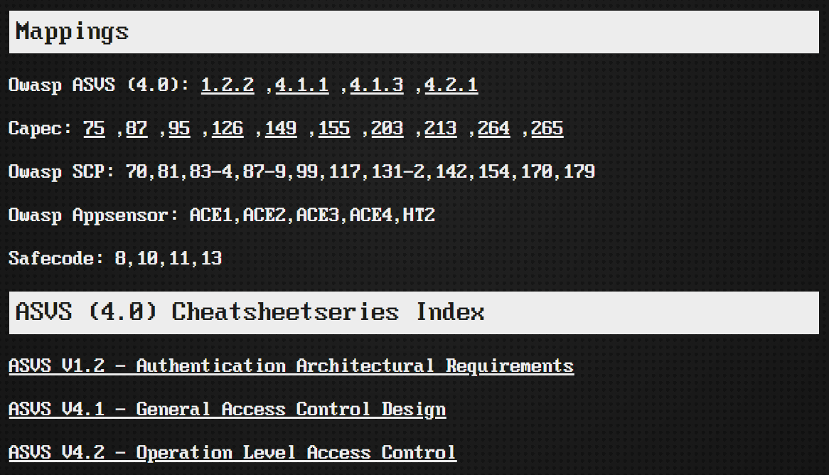
Website
Online card browser
How to play
Mappings
Attack descriptions
Taxonomy
Blog
Comment section

Slide 11
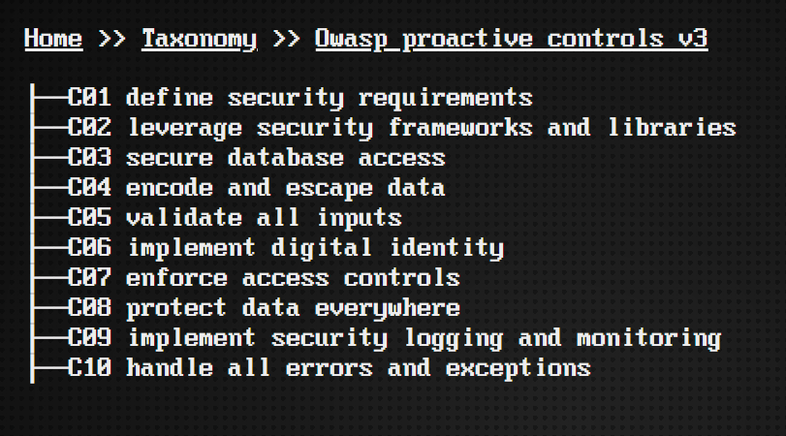
Website
Online card browser
How to play
Mappings
Attack descriptions
Taxonomy
Blog
Comment section

Slide 12
Cornucopia & Scrum
Why of scrum
Integration of Cornucopia

Slide 13
The WHY of Scrum (core concepts)
What type of process is Software Development?
The timebox principle
The KISS principle

Slide 14

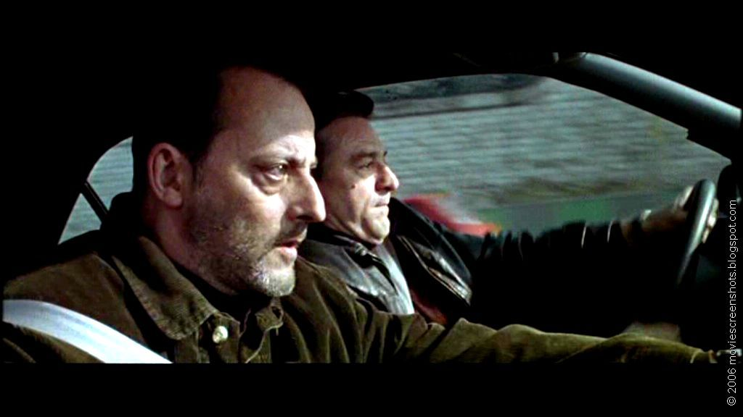
What type of process is Software Development?
Defined process VS Empirical process

Slide 15
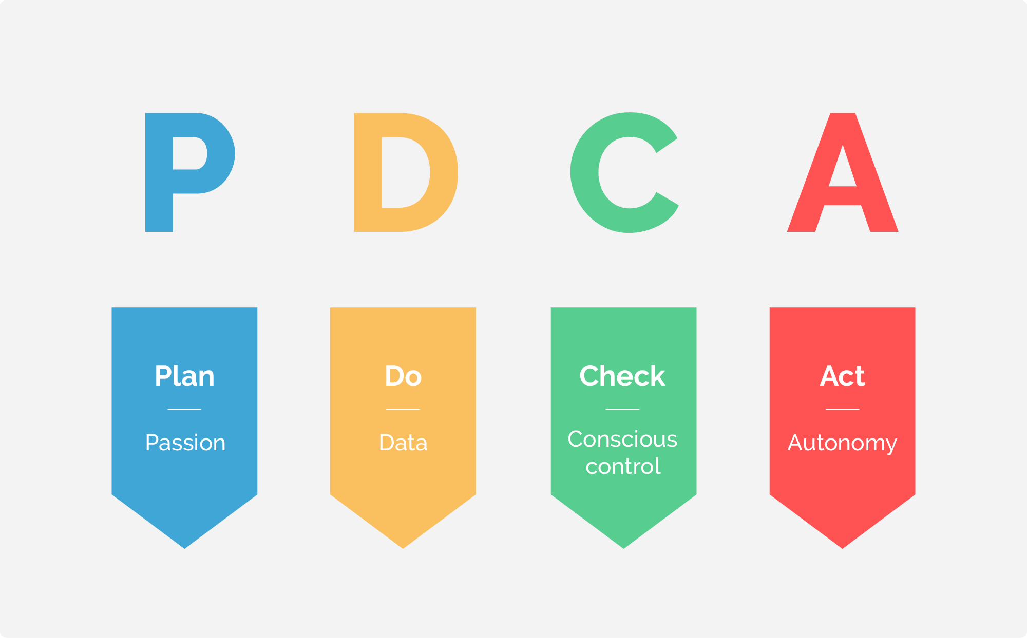
Scrum is so popular because it is the same type of process as Software Development
Defined process
Empirical process
Apply
Adapt
Inspect

Slide 16
Timebox
Time has a tendency to take all available space
“Student syndrome” is a major issue with planning of big projects
Solution: tight timeboxes!

Slide 17
Timeboxes in Scrum
Sprint (1-4 weeks)
Daily standup: 15 minutes
Workday (8 hours)
Sprint planning: 8 hours (dependent on sprint-length)
Sprint Review: 4 hours (dependent on sprint-length)
Sprint Retrospective: 3 hours (dep. On sprint-length)
More info: https://www.scrum.org/resources/blog/which-scrum-events-are-time-boxed

Slide 18
KISS
KISS
Keep It Simple, Stupid!
Process, project, technical solution
YAGNI
You Ain’t Gonna Need It
Functional, technical
Keep your architecture, software solution as simple as possible
While adhering to non-functional and functional requirements
Focus on working software

Slide 19
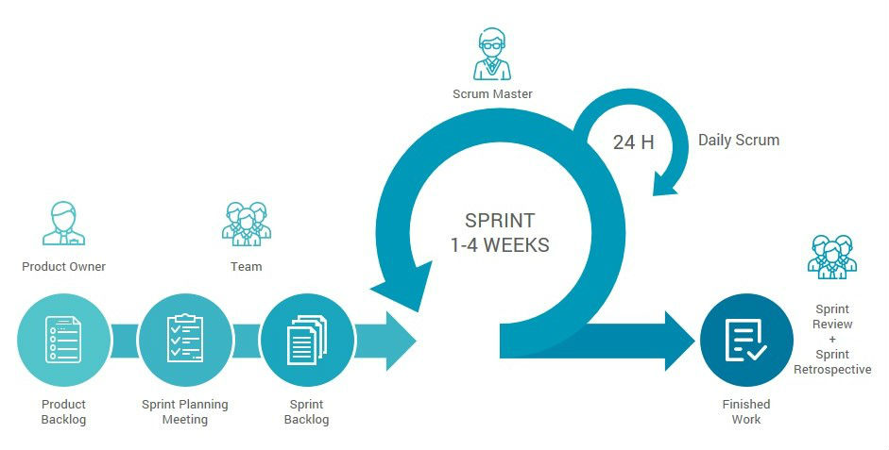

Scrum – Process & Integration of Cornucopia
Dedicated
Cornucopia meeting
Additional
Threat Modeling
Add nonfunctional requirements
to product backlog
Notes:
1, Overview of the scrum process
2, when to play Cornucopia?

Slide 20
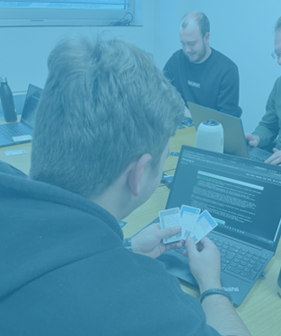
Cornucopia
Real world experience
Timebox (1h)
Keep it short and quick
Subset of card deck
Small team
Limit the application scope
Projects too big might need to be split up
Gamemaster needs to cut discussions short
Note down the threat. Don’t try to mitigate it during the session

Slide 21

Thanks for listening
Visit the site at
cornucopia.dotnetlab.eu

