Slide 1

Board financial overview
OWASP Foundation, Inc. | July 2026

Slide 2
Financial snapshot as of July 31, 2026
$2.24M
5.3
5.65:1
$3.29M
Cash on hand (down $241K in July)
Months of cash on hand
Current ratio
Total net assets

Slide 3

YEAR-TO-DATE RESULTS
$790K
Net income, year to date
Revenue of $3.77M came in 29.9% over the YTD budget, while expenses of $2.99M ran 5.8% over budget, driven by unbudgeted EU tax compliance costs.

Slide 4
Key metrics: year to date vs budget and prior year
Metric | 2026 YTD | YTD budget | Prior-year YTD
Total revenue | $3,774,802 | $2,907,024 | $2,954,697
Total expenses | $2,986,695 | $2,822,225 | $2,553,113
Net income | $788,191 | $91,799 | $409,341
Months of cash | 5.3 | — | —
Current ratio | 5.65:1 | — | —

Slide 5
Cash on hand: trailing 12 months
CASH ON HAND ($ MILLIONS)
KEY TAKEAWAY
Cash pulled back to $2.24M in July after EU tax payments and event vendor settlements, down from June's 12-month high of $2.48M; the Foundation still holds 5.3 months of cash on hand.

Slide 6
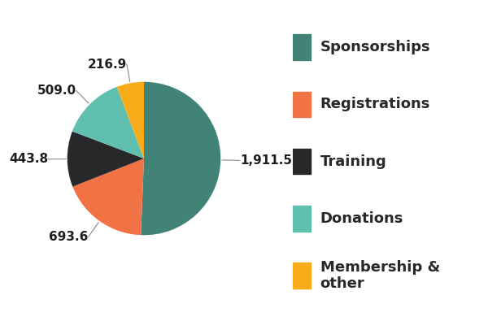
Revenue mix, year to date
$ THOUSANDS | TOTAL $3.77M
KEY TAKEAWAY
51%
of all revenue is driven by Sponsorships
81%
comes from Conference income (sponsorships, registrations, training)

Slide 7
Expense mix, year to date
$ THOUSANDS | TOTAL $2.99M
KEY TAKEAWAY
Conference costs (49%) and personnel (22%) account for roughly seventy percent of spend — both tied directly to the mission and events calendar.

Slide 8

Net income of $0.79M year to date.
Revenue of $3.77M is 29.9% over budget, led by sponsorships and training.
Expenses of $2.99M ran 5.8% over budget on unbudgeted EU tax compliance costs.
Strong liquidity: 5.3 months of cash and a 5.65:1 current ratio.
Actively addressing $447K receivables over 90 days.
WHAT THIS MEANS
Board takeaways

Slide 9
Thank you
Prepared by The Charity CFO | July 2026

