Slide 1

Board financial overview
OWASP Foundation, Inc. | June 2026

Slide 2
Financial snapshot as of June 30, 2026
$2.48M
6.61
9.19:1
$3.77M
Cash on hand (up $131K in June)
Months of cash on hand
Current ratio
Total net assets

Slide 3

YEAR-TO-DATE RESULTS
$1.27M
Net income, year to date
Revenue of $3.42M came in 31% over the YTD budget, while expenses of $2.15M held 17% under budget.

Slide 4
Key metrics: year to date vs budget and prior year
Metric | 2026 YTD | YTD budget | Prior-year YTD
Total revenue | $3,417,479 | $2,614,668 | $2,605,373
Total expenses | $2,149,305 | $2,595,620 | $2,237,385
Net income | $1,269,633 | $25,048 | $376,047
Months of cash | 6.61 | — | —
Current ratio | 9.19:1 | — | —

Slide 5
Cash on hand: trailing 12 months
CASH ON HAND ($ MILLIONS)
KEY TAKEAWAY
Cash has climbed steadily since the January low of $1.5M, ending June at $2.48M — the highest balance in the last 12 months and 6.6 months of runway.

Slide 6
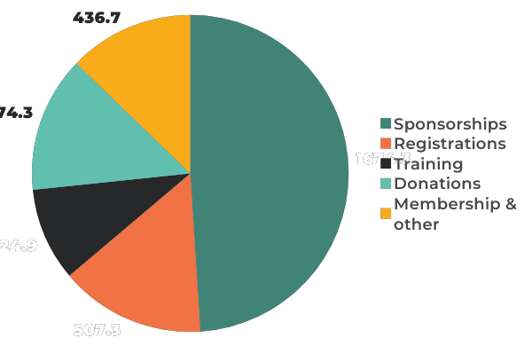
Revenue mix, year to date
$ THOUSANDS | TOTAL $3.42M
KEY TAKEAWAY
49%
of all revenue is driven by Sponsorships
73%
comes from Conference income (sponsorships, registrations, training)

Slide 7
Expense mix, year to date
$ THOUSANDS | TOTAL $2.15M
KEY TAKEAWAY
Conference costs (40%) and personnel (26%) account for two-thirds of spend — both tied directly to the mission and events calendar.

Slide 8

Net income of $1.27M year to date.
Revenue of $3.42M is 31% over budget, led by sponsorships.
Expenses of $2.15M came in 17% under budget.
Strong liquidity: 6.61 months of cash and a 9.19:1 current ratio.
Monitor $388K receivables over 90 days.
WHAT THIS MEANS
Board takeaways

Slide 9
Thank you
Prepared by The Charity CFO | June 2026

