Slide 1

Board financial overview
OWASP Foundation, Inc. | August 2026

Slide 2
Financial snapshot as of August 31, 2026
$1.90M
4.5
16.81:1
$3.32M
Cash on hand (down $340K in August)
Months of cash on hand
Current ratio
Total net assets

Slide 3

YEAR-TO-DATE RESULTS
$824K
Net income, year to date
Revenue of $4.15M came in 26.7% over the YTD budget, while expenses of $3.31M ran 6.9% over budget, driven by conference costs.

Slide 4
Key metrics: year to date vs budget and prior year
Metric | 2026 YTD | YTD budget | Prior-year YTD
Total revenue | $4,146,448 | $3,271,382 | $3,128,153
Total expenses | $3,314,841 | $3,101,168 | $3,033,425
Net income | $823,523 | $170,214 | $94,728
Months of cash | 4.5 | — | —
Current ratio | 16.81:1 | — | —

Slide 5
Cash on hand: trailing 12 months
CASH ON HAND ($ MILLIONS)
KEY TAKEAWAY
Cash declined to $1.90M in August after EU tax liability payments and final vendor/contractor settlements for the Global AppSec EU 2026 conference, down from July's $2.24M; the Foundation still holds 4.5 months of cash on hand.

Slide 6
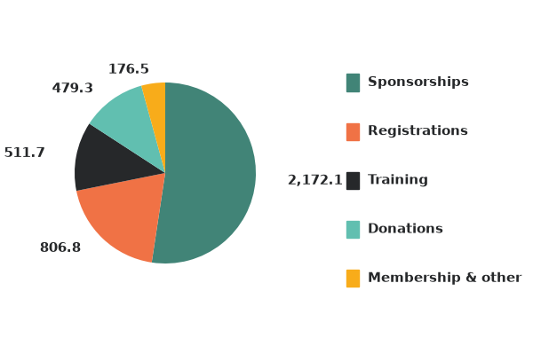
Revenue mix, year to date
$ THOUSANDS | TOTAL $4.15M
KEY TAKEAWAY
52%
of all revenue is driven by Sponsorships
84%
comes from Conference income (sponsorships, registrations, training)

Slide 7
Expense mix, year to date
$ THOUSANDS | TOTAL $3.31M
KEY TAKEAWAY
Conference costs (46%) and personnel (23%) account for roughly seventy percent of spend — both tied directly to the mission and events calendar.

Slide 8

Net income of $824K year to date.
Revenue of $4.15M is 26.7% over budget, led by sponsorships and training.
Expenses of $3.31M ran 6.9% over budget driven by increased conference costs.
Strong liquidity: 4.5 months of cash and a 16.81:1 current ratio.
Actively addressing $410K receivables over 90 days.
WHAT THIS MEANS
Board takeaways

Slide 9
Thank you
Prepared by The Charity CFO | August 2026

