Slide 1
A Fully Trained Jedi, You are Not
Adam Shostack
OWASP Aarhus
March, 2023

Slide 2
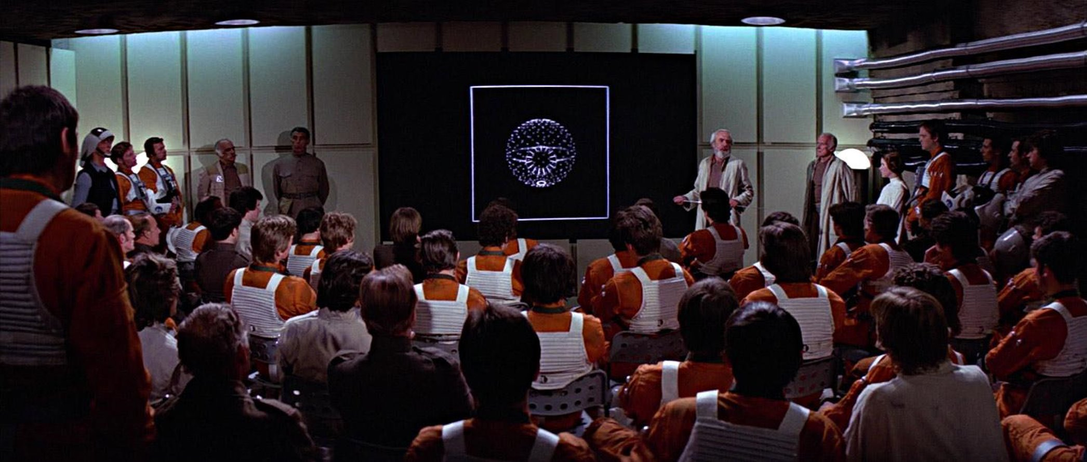
How Many Jedi?

Slide 3
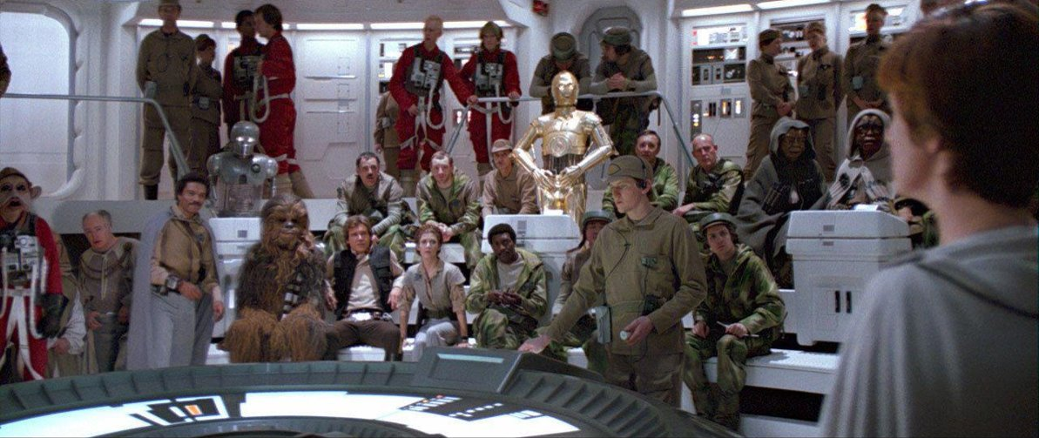
How Many Jedi?

Slide 4
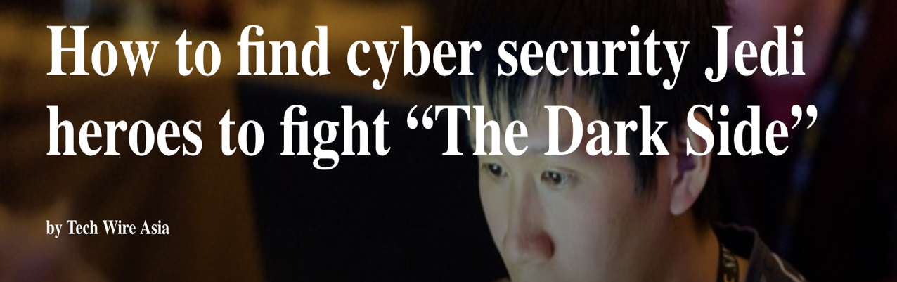
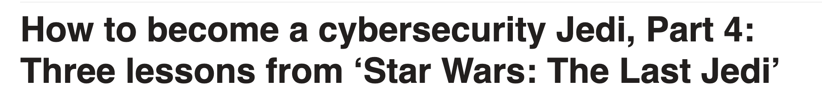
We talk a lot about Jedi

Slide 5
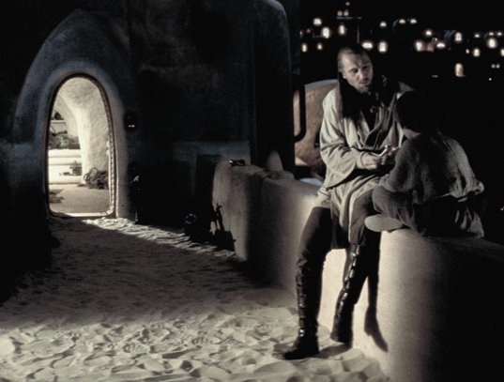
It's a Bad Goal
Expectations of heroism drive burnout
Tearing children from families…
… Forced to live without attachments
Even so, many people just don’t qualify

Slide 6





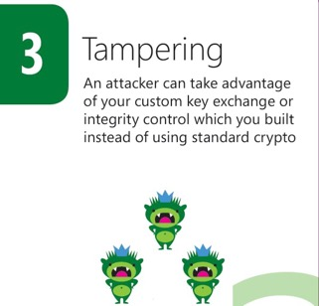
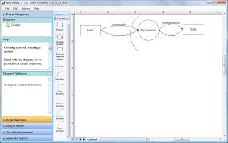

About Adam Shostack

Slide 7
Agenda
The problem starts with software
“Shifting left” isn’t working
Reasonable Expectations
Bloom
Chunking
Frames
Threats

Slide 8
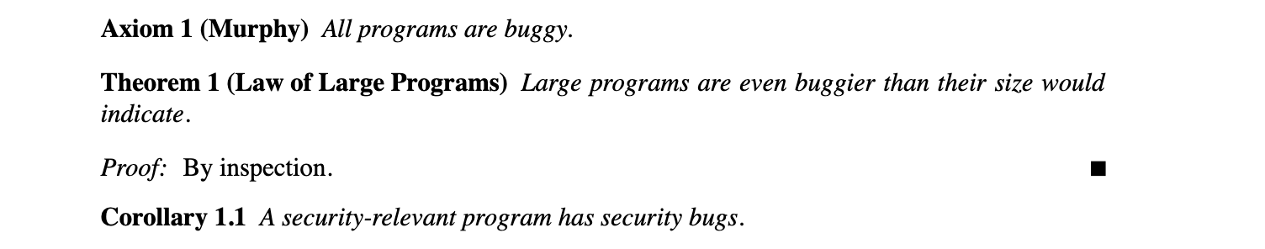
We’ve known for a while…
Firewalls and Internet Security
(Cheswick and Bellovin, 1994)

Slide 9
Where do bugs come from?
Software engineers
Developers

Slide 10
Developers introduce problems
Code with security bugs
Missing security features
Unusable security features

Slide 11
Software
Application security
Operational security
Dev
Production

Slide 12
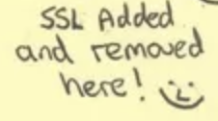
Software
Application security
Operational security
Dev
Production
Firehose of CVEs

Slide 13
Software
Pen Test
Application security
Operational security
Language improvements
Reverse engineering
Firewalls!
Fuzzing
Static analysis
Vuln Scan
SIEM
XDR
Dev
Production
Firehose of CVEs

Slide 14
Software
Pen Test
Application security
Operational security
Language improvements
Reverse engineering
Firewalls!
Fuzzing
Static analysis
Vuln Scan
SIEM
XDR
Dev
Production
Firehose of CVEs
“Shift Security Left”

Slide 15
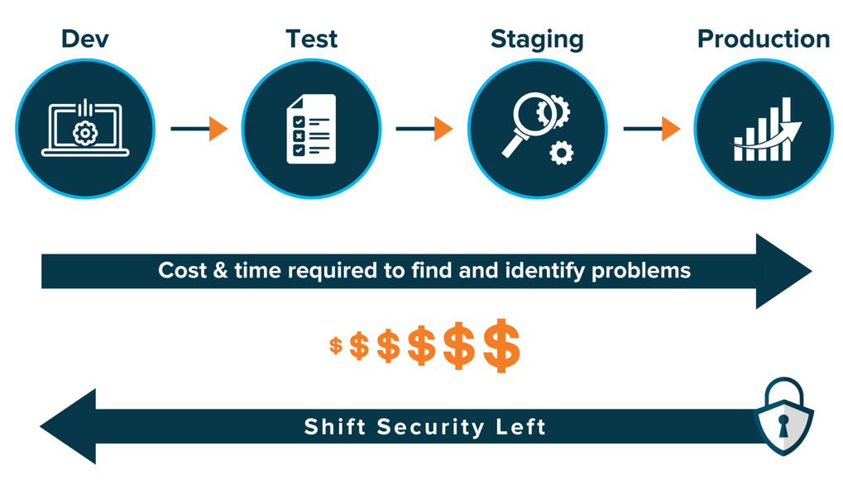
“Shift Left”
Build security in
Changes to how we/they design, develop, deploy
Requires new skills
Less pen testing
More software engineering
Growing popularity
Image: Klogix
Notes:
Building security in vs sprinkling it on at the end
Fewer problems or complex escalations when you build security in

Slide 16

Shifting left?

Slide 17
Shift left implies: Change the development process
Demands clear responsibilities
What exactly is changing?
Deliverables
Tasks
Skills
Risk: Are we doing this to please appsec?

Slide 18
Clarify
Who delivers what to whom?
How?

Slide 19
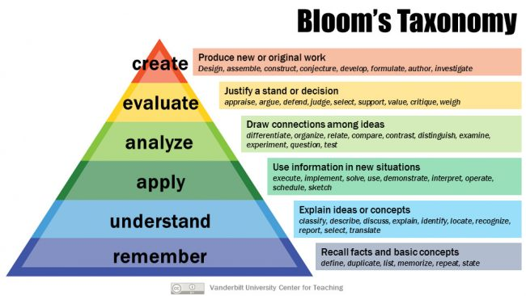
One tool - Bloom’s Taxonomy
Fundamental tool in learning
Goals + evaluations

Slide 20
Bloom’s Taxonomy: Remember
Recall facts and basic concepts
Define, duplicate, list, repeat
”Remember data sent over a network can be read by anyone”
Fundamental tool in learning
Goals + evaluations

Slide 21
Bloom’s Taxonomy: Understand
Explain ideas and concepts
Classify, describe, discuss, explain, identify, locate, recognize
Understand that this data is vulnerable
…because RPC sends it over a network
Fundamental tool in learning
Goals + evaluations

Slide 22
Bloom’s Taxonomy: Apply
Apply: use information in new situations
Execute, implement, solve, interpret…
Look at a system diagram and assess which data flows are vulnerable
Fundamental tool in learning
Goals + evaluations

Slide 23
Bloom’s Taxonomy: Analyze
Draw connections among ideas
Differentiate, organize, relate, compare, contrast, distinguish
How does authentication relate to authorization?
How does information disclosure relate to tampering?
Fundamental tool in learning
Goals + evaluations

Slide 24
Bloom’s Taxonomy: Evaluate
Justify a stand or decision
Argue, defend, judge, select, critique, weigh
Does encryption protect against that threat?
Fundamental tool in learning
Goals + evaluations

Slide 25
Bloom’s Taxonomy: Create
Produce new or original work
Design, assemble, investigate
Fundamental tool in learning
Goals + evaluations

Slide 26
Tools help us use Bloom to define skills + knowledge
The Helpful Hundred – Planning for Instruction
Smaldino, Lowther, and Russell (2008) suggest 100 verbs that highlight performance. Each of these verbs is observable and measurable, making them work quite well in writing objectives for learning. This is not to say that these 100 verbs are the only ones are can be used effectively; however, they provide a great reference.
add | compute | drill | label | predict | state
alphabetize | conduct | estimate | locate | prepare | subtract
analyze | construct | evaluate | make | present | suggest
apply | contrast | explain | manipulate | produce | swing
arrange | convert | extrapolate | match | pronounce | tabulate
assemble | correct | fit | measure | read | throw
attend | cut | generate | modify | reconstruct | time
bisect | deduce | graph | multiply | reduce | translate
build | defend | grasp | name | remove | type
cave | define | grind | operate | revise | underline
categorize | demonstrate | hit | order | select | verbalize
choose | derive | hold | organize | sketch | verify
classify | describe | identify | outline | ski | weave
color | design | illustrate | pack | solve | weigh
compare | designate | indicate | paint | sort | write
complete | diagram | install | plot | specify
compose | distinguish | kick | position | square
Source: Smaldino, S. E., Lowther, D. L., & Russell, J. D. (2008). Instructional Media and Technologies for Learning (9th ed). Upper Saddle River, NJ: Pearson.
Bloom Question Stems
Remembering
Make a story map showing the main events.
Make a time line of your typical day.
Make a concept map of the topic.
Write a list of keywords you know about….
What characters were in the story?
Make a chart showing…
Make an acrostic poem about…
Recite a poem you have learned.
Questions for Remembering
What happened after...?
How many...?
What is...?
Who was it that...?
Name the ...?
Find the definition of…
Describe what happened after…
Who spoke to...?
Which is true or false...?

Slide 27

What security work do we ask of different people?
Pen test
Speaker
Appsec
Champ
Developer

Slide 28
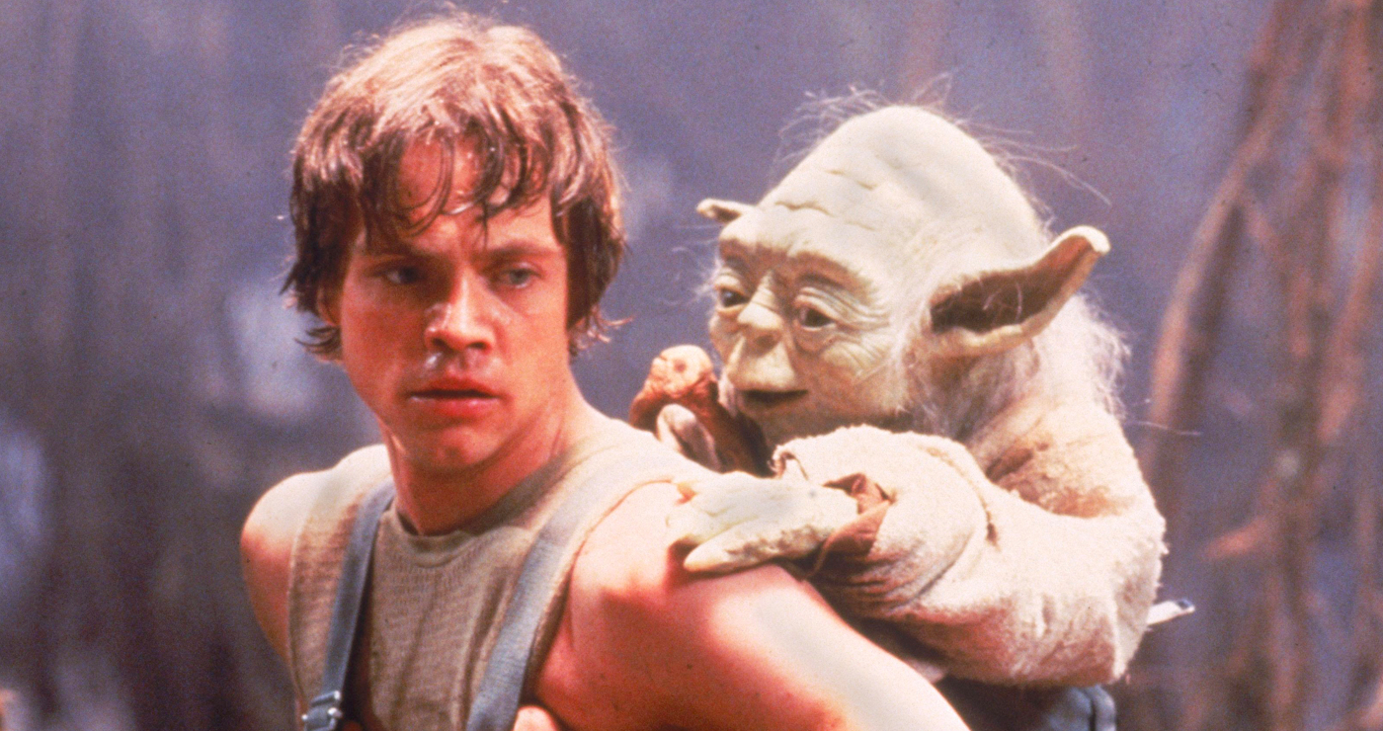
But instead… we teach like this?

Slide 29
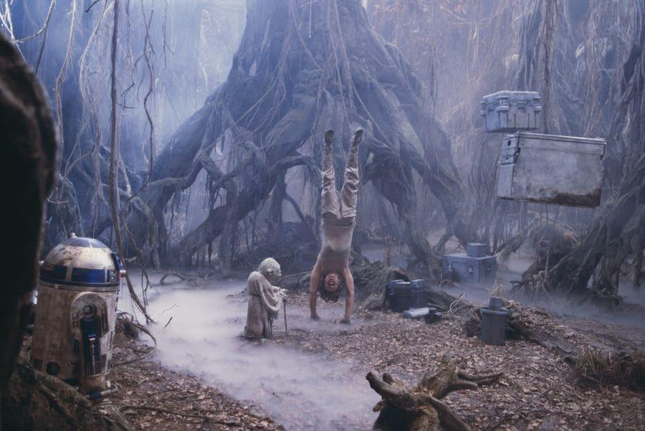

Slide 30
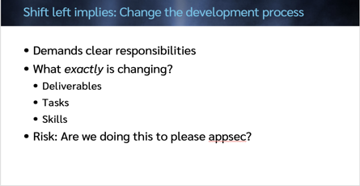
Criteria + constraints
Align to job, aspirations
Within reasonable training time
Goals
Help people find, follow paved roads
Recognize danger signs
Champ
What fits here?
Developer
Notes:
Frames either help us by showing possibilities, inspiring, and helping us categorize new information or hinder our learning by not aligning with our goals or giving us cubbyholes

Slide 31


Slide 32
Criteria + constraints
Align to job, aspirations
Within reasonable training time
Goals
Help people find, follow paved roads
Recognize danger signs
Champ
What fits here?
Developer
Notes:
Frames either help us by showing possibilities, inspiring, and helping us categorize new information or hinder our learning by not aligning with our goals or giving us cubbyholes

Slide 33
Chunking is crucial
Our brains are really, really good at pattern recognition
Dealing with information in “chunks”
Short term memory is 7 +/- 2 chunks
1,1,2,3,5,8,13,34,55…
If we don’t define the chunks, our students will
(They may anyway!)

Slide 34
Categories and frames
Exploit techniques?
Threat actors?
Compliance?
Cyberwar?
Top ten?
Threats?

Slide 35
“What can go wrong”
focuses our attention on threats

Slide 36
“What can go wrong?” is a powerful framing question
Everyone has an answer — if you ask and encourage
Across industries, technical skill, execs
Variants
“What keeps you up at night?”
“How would you attack this”
Fortunately/unfortunately game

Slide 37
“What can go wrong?” is an umbrella
Open ended is easier to answer, but answers vary a lot
Structures
Finance execs … ORX
Security … OWASP top ten
FDA …. inability to update
Compliance… see my Threat Modeling Compliance (BHAsia ’21)
Flaws, not bugs

Slide 38
What’s the single best toolset?
4 ways to do a side task?
I have to analyze, compare, evaluate?
Those are expert tasks!
So people need experts to offer specific advice

Slide 39
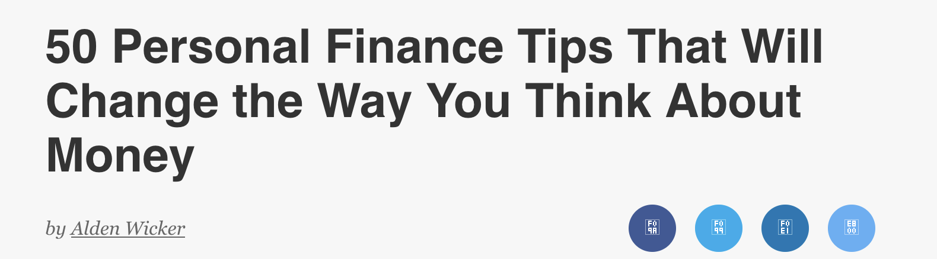
Single best tool need: Personal finance example
Max out your tax advantaged, matched accounts…
50?!?!!
Target date funds

Slide 40
What does every engineer need to know?
The question’s catalyzed by a couple of projects
Fast, Cheap + Good: An Unusual Tradeoff (whitepaper)
Threats: What Every Engineer Should Learn from Star Wars
Nothing Is Good Enough
All of which started with a simple question…
Whitepaper: Shostack.org/whitepapers/ • Threatsbook.com • IEEE S+P Magazine, Jan/Feb 2023

Slide 41
A simple question
Is every flaw unique?

Slide 42
Another simple question
Do flaws cluster?
What do we need to know to find them?

Slide 43
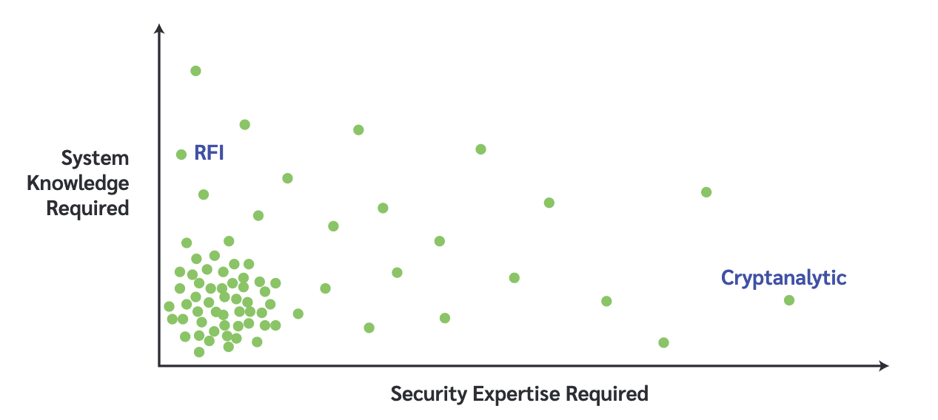
Where are the flaws? (1)

Slide 44
Where are the flaws? (2)

Slide 45
Maybe they’re easy to find?

Slide 46
If lightweight flaws are common,
we should transform how
we work with engineers
+
how we evaluate

Slide 47
Why do lightweight flaws exist?
Developers suck?
Bad tools? (Languages, scanners)
Lack of knowledge?

Slide 48
What developers need to know: Framework
My proposal:
STRIDE threats
(Spoofing, Tampering, Repudiation, Info disclose, DoS, Expansion of Authority)
Parsing + predictability generate danger
Kill chains bring these together

Slide 49
Recap
Code issues underly many (most?) security issues
Shifting left is an admirable goal
Only works when we’re clear about change

Slide 50
A possible future
Normal levels of security are defined
Developers able to build more secure systems
Less rework, fewer escalations, more predictable delivery

Slide 51
Thank you!

Slide 52
Questions?
Now or
adam@shostack.org

