Slide 1
Devsecops - it’s just a jump to the left
(and then a step to the ri-i-i-i-i-ight)
Keith Batterham, March 2020

Slide 2
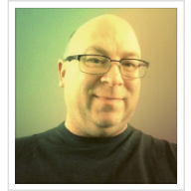


A little bit about me
Internationally experienced technology and security leader, helping drive change that sticks
Recovering software engineer who can still code, albeit in Python and Swift these days
Diverse background covering service & product supply, consulting and end user entities
Devoted dad and self-proclaimed geek who you might have seen talk at security conferences

Slide 3
A jump to the left?
Of course I’m talking about ‘left shifting’…
Moving the practice of security to the beginning of the product lifecycle
Using automation to improve the coverage of all types of testing
Enabling faster decision making based on data

Slide 4
why do this?
Relative cost of fixing a security vulnerability

Slide 5
guiding principles
Security is EVERYONE'S responsibility
We MUST automate security checking as much as possible
There has to be good quality, ACTIONABLE feedback
Use data to IMPROVE security posture over time

Slide 6
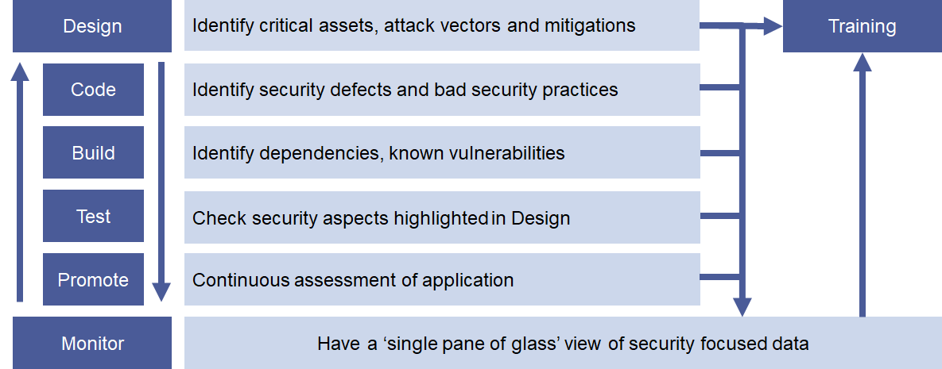
how it works

Slide 7
Getting started
Think of this as a long journey, don’t try and rush or you’ll get tired quickly
Start with simple threat modelling
What are the assets someone would want to take or compromise?
How would they achieve this and what are you going to stop this from happening?
Make sure your engineers know the fundamentals of security and apply it mindfully
Most modern languages have frameworks and plug-ins to help avoid common CVEs
Train one or more as security champions and have them do code reviews
Code copied or adapted from public GitHub etc ALWAYS needs to be security reviewed!
Use security tooling that fits your needs at this time
Take the opportunity to understand your ‘security defects’
Encourage your engineers to share their growing knowledge and best practices
Use the data from tools to highlight trends and drive learning opportunities

Slide 8

Easy enough, right?
Technical change is relatively easy, people change is HARD
You need to GRIN (yes really)
G
R
I
N
set realistic, achievable GOALS
have the right RESOURCES to make this a reality
agree the INCREMENTS that make up this journey
NOTICE the changes that are happening

Slide 9
Haven’t you forgotten something?
Keith…. what on Earth is this step to the right?

Slide 10
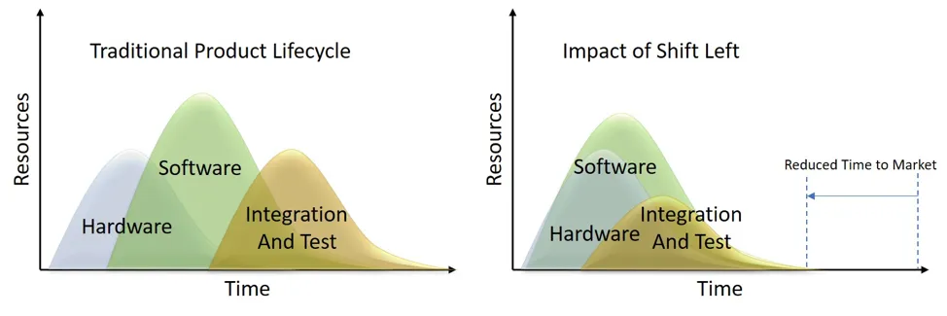
OK, so what’s the payoff?
Have I got your attention now?

Slide 11


T H A N K Y O U !
https://linkedin.com/in/ktbatterham
keith@twoo.tech

