Slide 1
OWASP Threat Dragon
Presentation to Bristol (UK) Chapter

Slide 2
Who am I?
C/C++ developer for 25 years
Security engineer for 11 years
Active in OWASP :
Leader + contributor to OWASP Threat Dragon project
Co-leader + contributor for OWASP Developer Guide project
Co-Leader of Bristol (UK) OWASP Chapter
Notes:
Please choose an upcoming AppSec Global, and any local regional or chapter events

Slide 3

Did you say Threat Dragon?
OWASP Lab Project
Tactical threat modeling
Stores threats
Data flow diagrams
Always free to download, free to use
Notes:
Place the logo and their support level in this slide. It should be the only place in which it appears in a presentation

Slide 4
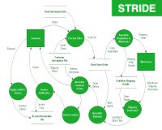
What is Threat Modeling?
Just 4 simple questions
What are we considering?
What can go wrong?
What to do about that?
How well did it turn out?
(Paraphrasing Shostack’s Four Questions)
Notes:
Place the logo and their support level in this slide. It should be the only place in which it appears in a presentation

Slide 5
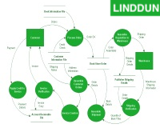
Why do Threat Modeling?
Well, because we are expected to do it
It is as useful if you make it
It can be fun!
It may be the only time when a team can sit back and ask: ‘If I was a bad person, what is the worst I can do?”
Notes:
Place the logo and their support level in this slide. It should be the only place in which it appears in a presentation

Slide 6
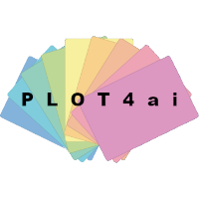
Is Threat Modeling painful?
It can be if you get it wrong
Tactical threat modeling
Make it bite size
Do it early; and its never too late
No security heroes
Notes:
Place the logo and their support level in this slide. It should be the only place in which it appears in a presentation

Slide 7
Where do I get Threat Dragon?
Download the desktop application
for Linux/MacOS/Windows
Or run your own web application
Or deploy a docker container
Or access the demo site:
www.threatdragon.com
Notes:
Place the logo and their support level in this slide. It should be the only place in which it appears in a presentation

Slide 8
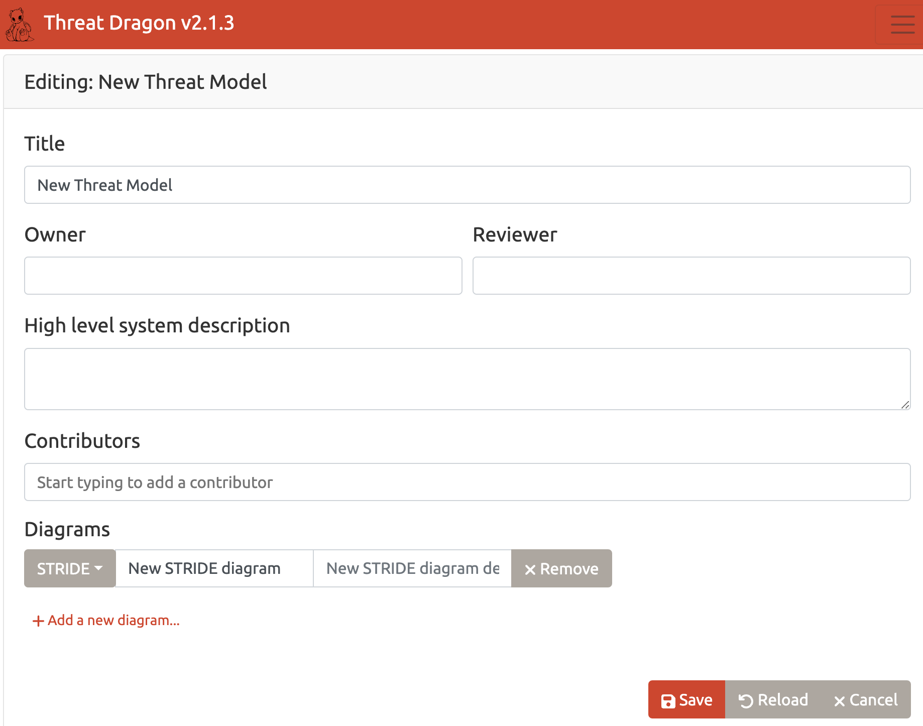
So where do I start?
Provide high level information
Add diagrams:
  STRIDE
  LINDDUN
  CIA, PLOT4ai, DIE
Notes:
Place the logo and their support level in this slide. It should be the only place in which it appears in a presentation

Slide 9
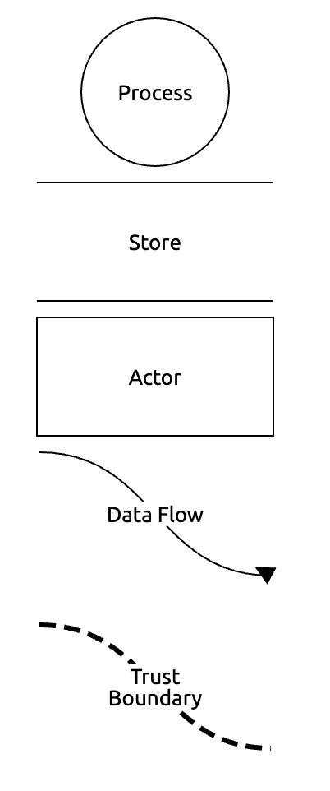
Did you say diagrams?
Data flow diagram components:
  Processes
  Actors
  Stores / Assets
  Trust boundaries
Data flow between components
Notes:
Place the logo and their support level in this slide. It should be the only place in which it appears in a presentation

Slide 10
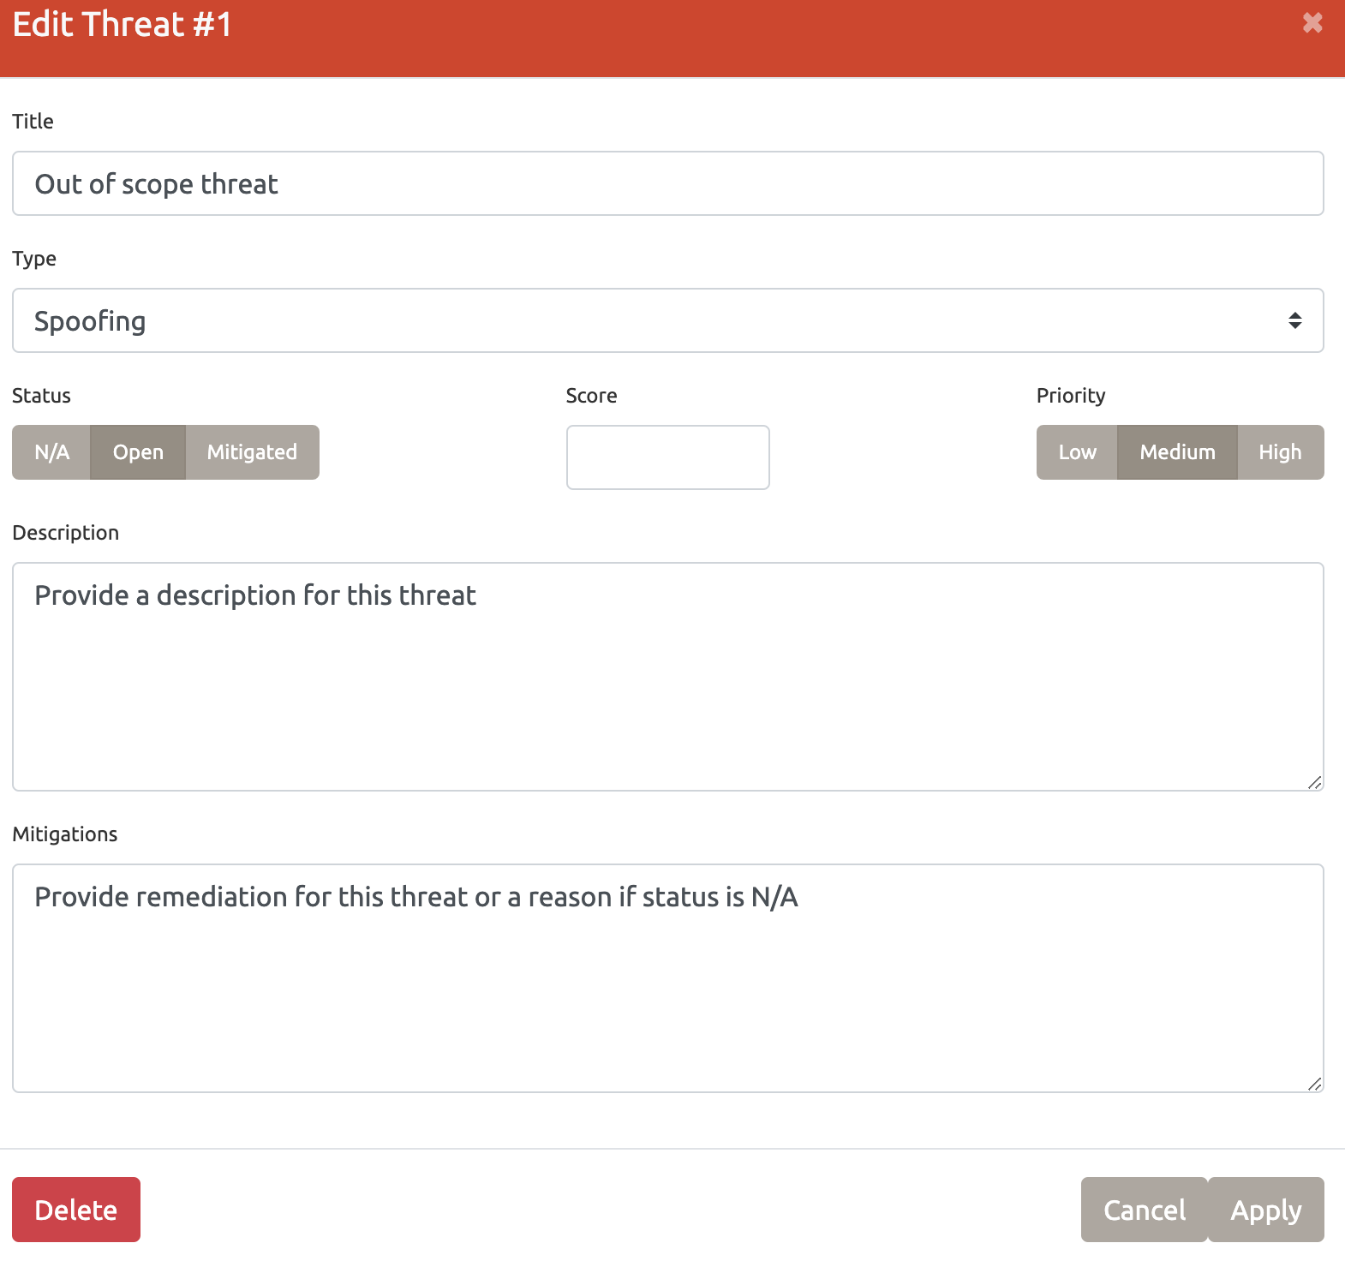
What about threats?
The reason for threat modeling
Stores threats within the model
Type: according to methodology
Status: Open / Mitigated / NA
Priority: High / Medium / Low
Score: any numeric value
Mitigation or Remediation?
TAME the threats
Notes:
Place the logo and their support level in this slide. It should be the only place in which it appears in a presentation

Slide 11
Did you say STRIDE?
 | Spoofing | Tampering | Repudiation | Information disclosure | Denial of service | Elevation of privileges
Process | X | X | X | X | X | X
Store |  | X | X | X | X
Actor | X |  | X
Data flow |  | X |  | X | X
Notes:
Place the logo and their support level in this slide. It should be the only place in which it appears in a presentation

Slide 12
Did you say LINDDUN?
 | Linkability | Identifiability | Non-repudiation | Detectability | Disclosure of information | Unawareness | Non-compliance
Process | X | X | X | X | X |  | X
Store | X | X | X | X | X |  | X
Actor | X | X |  |  |  | X
Data flow | X | X | X | X | X |  | X
Notes:
Place the logo and their support level in this slide. It should be the only place in which it appears in a presentation

Slide 13
Questions on Threat Dragon?
Making Threat Modeling less threatening
Always free to download, free to use
Contributions welcomed!
Notes:
Place the logo and their support level in this slide. It should be the only place in which it appears in a presentation

Slide 14
Time for a demo ?
Notes:
Place the logo and their support level in this slide. It should be the only place in which it appears in a presentation

