Slide 1
OWASP Bristol Chapter and
Women in Tech & Cyber Hub
Katy Anton
Craig Francis
Jon Gadsden
Notes:
Change this to your local chapter name. Add any host or food/beverage sponsor logos you need. Look at OWASP London for a chapter that has localized its front slide. Your custom slide must have the OWASP logo on it, but that’s the only restriction to changing the front slide.

Slide 2


GETTING TO KNOW OWASP
OWASP COMMUNITY
OWASP is a worldwide free and open community focused on improving the security of application software.
Our mission is to make application security visible so that people and organizations can make informed decisions about application security risks.
© 2024 OWASP Foundation, Inc. This work is licensed under Creative Commons Attribution 4.0 International
|

Slide 3

GETTING TO KNOW OWASP
IT’S ALL FOR FREE
Everyone is free to participate in OWASP, and all of our materials are available for free and with an open software license.
Most OWASP events are free for both members and non-members and can be attended by anyone interested in Application Security and Cyber Security in general.
© 2024 OWASP Foundation, Inc. This work is licensed under Creative Commons Attribution 4.0 International
|

Slide 4
Become a member today!
Networking!
Volunteer for your chapter or project
Discounts on Global AppSec events and training
Member Benefits
GSuite account
Vote in our elections
Stand for the Board!

Slide 5
Quiz time
Globally, as of 2024, how many people are members of OWASP?
811800
81180
8118
811

Slide 6
Quiz time
Globally, as of 2024, how many people are members of OWASP?
811800
81180
8118
811

Slide 7
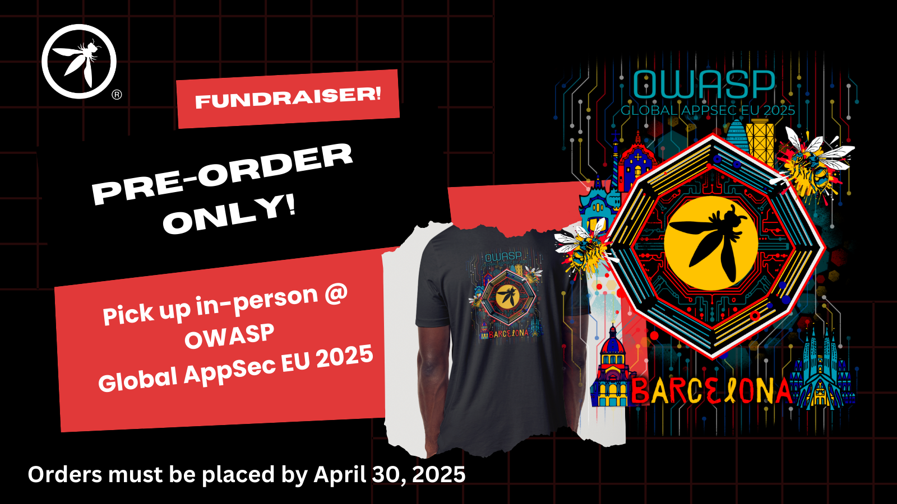

Upcoming Global Events

Slide 8
March 2025 meeting
Ship Happens: The Stormy Seas of Supply Chain Security
- David Archer, Endor Labs
Discussion on the human element of open source
- Women in Tech & Cyber Hub
Notes:
Change this to be the month of your meeting, or your chapter’s name. It’s up to you.

