Slide 1
OWASP Developer Guide
Presentation to Bristol (UK) Chapter

Slide 2
Who am I?
C/C++ developer for 25 years
Security engineer for 11 years
Active in OWASP :
Leader + contributor to OWASP Threat Dragon project
Co-leader + contributor for OWASP Developer Guide project
Co-Leader of Bristol (UK) OWASP Chapter
Notes:
Please choose an upcoming AppSec Global, and any local regional or chapter events

Slide 3
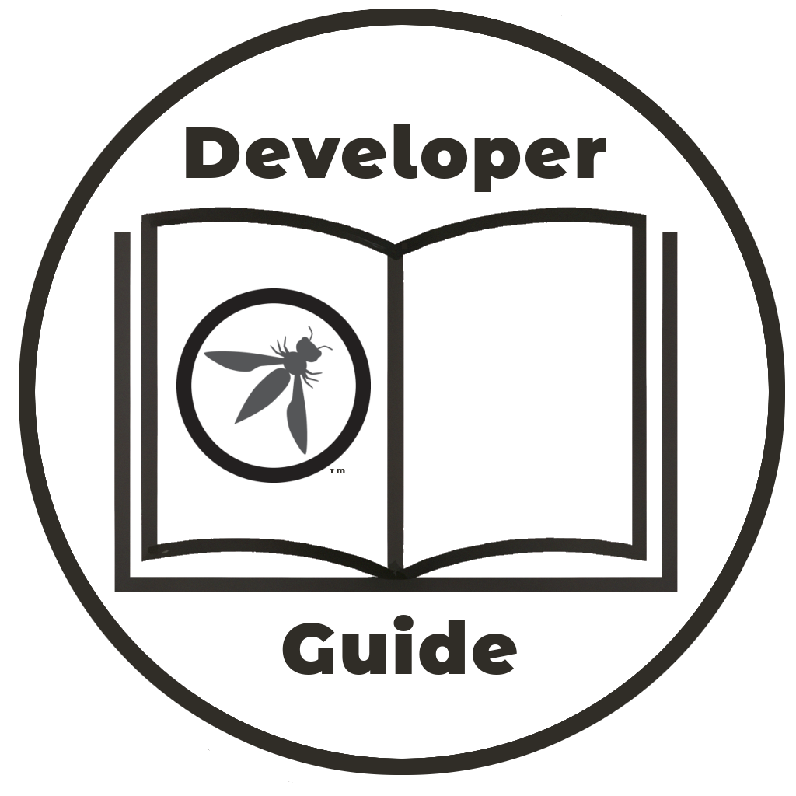
I am a developer, and I need help!
Have you ever said to yourself:
“I am a developer and I need a reference source to navigate the numerous projects and describes the security activities I really should be doing”
Notes:
Please choose an upcoming AppSec Global, and any local regional or chapter events

Slide 4
Quiz
How many official OWASP projects are there?
Notes:
Please choose an upcoming AppSec Global, and any local regional or chapter events

Slide 5
Quiz
How many official OWASP projects are there?
  There are (at least) 322
Notes:
Please choose an upcoming AppSec Global, and any local regional or chapter events

Slide 6
Quiz
How many official OWASP projects are there?
  There are (at least) 322
Bonus question
Name the OWASP projects categories
Notes:
Please choose an upcoming AppSec Global, and any local regional or chapter events

Slide 7
Quiz
How many official OWASP projects are there?
  There are (at least) 322
Bonus question
Name the OWASP projects categories
  Flagship : 15 projects
  Production : 6 projects
  Laboratory : 36 projects
  Incubator : at least 265 and counting
Notes:
Please choose an upcoming AppSec Global, and any local regional or chapter events

Slide 8
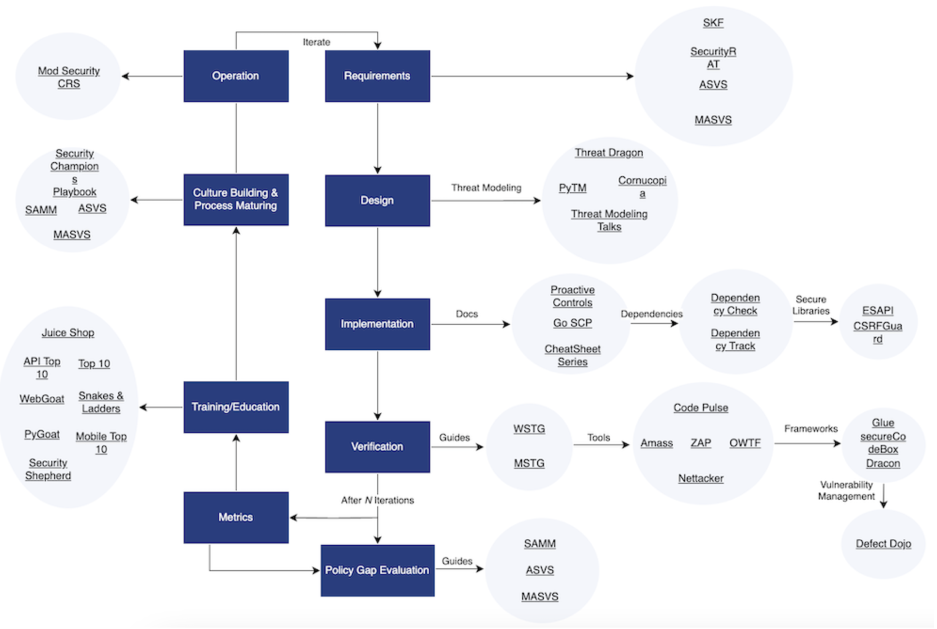
The OWASP Project Wayfinder
Notes:
Please choose an upcoming AppSec Global, and any local regional or chapter events

Slide 9
What is in the Developer Guide?
What it does do :
Enough theory to get you started, but no more
Brief introduction to each project in the Wayfinder
  What it does, why it is useful
  Where to get it, how to run it
Notes:
Please choose an upcoming AppSec Global, and any local regional or chapter events

Slide 10
What is in the Developer Guide?
What it does not do :
No topic in detail, lists further reading for that
No project in detail, refer to the documentation for that
Notes:
Please choose an upcoming AppSec Global, and any local regional or chapter events

Slide 11
Requirements
Software security requirements are important to get right
Overview of requirements
Descriptions of tools, notably
  ASVS
  MAS
  SKF
Notes:
Please choose an upcoming AppSec Global, and any local regional or chapter events

Slide 12

Design
Software design and architecture requires wide ranging skills and tools
OWASP tools for threat modeling:
PyTM
Threat Dragon
Cornucopia
Notes:
Please choose an upcoming AppSec Global, and any local regional or chapter events

Slide 13

Implementation
Many tools and guides
Dependencies
  For example CycloneDX
Libraries
  For example Secure Headers
Documentation
  For example Cheat sheet series
  Top 10 Proactive Controls
Notes:
Please choose an upcoming AppSec Global, and any local regional or chapter events

Slide 14
Verification
Wide range of tools and documentation
Guides, such as WSTG
Tools such as ZAP and Amass
Frameworks such as Dracon
Vulnerability Management using DefectDojo
Notes:
Please choose an upcoming AppSec Global, and any local regional or chapter events

Slide 15
Metrics
Nothing on metrics
Some introduction, that is all
No projects or tools :/
Obviously a gap :)
Notes:
Please choose an upcoming AppSec Global, and any local regional or chapter events

Slide 16
Training and Education
OWASP provides a wide range of tools
Secure Coding Dojo
SKF
Juice Shop
Web Goat
PyGoat
Security Shepherd
Samuari WTF
OWASP Top 10
Mobile Top 10
API Top 10
Wrong Secrets
Snakes & Ladders
Notes:
Please choose an upcoming AppSec Global, and any local regional or chapter events

Slide 17
Culture Building and Process Maturing
A good culture is beneficial in many ways
and processes need constant refinement
Security Champions
SAMM
ASVS
MAS
Notes:
Please choose an upcoming AppSec Global, and any local regional or chapter events

Slide 18
Operations
A very wide subject
OWASP restricts itself to WAFs
  Coraza
  ModSecurity
  Core Rule Set for ModSecurity
Notes:
Please choose an upcoming AppSec Global, and any local regional or chapter events

Slide 19
Gap Analysis
OK, maybe not everyone’s favourite,
but there is:
Bug Logging Tool
Guides:
  ASVS
  MAS
  SAMM
Notes:
Please choose an upcoming AppSec Global, and any local regional or chapter events

Slide 20
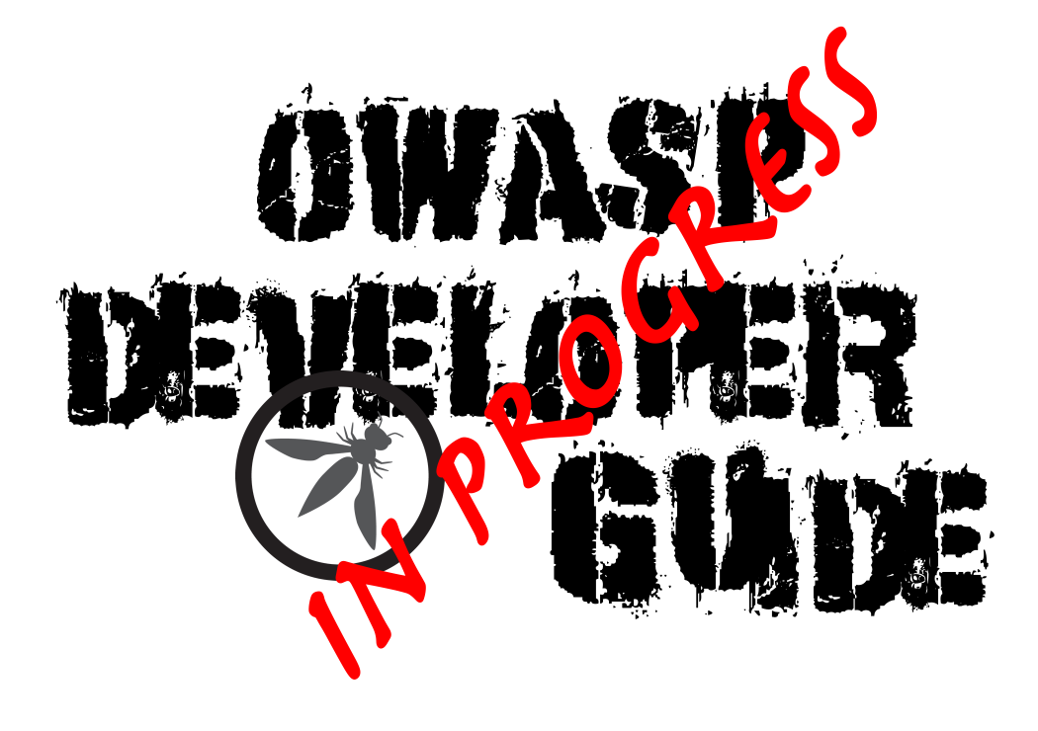
Contribute
>115 pages done
~25 projects still to do:
  What is it?
  Why is it useful?
  Where to get it
  How to run it
Notes:
Please choose an upcoming AppSec Global, and any local regional or chapter events

Slide 21
Time for a demo ?
Notes:
Place the logo and their support level in this slide. It should be the only place in which it appears in a presentation

