Slide 1
Distributed Security Champions: working for developers
Presentation to Bristol (UK) Chapter
30th September 2025

Slide 2
Who am I?
C/C++ developer for 25 years
Security engineer for over 12 years
But more importantly:
Leader & contributor to OWASP Threat Dragon project
Co-leader & contributor on OWASP Developer Guide project
Co-Leader of Bristol (UK) OWASP Chapter
Notes:
Please choose an upcoming AppSec Global, and any local regional or chapter events

Slide 3
Context:
Secure Development Lifecycle
Security requirements
Third party libraries / software composition analysis (SCA)
Secure coding
Static Application Security Testing (SAST)
Dynamic Application Security Testing (DAST)
Application Security Verification
Pentesting
so we get a security engineer to do all this, right?
Notes:
Please choose an upcoming AppSec Global, and any local regional or chapter events

Slide 4
Context: the problem with Nutella
Generalising:
Large companies may have security engineer ratio1:200
Small and Medium can have less
Security engineers are (still) hard to come by
CVEs are increasing year on year
if this was a war, then we are not winning it
Notes:
Please choose an upcoming AppSec Global, and any local regional or chapter events

Slide 5

Security Champions to the rescue!
Self selected by and from the development team itself
Can be a developer - could also be QA, project manager, etc
Bridge between Dev team and AppSec team
Trained in security activities
Knowledgable evangelist
Notes:
Please choose an upcoming AppSec Global, and any local regional or chapter events

Slide 6
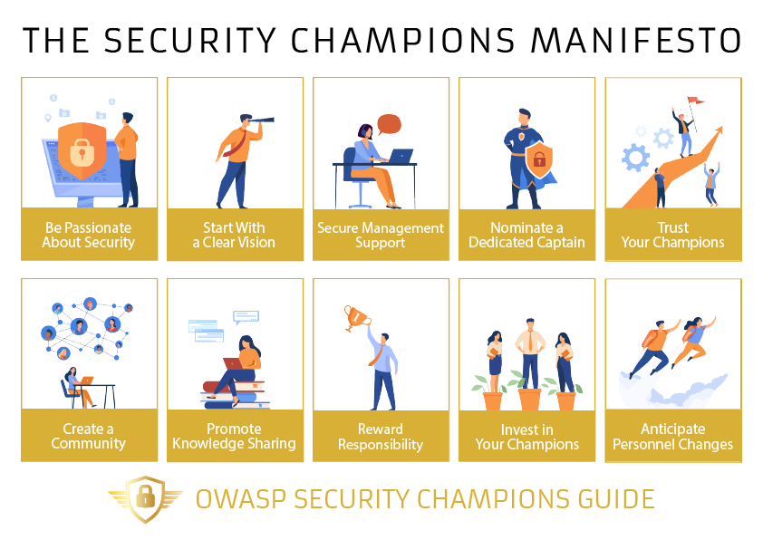
OWASP Security Champions Guide
Notes:
Please choose an upcoming AppSec Global, and any local regional or chapter events

Slide 7
What is a Security Champion?
Receives training and conference places
Ensure the security activities are correctly applied:
  Security requirements
  Third party libraries / software composition analysis (SCA)
  Secure coding
  Static Application Security Testing (SAST)
  Dynamic Application Security Testing (DAST)
  Application Security Verification
  Pentesting
Can it work? Well, you are looking at one :)
Notes:
Please choose an upcoming AppSec Global, and any local regional or chapter events

Slide 8
Can anything go wrong?
Notes:
Please choose an upcoming AppSec Global, and any local regional or chapter events

Slide 9
Can anything go wrong?
Yep, lots
Notes:
Please choose an upcoming AppSec Global, and any local regional or chapter events

Slide 10
Can anything go wrong?
Burn out - in addition to their ‘day’ job
Leave - highly trained → highly transferable
Self selecting - not everybody is interested
Expensive - training and conferences
Notes:
Please choose an upcoming AppSec Global, and any local regional or chapter events

Slide 11
Distributed Security Champions
Definition:
A Security Champion ensures that security activities are correctly applied to the application or product. To do this they receive training and attend conferences with support from the company Security Champions Program
A Distributed Security Champions Program is where these activities are shared out among the members of the development team. Training is given to the individual members according to what security activity they are responsible for
Notes:
Please choose an upcoming AppSec Global, and any local regional or chapter events

Slide 12
Distributed Security Champions
Avoid burn out: security is now everybody’s responsibility
Retain talent: share the training, share the satisfaction
Equitable: do not rely on ‘security heroes’
Affordable: more money for individual training
Notes:
Please choose an upcoming AppSec Global, and any local regional or chapter events

